Slide 1


Develop Blockchain and Web3 App with Vibe Coding
WSQ | TGS-2021009338
Solidity • Python Web3 • test-chain evidence
Tertiary Infotech Academy Pte Ltd | UEN 201200696W
Version v18.1 | 13 September 2026
1
Notes:
Course Develop Blockchain and Web3 App with Vibe Coding TGS-2021009338. Technical anchor: Course identity and version. Source: https://www.tertiarycourses.com.sg/wsq-develop-blockchain-and-web3-app-with-vibe-coding.html. Toolchain Solidity 0.8.30, OpenZeppelin 5.4.0, web3.py 8.0.0, Py-EVM 0.12.1b1; checked 13 September 2026.

Slide 2
MANDATORY
Digital Attendance and TRAQOM
1
2
3
AM / PM attendance
Assessment attendance
TRAQOM survey
SSG trainer QR
SSG trainer QR
LMS course page
ATTENDANCE EVIDENCE
Trainer supplies current QR. Record each required session; complete TRAQOM at course close.
Develop Blockchain and Web3 App with Vibe Coding | TGS-2021009338
© 2026 Tertiary Infotech Academy Pte Ltd
2
Notes:
Course Develop Blockchain and Web3 App with Vibe Coding TGS-2021009338. Technical anchor: . Source: https://docs.soliditylang.org/en/latest/ | https://web3py.readthedocs.io/en/stable/providers.html. Toolchain Solidity 0.8.30, OpenZeppelin 5.4.0, web3.py 8.0.0, Py-EVM 0.12.1b1; checked 13 September 2026.

Slide 3
TRAINER TEMPLATE
About the Trainer
QUALIFICATIONS
____________________________________________
TR
INDUSTRY EXPERIENCE
____________________________________________
Trainer name
Complete before delivery
CONTACT AND SUPPORT
____________________________________________
Develop Blockchain and Web3 App with Vibe Coding | TGS-2021009338
© 2026 Tertiary Infotech Academy Pte Ltd
3
Notes:
Course Develop Blockchain and Web3 App with Vibe Coding TGS-2021009338. Technical anchor: . Source: https://docs.soliditylang.org/en/latest/ | https://web3py.readthedocs.io/en/stable/providers.html. Toolchain Solidity 0.8.30, OpenZeppelin 5.4.0, web3.py 8.0.0, Py-EVM 0.12.1b1; checked 13 September 2026.

Slide 4
NAMED TRAINER
About the Trainer
QUALIFICATIONS
PhD • ACTA • DACE
AA
TEACHING FOCUS
Blockchain, coding and applied AI
Dr Alfred Ang
Tertiary Infotech Academy
LEARNER SUPPORT
enquiry@tertiaryinfotech.com | +65 6100 0613
Develop Blockchain and Web3 App with Vibe Coding | TGS-2021009338
© 2026 Tertiary Infotech Academy Pte Ltd
4
Notes:
Course Develop Blockchain and Web3 App with Vibe Coding TGS-2021009338. Technical anchor: . Source: course_application/SME resume and cert. Toolchain Solidity 0.8.30, OpenZeppelin 5.4.0, web3.py 8.0.0, Py-EVM 0.12.1b1; checked 13 September 2026.

Slide 5
CLASS BRIEFING
Learning introductions and ground rules
Learner context
Share one coding experience and one smart-contract requirement.
Participation
Ask questions, review peer code, respect differing solutions.
1
2
Attendance
Be punctual; minimum 75% attendance requirement from original materials.
Course evidence
Use synthetic records and isolated test-chain accounts.
3
4
Develop Blockchain and Web3 App with Vibe Coding | TGS-2021009338
© 2026 Tertiary Infotech Academy Pte Ltd
5
Notes:
Course Develop Blockchain and Web3 App with Vibe Coding TGS-2021009338. Technical anchor: . Source: https://docs.soliditylang.org/en/latest/ | https://web3py.readthedocs.io/en/stable/providers.html. Toolchain Solidity 0.8.30, OpenZeppelin 5.4.0, web3.py 8.0.0, Py-EVM 0.12.1b1; checked 13 September 2026.

Slide 6
LESSON PLAN
Two-day learning schedule
Day
Instructional focus
Evidence
1
8 hours training: Topics 1–2
Requirements, escrow, Solidity, ERC tokens and custody
2
5.5 hours training: Topics 3–4 + 2.5 assessment
Tests, receipts, gas, indexing and documented deployment
Assessment
150 assessment minutes: WA 60 / PP 90
Original approved instruments retained
WHEN IT MATTERS Programme 16 hours: 13.5 training + 2.5 assessment. Approved assessment plan totals 2.5 hours; authenticated LMS agrees13.5 training plus2.5 assessment hours.
Develop Blockchain and Web3 App with Vibe Coding | TGS-2021009338
© 2026 Tertiary Infotech Academy Pte Ltd
6
Notes:
Course Develop Blockchain and Web3 App with Vibe Coding TGS-2021009338. Technical anchor: . Source: https://www.tertiarycourses.com.sg/wsq-develop-blockchain-and-web3-app-with-vibe-coding.html | reference/Assessment Plan_NICf_Smart_Contract_v1.0.txt. Toolchain Solidity 0.8.30, OpenZeppelin 5.4.0, web3.py 8.0.0, Py-EVM 0.12.1b1; checked 13 September 2026.

Slide 7
SKILLS FRAMEWORK
Learning outcomes
LO1
Analyze business requirements for Blockchain, Cryptocurrency, Smart Contract and Token Economics.
LO2
Code smart contract for Ethereum blockchain using Solidity programming.
1
2
LO3
Test smart contract and monitor its outputs.
LO4
Deploy smart contract and ensure coding documentation is accurate.
3
4
Develop Blockchain and Web3 App with Vibe Coding | TGS-2021009338
© 2026 Tertiary Infotech Academy Pte Ltd
7
Notes:
Course Develop Blockchain and Web3 App with Vibe Coding TGS-2021009338. Technical anchor: . Source: https://docs.soliditylang.org/en/latest/ | https://web3py.readthedocs.io/en/stable/providers.html. Toolchain Solidity 0.8.30, OpenZeppelin 5.4.0, web3.py 8.0.0, Py-EVM 0.12.1b1; checked 13 September 2026.

Slide 8
PROGRAMMING AND CODING
FSE-DIT-4018-1.1 requirement mapping
Topic
Abilities
Knowledge
1 Blockchain, Cryptocurrency, Smart Contract and Token Economics
A1
K1
2 Ethereum Blockchain and Solidity Programming
A2, A3
K3
3 Smart Contract Testing
A4, A5
K4
4 Smart Contract Deployment
A6, A7
K5
Develop Blockchain and Web3 App with Vibe Coding | TGS-2021009338
© 2026 Tertiary Infotech Academy Pte Ltd
8
Notes:
Course Develop Blockchain and Web3 App with Vibe Coding TGS-2021009338. Technical anchor: . Source: https://docs.soliditylang.org/en/latest/ | https://web3py.readthedocs.io/en/stable/providers.html. Toolchain Solidity 0.8.30, OpenZeppelin 5.4.0, web3.py 8.0.0, Py-EVM 0.12.1b1; checked 13 September 2026.

Slide 9
TSC EVIDENCE
Abilities A1 to A7
A1
Gather and interpret requirements through business use cases.
A2 / A3
Propose coding best practices; detect and communicate code errors.
1
2
A4 / A5
Test code, identify improvements; manage coding and monitor outputs.
A6 / A7
Group outputs systematically; ensure accurate complete documentation.
3
4
Develop Blockchain and Web3 App with Vibe Coding | TGS-2021009338
© 2026 Tertiary Infotech Academy Pte Ltd
9
Notes:
Course Develop Blockchain and Web3 App with Vibe Coding TGS-2021009338. Technical anchor: . Source: https://docs.soliditylang.org/en/latest/ | https://web3py.readthedocs.io/en/stable/providers.html. Toolchain Solidity 0.8.30, OpenZeppelin 5.4.0, web3.py 8.0.0, Py-EVM 0.12.1b1; checked 13 September 2026.

Slide 10
TSC EVIDENCE
Knowledge K1 to K5
K1 / K2
Requirement mapping and organisational goals.
K3
Code and code-database organisation methodologies.
1
2
K4
Information gathering and questioning techniques.
K5
Programming/coding developments assessed through verified toolchain decisions.
3
4
Develop Blockchain and Web3 App with Vibe Coding | TGS-2021009338
© 2026 Tertiary Infotech Academy Pte Ltd
10
Notes:
Course Develop Blockchain and Web3 App with Vibe Coding TGS-2021009338. Technical anchor: . Source: https://docs.soliditylang.org/en/latest/ | https://web3py.readthedocs.io/en/stable/providers.html. Toolchain Solidity 0.8.30, OpenZeppelin 5.4.0, web3.py 8.0.0, Py-EVM 0.12.1b1; checked 13 September 2026.

Slide 11

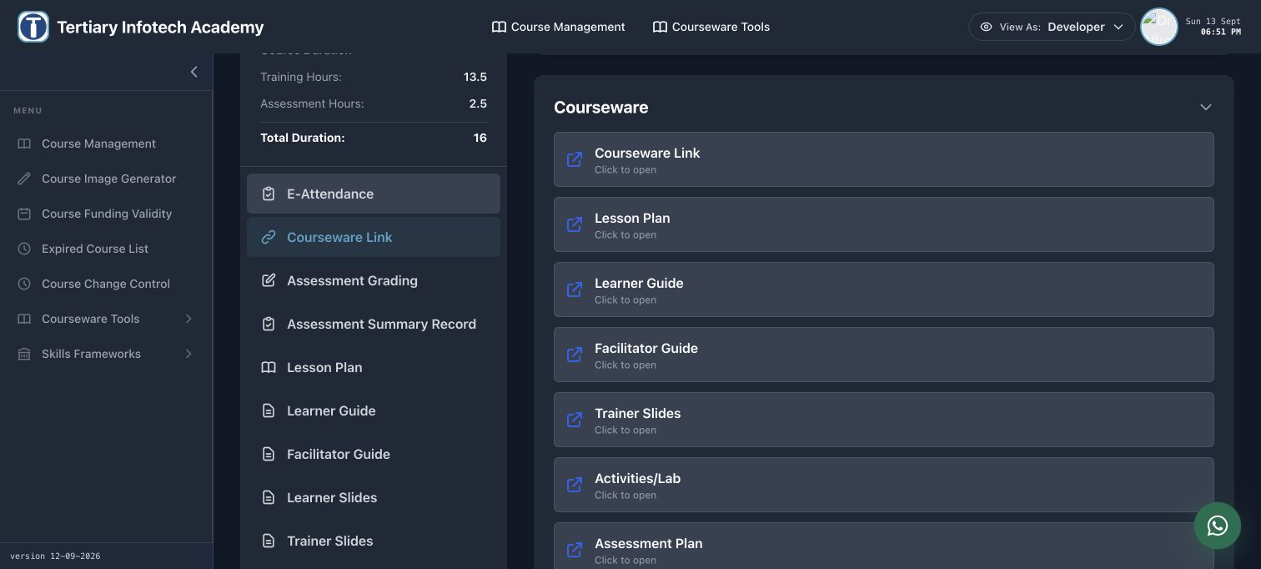
COURSE PORTAL
Login to LMS and Download Course Material
Log in at lms-tms.tertiaryinfotech.com with your registered email and the OTP sent to your inbox, then open this course to download the slides and Learner Guide.
Develop Blockchain and Web3 App with Vibe Coding | TGS-2021009338
© 2026 Tertiary Infotech Academy Pte Ltd
11

Slide 12
LEARNER MATERIAL
Download Course Material
1
2
3
LMS course page
Courseware links
Save verified package
lms-tms.tertiaryinfotech.c…
Slides • LG • Activities
Current version v18.1
DOWNLOAD EVIDENCE
Use the current course page and its courseware/resource links. Detailed download guidance belongs in the Learner Guide.
Develop Blockchain and Web3 App with Vibe Coding | TGS-2021009338
© 2026 Tertiary Infotech Academy Pte Ltd
12
Notes:
Course Develop Blockchain and Web3 App with Vibe Coding TGS-2021009338. Technical anchor: . Source: https://lms-tms.tertiaryinfotech.com. Toolchain Solidity 0.8.30, OpenZeppelin 5.4.0, web3.py 8.0.0, Py-EVM 0.12.1b1; checked 13 September 2026.

Slide 13
BEFORE ASSESSMENT
Assessment briefing
WA
5 short-answer questions | 60 minutes | K1–K5
PP
4 practical tasks | 90 minutes | A1–A7
1
2
Open book
Slides, LG and assessor-approved materials only.
Assessment conduct
Individual work; no discussion, recording or phones. Assessor explains appeal and sign-off.
3
4
Develop Blockchain and Web3 App with Vibe Coding | TGS-2021009338
© 2026 Tertiary Infotech Academy Pte Ltd
13
Notes:
Course Develop Blockchain and Web3 App with Vibe Coding TGS-2021009338. Technical anchor: . Source: https://docs.soliditylang.org/en/latest/ | https://web3py.readthedocs.io/en/stable/providers.html. Toolchain Solidity 0.8.30, OpenZeppelin 5.4.0, web3.py 8.0.0, Py-EVM 0.12.1b1; checked 13 September 2026.

Slide 14
1
TOPIC 1
Blockchain, Cryptocurrency, Smart Contract and Token Economics
A1, K1, K2
Develop Blockchain and Web3 App with Vibe Coding | TGS-2021009338
© 2026 Tertiary Infotech Academy Pte Ltd
14
Notes:
Course Develop Blockchain and Web3 App with Vibe Coding TGS-2021009338. Technical anchor: . Source: https://docs.soliditylang.org/en/latest/ | https://web3py.readthedocs.io/en/stable/providers.html. Toolchain Solidity 0.8.30, OpenZeppelin 5.4.0, web3.py 8.0.0, Py-EVM 0.12.1b1; checked 13 September 2026.

Slide 15
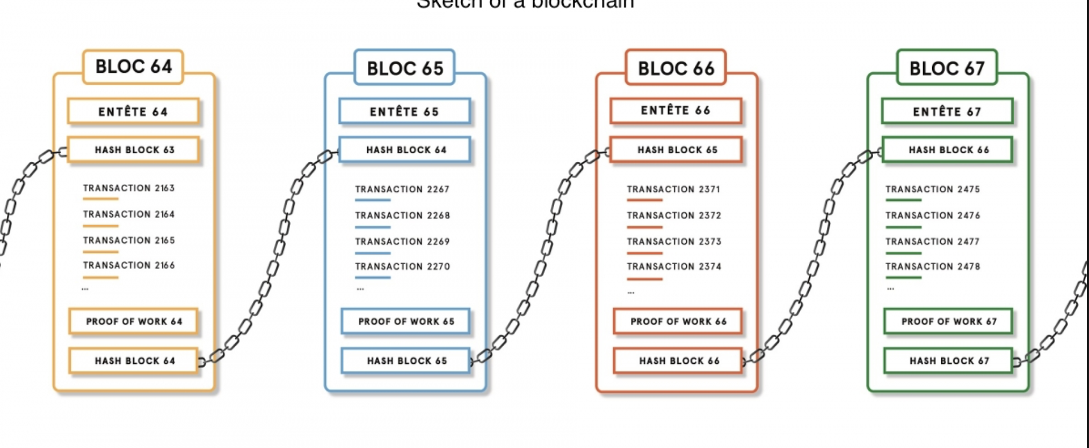
CODE • STATE • EVIDENCE
Header links and a registered evidence digest • 18
RETAINED V17 • WHAT IS BLOCKCHAIN?
1
INPUT
parentHash ← previous block hash; register(bytes32 digest)
Blockchain is set of distributed data structure blocks, that is not editable or removable after published, linked by cryptographic validation in peer-to-peer network. It is based on cryptographic ledgers which are treated in a decentralised and distributed manner. It is are maintained and verified by the…
Technical reading: A block header commits parentHash; a contract registry separately binds an evidence digest. These are different hash boundaries.
2
CONTROL
A block header commits parentHash; a contract registry separately binds an evidence digest. These are different hash boundaries.
parentHash ← previous block hash; register(bytes32 digest)
3
EVIDENCE
Getter/receipt values must satisfy this exact source-specific condition
Copied original diagram • v17 source 18
Develop Blockchain and Web3 App with Vibe Coding | TGS-2021009338
© 2026 Tertiary Infotech Academy Pte Ltd
15
Notes:
Course Develop Blockchain and Web3 App with Vibe Coding TGS-2021009338. Technical anchor: parentHash ← previous block hash; register(bytes32 digest). Source: https://docs.soliditylang.org/en/latest/ | https://web3py.readthedocs.io/en/stable/providers.html. Toolchain Solidity 0.8.30, OpenZeppelin 5.4.0, web3.py 8.0.0, Py-EVM 0.12.1b1; checked 13 September 2026.
Original v17 slide 18 verbatim content:
What is Blockchain?
Blockchain is set of distributed data structure blocks, that is not editable or removable after published, linked by cryptographic validation in peer-to-peer network.
It is based on cryptographic ledgers which are treated in a decentralised and distributed manner.
It is are maintained and verified by the actors participating in the system, ensuring digital transparency and confidence in the records of information blocks.
‹#›

Slide 16
CODE • STATE • EVIDENCE
Read replicas versus authenticated writes • 19
RETAINED V17 TOPIC
1
INPUT
registered[digest] reads public state; register requires issuer
Technical reading: Replication improves independent verification but does not remove application roles. Our registry uses issuer-only writes even on a permissionless execution chain.
Acceptance: registered[digest] reads public state; register requires issuer
2
CONTROL
Replication improves independent verification but does not remove application roles. Our registry uses issuer-only writes even on a permissionless execution cha
registered[digest] reads public state; register requires issuer
3
EVIDENCE
Getter/receipt values must satisfy this exact source-specific condition
Develop Blockchain and Web3 App with Vibe Coding | TGS-2021009338
© 2026 Tertiary Infotech Academy Pte Ltd
16
Notes:
Course Develop Blockchain and Web3 App with Vibe Coding TGS-2021009338. Technical anchor: registered[digest] reads public state; register requires issuer. Source: https://docs.soliditylang.org/en/latest/ | https://web3py.readthedocs.io/en/stable/providers.html. Toolchain Solidity 0.8.30, OpenZeppelin 5.4.0, web3.py 8.0.0, Py-EVM 0.12.1b1; checked 13 September 2026.
Original v17 slide 19 verbatim content:
Traditional vs Blockchain Databases
While all records secured on a traditional database are centralized managed by database administrators, each participant on a blockchain has a secured copy of all records and there is no database administrators.
This new approach has greatly enhance the data immutability, transparency and security of the data.
‹#›

Slide 17
CODE • STATE • EVIDENCE
Unauthorized database or contract writes • 20
RETAINED V17 • RISKS AND CHALLENGES OF TRADITIONAL MODEL
1
INPUT
reject(register(forgedDigest), outsider)
Single point of failure - all data is stored in a few centralized databases which are prompt to cyber hacking. Fraud and security breaches - database administrators have full control over delegating access and granting various permissions to other users. With sufficient permissions, any one can freely…
Technical reading: A leaked admin credential and an unguarded contract function create different write paths. Verify protected transitions with an outsider account.
2
CONTROL
A leaked admin credential and an unguarded contract function create different write paths. Verify protected transitions with an outsider account.
reject(register(forgedDigest), outsider)
3
EVIDENCE
Getter/receipt values must satisfy this exact source-specific condition
Develop Blockchain and Web3 App with Vibe Coding | TGS-2021009338
© 2026 Tertiary Infotech Academy Pte Ltd
17
Notes:
Course Develop Blockchain and Web3 App with Vibe Coding TGS-2021009338. Technical anchor: reject(register(forgedDigest), outsider). Source: https://docs.soliditylang.org/en/latest/ | https://web3py.readthedocs.io/en/stable/providers.html. Toolchain Solidity 0.8.30, OpenZeppelin 5.4.0, web3.py 8.0.0, Py-EVM 0.12.1b1; checked 13 September 2026.
Original v17 slide 20 verbatim content:
Risks and Challenges of Traditional Model
Single point of failure - all data is stored in a few centralized databases which are prompt to cyber hacking.
Fraud and security breaches - database administrators have full control over delegating access and granting various permissions to other users. With sufficient permissions, any one can freely alter information stored on the centralized server. If the security of the authority is compromised, the data can be altered, or even deleted.
Lack of transparency and visibility - traditional database keep information up-to-date at a point in time. There is no real-time visibility into what changes are being made by multiple users at the same time.
‹#›

Slide 18
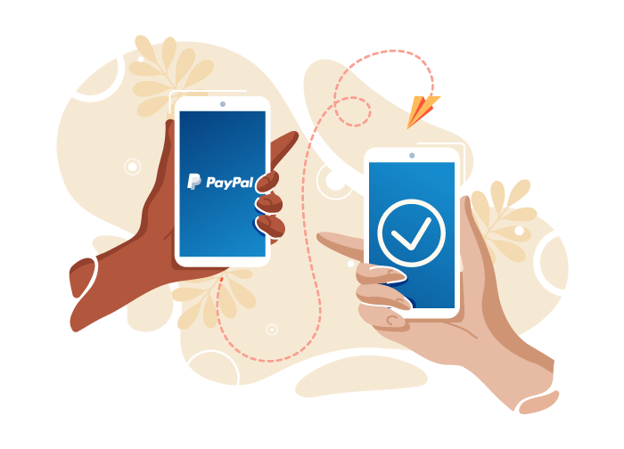
CODE • STATE • EVIDENCE
Escrow trust and off-chain delivery • 21
RETAINED V17 • TRUST IS IMPORTANT IN TRADITIONAL MODEL
1
INPUT
buyer = msg.sender; seller = constructor argument
When you use traditional methods of payment, you need to trust in a third party to set your transaction (e.g. Visa, Mastercard, PayPal, banks, kickstarter, Lazada, Shoppe etc...) What if the Trust is broken one day?
Technical reading: Buyer authorization replaces payment-intermediary execution in this escrow. Off-chain delivery remains a disputed input; a release policy must name who accepts it.
2
CONTROL
Buyer authorization replaces payment-intermediary execution in this escrow. Off-chain delivery remains a disputed input; a release policy must name who accepts
buyer = msg.sender; seller = constructor argument
3
EVIDENCE
Getter/receipt values must satisfy this exact source-specific condition
Copied original diagram • v17 source 21
Develop Blockchain and Web3 App with Vibe Coding | TGS-2021009338
© 2026 Tertiary Infotech Academy Pte Ltd
18
Notes:
Course Develop Blockchain and Web3 App with Vibe Coding TGS-2021009338. Technical anchor: buyer = msg.sender; seller = constructor argument. Source: https://docs.soliditylang.org/en/latest/ | https://web3py.readthedocs.io/en/stable/providers.html. Toolchain Solidity 0.8.30, OpenZeppelin 5.4.0, web3.py 8.0.0, Py-EVM 0.12.1b1; checked 13 September 2026.
Original v17 slide 21 verbatim content:
Trust is Important in Traditional Model
‹#›
When you use traditional methods of payment, you need to trust in a third party to set your transaction (e.g. Visa, Mastercard, PayPal, banks, kickstarter, Lazada, Shoppe etc...)
What if the Trust is broken one day?

Slide 19
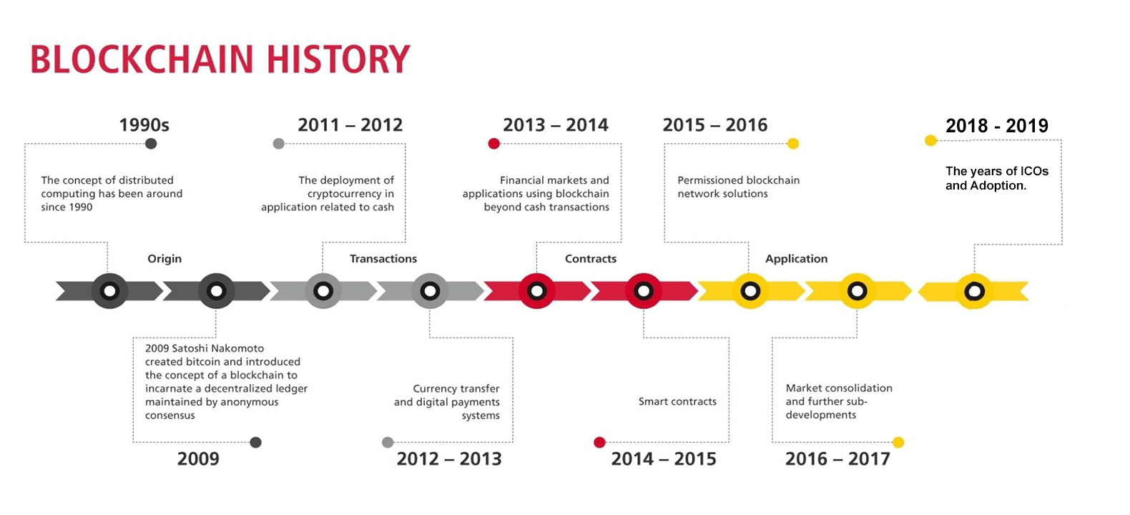
CODE • STATE • EVIDENCE
Historical Bitcoin versus current Ethereum execution • 22
RETAINED V17 • HISTORY OF BLOCKCHAIN
1
INPUT
Bitcoin: SHA256d header target; Ethereum: PoS validators
Blockchain started its journey back in 1991. 2009 - Satoshi Nakamoto introduce the first generation of blockchain - Bitcoin blockchain In 2013, a 19 years old Vitalik Buterin introduce the second generation of blockchain - Ethereum blockchain for smart contracts Since then, many blockchains have been created
Technical reading: Original history is retained as dated context. Bitcoin validates PoW block headers; Ethereum mainnet uses PoS while our local chain tests EVM contract semantics.
2
CONTROL
Original history is retained as dated context. Bitcoin validates PoW block headers; Ethereum mainnet uses PoS while our local chain tests EVM contract semantics
Bitcoin: SHA256d header target; Ethereum: PoS validators
3
EVIDENCE
Getter/receipt values must satisfy this exact source-specific condition
Copied original diagram • v17 source 22
Develop Blockchain and Web3 App with Vibe Coding | TGS-2021009338
© 2026 Tertiary Infotech Academy Pte Ltd
19
Notes:
Course Develop Blockchain and Web3 App with Vibe Coding TGS-2021009338. Technical anchor: Bitcoin: SHA256d header target; Ethereum: PoS validators. Source: https://docs.soliditylang.org/en/latest/ | https://web3py.readthedocs.io/en/stable/providers.html. Toolchain Solidity 0.8.30, OpenZeppelin 5.4.0, web3.py 8.0.0, Py-EVM 0.12.1b1; checked 13 September 2026.
Original v17 slide 22 verbatim content:
History of Blockchain
Blockchain started its journey back in 1991.
2009 - Satoshi Nakamoto introduce the first generation of blockchain - Bitcoin blockchain
In 2013, a 19 years old Vitalik Buterin introduce the second generation of blockchain - Ethereum blockchain for smart contracts
Since then, many blockchains have been created
‹#›

Slide 20


CODE • STATE • EVIDENCE
Protocol comparison with execution boundaries • 23
RETAINED V17 • POPULAR BLOCKCHAIN PROJECTS
1
INPUT
Bitcoin: no Solidity EVM; Ethereum: EVM; Py-EVM: local execution
and Many More!
Technical reading: Compare Bitcoin, Ethereum and a local EVM by contract execution, chain identity and consensus. A compatible address alone does not establish the network.
2
CONTROL
Compare Bitcoin, Ethereum and a local EVM by contract execution, chain identity and consensus. A compatible address alone does not establish the network.
Bitcoin: no Solidity EVM; Ethereum: EVM; Py-EVM: local execution
3
EVIDENCE
Getter/receipt values must satisfy this exact source-specific condition
Copied original diagram • v17 source 23
Develop Blockchain and Web3 App with Vibe Coding | TGS-2021009338
© 2026 Tertiary Infotech Academy Pte Ltd
20
Notes:
Course Develop Blockchain and Web3 App with Vibe Coding TGS-2021009338. Technical anchor: Bitcoin: no Solidity EVM; Ethereum: EVM; Py-EVM: local execution. Source: https://docs.soliditylang.org/en/latest/ | https://web3py.readthedocs.io/en/stable/providers.html. Toolchain Solidity 0.8.30, OpenZeppelin 5.4.0, web3.py 8.0.0, Py-EVM 0.12.1b1; checked 13 September 2026.
Original v17 slide 23 verbatim content:
Popular Blockchain Projects
‹#›
and Many More!

Slide 21
CODE • STATE • EVIDENCE
Web1 page versus wallet-backed state query • 24
RETAINED V17 TOPIC
1
INPUT
static HTML → EIP-1193 wallet → eth_call → contract state
Technical reading: A static page can host a Web3 client. In Activity12 the page performs wallet chain checking and an eth_call against the manifest address.
Acceptance: static HTML → EIP-1193 wallet → eth_call → contract state
2
CONTROL
A static page can host a Web3 client. In Activity12 the page performs wallet chain checking and an eth_call against the manifest address.
static HTML → EIP-1193 wallet → eth_call → contract state
3
EVIDENCE
Getter/receipt values must satisfy this exact source-specific condition
Develop Blockchain and Web3 App with Vibe Coding | TGS-2021009338
© 2026 Tertiary Infotech Academy Pte Ltd
21
Notes:
Course Develop Blockchain and Web3 App with Vibe Coding TGS-2021009338. Technical anchor: static HTML → EIP-1193 wallet → eth_call → contract state. Source: https://docs.soliditylang.org/en/latest/ | https://web3py.readthedocs.io/en/stable/providers.html. Toolchain Solidity 0.8.30, OpenZeppelin 5.4.0, web3.py 8.0.0, Py-EVM 0.12.1b1; checked 13 September 2026.
Original v17 slide 24 verbatim content:
Web3
Web 1 is characterized by static information webpages
Web 2 is characterized by centralized internet platform and user interactivity .
Web 3 is characterized by decentralized apps that run on the blockchain.
‹#›

Slide 22
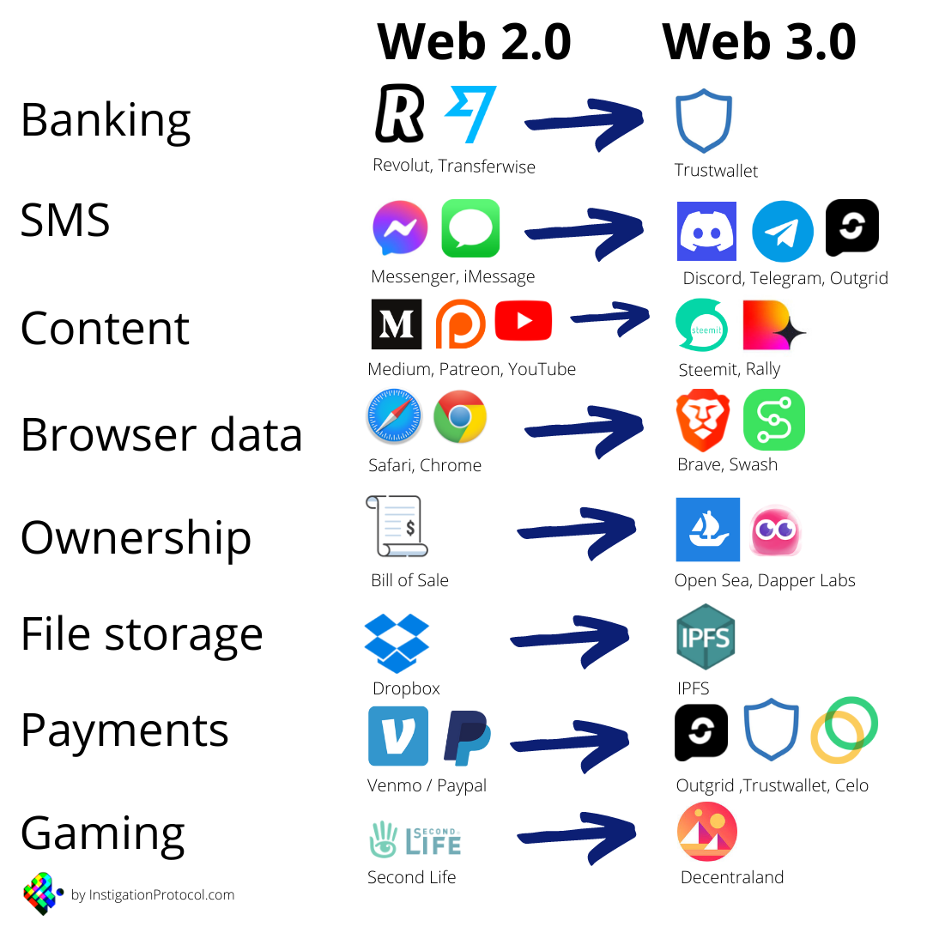
CODE • STATE • EVIDENCE
dApp provider and network precondition • 25
RETAINED V17 • THE EMERGENCE OF WEB3
1
INPUT
BigInt(walletChainId) === BigInt(manifest.chainId)
The Emergence of Web3
Technical reading: A wallet-backed page is not valid until provider chain ID matches the current deployment. Reject mismatches before requesting contract readback.
2
CONTROL
A wallet-backed page is not valid until provider chain ID matches the current deployment. Reject mismatches before requesting contract readback.
BigInt(walletChainId) === BigInt(manifest.chainId)
3
EVIDENCE
Getter/receipt values must satisfy this exact source-specific condition
Copied original diagram • v17 source 25
Develop Blockchain and Web3 App with Vibe Coding | TGS-2021009338
© 2026 Tertiary Infotech Academy Pte Ltd
22
Notes:
Course Develop Blockchain and Web3 App with Vibe Coding TGS-2021009338. Technical anchor: BigInt(walletChainId) === BigInt(manifest.chainId). Source: https://docs.soliditylang.org/en/latest/ | https://web3py.readthedocs.io/en/stable/providers.html. Toolchain Solidity 0.8.30, OpenZeppelin 5.4.0, web3.py 8.0.0, Py-EVM 0.12.1b1; checked 13 September 2026.
Original v17 slide 25 verbatim content:
The Emergence of Web3
‹#›

Slide 23
CODE • STATE • EVIDENCE
Chain currency versus contract token units • 26
HISTORICAL V17 • BLOCKCHAINS, CRYPTO AND TOKENS
1
INPUT
msg.value (wei) differs from balanceOf(holder) (token units)
Ethereum PoW Polygon PoS Bitcoin PoW Blockchains Protocol Ether LINK USTD WBTC OMG SAND MANA MATIC Blockchain Technology Blockchains Crypto and Tokens Solana PoH SOL ERC-20, ERC-721, ERC-1155
Current exercise: ETH is the Ethereum native currency used for gas; ERC20 credits are contract balances. A transfer of credits does not send native ETH.
2
CONTROL
ETH is the Ethereum native currency used for gas; ERC20 credits are contract balances. A transfer of credits does not send native ETH.
msg.value (wei) differs from balanceOf(holder) (token units)
3
EVIDENCE
Getter/receipt values must satisfy this exact source-specific condition
Develop Blockchain and Web3 App with Vibe Coding | TGS-2021009338
© 2026 Tertiary Infotech Academy Pte Ltd
23
Notes:
Course Develop Blockchain and Web3 App with Vibe Coding TGS-2021009338. Technical anchor: msg.value (wei) differs from balanceOf(holder) (token units). Source: https://docs.soliditylang.org/en/latest/ | https://web3py.readthedocs.io/en/stable/providers.html. Toolchain Solidity 0.8.30, OpenZeppelin 5.4.0, web3.py 8.0.0, Py-EVM 0.12.1b1; checked 13 September 2026.
Original v17 slide 26 verbatim content:
Blockchains, Crypto and Tokens
‹#›
Ethereum
PoW
Polygon
PoS
Bitcoin
PoW
Blockchains
Protocol
Ether
LINK
USTD
WBTC
OMG
SAND
MANA
MATIC
Blockchain Technology
Blockchains
Crypto and Tokens
Solana
PoH
SOL
ERC-20, ERC-721, ERC-1155

Slide 24
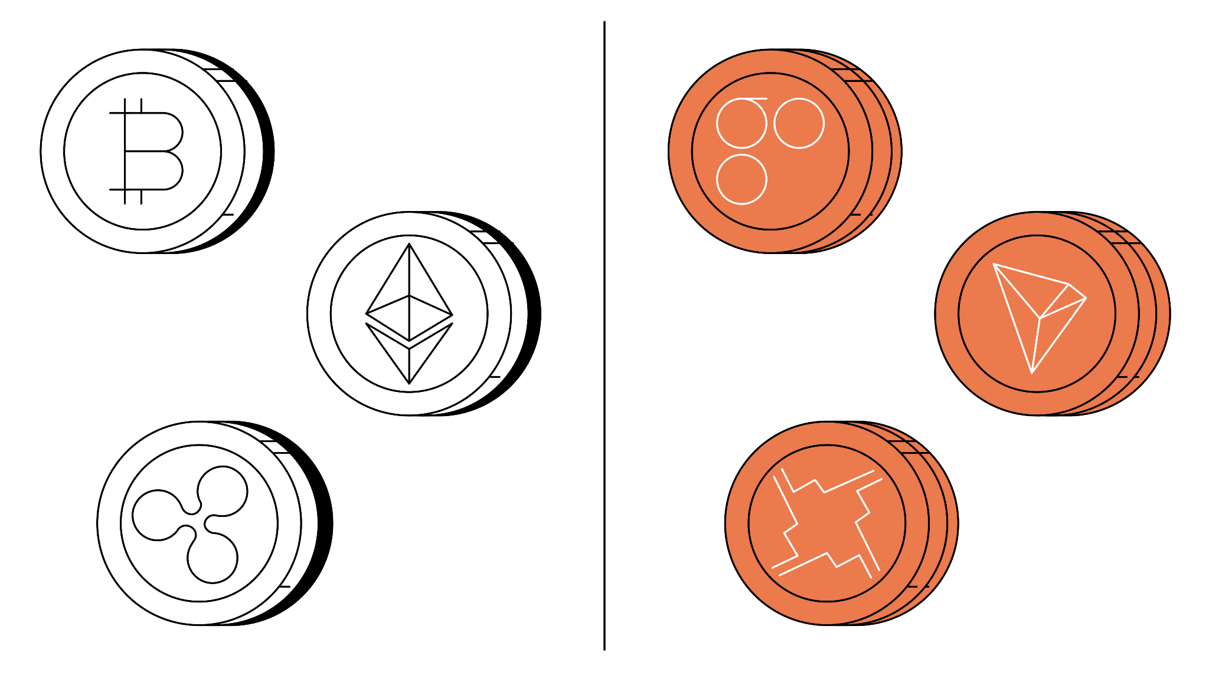
CODE • STATE • EVIDENCE
Native transfer versus ERC20 transfer • 27
RETAINED V17 • CRYPTOCURRENCIES VS. TOKENS
1
INPUT
ETH: tx.value; ERC20: transfer(to, amount) calldata
It’s important not to confuse the terms “cryptocurrencies” and “tokens,” as there are fundamental differences that distinguish them. The biggest differentiation between the two is that cryptocurrencies have their own blockchains, whereas crypto tokens are built on an existing blockchain.
Technical reading: An ETH transaction uses value in wei. An ERC20 transfer encodes recipient and amount into calldata and can set transaction value to0.
2
CONTROL
An ETH transaction uses value in wei. An ERC20 transfer encodes recipient and amount into calldata and can set transaction value to0.
ETH: tx.value; ERC20: transfer(to, amount) calldata
3
EVIDENCE
Getter/receipt values must satisfy this exact source-specific condition
Copied original diagram • v17 source 27
Develop Blockchain and Web3 App with Vibe Coding | TGS-2021009338
© 2026 Tertiary Infotech Academy Pte Ltd
24
Notes:
Course Develop Blockchain and Web3 App with Vibe Coding TGS-2021009338. Technical anchor: ETH: tx.value; ERC20: transfer(to, amount) calldata. Source: https://docs.soliditylang.org/en/latest/ | https://web3py.readthedocs.io/en/stable/providers.html. Toolchain Solidity 0.8.30, OpenZeppelin 5.4.0, web3.py 8.0.0, Py-EVM 0.12.1b1; checked 13 September 2026.
Original v17 slide 27 verbatim content:
Cryptocurrencies vs. Tokens
It’s important not to confuse the terms “cryptocurrencies” and “tokens,” as there are fundamental differences that distinguish them.
The biggest differentiation between the two is that cryptocurrencies have their own blockchains, whereas crypto tokens are built on an existing blockchain.
‹#›

Slide 25
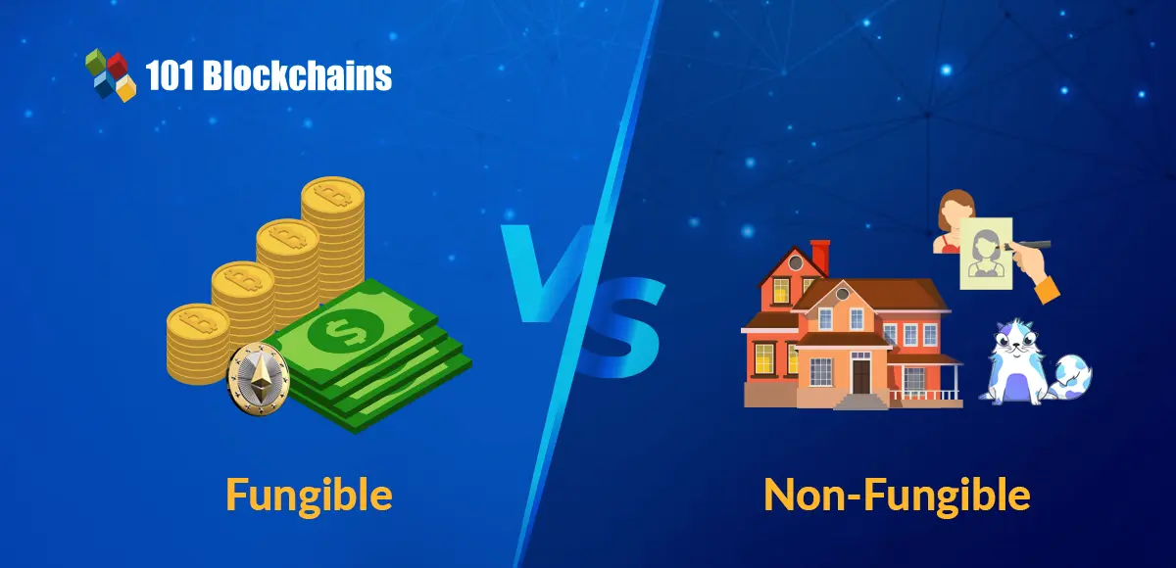
CODE • STATE • EVIDENCE
ERC20 interface and balance conservation • 28
RETAINED V17 • TOKEN STANDARDS
1
INPUT
balanceOf(a)+balanceOf(b)+balanceOf(c) == totalSupply()
There are several widely used token standards for creating crypto tokens, the majority of which have been built on top of Ethereum. Two most popular Ethereum tokens are: Fungible tokens - ERC 20 standards. Non-Fungible tokens - ERC 721 standards.
Technical reading: The standard interface defines transfer, allowance and balance methods. The issuer, learner and spender balances must sum to totalSupply.
2
CONTROL
The standard interface defines transfer, allowance and balance methods. The issuer, learner and spender balances must sum to totalSupply.
balanceOf(a)+balanceOf(b)+balanceOf(c) == totalSupply()
3
EVIDENCE
Getter/receipt values must satisfy this exact source-specific condition
Copied original diagram • v17 source 28
Develop Blockchain and Web3 App with Vibe Coding | TGS-2021009338
© 2026 Tertiary Infotech Academy Pte Ltd
25
Notes:
Course Develop Blockchain and Web3 App with Vibe Coding TGS-2021009338. Technical anchor: balanceOf(a)+balanceOf(b)+balanceOf(c) == totalSupply(). Source: https://docs.soliditylang.org/en/latest/ | https://web3py.readthedocs.io/en/stable/providers.html. Toolchain Solidity 0.8.30, OpenZeppelin 5.4.0, web3.py 8.0.0, Py-EVM 0.12.1b1; checked 13 September 2026.
Original v17 slide 28 verbatim content:
Token Standards
‹#›
There are several widely used token standards for creating crypto tokens, the majority of which have been built on top of Ethereum. Two most popular Ethereum tokens are:
Fungible tokens - ERC 20 standards.
Non-Fungible tokens - ERC 721 standards.

Slide 26
CODE • STATE • EVIDENCE
ERC721 ownership and receiver interface • 29
RETAINED V17 • TOKEN STANDARDS
1
INPUT
supportsInterface(0x80ac58cd); ownerOf(tokenId)
Token Standards
Technical reading: A unique token ID has an owner. safeTransferFrom also checks contract receiver compatibility; document validity requires separate issuer/digest/revocation controls.
2
CONTROL
A unique token ID has an owner. safeTransferFrom also checks contract receiver compatibility; document validity requires separate issuer/digest/revocation contr
supportsInterface(0x80ac58cd); ownerOf(tokenId)
3
EVIDENCE
Getter/receipt values must satisfy this exact source-specific condition
Develop Blockchain and Web3 App with Vibe Coding | TGS-2021009338
© 2026 Tertiary Infotech Academy Pte Ltd
26
Notes:
Course Develop Blockchain and Web3 App with Vibe Coding TGS-2021009338. Technical anchor: supportsInterface(0x80ac58cd); ownerOf(tokenId). Source: https://docs.soliditylang.org/en/latest/ | https://web3py.readthedocs.io/en/stable/providers.html. Toolchain Solidity 0.8.30, OpenZeppelin 5.4.0, web3.py 8.0.0, Py-EVM 0.12.1b1; checked 13 September 2026.
Original v17 slide 29 verbatim content:
Token Standards
‹#›

Slide 27
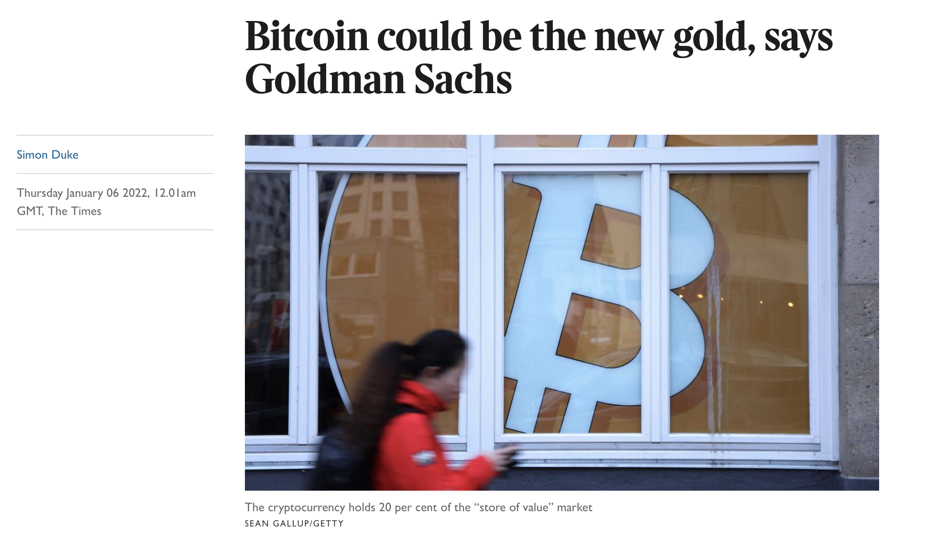
CODE • STATE • EVIDENCE
Bitcoin PoW scope and Solidity portability • 30
RETAINED V17 • BITCOIN
1
INPUT
Bitcoin hash target is not Ethereum EVM contract execution
Bitcoin (https://bitcoin.org/en/) was the first cryptocurrency created using Blockchain Technology and many people have perception that Bitcoin is Blockchain
Technical reading: Bitcoin source examples explain hash-linked PoW records. Solidity contracts run in an EVM environment; do not deploy our ABI to a Bitcoin address.
2
CONTROL
Bitcoin source examples explain hash-linked PoW records. Solidity contracts run in an EVM environment; do not deploy our ABI to a Bitcoin address.
Bitcoin hash target is not Ethereum EVM contract execution
3
EVIDENCE
Getter/receipt values must satisfy this exact source-specific condition
Copied original diagram • v17 source 30
Develop Blockchain and Web3 App with Vibe Coding | TGS-2021009338
© 2026 Tertiary Infotech Academy Pte Ltd
27
Notes:
Course Develop Blockchain and Web3 App with Vibe Coding TGS-2021009338. Technical anchor: Bitcoin hash target is not Ethereum EVM contract execution. Source: https://docs.soliditylang.org/en/latest/ | https://web3py.readthedocs.io/en/stable/providers.html. Toolchain Solidity 0.8.30, OpenZeppelin 5.4.0, web3.py 8.0.0, Py-EVM 0.12.1b1; checked 13 September 2026.
Original v17 slide 30 verbatim content:
Bitcoin
‹#›
Bitcoin (https://bitcoin.org/en/) was the first cryptocurrency created using Blockchain Technology and many people have perception that Bitcoin is Blockchain

Slide 28
CODE • STATE • EVIDENCE
Wallet address and signing authority • 31
RETAINED V17 TOPIC
1
INPUT
eth_accounts → address; require(msg.sender == issuer)
Technical reading: A wallet address identifies a signer or recipient, not their legal identity. Distinguish provider accounts from on-chain role checks.
Acceptance: eth_accounts → address; require(msg.sender == issuer)
2
CONTROL
A wallet address identifies a signer or recipient, not their legal identity. Distinguish provider accounts from on-chain role checks.
eth_accounts → address; require(msg.sender == issuer)
3
EVIDENCE
Getter/receipt values must satisfy this exact source-specific condition
Develop Blockchain and Web3 App with Vibe Coding | TGS-2021009338
© 2026 Tertiary Infotech Academy Pte Ltd
28
Notes:
Course Develop Blockchain and Web3 App with Vibe Coding TGS-2021009338. Technical anchor: eth_accounts → address; require(msg.sender == issuer). Source: https://docs.soliditylang.org/en/latest/ | https://web3py.readthedocs.io/en/stable/providers.html. Toolchain Solidity 0.8.30, OpenZeppelin 5.4.0, web3.py 8.0.0, Py-EVM 0.12.1b1; checked 13 September 2026.
Original v17 slide 31 verbatim content:
Bitcoin Wallet
‹#›
A Bitcoin wallet is a type of digital wallet used to send and receive Bitcoins. This is analogous to a physical wallet.
However, instead of storing physical currency, the wallet stores the cryptographic information used to access Bitcoin addresses and send transactions.
Some Bitcoin wallets can also be used for other cryptocurrencies.

Slide 29
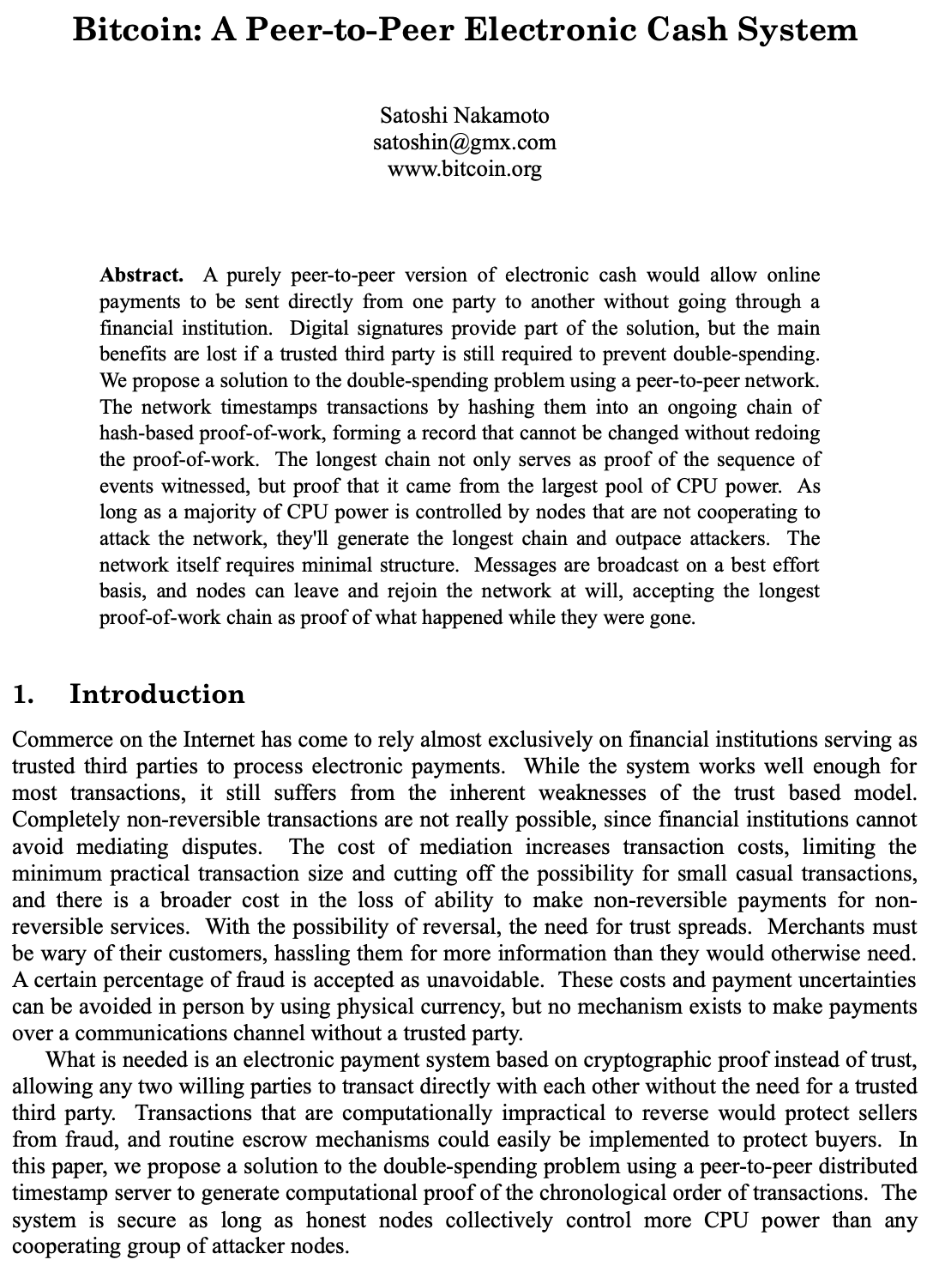
CODE • STATE • EVIDENCE
PoW block origin and ancestry verification • 32
RETAINED V17 • THE BIRTH OF BLOCKCHAIN IN BITCOIN
1
INPUT
hash(block_i.parent) == hash(block_(i-1))
In October 2008, Satoshi published the original whitepaper, describing his blueprint for a “A Peer-to-Peer Electronic Cash System.” In January 2009 he released version 0.1 of the source code and launched the cryptocurrency by mining the genesis block. Nakamoto was the first to solve the double-spending…
Technical reading: Historical Bitcoin context is scoped to header validation. Our linked-block exercise checks each parent digest without claiming distributed consensus.
2
CONTROL
Historical Bitcoin context is scoped to header validation. Our linked-block exercise checks each parent digest without claiming distributed consensus.
hash(block_i.parent) == hash(block_(i-1))
3
EVIDENCE
Getter/receipt values must satisfy this exact source-specific condition
Copied original diagram • v17 source 32
Develop Blockchain and Web3 App with Vibe Coding | TGS-2021009338
© 2026 Tertiary Infotech Academy Pte Ltd
29
Notes:
Course Develop Blockchain and Web3 App with Vibe Coding TGS-2021009338. Technical anchor: hash(block_i.parent) == hash(block_(i-1)). Source: https://docs.soliditylang.org/en/latest/ | https://web3py.readthedocs.io/en/stable/providers.html. Toolchain Solidity 0.8.30, OpenZeppelin 5.4.0, web3.py 8.0.0, Py-EVM 0.12.1b1; checked 13 September 2026.
Original v17 slide 32 verbatim content:
The Birth of Blockchain in Bitcoin
In October 2008, Satoshi published the original whitepaper, describing his blueprint for a “A Peer-to-Peer Electronic Cash System.”
In January 2009 he released version 0.1 of the source code and launched the cryptocurrency by mining the genesis block.
Nakamoto was the first to solve the double-spending problem for a decentralized digital currency, creating a new asset, the likes of which the world had never seen before: Bitcoin.
‹#›

Slide 30

CODE • STATE • EVIDENCE
Identity claims versus cryptographic evidence • 33
RETAINED V17 • WHO IS SATOSHI NAKAMOTO?
1
INPUT
certificate validity = issuer policy ∧ digest match ∧ !revoked
The name Satoshi Nakamoto is an alias used by the person or entity who created Bitcoin to hide their true identity. The founder of Bitcoin continued to work on the software project for about another year and a half before disengaging from active development.
Technical reading: A named inventor is historical context, not an application security assumption. Verify exact digest, holder and issuer rather than relying on a claimed identity.
2
CONTROL
A named inventor is historical context, not an application security assumption. Verify exact digest, holder and issuer rather than relying on a claimed identity
certificate validity = issuer policy ∧ digest match ∧ !revoked
3
EVIDENCE
Getter/receipt values must satisfy this exact source-specific condition
Copied original diagram • v17 source 33
Develop Blockchain and Web3 App with Vibe Coding | TGS-2021009338
© 2026 Tertiary Infotech Academy Pte Ltd
30
Notes:
Course Develop Blockchain and Web3 App with Vibe Coding TGS-2021009338. Technical anchor: certificate validity = issuer policy ∧ digest match ∧ !revoked. Source: https://docs.soliditylang.org/en/latest/ | https://web3py.readthedocs.io/en/stable/providers.html. Toolchain Solidity 0.8.30, OpenZeppelin 5.4.0, web3.py 8.0.0, Py-EVM 0.12.1b1; checked 13 September 2026.
Original v17 slide 33 verbatim content:
Who is Satoshi Nakamoto?
The name Satoshi Nakamoto is an alias used by the person or entity who created Bitcoin to hide their true identity.
The founder of Bitcoin continued to work on the software project for about another year and a half before disengaging from active development.
‹#›

Slide 31
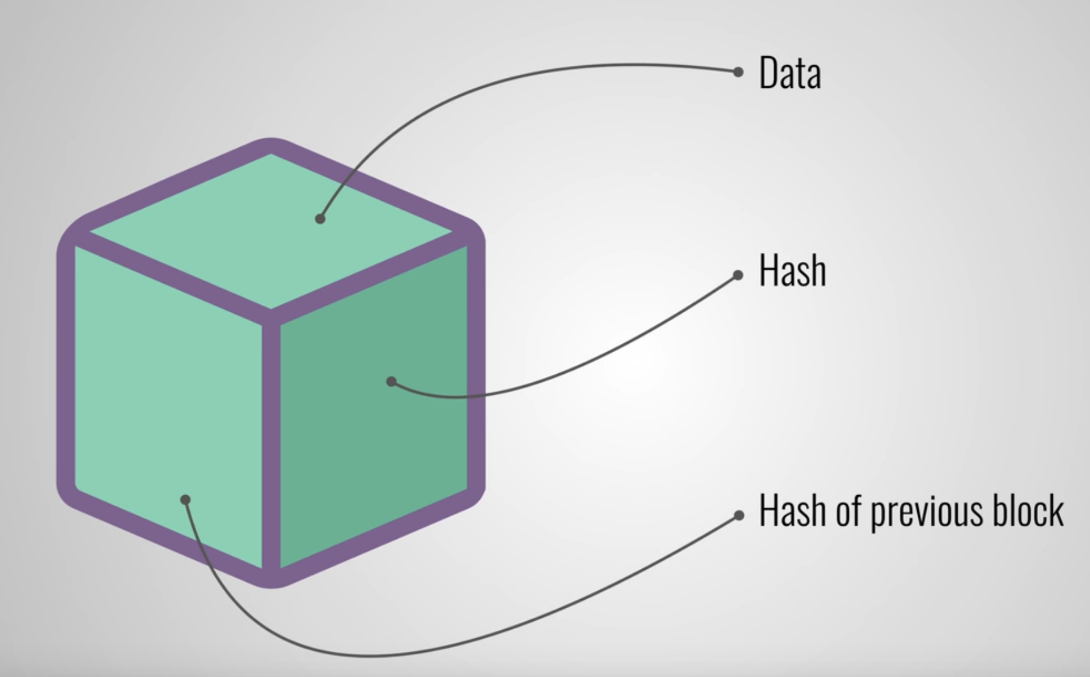
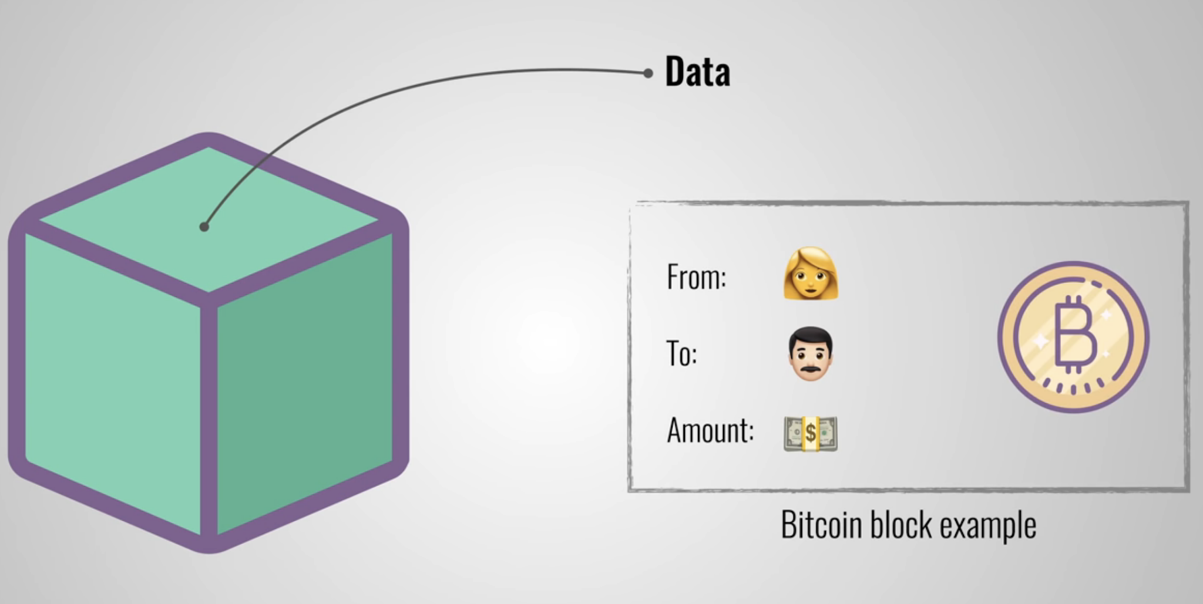
CODE • STATE • EVIDENCE
Block fields and transaction inclusion • 34
RETAINED V17 • WHAT IS A BLOCK?
1
INPUT
w3.eth.get_block(receipt.blockNumber)["parentHash"]
A block can be thought of like a link or node in a chain. It consists of at least 3 main components Data Hash Hash of previous block The data contains all of the records of the transactions Eg Buyer, seller, and the amount.
Technical reading: Read a block by number and identify hash, parentHash and transaction hashes. A block hash is not an application document digest.
2
CONTROL
Read a block by number and identify hash, parentHash and transaction hashes. A block hash is not an application document digest.
w3.eth.get_block(receipt.blockNumber)["parentHash"]
3
EVIDENCE
Getter/receipt values must satisfy this exact source-specific condition
Copied original diagram • v17 source 34
Develop Blockchain and Web3 App with Vibe Coding | TGS-2021009338
© 2026 Tertiary Infotech Academy Pte Ltd
31
Notes:
Course Develop Blockchain and Web3 App with Vibe Coding TGS-2021009338. Technical anchor: w3.eth.get_block(receipt.blockNumber)["parentHash"]. Source: https://docs.soliditylang.org/en/latest/ | https://web3py.readthedocs.io/en/stable/providers.html. Toolchain Solidity 0.8.30, OpenZeppelin 5.4.0, web3.py 8.0.0, Py-EVM 0.12.1b1; checked 13 September 2026.
Original v17 slide 34 verbatim content:
What is a Block?
‹#›
A block can be thought of like a link or node in a chain.
It consists of at least 3 main components
Data
Hash
Hash of previous block
The data contains all of the records of the transactions Eg Buyer, seller, and the amount.

Slide 32
CODE • STATE • EVIDENCE
Canonical evidence SHA256 • 35
RETAINED V17 TOPIC
1
INPUT
sha256(json.dumps(mock,sort_keys=True,separators=(",",":")).encode())
Technical reading: Different JSON key orders must canonicalize to the same bytes. Our client sorts keys and removes extra separators before SHA256.
Acceptance: sha256(json.dumps(mock,sort_keys=True,separators=(",",":")).encode())
2
CONTROL
Different JSON key orders must canonicalize to the same bytes. Our client sorts keys and removes extra separators before SHA256.
sha256(json.dumps(mock,sort_keys=True,separators=(",",":")).encode())
3
EVIDENCE
Getter/receipt values must satisfy this exact source-specific condition
Develop Blockchain and Web3 App with Vibe Coding | TGS-2021009338
© 2026 Tertiary Infotech Academy Pte Ltd
32
Notes:
Course Develop Blockchain and Web3 App with Vibe Coding TGS-2021009338. Technical anchor: sha256(json.dumps(mock,sort_keys=True,separators=(",",":")).encode()). Source: https://docs.soliditylang.org/en/latest/ | https://web3py.readthedocs.io/en/stable/providers.html. Toolchain Solidity 0.8.30, OpenZeppelin 5.4.0, web3.py 8.0.0, Py-EVM 0.12.1b1; checked 13 September 2026.
Original v17 slide 35 verbatim content:
Hashing
‹#›
Hashing means taking an input string of any length and giving out an output of a fixed length.
In the context of cryptocurrencies like Bitcoin, the transactions are taken as input and run through a hashing algorithm (Bitcoin uses SHA-256) which gives an output of a fixed length.
The hash can be thought of like the fingerprint of the block.

Slide 33
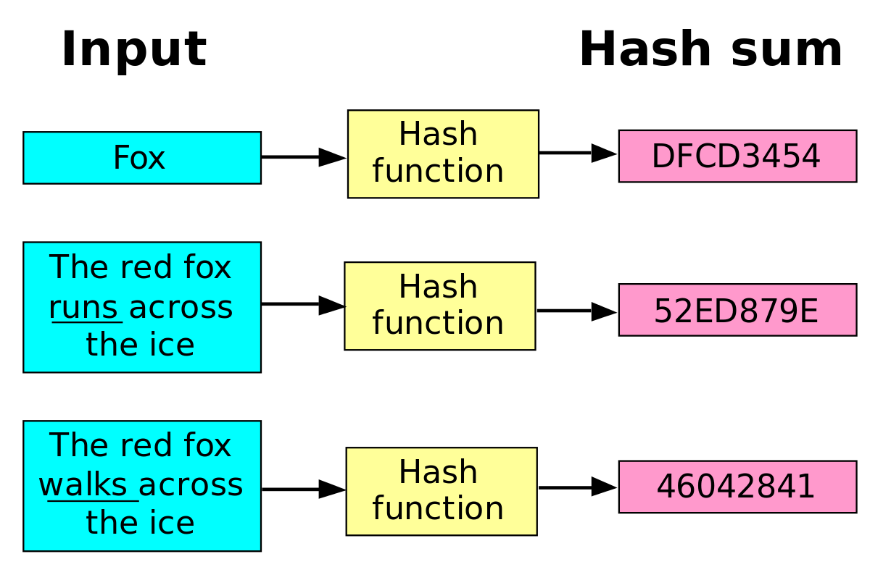
CODE • STATE • EVIDENCE
Hash output width and changed input • 36
RETAINED V17 • HASH FUNCTION
1
INPUT
len(digest) == 32; digest_old != digest_changed
A hash function is any function that can be used to map data of arbitrary size onto data of a fixed size
Technical reading: SHA256 returns32 bytes. One changed synthetic record changes the digest; equal outputs are evidence of byte consistency, not physical authenticity.
2
CONTROL
SHA256 returns32 bytes. One changed synthetic record changes the digest; equal outputs are evidence of byte consistency, not physical authenticity.
len(digest) == 32; digest_old != digest_changed
3
EVIDENCE
Getter/receipt values must satisfy this exact source-specific condition
Copied original diagram • v17 source 36
Develop Blockchain and Web3 App with Vibe Coding | TGS-2021009338
© 2026 Tertiary Infotech Academy Pte Ltd
33
Notes:
Course Develop Blockchain and Web3 App with Vibe Coding TGS-2021009338. Technical anchor: len(digest) == 32; digest_old != digest_changed. Source: https://docs.soliditylang.org/en/latest/ | https://web3py.readthedocs.io/en/stable/providers.html. Toolchain Solidity 0.8.30, OpenZeppelin 5.4.0, web3.py 8.0.0, Py-EVM 0.12.1b1; checked 13 September 2026.
Original v17 slide 36 verbatim content:
Hash Function
A hash function is any function that can be used to map data of arbitrary size onto data of a fixed size
‹#›

Slide 34
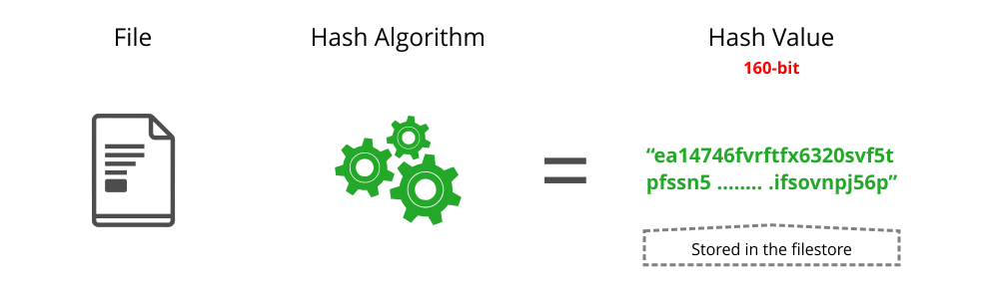
CODE • STATE • EVIDENCE
SHA256 bytes versus hex encoding • 37
RETAINED V17 • SHA-256 HASHING FUNCTION
1
INPUT
digest.hex():64 chars; bytes32 digest:32 bytes
SHA (Secure Hash Algorithm) is the one used in bitcoin and most blockchains. SHA-256 algorithm generates an almost-unique, fixed size 256-bit (32-byte) hash. This makes it suitable for password validation, challenge hash authentication, anti-tamper, digital signatures. File SHA 256 Hash value
Technical reading: A32-byte digest becomes64 hexadecimal characters. Solidity bytes32 accepts the bytes, not an unpadded human phrase.
2
CONTROL
A32-byte digest becomes64 hexadecimal characters. Solidity bytes32 accepts the bytes, not an unpadded human phrase.
digest.hex():64 chars; bytes32 digest:32 bytes
3
EVIDENCE
Getter/receipt values must satisfy this exact source-specific condition
Copied original diagram • v17 source 37
Develop Blockchain and Web3 App with Vibe Coding | TGS-2021009338
© 2026 Tertiary Infotech Academy Pte Ltd
34
Notes:
Course Develop Blockchain and Web3 App with Vibe Coding TGS-2021009338. Technical anchor: digest.hex():64 chars; bytes32 digest:32 bytes. Source: https://docs.soliditylang.org/en/latest/ | https://web3py.readthedocs.io/en/stable/providers.html. Toolchain Solidity 0.8.30, OpenZeppelin 5.4.0, web3.py 8.0.0, Py-EVM 0.12.1b1; checked 13 September 2026.
Original v17 slide 37 verbatim content:
SHA-256 Hashing Function
SHA (Secure Hash Algorithm) is the one used in bitcoin and most blockchains.
SHA-256 algorithm generates an almost-unique, fixed size 256-bit (32-byte) hash.
This makes it suitable for password validation, challenge hash authentication, anti-tamper, digital signatures.
‹#›
File
SHA 256
Hash value

Slide 35
CODE • STATE • EVIDENCE
Hash-generator evidence cross-check • 38
RETAINED V17 TOPIC
1
INPUT
SHA256(canonical_bytes) == independently computed SHA256
Technical reading: Use the supplied hash-generator example as an independent digest tool. Match the exact input bytes and hash algorithm; do not compare canonical JSON to formatted JSON bytes.
Acceptance: SHA256(canonical_bytes) == independently computed SHA256
2
CONTROL
Use the supplied hash-generator example as an independent digest tool. Match the exact input bytes and hash algorithm; do not compare canonical JSON to formatte
SHA256(canonical_bytes) == independently computed SHA256
3
EVIDENCE
Getter/receipt values must satisfy this exact source-specific condition
Develop Blockchain and Web3 App with Vibe Coding | TGS-2021009338
© 2026 Tertiary Infotech Academy Pte Ltd
35
Notes:
Course Develop Blockchain and Web3 App with Vibe Coding TGS-2021009338. Technical anchor: SHA256(canonical_bytes) == independently computed SHA256. Source: https://docs.soliditylang.org/en/latest/ | https://web3py.readthedocs.io/en/stable/providers.html. Toolchain Solidity 0.8.30, OpenZeppelin 5.4.0, web3.py 8.0.0, Py-EVM 0.12.1b1; checked 13 September 2026.
Original v17 slide 38 verbatim content:
Activity: SHA256 Hashing
https://demoblockchain.org/hash
Type "Blockchain is a trustless distributed ledger"
As you type, change the length of th Hash is it the same.
Change Blockchain to lowercase "blockchain" and see the change in hash.
‹#›

Slide 36
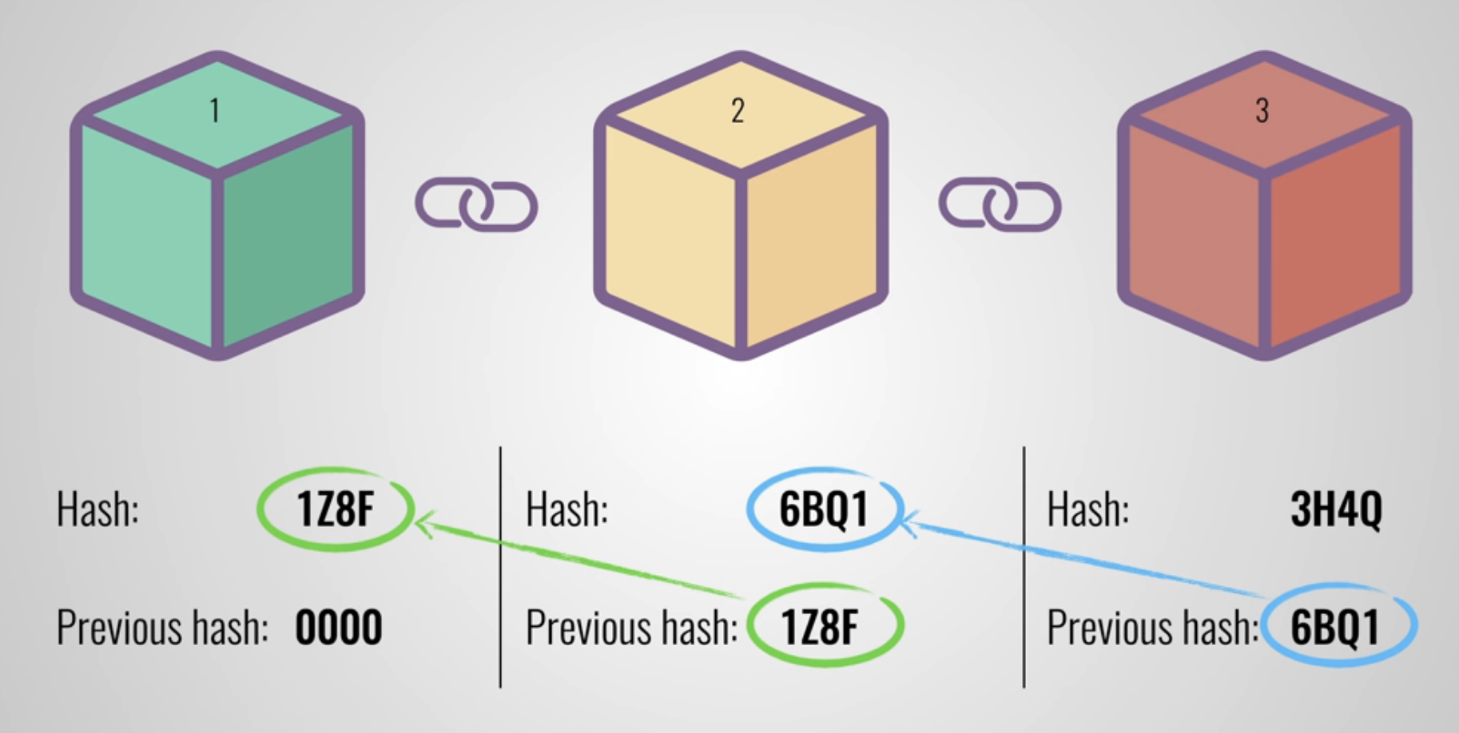
CODE • STATE • EVIDENCE
Tamper detection across block links • 39
RETAINED V17 • LINKING THE BLOCKS
1
INPUT
recomputed_previous_hash != next_block.parent_hash
To link up the blocks, each block will store the hash of the previous block.
Technical reading: Change an earlier block payload and recompute its digest. The next stored parent digest becomes inconsistent; recomputation alone does not authorize history rewrite.
2
CONTROL
Change an earlier block payload and recompute its digest. The next stored parent digest becomes inconsistent; recomputation alone does not authorize history rew
recomputed_previous_hash != next_block.parent_hash
3
EVIDENCE
Getter/receipt values must satisfy this exact source-specific condition
Copied original diagram • v17 source 39
Develop Blockchain and Web3 App with Vibe Coding | TGS-2021009338
© 2026 Tertiary Infotech Academy Pte Ltd
36
Notes:
Course Develop Blockchain and Web3 App with Vibe Coding TGS-2021009338. Technical anchor: recomputed_previous_hash != next_block.parent_hash. Source: https://docs.soliditylang.org/en/latest/ | https://web3py.readthedocs.io/en/stable/providers.html. Toolchain Solidity 0.8.30, OpenZeppelin 5.4.0, web3.py 8.0.0, Py-EVM 0.12.1b1; checked 13 September 2026.
Original v17 slide 39 verbatim content:
Linking the Blocks
‹#›
To link up the blocks, each block will store the hash of the previous block.

Slide 37
CODE • STATE • EVIDENCE
Linked-block acceptance invariant • 40
RETAINED V17 TOPIC
1
INPUT
for i>0: blocks[i].parent == hash(blocks[i-1])
Technical reading: Verify every block except the first references the previous digest. The demo models linkage, while actual EVM state changes are tested separately.
Acceptance: for i>0: blocks[i].parent == hash(blocks[i-1])
2
CONTROL
Verify every block except the first references the previous digest. The demo models linkage, while actual EVM state changes are tested separately.
for i>0: blocks[i].parent == hash(blocks[i-1])
3
EVIDENCE
Getter/receipt values must satisfy this exact source-specific condition
Develop Blockchain and Web3 App with Vibe Coding | TGS-2021009338
© 2026 Tertiary Infotech Academy Pte Ltd
37
Notes:
Course Develop Blockchain and Web3 App with Vibe Coding TGS-2021009338. Technical anchor: for i>0: blocks[i].parent == hash(blocks[i-1]). Source: https://docs.soliditylang.org/en/latest/ | https://web3py.readthedocs.io/en/stable/providers.html. Toolchain Solidity 0.8.30, OpenZeppelin 5.4.0, web3.py 8.0.0, Py-EVM 0.12.1b1; checked 13 September 2026.
Original v17 slide 40 verbatim content:
Activity: Linking the Blocks
Goto https://demoblockchain.org/block
Add the following to the data to Block 1:
Buyer: Alice
Seller: Bob
Transaction: 10000
To add the block to the blockchain, you need to mine the block.
‹#›

Slide 38
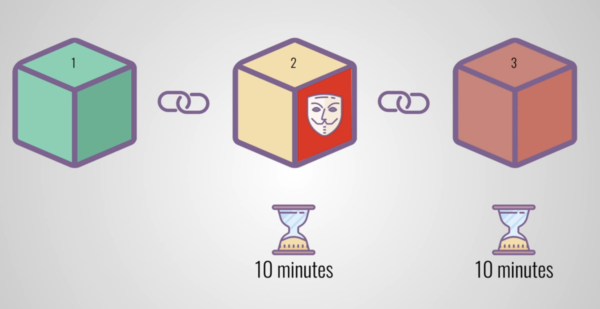
CODE • STATE • EVIDENCE
PoW mining scoped to Bitcoin header models • 41
RETAINED V17 • MINING
1
INPUT
int(SHA256d(header),16) < target
To further mitigate any data tampering by hackers, blockchain requires validation of a new block in order to add the block to a blockchain, This is known as Proof of Work (PoW) In Bitcoin, it takes about 10 mins for each PoW.
Technical reading: Mining searches a nonce satisfying a target condition. It is a historical Bitcoin mechanism and is not Ethereum mainnet consensus after the Merge.
2
CONTROL
Mining searches a nonce satisfying a target condition. It is a historical Bitcoin mechanism and is not Ethereum mainnet consensus after the Merge.
int(SHA256d(header),16) < target
3
EVIDENCE
Getter/receipt values must satisfy this exact source-specific condition
Copied original diagram • v17 source 41
Develop Blockchain and Web3 App with Vibe Coding | TGS-2021009338
© 2026 Tertiary Infotech Academy Pte Ltd
38
Notes:
Course Develop Blockchain and Web3 App with Vibe Coding TGS-2021009338. Technical anchor: int(SHA256d(header),16) < target. Source: https://docs.soliditylang.org/en/latest/ | https://web3py.readthedocs.io/en/stable/providers.html. Toolchain Solidity 0.8.30, OpenZeppelin 5.4.0, web3.py 8.0.0, Py-EVM 0.12.1b1; checked 13 September 2026.
Original v17 slide 41 verbatim content:
Mining
‹#›
To further mitigate any data tampering by hackers, blockchain requires validation of a new block in order to add the block to a blockchain, This is known as Proof of Work (PoW)
In Bitcoin, it takes about 10 mins for each PoW.

Slide 39
CODE • STATE • EVIDENCE
Toy-chain model versus real EVM state • 42
RETAINED V17 TOPIC
1
INPUT
Toy model: linked bytes; Py-EVM: receipts + storage assertions
Technical reading: Original toy blockchain content is retained as a linkage model. Local Solidity activity execution deploys actual bytecode; neither proves public-chain finality.
Acceptance: Toy model: linked bytes; Py-EVM: receipts + storage assertions
2
CONTROL
Original toy blockchain content is retained as a linkage model. Local Solidity activity execution deploys actual bytecode; neither proves public-chain finality.
Toy model: linked bytes; Py-EVM: receipts + storage assertions
3
EVIDENCE
Getter/receipt values must satisfy this exact source-specific condition
Develop Blockchain and Web3 App with Vibe Coding | TGS-2021009338
© 2026 Tertiary Infotech Academy Pte Ltd
39
Notes:
Course Develop Blockchain and Web3 App with Vibe Coding TGS-2021009338. Technical anchor: Toy model: linked bytes; Py-EVM: receipts + storage assertions. Source: https://docs.soliditylang.org/en/latest/ | https://web3py.readthedocs.io/en/stable/providers.html. Toolchain Solidity 0.8.30, OpenZeppelin 5.4.0, web3.py 8.0.0, Py-EVM 0.12.1b1; checked 13 September 2026.
Original v17 slide 42 verbatim content:
Activity: Blockchain
Goto https://demoblockchain.org/blockchain
Add the data "Buyer: Alice, Seller: Bob, Transaction: 10000" to Block 1
Add the data "Buyer: Charlie, Seller: Eve, Transaction: 20000" to Block 2
Add the data "Buyer: Alice, Seller: Eve, Transaction: 30000" to Block 3
Mine the 3 blocks
Change Transaction from 20000 to 20001 in Block 2 and see what happen to the block 2 and 3.
Note that the prev hash is the same value as the has has in previous block
‹#›

Slide 40
CODE • STATE • EVIDENCE
Consensus selection versus contract authorization • 43
RETAINED V17 • CONSENSUS MECHANISM
1
INPUT
block accepted ≠ caller authorized ≠ evidence authentic
Public blockchains that operate as decentralized, self-regulating systems work on a global scale without any single authority. They involve contributions from hundreds of thousands of participants who work on verification and authentication of transactions occurring on the blockchain, and on the block…
Technical reading: Consensus chooses canonical blocks; contract authorization decides permitted state transitions. Valid inclusion does not imply a function is safe or a physical claim true.
2
CONTROL
Consensus chooses canonical blocks; contract authorization decides permitted state transitions. Valid inclusion does not imply a function is safe or a physical
block accepted ≠ caller authorized ≠ evidence authentic
3
EVIDENCE
Getter/receipt values must satisfy this exact source-specific condition
Develop Blockchain and Web3 App with Vibe Coding | TGS-2021009338
© 2026 Tertiary Infotech Academy Pte Ltd
40
Notes:
Course Develop Blockchain and Web3 App with Vibe Coding TGS-2021009338. Technical anchor: block accepted ≠ caller authorized ≠ evidence authentic. Source: https://docs.soliditylang.org/en/latest/ | https://web3py.readthedocs.io/en/stable/providers.html. Toolchain Solidity 0.8.30, OpenZeppelin 5.4.0, web3.py 8.0.0, Py-EVM 0.12.1b1; checked 13 September 2026.
Original v17 slide 43 verbatim content:
Consensus Mechanism
Public blockchains that operate as decentralized, self-regulating systems work on a global scale without any single authority.
They involve contributions from hundreds of thousands of participants who work on verification and authentication of transactions occurring on the blockchain, and on the block mining activities.
In such a dynamically changing status of the blockchain, these publicly shared ledgers need an efficient, fair, real-time, functional, reliable, and secure mechanism to ensure that all the transactions occurring on the network are genuine and all participants agree on a consensus on the status of the ledger.
This all-important task is performed by the consensus mechanism, which is a set of rules that decides on the legitimacy of contributions made by the various participants (i.e., nodes or transactors) of the blockchain.
‹#›

Slide 41
CODE • STATE • EVIDENCE
PoW and PoS distinct acceptance mechanisms • 44
RETAINED V17 • CONSENSUS MECHANISMS
1
INPUT
Bitcoin: hash<target; Ethereum: validators; local: execution only
Consensus Mechanisms
Technical reading: Bitcoin PoW measures header hash against target. Ethereum PoS relies on staked validators and protocol attestations. Py-EVM exercises neither distributed consensus path.
2
CONTROL
Bitcoin PoW measures header hash against target. Ethereum PoS relies on staked validators and protocol attestations. Py-EVM exercises neither distributed consen
Bitcoin: hash<target; Ethereum: validators; local: execution only
3
EVIDENCE
Getter/receipt values must satisfy this exact source-specific condition
Develop Blockchain and Web3 App with Vibe Coding | TGS-2021009338
© 2026 Tertiary Infotech Academy Pte Ltd
41
Notes:
Course Develop Blockchain and Web3 App with Vibe Coding TGS-2021009338. Technical anchor: Bitcoin: hash<target; Ethereum: validators; local: execution only. Source: https://docs.soliditylang.org/en/latest/ | https://web3py.readthedocs.io/en/stable/providers.html. Toolchain Solidity 0.8.30, OpenZeppelin 5.4.0, web3.py 8.0.0, Py-EVM 0.12.1b1; checked 13 September 2026.
Original v17 slide 44 verbatim content:
Consensus Mechanisms
‹#›

Slide 42
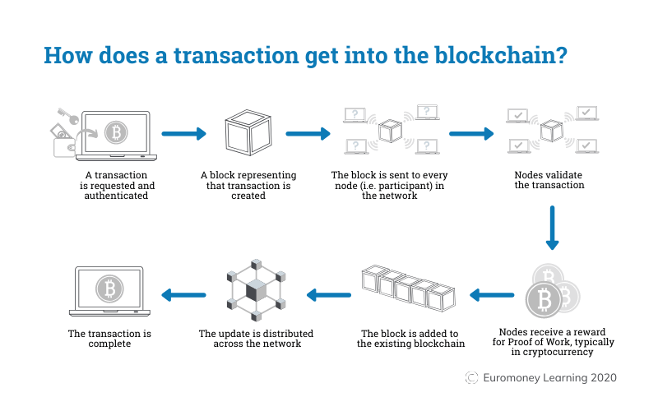
CODE • STATE • EVIDENCE
Nonce search and target probability • 45
RETAINED V17 • PROOF OF WORK (POW)
1
INPUT
P(success)=16^-4; E[trials]=65536
Blockchains use Proof-of-Work, or PoW, consensus algorithms to elect a leader who will decide the contents of the next block. This algorithm is used to confirm transactions and produce new blocks to the chain.
Technical reading: For a toy target requiring4 leading hex zeros, each trial has probability1/16^4. Expected trials65536 is a model, not a live difficulty claim.
2
CONTROL
For a toy target requiring4 leading hex zeros, each trial has probability1/16^4. Expected trials65536 is a model, not a live difficulty claim.
P(success)=16^-4; E[trials]=65536
3
EVIDENCE
Getter/receipt values must satisfy this exact source-specific condition
Copied original diagram • v17 source 45
Develop Blockchain and Web3 App with Vibe Coding | TGS-2021009338
© 2026 Tertiary Infotech Academy Pte Ltd
42
Notes:
Course Develop Blockchain and Web3 App with Vibe Coding TGS-2021009338. Technical anchor: P(success)=16^-4; E[trials]=65536. Source: https://docs.soliditylang.org/en/latest/ | https://web3py.readthedocs.io/en/stable/providers.html. Toolchain Solidity 0.8.30, OpenZeppelin 5.4.0, web3.py 8.0.0, Py-EVM 0.12.1b1; checked 13 September 2026.
Original v17 slide 45 verbatim content:
Proof of Work (PoW)
Blockchains use Proof-of-Work, or PoW, consensus algorithms to elect a leader who will decide the contents of the next block.
This algorithm is used to confirm transactions and produce new blocks to the chain.
‹#›

Slide 43
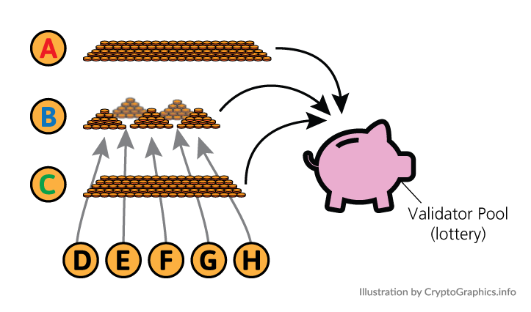
CODE • STATE • EVIDENCE
PoS role and local-test limitation • 46
RETAINED V17 • PROOF OF STAKE (POS)
1
INPUT
receipt.status validates execution; public finality is separate
With proof-of-stake (POS), cryptocurrency owners validate block transactions based on the number of coins a validator stakes. Proof-of-stake reduces the amount of computational work needed to verify blocks and transactions Validators are then selected randomly to "mine," or validate the block. This system…
Technical reading: Ethereum mainnet uses proof of stake. Contract unit tests cannot prove validator liveness, slashing or finality, which require separate protocol evidence.
2
CONTROL
Ethereum mainnet uses proof of stake. Contract unit tests cannot prove validator liveness, slashing or finality, which require separate protocol evidence.
receipt.status validates execution; public finality is separate
3
EVIDENCE
Getter/receipt values must satisfy this exact source-specific condition
Copied original diagram • v17 source 46
Develop Blockchain and Web3 App with Vibe Coding | TGS-2021009338
© 2026 Tertiary Infotech Academy Pte Ltd
43
Notes:
Course Develop Blockchain and Web3 App with Vibe Coding TGS-2021009338. Technical anchor: receipt.status validates execution; public finality is separate. Source: https://docs.soliditylang.org/en/latest/ | https://web3py.readthedocs.io/en/stable/providers.html. Toolchain Solidity 0.8.30, OpenZeppelin 5.4.0, web3.py 8.0.0, Py-EVM 0.12.1b1; checked 13 September 2026.
Original v17 slide 46 verbatim content:
Proof of Stake (PoS)
‹#›
With proof-of-stake (POS), cryptocurrency owners validate block transactions based on the number of coins a validator stakes.
Proof-of-stake reduces the amount of computational work needed to verify blocks and transactions
Validators are then selected randomly to "mine," or validate the block. This system randomizes who gets to "mine" rather than using a competition-based mechanism like proof-of-work.

Slide 44
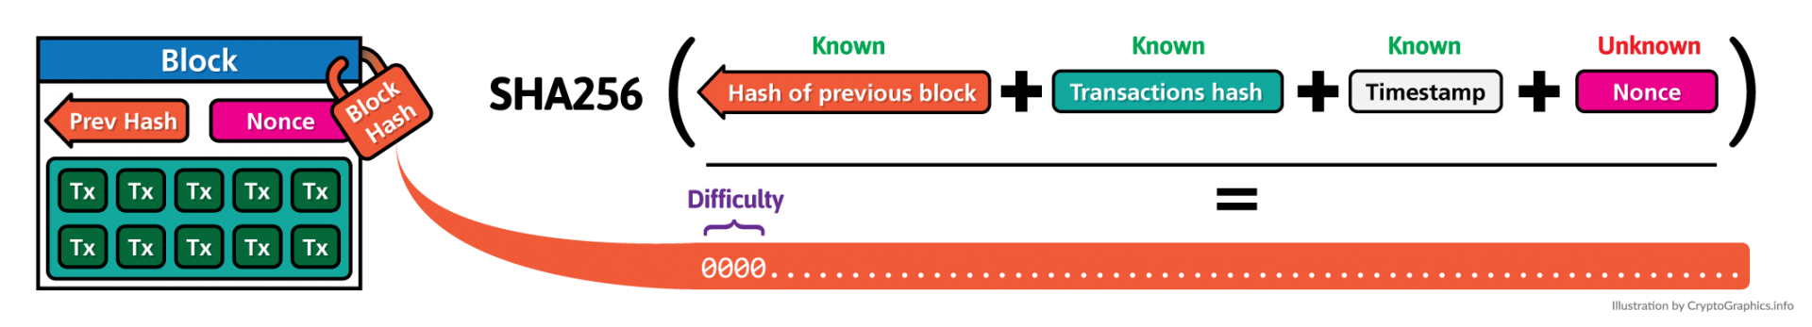
CODE • STATE • EVIDENCE
Target difficulty as a numeric threshold • 47
RETAINED V17 • NONCE AND DIFFICULTY LEVEL
1
INPUT
hash_int < target; lower target → lower success probability
A nonce is an abbreviation for "number only used once," which, in the context of cryptocurrency mining, is a number added to a hashed—or encrypted—block in a blockchain that, when rehashed, meets the difficulty level restrictions. The nonce is the number that blockchain miners are solving for. When the…
Technical reading: Lower target implies fewer acceptable hashes and higher expected work. Increment nonce while keeping the modeled header fields fixed.
2
CONTROL
Lower target implies fewer acceptable hashes and higher expected work. Increment nonce while keeping the modeled header fields fixed.
hash_int < target; lower target → lower success probability
3
EVIDENCE
Getter/receipt values must satisfy this exact source-specific condition
Copied original diagram • v17 source 47
Develop Blockchain and Web3 App with Vibe Coding | TGS-2021009338
© 2026 Tertiary Infotech Academy Pte Ltd
44
Notes:
Course Develop Blockchain and Web3 App with Vibe Coding TGS-2021009338. Technical anchor: hash_int < target; lower target → lower success probability. Source: https://docs.soliditylang.org/en/latest/ | https://web3py.readthedocs.io/en/stable/providers.html. Toolchain Solidity 0.8.30, OpenZeppelin 5.4.0, web3.py 8.0.0, Py-EVM 0.12.1b1; checked 13 September 2026.
Original v17 slide 47 verbatim content:
Nonce and Difficulty Level
A nonce is an abbreviation for "number only used once," which, in the context of cryptocurrency mining, is a number added to a hashed—or encrypted—block in a blockchain that, when rehashed, meets the difficulty level restrictions.
The nonce is the number that blockchain miners are solving for. When the solution is found, the blockchain miners are offered cryptocurrency in exchange.
‹#›

Slide 45
CODE • STATE • EVIDENCE
Deterministic nonce acceptance evidence • 48
RETAINED V17 TOPIC
1
INPUT
verify(header,nonce,target): computed_hash_int < target
Technical reading: A toy nonce activity records nonce and resulting hash so another learner can independently verify the same target comparison. It is not an Ethereum mining task.
Acceptance: verify(header,nonce,target): computed_hash_int < target
2
CONTROL
A toy nonce activity records nonce and resulting hash so another learner can independently verify the same target comparison. It is not an Ethereum mining task.
verify(header,nonce,target): computed_hash_int < target
3
EVIDENCE
Getter/receipt values must satisfy this exact source-specific condition
Develop Blockchain and Web3 App with Vibe Coding | TGS-2021009338
© 2026 Tertiary Infotech Academy Pte Ltd
45
Notes:
Course Develop Blockchain and Web3 App with Vibe Coding TGS-2021009338. Technical anchor: verify(header,nonce,target): computed_hash_int < target. Source: https://docs.soliditylang.org/en/latest/ | https://web3py.readthedocs.io/en/stable/providers.html. Toolchain Solidity 0.8.30, OpenZeppelin 5.4.0, web3.py 8.0.0, Py-EVM 0.12.1b1; checked 13 September 2026.
Original v17 slide 48 verbatim content:
Activity: Nonce
Goto https://demoblockchain.org/blockchain
Add the data "Buyer: Alice, Seller: Bob, Transaction: 10000" to Block 1
Manually change the nonce to obtain first 4 digit to be 0000 in the hash
Then press the Mine button to find the correct nonce.
‹#›

Slide 46
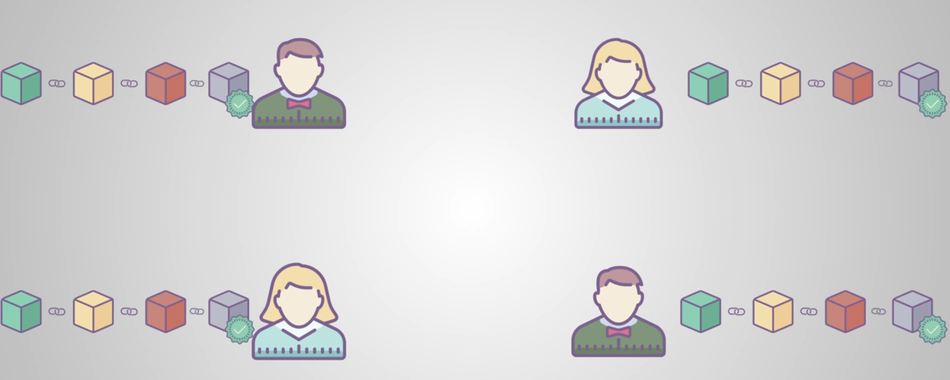
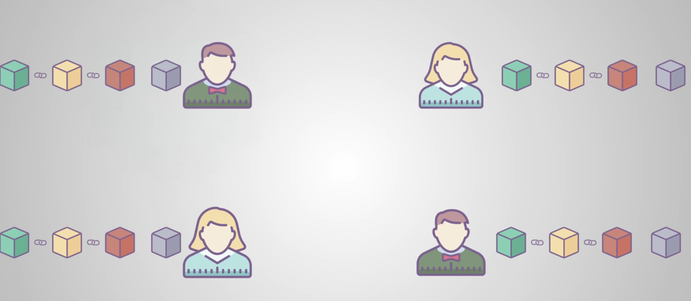
CODE • STATE • EVIDENCE
Peer replication versus provider endpoint • 49
RETAINED V17 • PEER TO PEER DISTRIBUTED NETWORK
1
INPUT
client → HTTPProvider → RPC node; node ↔ peers
The PoW is carried out on a Peer to Peer (P2P) distributed network. Whenever there is a new block, it will be send to every peer in the blockchain. The miners will validate the block via PoW. Once validated, the block will be added to the blockchain. The winning miner will be rewarded with bitcoins. In…
Technical reading: A blockchain peer and a JSONRPC provider serve different roles. Our Python client reads one provider; it does not start an Ethereum consensus peer.
2
CONTROL
A blockchain peer and a JSONRPC provider serve different roles. Our Python client reads one provider; it does not start an Ethereum consensus peer.
client → HTTPProvider → RPC node; node ↔ peers
3
EVIDENCE
Getter/receipt values must satisfy this exact source-specific condition
Copied original diagram • v17 source 49
Develop Blockchain and Web3 App with Vibe Coding | TGS-2021009338
© 2026 Tertiary Infotech Academy Pte Ltd
46
Notes:
Course Develop Blockchain and Web3 App with Vibe Coding TGS-2021009338. Technical anchor: client → HTTPProvider → RPC node; node ↔ peers. Source: https://docs.soliditylang.org/en/latest/ | https://web3py.readthedocs.io/en/stable/providers.html. Toolchain Solidity 0.8.30, OpenZeppelin 5.4.0, web3.py 8.0.0, Py-EVM 0.12.1b1; checked 13 September 2026.
Original v17 slide 49 verbatim content:
Peer to Peer Distributed Network
The PoW is carried out on a Peer to Peer (P2P) distributed network.
Whenever there is a new block, it will be send to every peer in the blockchain.
The miners will validate the block via PoW.
Once validated, the block will be added to the blockchain. The winning miner will be rewarded with bitcoins.
In Blockchain, a P2P network has replaced the role the central authority of a centralized database.
‹#›

Slide 47
CODE • STATE • EVIDENCE
Independent node-read reconciliation • 50
RETAINED V17 TOPIC
1
INPUT
chainId_A == chainId_B; blockHash_A(n) == blockHash_B(n)
Technical reading: Compare chain ID and block hash before comparing state between two endpoints. A difference can indicate different networks or chain heads.
Acceptance: chainId_A == chainId_B; blockHash_A(n) == blockHash_B(n)
2
CONTROL
Compare chain ID and block hash before comparing state between two endpoints. A difference can indicate different networks or chain heads.
chainId_A == chainId_B; blockHash_A(n) == blockHash_B(n)
3
EVIDENCE
Getter/receipt values must satisfy this exact source-specific condition
Develop Blockchain and Web3 App with Vibe Coding | TGS-2021009338
© 2026 Tertiary Infotech Academy Pte Ltd
47
Notes:
Course Develop Blockchain and Web3 App with Vibe Coding TGS-2021009338. Technical anchor: chainId_A == chainId_B; blockHash_A(n) == blockHash_B(n). Source: https://docs.soliditylang.org/en/latest/ | https://web3py.readthedocs.io/en/stable/providers.html. Toolchain Solidity 0.8.30, OpenZeppelin 5.4.0, web3.py 8.0.0, Py-EVM 0.12.1b1; checked 13 September 2026.
Original v17 slide 50 verbatim content:
Activity: Peer to Peer Network
Goto https://demoblockchain.org/distributed
The blockchains for all 3 peers are the same.
Assume we temper Block 3 for Peer 1 by adding some new data
Mine the Block 3, 4, 5 blockchain for Peer 1
Notice the hashes of Peer 1 are different from Peer 2 and Peer 3.
Therefore the community will know Peer 1 Block is being tempered.
‹#›
Tampered!

Slide 48
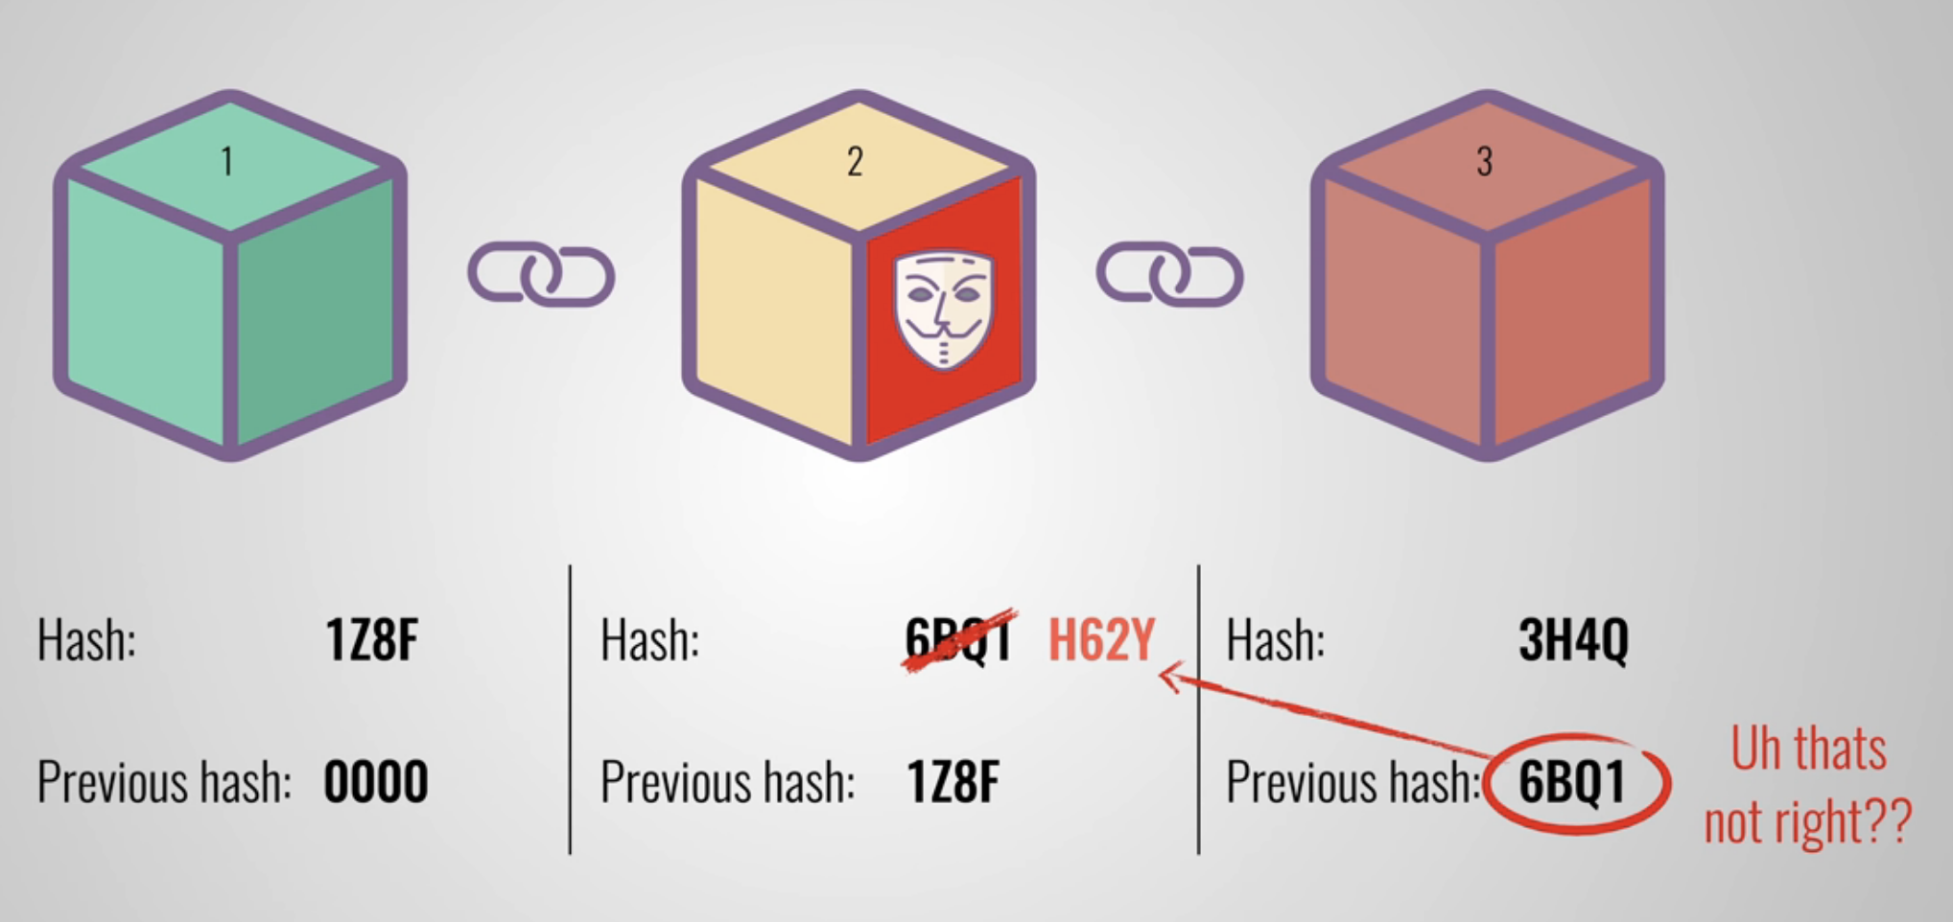
CODE • STATE • EVIDENCE
Committed history and mutable contract state • 51
RETAINED V17 • IMMUTABLE
1
INPUT
state getter = current value; event logs = historical transitions
One of the attributes that the blockchain is often associated with is its immutability. If the data of a block is tampered, the hash will change, this will cause a mismatch in the hash. So a hacker would need to change the hashes for all the subsequent blocks to avoid being detected! This make the data…
Technical reading: Chain history can be append-only while smart-contract storage changes through authorized transactions. The current value is not the complete change history.
2
CONTROL
Chain history can be append-only while smart-contract storage changes through authorized transactions. The current value is not the complete change history.
state getter = current value; event logs = historical transitions
3
EVIDENCE
Getter/receipt values must satisfy this exact source-specific condition
Copied original diagram • v17 source 51
Develop Blockchain and Web3 App with Vibe Coding | TGS-2021009338
© 2026 Tertiary Infotech Academy Pte Ltd
48
Notes:
Course Develop Blockchain and Web3 App with Vibe Coding TGS-2021009338. Technical anchor: state getter = current value; event logs = historical transitions. Source: https://docs.soliditylang.org/en/latest/ | https://web3py.readthedocs.io/en/stable/providers.html. Toolchain Solidity 0.8.30, OpenZeppelin 5.4.0, web3.py 8.0.0, Py-EVM 0.12.1b1; checked 13 September 2026.
Original v17 slide 51 verbatim content:
Immutable
One of the attributes that the blockchain is often associated with is its immutability.
If the data of a block is tampered, the hash will change, this will cause a mismatch in the hash.
So a hacker would need to change the hashes for all the subsequent blocks to avoid being detected!
This make the data immutable.
‹#›

Slide 49
CODE • STATE • EVIDENCE
Immutable deployment role versus mutable records • 52
RETAINED V17 TOPIC
1
INPUT
issuer fixed; registered[digest]:false → true
Technical reading: immutable issuer remains fixed after construction. Registered records still change false→true under permitted transitions; language immutability is not all-state immutability.
Acceptance: issuer fixed; registered[digest]:false → true
2
CONTROL
immutable issuer remains fixed after construction. Registered records still change false→true under permitted transitions; language immutability is not all-stat
issuer fixed; registered[digest]:false → true
3
EVIDENCE
Getter/receipt values must satisfy this exact source-specific condition
Develop Blockchain and Web3 App with Vibe Coding | TGS-2021009338
© 2026 Tertiary Infotech Academy Pte Ltd
49
Notes:
Course Develop Blockchain and Web3 App with Vibe Coding TGS-2021009338. Technical anchor: issuer fixed; registered[digest]:false → true. Source: https://docs.soliditylang.org/en/latest/ | https://web3py.readthedocs.io/en/stable/providers.html. Toolchain Solidity 0.8.30, OpenZeppelin 5.4.0, web3.py 8.0.0, Py-EVM 0.12.1b1; checked 13 September 2026.
Original v17 slide 52 verbatim content:
Activity: Immutable
Goto https://demoblockchain.org/tokens
The blockchains for all 3 peers are the same.
Assume we temper Block 3 for Peer 1 by changing the transaction fee from $5 to $7..
Mine the Block 3, 4, 5 blockchain for Peer 1
Notice the hashes of Peer 1 are different from Peer 2 and Peer 3.
Therefore the community will know Peer 1 Block is being tempered
‹#›
Tampered!

Slide 50
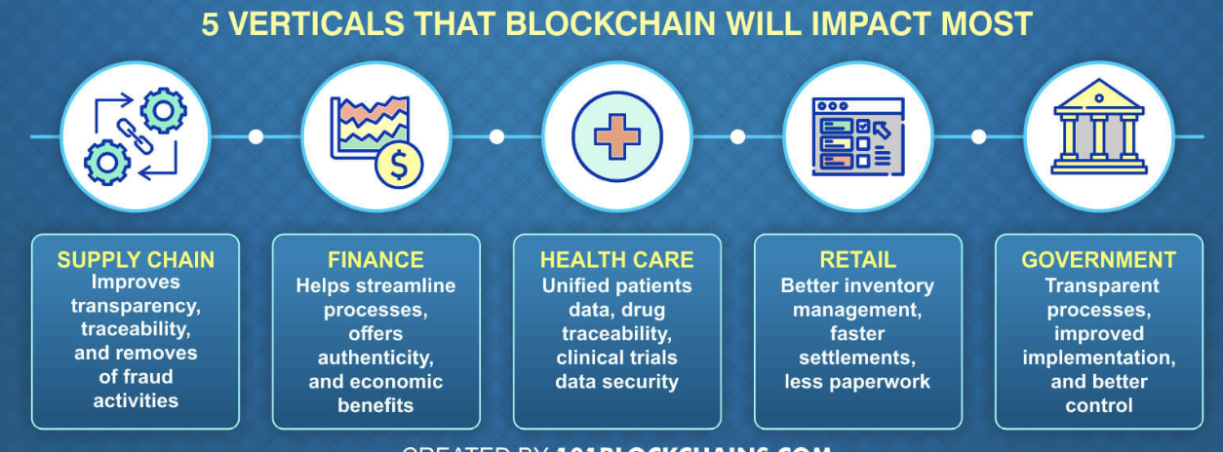
CODE • STATE • EVIDENCE
Industry evidence boundary for medicine custody • 53
RETAINED V17 • IMPACT OF BLOCKCHAIN ON INDUSTRY
1
INPUT
Batch{id,custodian,digest,stage} + authorized Handover
The applications of blockchain technology are far beyond virtual currency and the financial industry. This technology have disrupt many sectors such as below:
Technical reading: A batch custody contract binds document bytes and permitted handovers. Physical inspection, sensor calibration and identity controls are distinct required evidence.
2
CONTROL
A batch custody contract binds document bytes and permitted handovers. Physical inspection, sensor calibration and identity controls are distinct required evide
Batch{id,custodian,digest,stage} + authorized Handover
3
EVIDENCE
Getter/receipt values must satisfy this exact source-specific condition
Copied original diagram • v17 source 53
Develop Blockchain and Web3 App with Vibe Coding | TGS-2021009338
© 2026 Tertiary Infotech Academy Pte Ltd
50
Notes:
Course Develop Blockchain and Web3 App with Vibe Coding TGS-2021009338. Technical anchor: Batch{id,custodian,digest,stage} + authorized Handover. Source: https://docs.soliditylang.org/en/latest/ | https://web3py.readthedocs.io/en/stable/providers.html. Toolchain Solidity 0.8.30, OpenZeppelin 5.4.0, web3.py 8.0.0, Py-EVM 0.12.1b1; checked 13 September 2026.
Original v17 slide 53 verbatim content:
Impact of Blockchain on Industry
‹#›
The applications of blockchain technology are far beyond virtual currency and the financial industry. This technology have disrupt many sectors such as below:

Slide 51
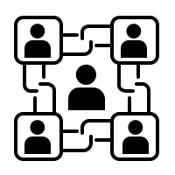
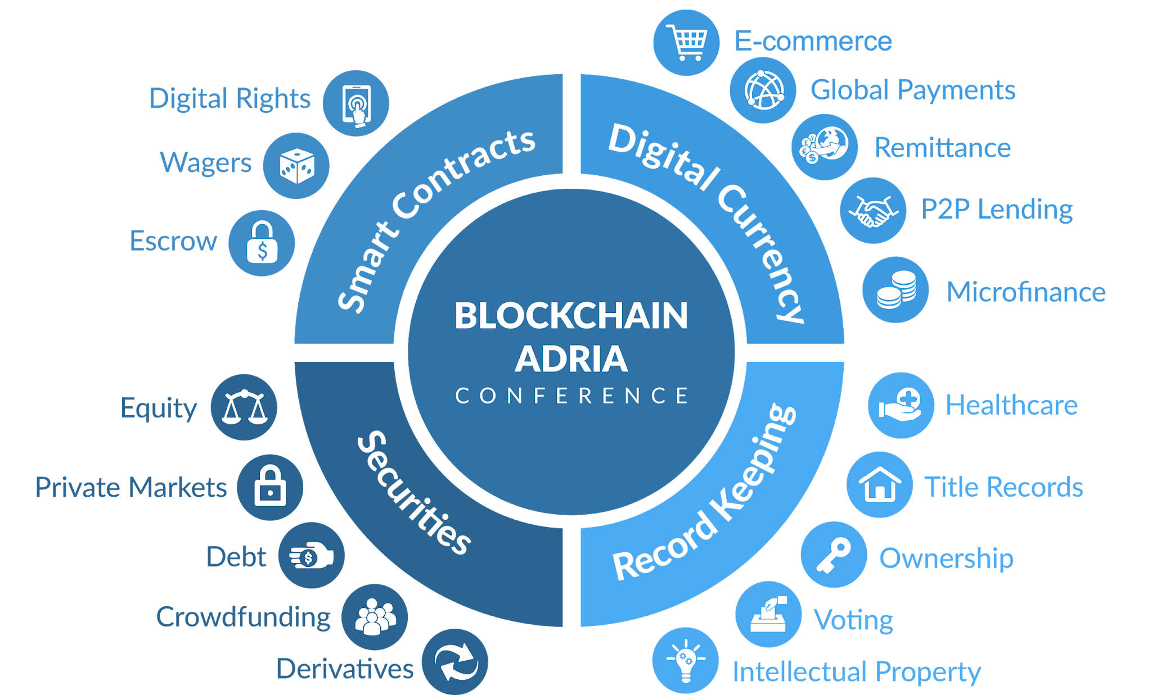
CODE • STATE • EVIDENCE
Application choice from actor and evidence schema • 54
RETAINED V17 • BLOCKCHAIN APPLICATIONS
1
INPUT
Certificate:{id,holder,digest,revoked}; Batch:{id,custodian,stage}
Blockchain Applications
Technical reading: Select certificate or supply custody based on actor, record identifier and allowed transitions. Avoid storing personal records when a hash and reference suffice.
2
CONTROL
Select certificate or supply custody based on actor, record identifier and allowed transitions. Avoid storing personal records when a hash and reference suffice
Certificate:{id,holder,digest,revoked}; Batch:{id,custodian,stage}
3
EVIDENCE
Getter/receipt values must satisfy this exact source-specific condition
Copied original diagram • v17 source 54
Develop Blockchain and Web3 App with Vibe Coding | TGS-2021009338
© 2026 Tertiary Infotech Academy Pte Ltd
51
Notes:
Course Develop Blockchain and Web3 App with Vibe Coding TGS-2021009338. Technical anchor: Certificate:{id,holder,digest,revoked}; Batch:{id,custodian,stage}. Source: https://docs.soliditylang.org/en/latest/ | https://web3py.readthedocs.io/en/stable/providers.html. Toolchain Solidity 0.8.30, OpenZeppelin 5.4.0, web3.py 8.0.0, Py-EVM 0.12.1b1; checked 13 September 2026.
Original v17 slide 54 verbatim content:
Blockchain Applications
‹#›

Slide 52

CODE • STATE • EVIDENCE
Escrow value conservation and release risk • 55
RETAINED V17 • DEFI
1
INPUT
contract_balance_before_release == price
Decentralized finance (DeFi) is an emerging financial technology based on secure distributed ledgers similar to those used by cryptocurrencies. The system removes the control banks and institutions have on money, financial products, and financial services.
Technical reading: The financial contract conserves0.1ETH from funding to release. It does not guarantee delivery or repay a lender; requirements must specify the settlement assumption.
2
CONTROL
The financial contract conserves0.1ETH from funding to release. It does not guarantee delivery or repay a lender; requirements must specify the settlement assum
contract_balance_before_release == price
3
EVIDENCE
Getter/receipt values must satisfy this exact source-specific condition
Copied original diagram • v17 source 55
Develop Blockchain and Web3 App with Vibe Coding | TGS-2021009338
© 2026 Tertiary Infotech Academy Pte Ltd
52
Notes:
Course Develop Blockchain and Web3 App with Vibe Coding TGS-2021009338. Technical anchor: contract_balance_before_release == price. Source: https://docs.soliditylang.org/en/latest/ | https://web3py.readthedocs.io/en/stable/providers.html. Toolchain Solidity 0.8.30, OpenZeppelin 5.4.0, web3.py 8.0.0, Py-EVM 0.12.1b1; checked 13 September 2026.
Original v17 slide 55 verbatim content:
DeFi
Decentralized finance (DeFi) is an emerging financial technology based on secure distributed ledgers similar to those used by cryptocurrencies.
The system removes the control banks and institutions have on money, financial products, and financial services.
‹#›

Slide 53
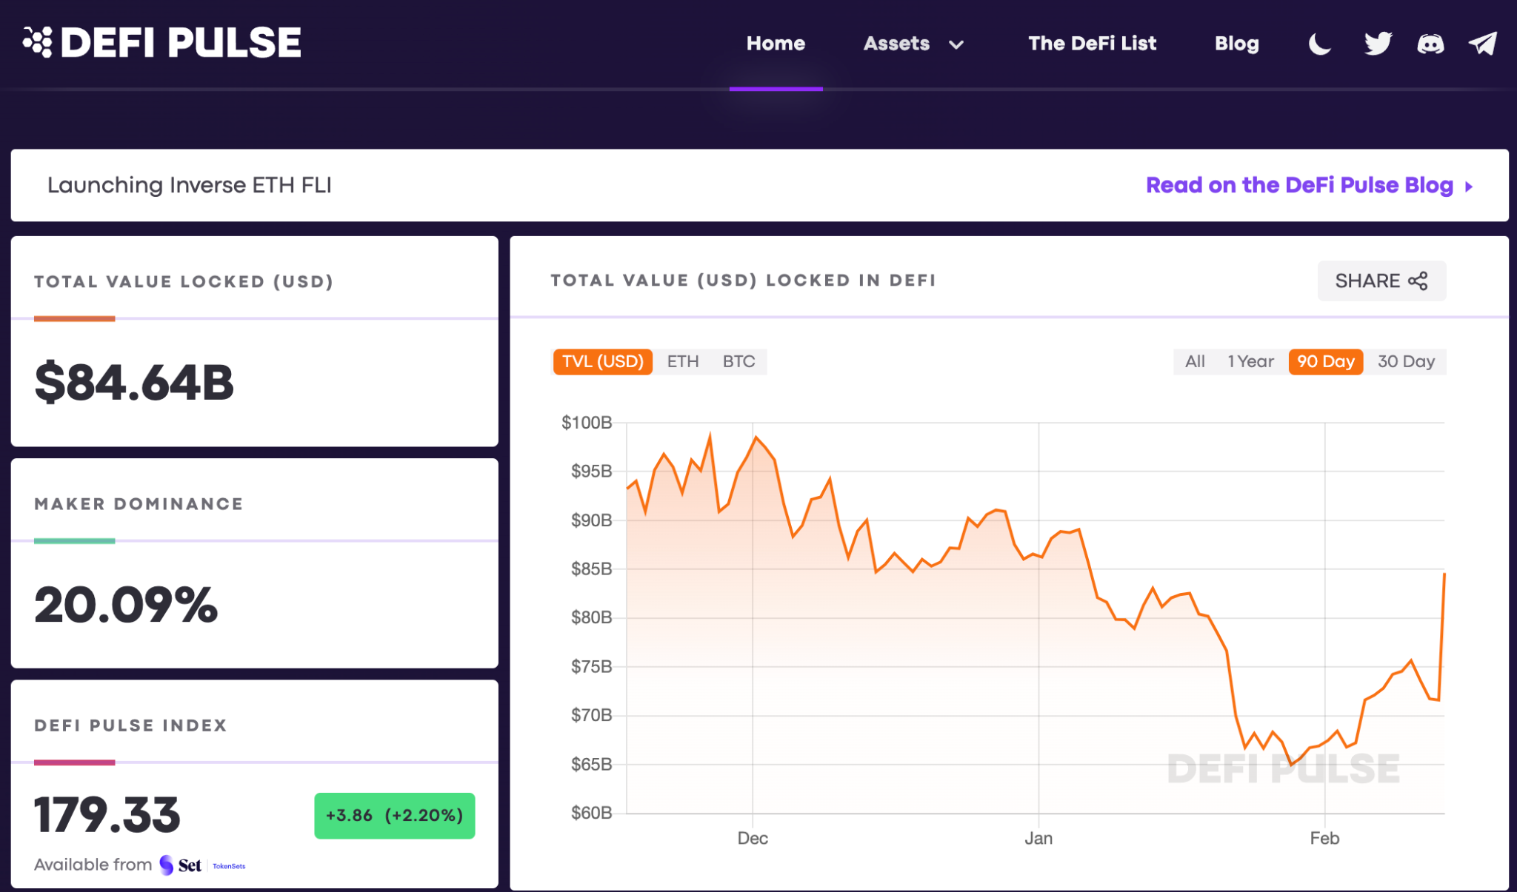
CODE • STATE • EVIDENCE
Financial model assumptions instead of market-size claims • 56
RETAINED V17 • DEFI MARKET SIZE
1
INPUT
0.1 ETH principal; fee = gasUsed × effectiveGasPrice
https://www.defipulse.com/
Technical reading: Original market-size figures are dated and not current forecasts. Analyze the actual escrow with value, authorization and gas cost under named assumptions.
2
CONTROL
Original market-size figures are dated and not current forecasts. Analyze the actual escrow with value, authorization and gas cost under named assumptions.
0.1 ETH principal; fee = gasUsed × effectiveGasPrice
3
EVIDENCE
Getter/receipt values must satisfy this exact source-specific condition
Copied original diagram • v17 source 56
Develop Blockchain and Web3 App with Vibe Coding | TGS-2021009338
© 2026 Tertiary Infotech Academy Pte Ltd
53
Notes:
Course Develop Blockchain and Web3 App with Vibe Coding TGS-2021009338. Technical anchor: 0.1 ETH principal; fee = gasUsed × effectiveGasPrice. Source: https://docs.soliditylang.org/en/latest/ | https://web3py.readthedocs.io/en/stable/providers.html. Toolchain Solidity 0.8.30, OpenZeppelin 5.4.0, web3.py 8.0.0, Py-EVM 0.12.1b1; checked 13 September 2026.
Original v17 slide 56 verbatim content:
DeFi Market Size
‹#›
https://www.defipulse.com/

Slide 54
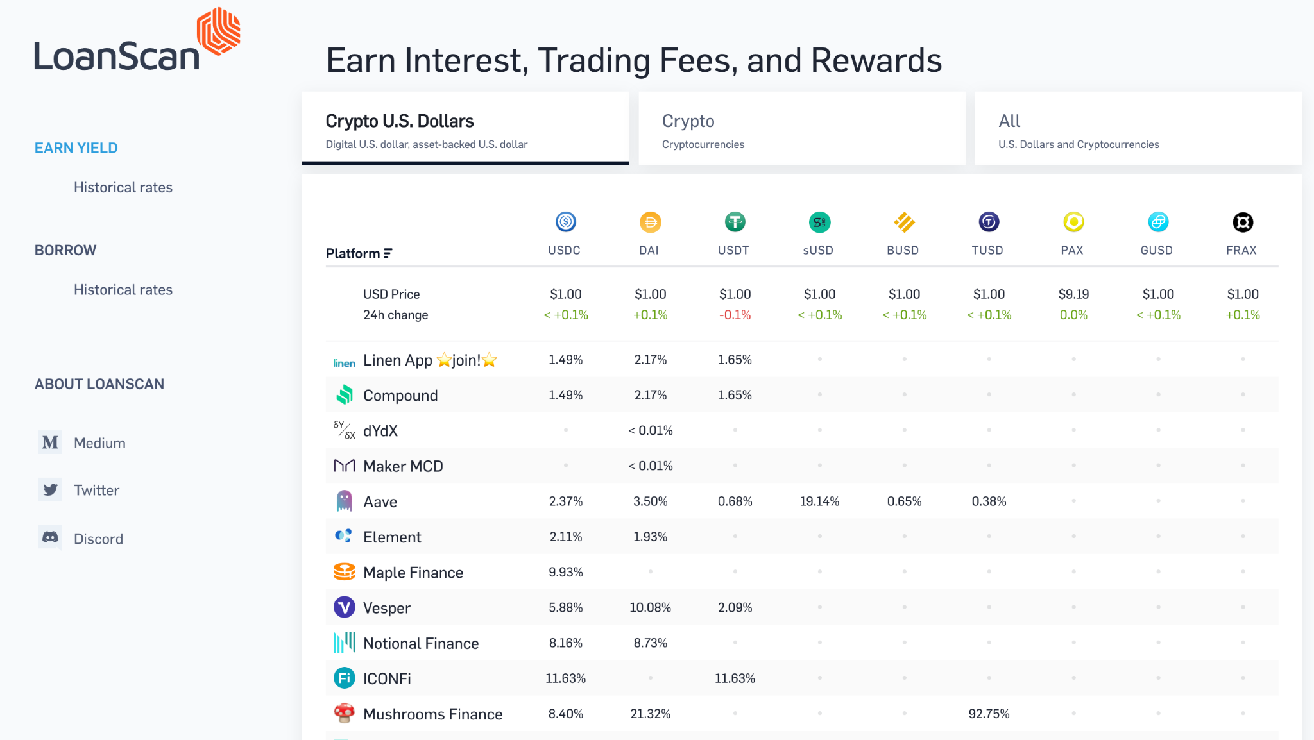
CODE • STATE • EVIDENCE
Collateral arithmetic and oracle trust • 57
RETAINED V17 • DEFI LOAN AND LENDING PLATFORMS
1
INPUT
collateral_ratio = collateral_value/debt; require(ratio>=1.5)
https://loanscan.io/
Technical reading: A worked collateral rule uses explicit numbers and an oracle boundary. At collateral200 and loan100, ratio200%; a price drop to120 gives120% and may breach150% threshold.
2
CONTROL
A worked collateral rule uses explicit numbers and an oracle boundary. At collateral200 and loan100, ratio200%; a price drop to120 gives120% and may breach150%
collateral_ratio = collateral_value/debt; require(ratio>=1.5)
3
EVIDENCE
Getter/receipt values must satisfy this exact source-specific condition
Copied original diagram • v17 source 57
Develop Blockchain and Web3 App with Vibe Coding | TGS-2021009338
© 2026 Tertiary Infotech Academy Pte Ltd
54
Notes:
Course Develop Blockchain and Web3 App with Vibe Coding TGS-2021009338. Technical anchor: collateral_ratio = collateral_value/debt; require(ratio>=1.5). Source: https://docs.soliditylang.org/en/latest/ | https://web3py.readthedocs.io/en/stable/providers.html. Toolchain Solidity 0.8.30, OpenZeppelin 5.4.0, web3.py 8.0.0, Py-EVM 0.12.1b1; checked 13 September 2026.
Original v17 slide 57 verbatim content:
DeFi Loan and Lending Platforms
‹#›
https://loanscan.io/

Slide 55
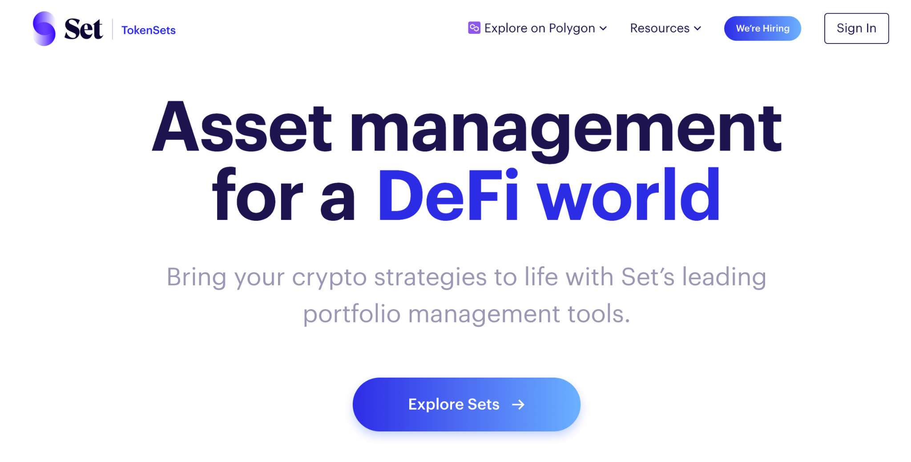
CODE • STATE • EVIDENCE
Token-set accounting and smallest units • 58
RETAINED V17 • TOKENSETS
1
INPUT
sum(holder balances) == totalSupply in smallest units
https://www.tokensets.com/
Technical reading: A token basket requires explicit balance and supply reconciliation. Our workshop credit transfer demonstrates conservation, not a tradeable investment return.
2
CONTROL
A token basket requires explicit balance and supply reconciliation. Our workshop credit transfer demonstrates conservation, not a tradeable investment return.
sum(holder balances) == totalSupply in smallest units
3
EVIDENCE
Getter/receipt values must satisfy this exact source-specific condition
Copied original diagram • v17 source 58
Develop Blockchain and Web3 App with Vibe Coding | TGS-2021009338
© 2026 Tertiary Infotech Academy Pte Ltd
55
Notes:
Course Develop Blockchain and Web3 App with Vibe Coding TGS-2021009338. Technical anchor: sum(holder balances) == totalSupply in smallest units. Source: https://docs.soliditylang.org/en/latest/ | https://web3py.readthedocs.io/en/stable/providers.html. Toolchain Solidity 0.8.30, OpenZeppelin 5.4.0, web3.py 8.0.0, Py-EVM 0.12.1b1; checked 13 September 2026.
Original v17 slide 58 verbatim content:
TokenSets
‹#›
https://www.tokensets.com/

Slide 56
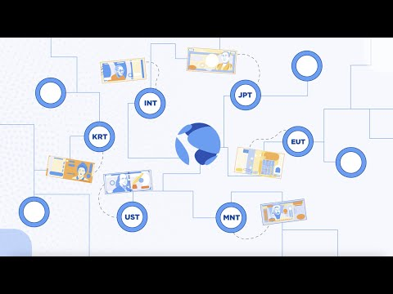
CODE • STATE • EVIDENCE
Stable-value promise versus reserve evidence • 59
RETAINED V17 • WHAT IS TERRA STABLECOINS?
1
INPUT
on-chain totalSupply is not proof of off-chain reserve value
What is Terra Stablecoins?
Technical reading: A token name does not guarantee redemption or price stability. A smart-contract test can check mint limits and balances, but off-chain reserves need external evidence.
2
CONTROL
A token name does not guarantee redemption or price stability. A smart-contract test can check mint limits and balances, but off-chain reserves need external ev
on-chain totalSupply is not proof of off-chain reserve value
3
EVIDENCE
Getter/receipt values must satisfy this exact source-specific condition
Copied original diagram • v17 source 59
Develop Blockchain and Web3 App with Vibe Coding | TGS-2021009338
© 2026 Tertiary Infotech Academy Pte Ltd
56
Notes:
Course Develop Blockchain and Web3 App with Vibe Coding TGS-2021009338. Technical anchor: on-chain totalSupply is not proof of off-chain reserve value. Source: https://docs.soliditylang.org/en/latest/ | https://web3py.readthedocs.io/en/stable/providers.html. Toolchain Solidity 0.8.30, OpenZeppelin 5.4.0, web3.py 8.0.0, Py-EVM 0.12.1b1; checked 13 September 2026.
Original v17 slide 59 verbatim content:
‹#›
What is Terra Stablecoins?

Slide 57
CODE • STATE • EVIDENCE
DeFi implementation change-control record • 60
RETAINED V17 • THE FUTURE OF DEFI
1
INPUT
source hash + dependency lock + invariant test + receipt evidence
Decentralized Finance has already seen phenomenal growth over the last few years. However, there are over 1.7 billion unbanked people in the World excluded from the traditional financial system who could benefit from DeFi. Imagine if you are living in a developing country with high inflation. DeFi gives…
Technical reading: Treat original future statements as dated context. Compare a pinned compiler/dependency and tested invariant against a proposed change before release.
2
CONTROL
Treat original future statements as dated context. Compare a pinned compiler/dependency and tested invariant against a proposed change before release.
source hash + dependency lock + invariant test + receipt evidence
3
EVIDENCE
Getter/receipt values must satisfy this exact source-specific condition
Develop Blockchain and Web3 App with Vibe Coding | TGS-2021009338
© 2026 Tertiary Infotech Academy Pte Ltd
57
Notes:
Course Develop Blockchain and Web3 App with Vibe Coding TGS-2021009338. Technical anchor: source hash + dependency lock + invariant test + receipt evidence. Source: https://docs.soliditylang.org/en/latest/ | https://web3py.readthedocs.io/en/stable/providers.html. Toolchain Solidity 0.8.30, OpenZeppelin 5.4.0, web3.py 8.0.0, Py-EVM 0.12.1b1; checked 13 September 2026.
Original v17 slide 60 verbatim content:
The Future of DeFi
‹#›
Decentralized Finance has already seen phenomenal growth over the last few years. However, there are over 1.7 billion unbanked people in the World excluded from the traditional financial system who could benefit from DeFi.
Imagine if you are living in a developing country with high inflation. DeFi gives you the opportunity to get out of your local currency and hold USD via stable coins like Dai. Even better, you can then take that Dai and lend it out at 5+% interest on DeFi platforms like Compound Finance. DeFi already offers people the tools to hedge out local currency risk and that’s a pretty big deal in countries like Venezuela.
Although DeFi loans currently need to be over-collateralized, it will only be a matter of time befer under-collateralized loans are available via a form of DeFi borrowing reputation system

Slide 58
CODE • STATE • EVIDENCE
External-call risk and reentrancy verification • 61
RETAINED V17 • PROBLEMS WITH DEFI
1
INPUT
effects before interaction; ReenterProbe.blocked()==true
It’s hard for the average person to access DeFi and that's due to friction between the crypto and traditional finance ecosystem. . Another major issue facing DeFi are smart contract bugs. These could result in DeFi users losing access to a significant amount of funds and it’s even more worrying seeing…
Technical reading: A recursive callback probes whether withdrawal pays twice. The vault zeros balance before calling and guards entry; an actual adversarial probe must report blocked.
2
CONTROL
A recursive callback probes whether withdrawal pays twice. The vault zeros balance before calling and guards entry; an actual adversarial probe must report bloc
effects before interaction; ReenterProbe.blocked()==true
3
EVIDENCE
Getter/receipt values must satisfy this exact source-specific condition
Develop Blockchain and Web3 App with Vibe Coding | TGS-2021009338
© 2026 Tertiary Infotech Academy Pte Ltd
58
Notes:
Course Develop Blockchain and Web3 App with Vibe Coding TGS-2021009338. Technical anchor: effects before interaction; ReenterProbe.blocked()==true. Source: https://docs.soliditylang.org/en/latest/ | https://web3py.readthedocs.io/en/stable/providers.html. Toolchain Solidity 0.8.30, OpenZeppelin 5.4.0, web3.py 8.0.0, Py-EVM 0.12.1b1; checked 13 September 2026.
Original v17 slide 61 verbatim content:
Problems With DeFi
‹#›
It’s hard for the average person to access DeFi and that's due to friction between the crypto and traditional finance ecosystem. .
Another major issue facing DeFi are smart contract bugs. These could result in DeFi users losing access to a significant amount of funds and it’s even more worrying seeing that bugs are not unheard of in smart contracts.

Slide 59
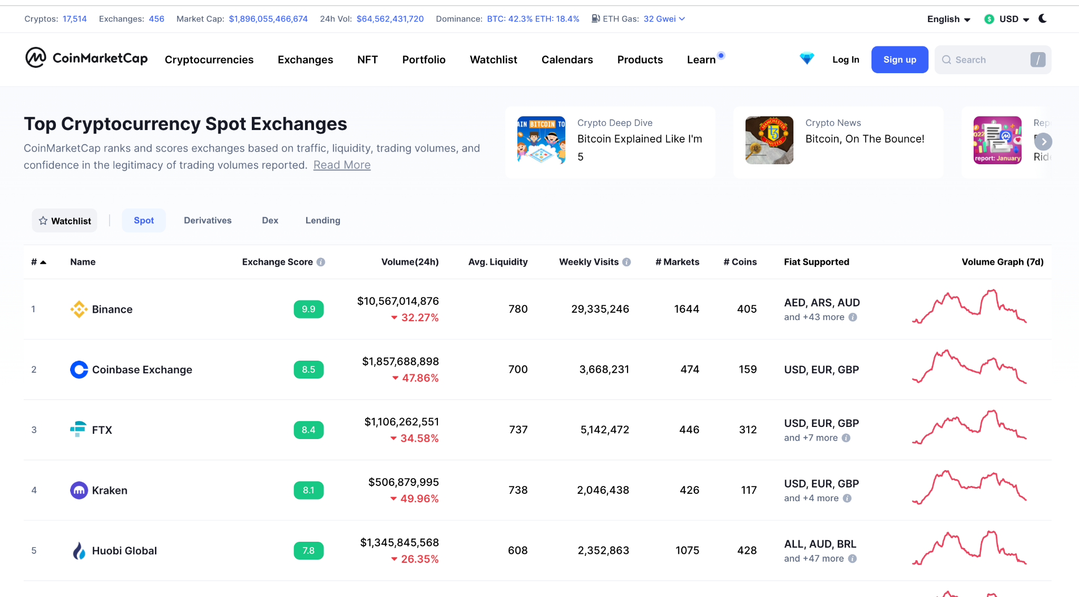
CODE • STATE • EVIDENCE
Exchange custody versus self-controlled signing • 62
RETAINED V17 • CRYPTO EXCHANGES
1
INPUT
w3.eth.get_balance(test_address) reads selected chain
https://coinmarketcap.com/rankings/exchanges/
Technical reading: A hosted exchange balance is a service ledger; a test-wallet balance is queried from the selected chain. Do not treat an exchange account as a contract signer.
2
CONTROL
A hosted exchange balance is a service ledger; a test-wallet balance is queried from the selected chain. Do not treat an exchange account as a contract signer.
w3.eth.get_balance(test_address) reads selected chain
3
EVIDENCE
Getter/receipt values must satisfy this exact source-specific condition
Copied original diagram • v17 source 62
Develop Blockchain and Web3 App with Vibe Coding | TGS-2021009338
© 2026 Tertiary Infotech Academy Pte Ltd
59
Notes:
Course Develop Blockchain and Web3 App with Vibe Coding TGS-2021009338. Technical anchor: w3.eth.get_balance(test_address) reads selected chain. Source: https://docs.soliditylang.org/en/latest/ | https://web3py.readthedocs.io/en/stable/providers.html. Toolchain Solidity 0.8.30, OpenZeppelin 5.4.0, web3.py 8.0.0, Py-EVM 0.12.1b1; checked 13 September 2026.
Original v17 slide 62 verbatim content:
Crypto Exchanges
‹#›
https://coinmarketcap.com/rankings/exchanges/

Slide 60
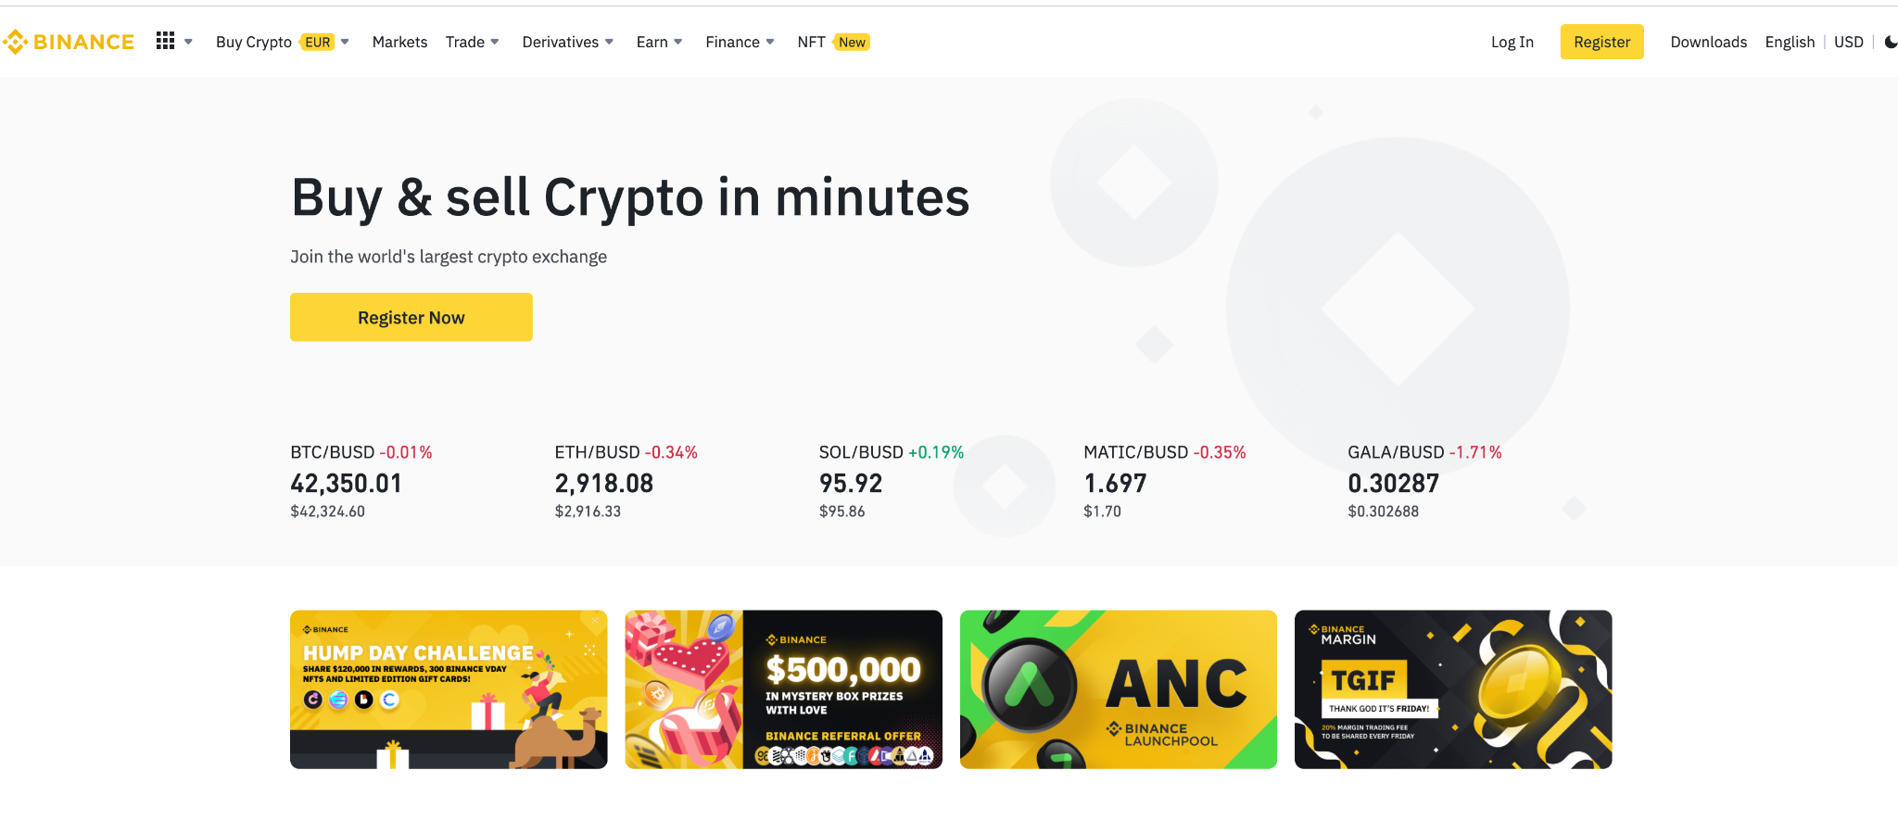
CODE • STATE • EVIDENCE
Hosted exchange API is outside test execution • 63
RETAINED V17 • BINANCE
1
INPUT
No exchange API credentials; local test accounts only
https://www.binance.com
Technical reading: Original Binance context is historical application material. The course does not require exchange API keys; test accounts are disposable local-chain addresses.
2
CONTROL
Original Binance context is historical application material. The course does not require exchange API keys; test accounts are disposable local-chain addresses.
No exchange API credentials; local test accounts only
3
EVIDENCE
Getter/receipt values must satisfy this exact source-specific condition
Copied original diagram • v17 source 63
Develop Blockchain and Web3 App with Vibe Coding | TGS-2021009338
© 2026 Tertiary Infotech Academy Pte Ltd
60
Notes:
Course Develop Blockchain and Web3 App with Vibe Coding TGS-2021009338. Technical anchor: No exchange API credentials; local test accounts only. Source: https://docs.soliditylang.org/en/latest/ | https://web3py.readthedocs.io/en/stable/providers.html. Toolchain Solidity 0.8.30, OpenZeppelin 5.4.0, web3.py 8.0.0, Py-EVM 0.12.1b1; checked 13 September 2026.
Original v17 slide 63 verbatim content:
Binance
‹#›
https://www.binance.com

Slide 61
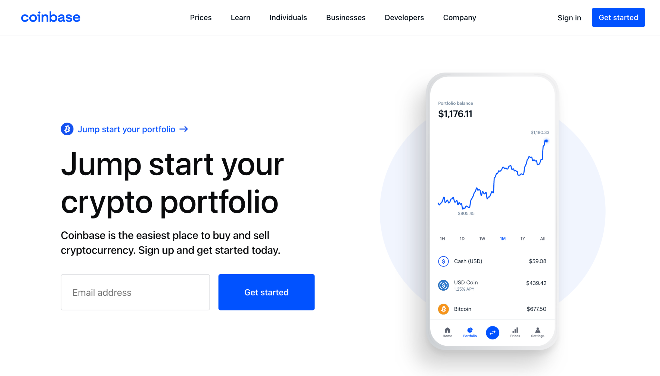
CODE • STATE • EVIDENCE
Custodial service transfer versus chain receipt • 64
RETAINED V17 • COINBASE
1
INPUT
receipt.status==1 ∧ recipient balance delta correct
https://www.coinbase.com/
Technical reading: A platform credit or pending withdrawal is not a chain transaction receipt. Verify actual selected-chain hash, status, block and recipient balance.
2
CONTROL
A platform credit or pending withdrawal is not a chain transaction receipt. Verify actual selected-chain hash, status, block and recipient balance.
receipt.status==1 ∧ recipient balance delta correct
3
EVIDENCE
Getter/receipt values must satisfy this exact source-specific condition
Copied original diagram • v17 source 64
Develop Blockchain and Web3 App with Vibe Coding | TGS-2021009338
© 2026 Tertiary Infotech Academy Pte Ltd
61
Notes:
Course Develop Blockchain and Web3 App with Vibe Coding TGS-2021009338. Technical anchor: receipt.status==1 ∧ recipient balance delta correct. Source: https://docs.soliditylang.org/en/latest/ | https://web3py.readthedocs.io/en/stable/providers.html. Toolchain Solidity 0.8.30, OpenZeppelin 5.4.0, web3.py 8.0.0, Py-EVM 0.12.1b1; checked 13 September 2026.
Original v17 slide 64 verbatim content:
Coinbase
‹#›
https://www.coinbase.com/

Slide 62
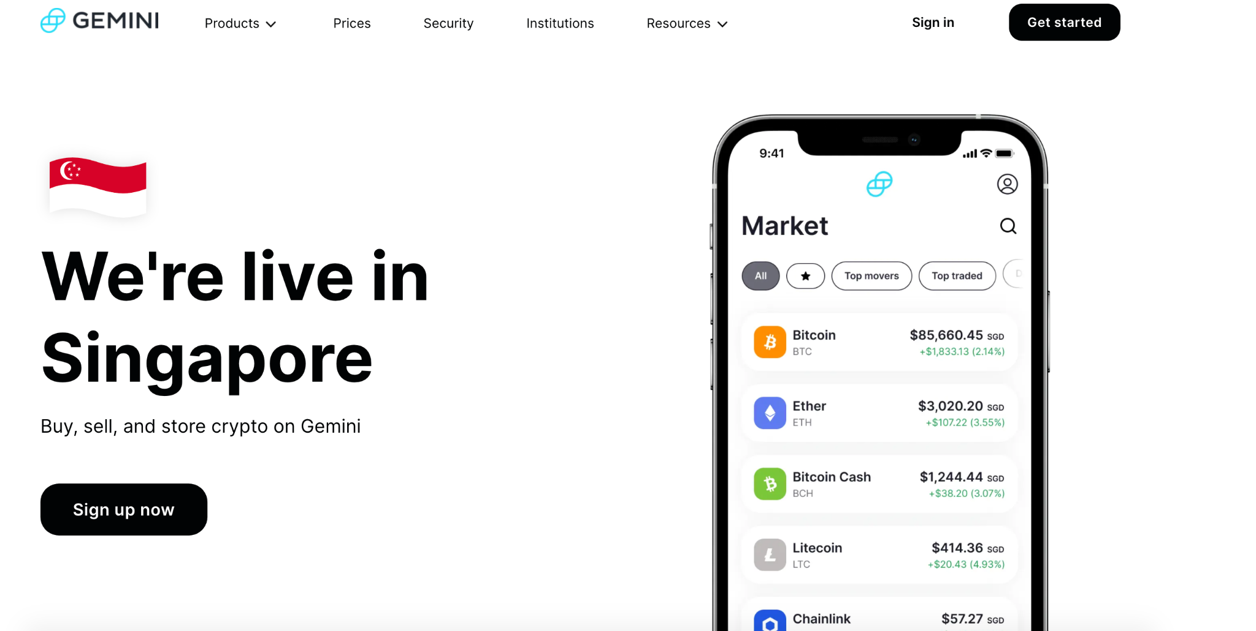
CODE • STATE • EVIDENCE
Custody risk and application authorization • 65
RETAINED V17 • GEMINI
1
INPUT
reject(issue(outsider,id,digest), outsider)
https://www.gemini.com/share/gyx5ekvtx
Technical reading: A service account and contract issuer are different trust boundaries. Protect a certificate issuer role and reject outsider issuance regardless of service branding.
2
CONTROL
A service account and contract issuer are different trust boundaries. Protect a certificate issuer role and reject outsider issuance regardless of service brand
reject(issue(outsider,id,digest), outsider)
3
EVIDENCE
Getter/receipt values must satisfy this exact source-specific condition
Copied original diagram • v17 source 65
Develop Blockchain and Web3 App with Vibe Coding | TGS-2021009338
© 2026 Tertiary Infotech Academy Pte Ltd
62
Notes:
Course Develop Blockchain and Web3 App with Vibe Coding TGS-2021009338. Technical anchor: reject(issue(outsider,id,digest), outsider). Source: https://docs.soliditylang.org/en/latest/ | https://web3py.readthedocs.io/en/stable/providers.html. Toolchain Solidity 0.8.30, OpenZeppelin 5.4.0, web3.py 8.0.0, Py-EVM 0.12.1b1; checked 13 September 2026.
Original v17 slide 65 verbatim content:
Gemini
‹#›
https://www.gemini.com/share/gyx5ekvtx

Slide 63

CODE • STATE • EVIDENCE
Incident analysis with named failure control • 66
RETAINED V17 • SOURCE VISUAL
1
INPUT
Which caller may change custody? Which assertion rejects it?
Technical reading: Original incident images are historical evidence. Translate the failure into a concrete role/control question rather than a general security warning.
2
CONTROL
Original incident images are historical evidence. Translate the failure into a concrete role/control question rather than a general security warning.
Which caller may change custody? Which assertion rejects it?
3
EVIDENCE
Getter/receipt values must satisfy this exact source-specific condition
Copied original diagram • v17 source 66
Develop Blockchain and Web3 App with Vibe Coding | TGS-2021009338
© 2026 Tertiary Infotech Academy Pte Ltd
63
Notes:
Course Develop Blockchain and Web3 App with Vibe Coding TGS-2021009338. Technical anchor: Which caller may change custody? Which assertion rejects it?. Source: https://docs.soliditylang.org/en/latest/ | https://web3py.readthedocs.io/en/stable/providers.html. Toolchain Solidity 0.8.30, OpenZeppelin 5.4.0, web3.py 8.0.0, Py-EVM 0.12.1b1; checked 13 September 2026.
Original v17 slide 66 verbatim content:
‹#›

Slide 64

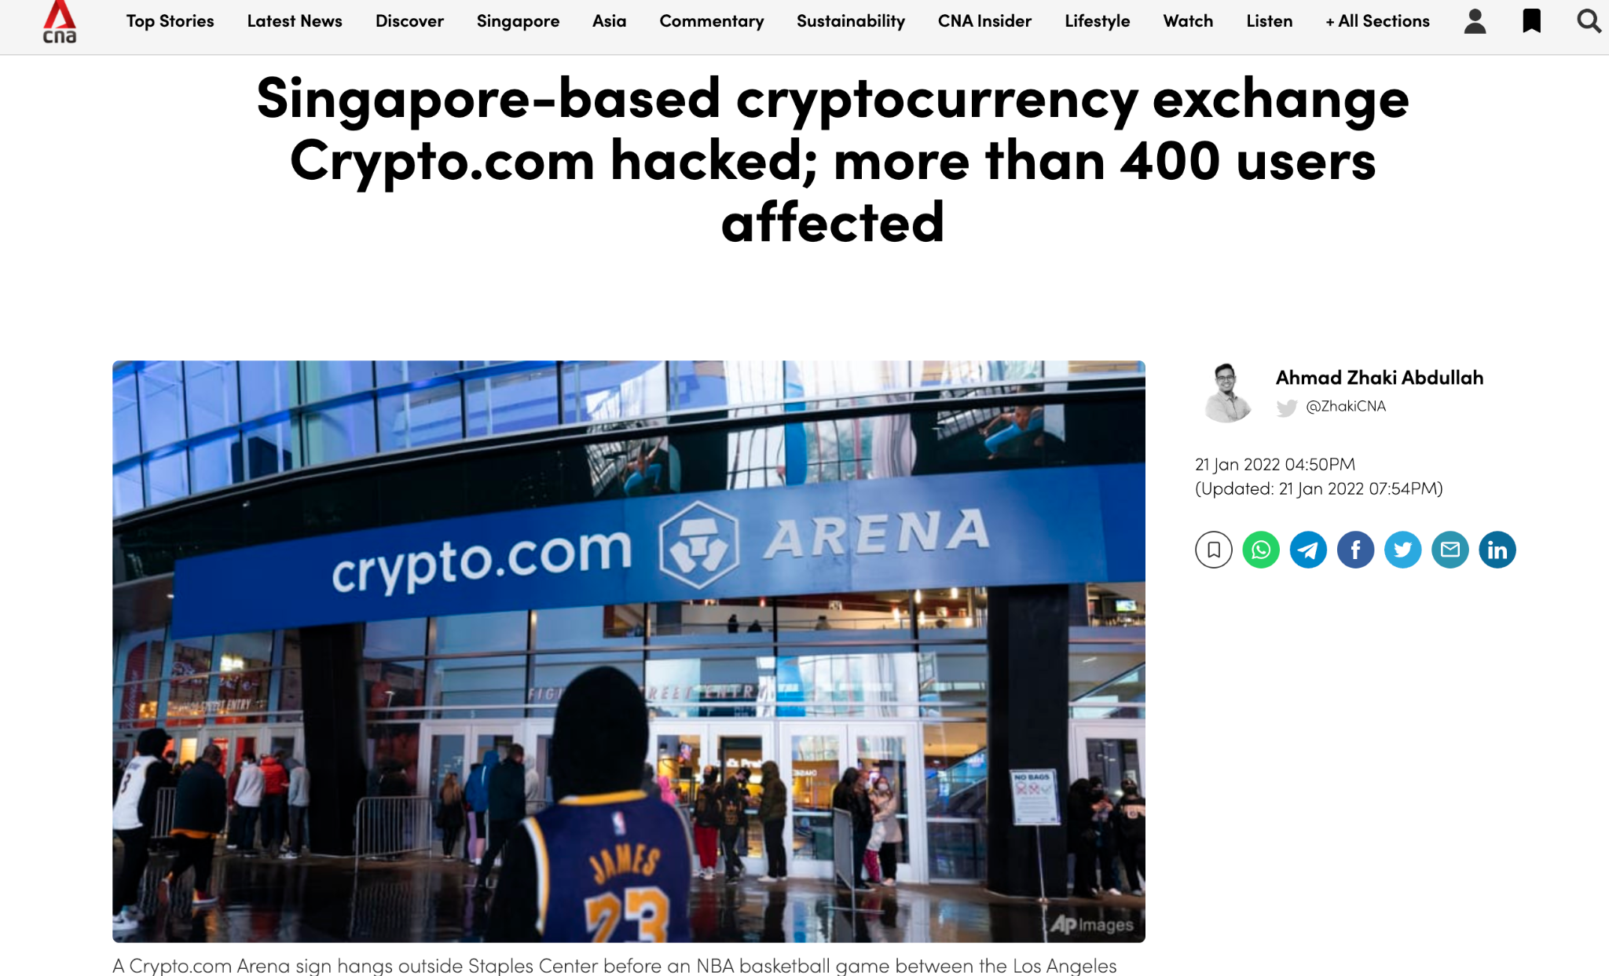
CODE • STATE • EVIDENCE
Historical exchange incident and credential boundary • 67
RETAINED V17 • SOURCE: HTTPS://WWW.CHANNELNEWSASIA.COM/BUSINESS/SINGAP
1
INPUT
outsider handover attempt must revert without state change
source: https://www.channelnewsasia.com/business/singapore-based-cryptocurrency-exchange-cryptocom-hacked-more-400-users-affected-2450671
Technical reading: The cited original incident remains a historical source. Our activities use no production credentials and test contract authorization with disposable accounts.
2
CONTROL
The cited original incident remains a historical source. Our activities use no production credentials and test contract authorization with disposable accounts.
outsider handover attempt must revert without state change
3
EVIDENCE
Getter/receipt values must satisfy this exact source-specific condition
Copied original diagram • v17 source 67
Develop Blockchain and Web3 App with Vibe Coding | TGS-2021009338
© 2026 Tertiary Infotech Academy Pte Ltd
64
Notes:
Course Develop Blockchain and Web3 App with Vibe Coding TGS-2021009338. Technical anchor: outsider handover attempt must revert without state change. Source: https://docs.soliditylang.org/en/latest/ | https://web3py.readthedocs.io/en/stable/providers.html. Toolchain Solidity 0.8.30, OpenZeppelin 5.4.0, web3.py 8.0.0, Py-EVM 0.12.1b1; checked 13 September 2026.
Original v17 slide 67 verbatim content:
‹#›
source: https://www.channelnewsasia.com/business/singapore-based-cryptocurrency-exchange-cryptocom-hacked-more-400-users-affected-2450671

Slide 65
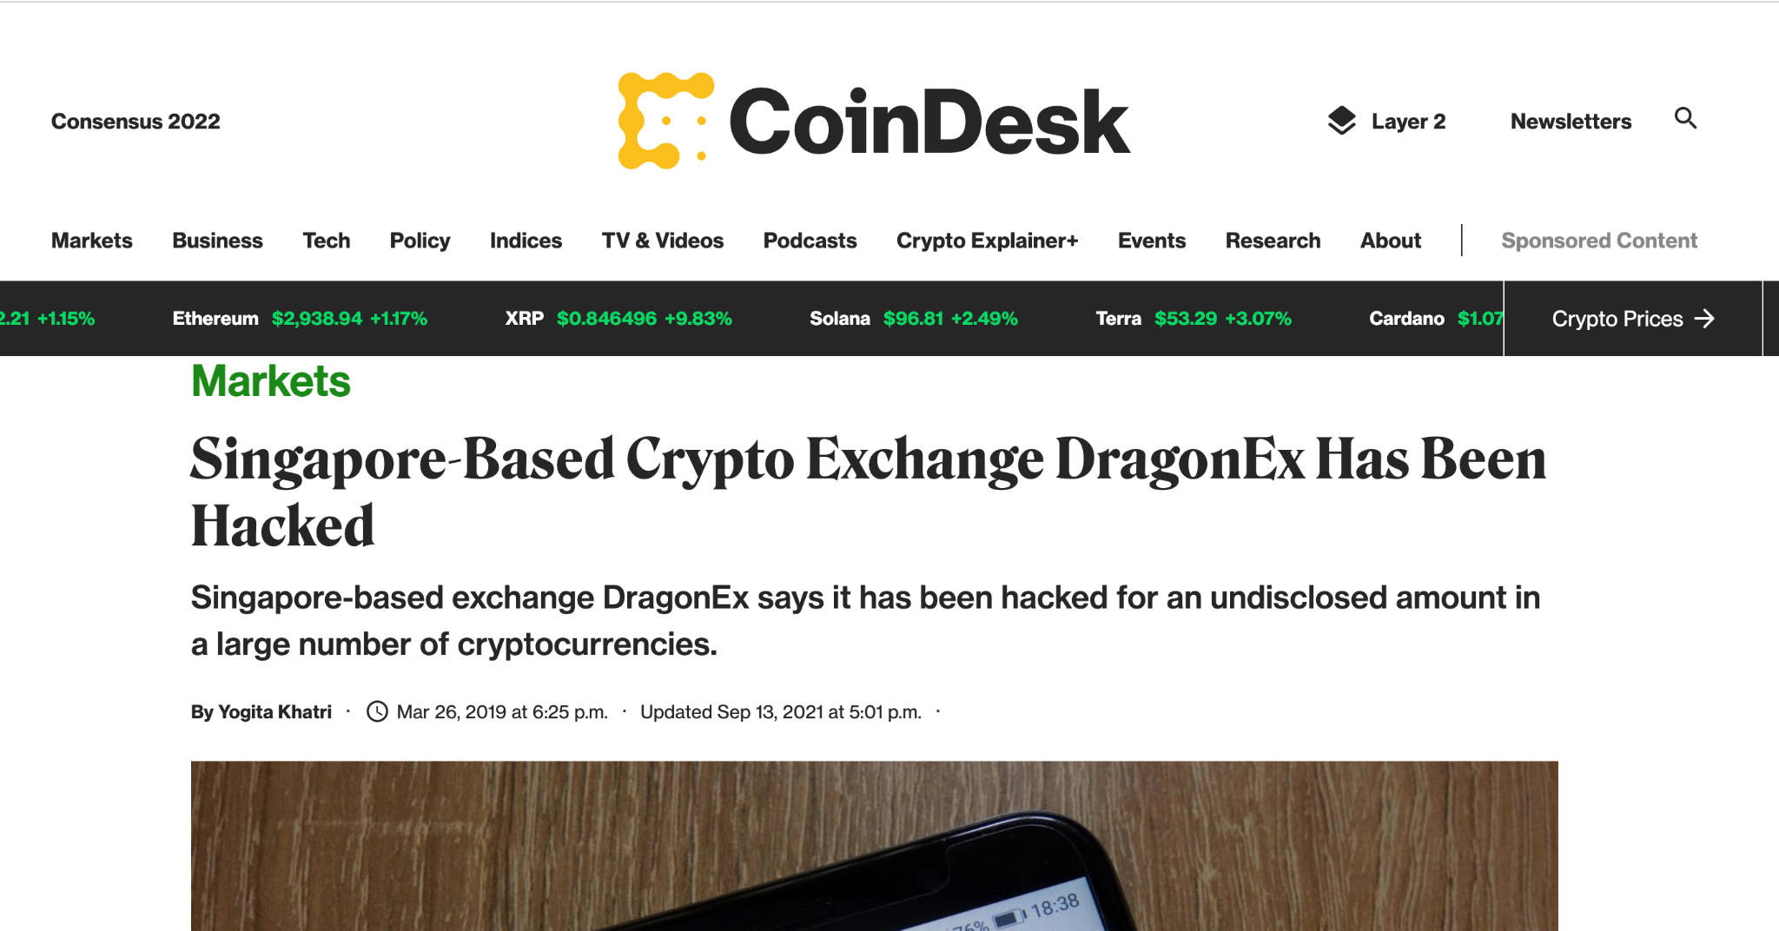
CODE • STATE • EVIDENCE
Historical breach and withdrawal invariant • 68
RETAINED V17 • SOURCE:" HTTPS://WWW.COINDESK.COM/MARKETS/2019/03/26/SI
1
INPUT
vault total balance stays1 ETH during0.1 ETH reentrant probe
source:" https://www.coindesk.com/markets/2019/03/26/singapore-based-crypto-exchange-dragonex-has-been-hacked/
Technical reading: The original DragonEx incident context is dated. The local vault test proves a specific recursive-call control, not broad immunity to exchange or key theft.
2
CONTROL
The original DragonEx incident context is dated. The local vault test proves a specific recursive-call control, not broad immunity to exchange or key theft.
vault total balance stays1 ETH during0.1 ETH reentrant probe
3
EVIDENCE
Getter/receipt values must satisfy this exact source-specific condition
Copied original diagram • v17 source 68
Develop Blockchain and Web3 App with Vibe Coding | TGS-2021009338
© 2026 Tertiary Infotech Academy Pte Ltd
65
Notes:
Course Develop Blockchain and Web3 App with Vibe Coding TGS-2021009338. Technical anchor: vault total balance stays1 ETH during0.1 ETH reentrant probe. Source: https://docs.soliditylang.org/en/latest/ | https://web3py.readthedocs.io/en/stable/providers.html. Toolchain Solidity 0.8.30, OpenZeppelin 5.4.0, web3.py 8.0.0, Py-EVM 0.12.1b1; checked 13 September 2026.
Original v17 slide 68 verbatim content:
‹#›
source:" https://www.coindesk.com/markets/2019/03/26/singapore-based-crypto-exchange-dragonex-has-been-hacked/

Slide 66
ALIGNED PRACTICE
Hash and anchor certificate evidence
ACTIVITY 01
A1, K1, K2
register(digest) commits a SHA-256 evidence digest; issuer authorization and duplicate rejection define acceptance.
YOU'LL BUILD
TOOLCHAIN
DONE WHEN
HashRegistry source, Python assertions and receipts
Solidity 0.8.30 • Python Web3 • local Py-EVM
All actual EVM positive/negative assertions pass
Develop Blockchain and Web3 App with Vibe Coding | TGS-2021009338
© 2026 Tertiary Infotech Academy Pte Ltd
66
Notes:
Course Develop Blockchain and Web3 App with Vibe Coding TGS-2021009338. Technical anchor: register(digest) commits a SHA-256 evidence digest; issuer authorization and duplicate rejection define acceptance.. Source: https://docs.soliditylang.org/en/latest/ | https://web3py.readthedocs.io/en/stable/providers.html. Toolchain Solidity 0.8.30, OpenZeppelin 5.4.0, web3.py 8.0.0, Py-EVM 0.12.1b1; checked 13 September 2026.

Slide 67
CODE • STATE • EVIDENCE
HashRegistry runtime boundary
NAMED STATE AND CONTROL
1
INPUT
mock-data.json + actor accounts
register(digest) commits a SHA-256 evidence digest; issuer authorization and duplicate rejection define acceptance.
2
CONTROL
Solidity authorization and state requirements
Contract.sol → ABI / bytecode → EVM → receipt
3
EVIDENCE
run_activity.py asserts actual chain outputs
Develop Blockchain and Web3 App with Vibe Coding | TGS-2021009338
© 2026 Tertiary Infotech Academy Pte Ltd
67
Notes:
Course Develop Blockchain and Web3 App with Vibe Coding TGS-2021009338. Technical anchor: Contract.sol → ABI / bytecode → EVM → receipt. Source: https://docs.soliditylang.org/en/latest/ | https://web3py.readthedocs.io/en/stable/providers.html. Toolchain Solidity 0.8.30, OpenZeppelin 5.4.0, web3.py 8.0.0, Py-EVM 0.12.1b1; checked 13 September 2026.

Slide 68
CODE • STATE • EVIDENCE
Vibe Coding prompt 01 • 1/2
PROMPT • HASH AND ANCHOR CERTIFICATE EVIDENCE
1
INPUT
Exact business requirement and mock schema
Act as a Solidity and Python Web3 developer. Build hash and anchor certificate evidence for an isolated test chain. Use Solidity 0.8.30 and web3.py 8.0.0 with EthereumTesterProvider backed by Py-EVM; also allow --rpc for an isolated unlocked local JSON-RPC test chain. Requirements: register(digest) commits a SHA-256 evidence digest; issuer authorization and duplicate rejection define acceptance. Read mock-data.json, derive a canonical SHA-256 digest where required, compile using pinned solc-js 0.8.30, deploy actual EVM
2
CONTROL
Require pinned compiler, negative tests and receipts
Generate actual Solidity EVM tests; never mock contract state.
3
EVIDENCE
Review generated code against supplied baseline
Develop Blockchain and Web3 App with Vibe Coding | TGS-2021009338
© 2026 Tertiary Infotech Academy Pte Ltd
68
Notes:
Course Develop Blockchain and Web3 App with Vibe Coding TGS-2021009338. Technical anchor: Generate actual Solidity EVM tests; never mock contract state.. Source: https://docs.soliditylang.org/en/latest/ | https://web3py.readthedocs.io/en/stable/providers.html. Toolchain Solidity 0.8.30, OpenZeppelin 5.4.0, web3.py 8.0.0, Py-EVM 0.12.1b1; checked 13 September 2026.

Slide 69
CODE • STATE • EVIDENCE
Vibe Coding prompt 01 • 2/2
PROMPT • HASH AND ANCHOR CERTIFICATE EVIDENCE
1
INPUT
Exact business requirement and mock schema
bytecode, wait for every receipt and assert receipt status. Include positive and negative authorization/state tests, output chain ID/address/transaction hashes/gas and a deployment manifest. Do not simulate contract state in Python or use mainnet keys. Use OpenZeppelin 5.4.0 for ERC standards. Return Contract.sol, run_activity.py, mock-data.json, compile.cjs, requirements.txt and a detailed troubleshooting guide. Explain integer units, failure cases and what the assertions prove. Never claim a browser wallet or public testnet succeeded unless actually exercised.
2
CONTROL
Require pinned compiler, negative tests and receipts
Generate actual Solidity EVM tests; never mock contract state.
3
EVIDENCE
Review generated code against supplied baseline
Develop Blockchain and Web3 App with Vibe Coding | TGS-2021009338
© 2026 Tertiary Infotech Academy Pte Ltd
69
Notes:
Course Develop Blockchain and Web3 App with Vibe Coding TGS-2021009338. Technical anchor: Generate actual Solidity EVM tests; never mock contract state.. Source: https://docs.soliditylang.org/en/latest/ | https://web3py.readthedocs.io/en/stable/providers.html. Toolchain Solidity 0.8.30, OpenZeppelin 5.4.0, web3.py 8.0.0, Py-EVM 0.12.1b1; checked 13 September 2026.

Slide 70
CODE • STATE • EVIDENCE
Acceptance evidence • 01
REAL LOCAL EVM OUTPUT
1
INPUT
Synthetic record and deterministic assertions
Block 1 | gasUsed 168165 | tx c1d11e5b2a90052668…
Block 2 | gasUsed 45759 | tx 2b8baeccf18fe95d34…
2
CONTROL
Positive state assertions + rejected invalid calls
register(digest) commits a SHA-256 evidence digest; issuer authorization and duplicate rejection define acceptance.
3
EVIDENCE
Local EVM execution only; browser/Sepolia separate
Develop Blockchain and Web3 App with Vibe Coding | TGS-2021009338
© 2026 Tertiary Infotech Academy Pte Ltd
70
Notes:
Course Develop Blockchain and Web3 App with Vibe Coding TGS-2021009338. Technical anchor: register(digest) commits a SHA-256 evidence digest; issuer authorization and duplicate rejection define acceptance.. Source: https://docs.soliditylang.org/en/latest/ | https://web3py.readthedocs.io/en/stable/providers.html. Toolchain Solidity 0.8.30, OpenZeppelin 5.4.0, web3.py 8.0.0, Py-EVM 0.12.1b1; checked 13 September 2026.

Slide 71
ALIGNED PRACTICE
Map buyer requirements to Ether escrow
ACTIVITY 02
A1, K1, K2
Created → funded → released; exactly 0.1 ETH is paid once and only the buyer authorizes release.
YOU'LL BUILD
TOOLCHAIN
DONE WHEN
Escrow source, Python assertions and receipts
Solidity 0.8.30 • Python Web3 • local Py-EVM
All actual EVM positive/negative assertions pass
Develop Blockchain and Web3 App with Vibe Coding | TGS-2021009338
© 2026 Tertiary Infotech Academy Pte Ltd
71
Notes:
Course Develop Blockchain and Web3 App with Vibe Coding TGS-2021009338. Technical anchor: Created → funded → released; exactly 0.1 ETH is paid once and only the buyer authorizes release.. Source: https://docs.soliditylang.org/en/latest/ | https://web3py.readthedocs.io/en/stable/providers.html. Toolchain Solidity 0.8.30, OpenZeppelin 5.4.0, web3.py 8.0.0, Py-EVM 0.12.1b1; checked 13 September 2026.

Slide 72
CODE • STATE • EVIDENCE
Escrow runtime boundary
NAMED STATE AND CONTROL
1
INPUT
mock-data.json + actor accounts
Created → funded → released; exactly 0.1 ETH is paid once and only the buyer authorizes release.
2
CONTROL
Solidity authorization and state requirements
Contract.sol → ABI / bytecode → EVM → receipt
3
EVIDENCE
run_activity.py asserts actual chain outputs
Develop Blockchain and Web3 App with Vibe Coding | TGS-2021009338
© 2026 Tertiary Infotech Academy Pte Ltd
72
Notes:
Course Develop Blockchain and Web3 App with Vibe Coding TGS-2021009338. Technical anchor: Contract.sol → ABI / bytecode → EVM → receipt. Source: https://docs.soliditylang.org/en/latest/ | https://web3py.readthedocs.io/en/stable/providers.html. Toolchain Solidity 0.8.30, OpenZeppelin 5.4.0, web3.py 8.0.0, Py-EVM 0.12.1b1; checked 13 September 2026.

Slide 73
CODE • STATE • EVIDENCE
Vibe Coding prompt 02 • 1/2
PROMPT • MAP BUYER REQUIREMENTS TO ETHER ESCROW
1
INPUT
Exact business requirement and mock schema
Act as a Solidity and Python Web3 developer. Build map buyer requirements to ether escrow for an isolated test chain. Use Solidity 0.8.30 and web3.py 8.0.0 with EthereumTesterProvider backed by Py-EVM; also allow --rpc for an isolated unlocked local JSON-RPC test chain. Requirements: Created → funded → released; exactly 0.1 ETH is paid once and only the buyer authorizes release. Read mock-data.json, derive a canonical SHA-256 digest where required, compile using pinned solc-js 0.8.30, deploy
2
CONTROL
Require pinned compiler, negative tests and receipts
Generate actual Solidity EVM tests; never mock contract state.
3
EVIDENCE
Review generated code against supplied baseline
Develop Blockchain and Web3 App with Vibe Coding | TGS-2021009338
© 2026 Tertiary Infotech Academy Pte Ltd
73
Notes:
Course Develop Blockchain and Web3 App with Vibe Coding TGS-2021009338. Technical anchor: Generate actual Solidity EVM tests; never mock contract state.. Source: https://docs.soliditylang.org/en/latest/ | https://web3py.readthedocs.io/en/stable/providers.html. Toolchain Solidity 0.8.30, OpenZeppelin 5.4.0, web3.py 8.0.0, Py-EVM 0.12.1b1; checked 13 September 2026.

Slide 74
CODE • STATE • EVIDENCE
Vibe Coding prompt 02 • 2/2
PROMPT • MAP BUYER REQUIREMENTS TO ETHER ESCROW
1
INPUT
Exact business requirement and mock schema
actual EVM bytecode, wait for every receipt and assert receipt status. Include positive and negative authorization/state tests, output chain ID/address/transaction hashes/gas and a deployment manifest. Do not simulate contract state in Python or use mainnet keys. Use OpenZeppelin 5.4.0 for ERC standards. Return Contract.sol, run_activity.py, mock-data.json, compile.cjs, requirements.txt and a detailed troubleshooting guide. Explain integer units, failure cases and what the assertions prove. Never claim a browser wallet or public testnet succeeded unless actually exercised.
2
CONTROL
Require pinned compiler, negative tests and receipts
Generate actual Solidity EVM tests; never mock contract state.
3
EVIDENCE
Review generated code against supplied baseline
Develop Blockchain and Web3 App with Vibe Coding | TGS-2021009338
© 2026 Tertiary Infotech Academy Pte Ltd
74
Notes:
Course Develop Blockchain and Web3 App with Vibe Coding TGS-2021009338. Technical anchor: Generate actual Solidity EVM tests; never mock contract state.. Source: https://docs.soliditylang.org/en/latest/ | https://web3py.readthedocs.io/en/stable/providers.html. Toolchain Solidity 0.8.30, OpenZeppelin 5.4.0, web3.py 8.0.0, Py-EVM 0.12.1b1; checked 13 September 2026.

Slide 75
CODE • STATE • EVIDENCE
Acceptance evidence • 02
REAL LOCAL EVM OUTPUT
1
INPUT
Synthetic record and deterministic assertions
Block 1 | gasUsed 277476 | tx 398e2614094364fed7…
Block 2 | gasUsed 43545 | tx 66652ebbbbff2da878…
Block 3 | gasUsed 36018 | tx 9120946f48867afdeb…
2
CONTROL
Positive state assertions + rejected invalid calls
Created → funded → released; exactly 0.1 ETH is paid once and only the buyer authorizes release.
3
EVIDENCE
Local EVM execution only; browser/Sepolia separate
Develop Blockchain and Web3 App with Vibe Coding | TGS-2021009338
© 2026 Tertiary Infotech Academy Pte Ltd
75
Notes:
Course Develop Blockchain and Web3 App with Vibe Coding TGS-2021009338. Technical anchor: Created → funded → released; exactly 0.1 ETH is paid once and only the buyer authorizes release.. Source: https://docs.soliditylang.org/en/latest/ | https://web3py.readthedocs.io/en/stable/providers.html. Toolchain Solidity 0.8.30, OpenZeppelin 5.4.0, web3.py 8.0.0, Py-EVM 0.12.1b1; checked 13 September 2026.

Slide 76
EDITABLE MODEL
Escrow conserved Ether — worked state model
WHAT THE DATA SHOWS
Illustrative 0.1 ETH requirement. Fund and release state are asserted by Activity 02; balances exclude sender gas.
Develop Blockchain and Web3 App with Vibe Coding | TGS-2021009338
© 2026 Tertiary Infotech Academy Pte Ltd
76
Notes:
Course Develop Blockchain and Web3 App with Vibe Coding TGS-2021009338. Technical anchor: 0.1 ETH conserved through escrow state. Source: https://docs.soliditylang.org/en/latest/ | https://web3py.readthedocs.io/en/stable/providers.html. Toolchain Solidity 0.8.30, OpenZeppelin 5.4.0, web3.py 8.0.0, Py-EVM 0.12.1b1; checked 13 September 2026.

Slide 77
2
TOPIC 2
Ethereum Blockchain and Solidity Programming
A2, A3, K3
Develop Blockchain and Web3 App with Vibe Coding | TGS-2021009338
© 2026 Tertiary Infotech Academy Pte Ltd
77
Notes:
Course Develop Blockchain and Web3 App with Vibe Coding TGS-2021009338. Technical anchor: . Source: https://docs.soliditylang.org/en/latest/ | https://web3py.readthedocs.io/en/stable/providers.html. Toolchain Solidity 0.8.30, OpenZeppelin 5.4.0, web3.py 8.0.0, Py-EVM 0.12.1b1; checked 13 September 2026.

Slide 78
CODE • STATE • EVIDENCE
Ethereum account state and EVM execution • 70
RETAINED V17 TOPIC
1
INPUT
len(w3.eth.get_code(address)) > 0
Technical reading: Each deployment creates runtime code at an address. Read code, storage getters and receipt status from the same chain.
Acceptance: len(w3.eth.get_code(address)) > 0
2
CONTROL
Each deployment creates runtime code at an address. Read code, storage getters and receipt status from the same chain.
len(w3.eth.get_code(address)) > 0
3
EVIDENCE
Getter/receipt values must satisfy this exact source-specific condition
Develop Blockchain and Web3 App with Vibe Coding | TGS-2021009338
© 2026 Tertiary Infotech Academy Pte Ltd
78
Notes:
Course Develop Blockchain and Web3 App with Vibe Coding TGS-2021009338. Technical anchor: len(w3.eth.get_code(address)) > 0. Source: https://docs.soliditylang.org/en/latest/ | https://web3py.readthedocs.io/en/stable/providers.html. Toolchain Solidity 0.8.30, OpenZeppelin 5.4.0, web3.py 8.0.0, Py-EVM 0.12.1b1; checked 13 September 2026.
Original v17 slide 70 verbatim content:
What is Ethereum ?
Ethereum (https://www.ethereum.org/) is a new generation of blockchain (first generation is the bitcoin).
It is an open-source, public, blockchain-based distributed computing platform featuring smart contract functionality.
It is a programmable Blockchain platform for Decentralized Applications (DApps) that run on Ethereum Virtual Machine (EVM)
Developers can create smart contract DApps on EVM using Solidity programming language
‹#›

Slide 79

CODE • STATE • EVIDENCE
Ethereum protocol change versus compiler lock • 71
RETAINED V17 • HISTORY OF ETHEREUM
1
INPUT
solc0.8.30 + evmVersion=cancun + chainId manifest
Ethereum was proposed in late 2013 by Vitalik Buterin Development was funded by an online crowdsale that took place between July and August 2014. Ethereum went live on 30 July 2015
Technical reading: Ethereum mainnet PoS is separate from the pinned Cancun target used in this exercise. Record protocol and toolchain assumptions rather than reuse dated network labels.
2
CONTROL
Ethereum mainnet PoS is separate from the pinned Cancun target used in this exercise. Record protocol and toolchain assumptions rather than reuse dated network
solc0.8.30 + evmVersion=cancun + chainId manifest
3
EVIDENCE
Getter/receipt values must satisfy this exact source-specific condition
Copied original diagram • v17 source 71
Develop Blockchain and Web3 App with Vibe Coding | TGS-2021009338
© 2026 Tertiary Infotech Academy Pte Ltd
79
Notes:
Course Develop Blockchain and Web3 App with Vibe Coding TGS-2021009338. Technical anchor: solc0.8.30 + evmVersion=cancun + chainId manifest. Source: https://docs.soliditylang.org/en/latest/ | https://web3py.readthedocs.io/en/stable/providers.html. Toolchain Solidity 0.8.30, OpenZeppelin 5.4.0, web3.py 8.0.0, Py-EVM 0.12.1b1; checked 13 September 2026.
Original v17 slide 71 verbatim content:
History of Ethereum
Ethereum was proposed in late 2013 by Vitalik Buterin
Development was funded by an online crowdsale that took place between July and August 2014.
Ethereum went live on 30 July 2015
‹#›

Slide 80
CODE • STATE • EVIDENCE
Transaction to opcode execution and state commit • 72
RETAINED V17 TOPIC
1
INPUT
calldata → EVM → receipt.status1 → getter assertion
Technical reading: The client encodes calldata, provider submits it and the EVM executes contract code. Wait for receipt and assert storage change.
Acceptance: calldata → EVM → receipt.status1 → getter assertion
2
CONTROL
The client encodes calldata, provider submits it and the EVM executes contract code. Wait for receipt and assert storage change.
calldata → EVM → receipt.status1 → getter assertion
3
EVIDENCE
Getter/receipt values must satisfy this exact source-specific condition
Develop Blockchain and Web3 App with Vibe Coding | TGS-2021009338
© 2026 Tertiary Infotech Academy Pte Ltd
80
Notes:
Course Develop Blockchain and Web3 App with Vibe Coding TGS-2021009338. Technical anchor: calldata → EVM → receipt.status1 → getter assertion. Source: https://docs.soliditylang.org/en/latest/ | https://web3py.readthedocs.io/en/stable/providers.html. Toolchain Solidity 0.8.30, OpenZeppelin 5.4.0, web3.py 8.0.0, Py-EVM 0.12.1b1; checked 13 September 2026.
Original v17 slide 72 verbatim content:
How Ethereum Work?
‹#›
Contracts written in a smart contract-specific programming languages eg Solidity are compiled into ‘bytecode’ that can run on ‘ethereum virtual machine’ (EVM)

Slide 81
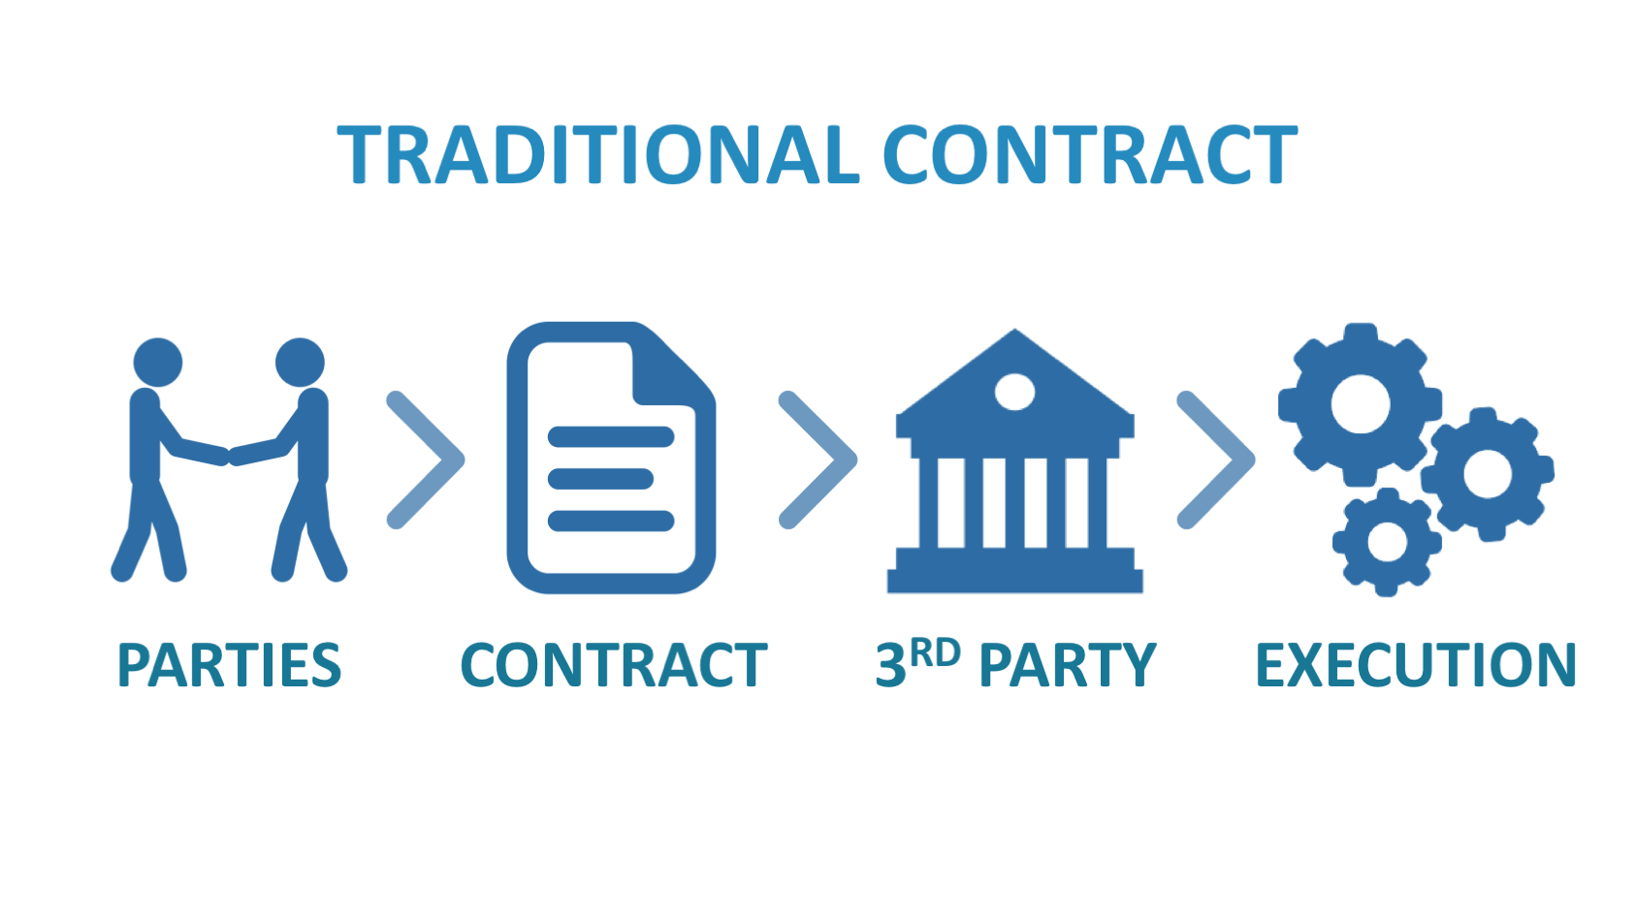
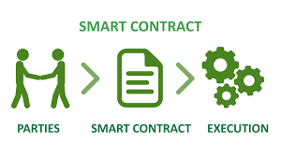
CODE • STATE • EVIDENCE
Smart contract precondition and transition • 73
RETAINED V17 • SMART CONTRACT
1
INPUT
require(msg.sender==buyer && !funded,"buyer/state")
Smart Contracts are sets of Business Rules in the system. All smart contracts are verified and signed by participants. When certain conditions are met, auto execute it with together the transaction Ethereum is the first blockchain platform that implement smart contracts in Dapp
Technical reading: An executable requirement names sender, value and state before modifying storage. A generic payable function without checks does not implement escrow policy.
2
CONTROL
An executable requirement names sender, value and state before modifying storage. A generic payable function without checks does not implement escrow policy.
require(msg.sender==buyer && !funded,"buyer/state")
3
EVIDENCE
Getter/receipt values must satisfy this exact source-specific condition
Copied original diagram • v17 source 73
Develop Blockchain and Web3 App with Vibe Coding | TGS-2021009338
© 2026 Tertiary Infotech Academy Pte Ltd
81
Notes:
Course Develop Blockchain and Web3 App with Vibe Coding TGS-2021009338. Technical anchor: require(msg.sender==buyer && !funded,"buyer/state"). Source: https://docs.soliditylang.org/en/latest/ | https://web3py.readthedocs.io/en/stable/providers.html. Toolchain Solidity 0.8.30, OpenZeppelin 5.4.0, web3.py 8.0.0, Py-EVM 0.12.1b1; checked 13 September 2026.
Original v17 slide 73 verbatim content:
Smart Contract
Smart Contracts are sets of Business Rules in the system.
All smart contracts are verified and signed by participants.
When certain conditions are met, auto execute it with together the transaction
Ethereum is the first blockchain platform that implement smart contracts in Dapp
‹#›

Slide 82
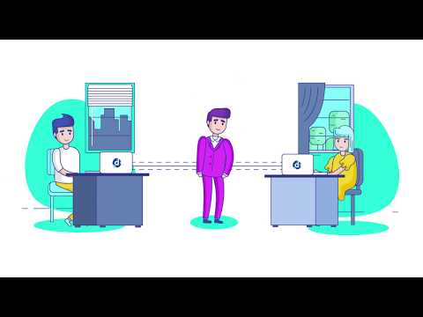
CODE • STATE • EVIDENCE
Escrow state tuple defines accepted calls • 74
RETAINED V17 • OVERVIEW OF SMART CONTRACT
1
INPUT
fund:(buyer,price,!funded); release:(buyer,funded,!released)
Overview of Smart Contract
Technical reading: The state tuple buyer/seller/price/funded/released constrains which calls are valid. Inspect all fields when diagnosing a revert.
2
CONTROL
The state tuple buyer/seller/price/funded/released constrains which calls are valid. Inspect all fields when diagnosing a revert.
fund:(buyer,price,!funded); release:(buyer,funded,!released)
3
EVIDENCE
Getter/receipt values must satisfy this exact source-specific condition
Copied original diagram • v17 source 74
Develop Blockchain and Web3 App with Vibe Coding | TGS-2021009338
© 2026 Tertiary Infotech Academy Pte Ltd
82
Notes:
Course Develop Blockchain and Web3 App with Vibe Coding TGS-2021009338. Technical anchor: fund:(buyer,price,!funded); release:(buyer,funded,!released). Source: https://docs.soliditylang.org/en/latest/ | https://web3py.readthedocs.io/en/stable/providers.html. Toolchain Solidity 0.8.30, OpenZeppelin 5.4.0, web3.py 8.0.0, Py-EVM 0.12.1b1; checked 13 September 2026.
Original v17 slide 74 verbatim content:
Overview of Smart Contract
‹#›

Slide 83
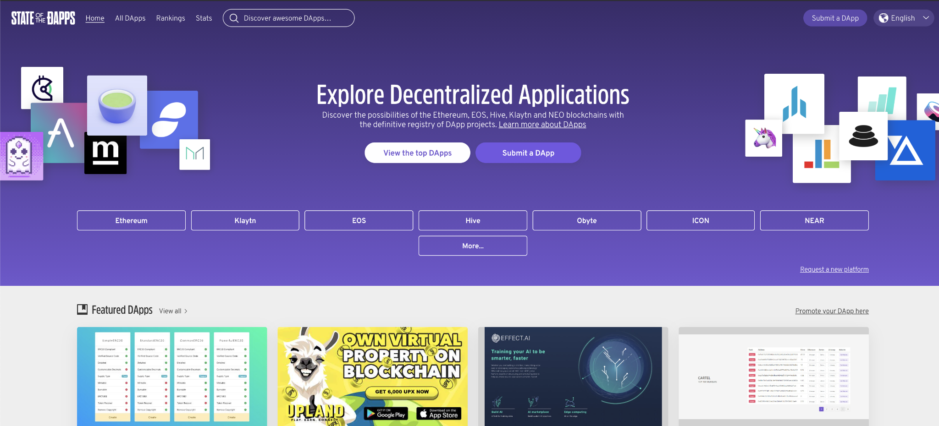
CODE • STATE • EVIDENCE
dApp frontend backend and evidence connection • 75
RETAINED V17 • A DAPP HAS ITS BACKEND CODE RUNNING ON A DECENTRALIZED
1
INPUT
index.html → deployment.json → wallet → CertificateNFT
You can explore the DApps created on Ethereum here https://www.stateofthedapps.com/ What is a DApp
Technical reading: The static client reads an address/ABI manifest, checks wallet chain and performs eth_call. Provider availability and chain identity are named runtime controls.
2
CONTROL
The static client reads an address/ABI manifest, checks wallet chain and performs eth_call. Provider availability and chain identity are named runtime controls.
index.html → deployment.json → wallet → CertificateNFT
3
EVIDENCE
Getter/receipt values must satisfy this exact source-specific condition
Copied original diagram • v17 source 75
Develop Blockchain and Web3 App with Vibe Coding | TGS-2021009338
© 2026 Tertiary Infotech Academy Pte Ltd
83
Notes:
Course Develop Blockchain and Web3 App with Vibe Coding TGS-2021009338. Technical anchor: index.html → deployment.json → wallet → CertificateNFT. Source: https://docs.soliditylang.org/en/latest/ | https://web3py.readthedocs.io/en/stable/providers.html. Toolchain Solidity 0.8.30, OpenZeppelin 5.4.0, web3.py 8.0.0, Py-EVM 0.12.1b1; checked 13 September 2026.
Original v17 slide 75 verbatim content:
A dapp has its backend code running on a decentralized peer-to-peer network.
You can explore the DApps created on Ethereum here
https://www.stateofthedapps.com/
What is a DApp
‹#›

Slide 84
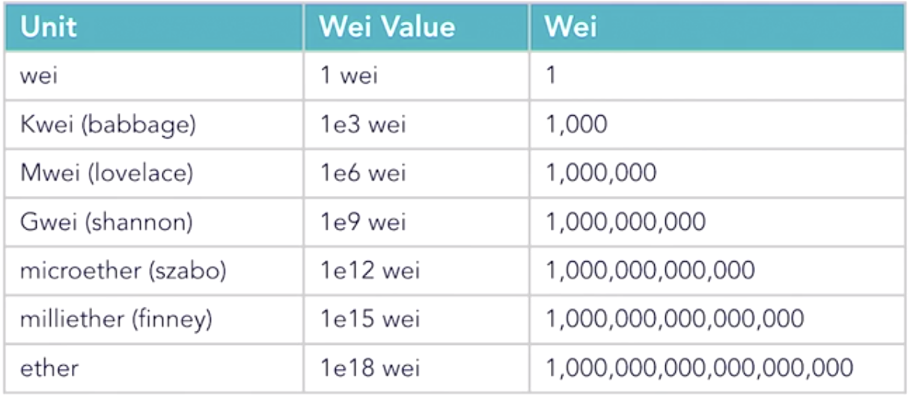
CODE • STATE • EVIDENCE
Ether and wei integer conversion • 76
RETAINED V17 • ETHER (ETH) UNIT
1
INPUT
w3.to_wei("0.1","ether") == 10**17
Ether can be broken down to smaller units:
Technical reading: Use Decimal-compatible string values with to_wei. A0.1ETH escrow requires100000000000000000wei; floats are excluded from token accounting.
2
CONTROL
Use Decimal-compatible string values with to_wei. A0.1ETH escrow requires100000000000000000wei; floats are excluded from token accounting.
w3.to_wei("0.1","ether") == 10**17
3
EVIDENCE
Getter/receipt values must satisfy this exact source-specific condition
Copied original diagram • v17 source 76
Develop Blockchain and Web3 App with Vibe Coding | TGS-2021009338
© 2026 Tertiary Infotech Academy Pte Ltd
84
Notes:
Course Develop Blockchain and Web3 App with Vibe Coding TGS-2021009338. Technical anchor: w3.to_wei("0.1","ether") == 10**17. Source: https://docs.soliditylang.org/en/latest/ | https://web3py.readthedocs.io/en/stable/providers.html. Toolchain Solidity 0.8.30, OpenZeppelin 5.4.0, web3.py 8.0.0, Py-EVM 0.12.1b1; checked 13 September 2026.
Original v17 slide 76 verbatim content:
Ether (ETH) Unit
Ether can be broken down to smaller units:
‹#›

Slide 85
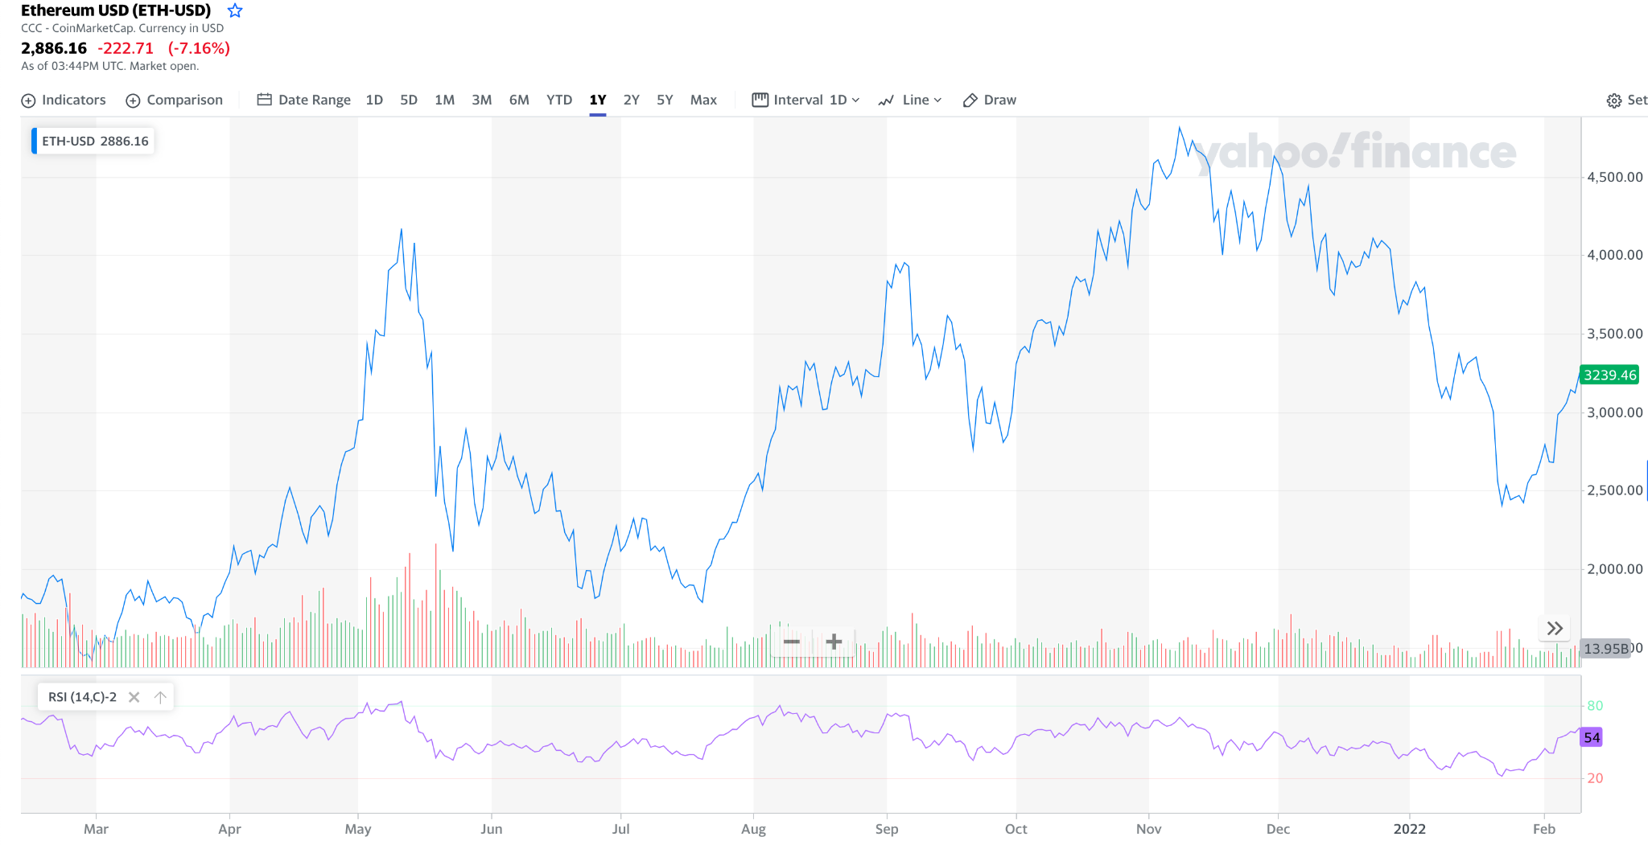
CODE • STATE • EVIDENCE
Price assumption and fee calculation boundary • 77
RETAINED V17 • ETHER PRICE
1
INPUT
fee_wei = receipt.gasUsed × receipt.effectiveGasPrice
https://finance.yahoo.com/chart/ETH-USD
Technical reading: Original Ether market prices are dated. This course uses a fixed synthetic0.1ETH requirement and measured gas; no current market-price assertion is made.
2
CONTROL
Original Ether market prices are dated. This course uses a fixed synthetic0.1ETH requirement and measured gas; no current market-price assertion is made.
fee_wei = receipt.gasUsed × receipt.effectiveGasPrice
3
EVIDENCE
Getter/receipt values must satisfy this exact source-specific condition
Copied original diagram • v17 source 77
Develop Blockchain and Web3 App with Vibe Coding | TGS-2021009338
© 2026 Tertiary Infotech Academy Pte Ltd
85
Notes:
Course Develop Blockchain and Web3 App with Vibe Coding TGS-2021009338. Technical anchor: fee_wei = receipt.gasUsed × receipt.effectiveGasPrice. Source: https://docs.soliditylang.org/en/latest/ | https://web3py.readthedocs.io/en/stable/providers.html. Toolchain Solidity 0.8.30, OpenZeppelin 5.4.0, web3.py 8.0.0, Py-EVM 0.12.1b1; checked 13 September 2026.
Original v17 slide 77 verbatim content:
Ether Price
‹#›
https://finance.yahoo.com/chart/ETH-USD

Slide 86
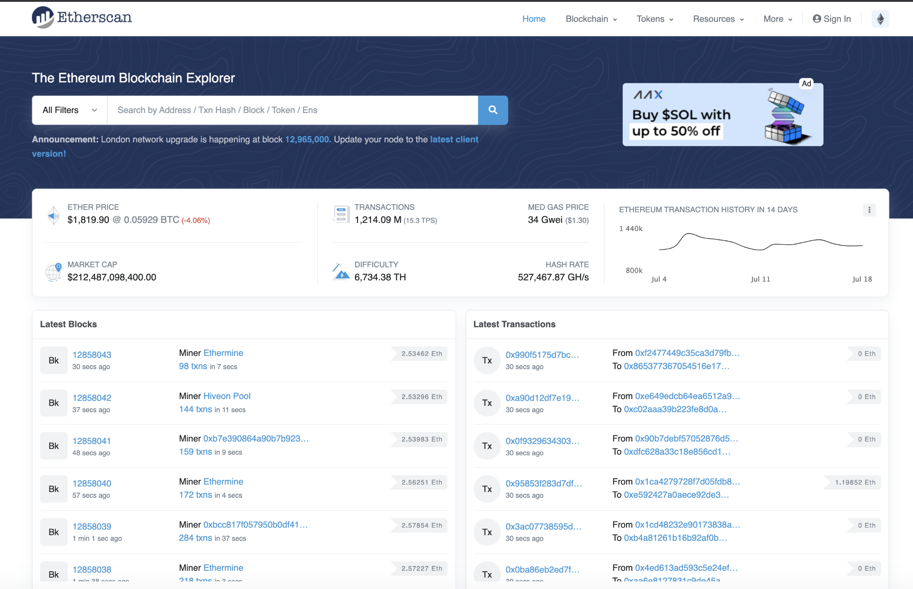
CODE • STATE • EVIDENCE
Explorer creation transaction and current code • 78
RETAINED V17 • ETHERSCAN IS WEBSITE THAT MONITORS ALL THE ETHEREUM TRA
1
INPUT
chainId + contractAddress + receipt.status + get_code
https://etherscan.io/ Etherscan
Technical reading: An explorer page must match both selected network and deployed address. A creation receipt and nonempty runtime code establish deployment evidence.
2
CONTROL
An explorer page must match both selected network and deployed address. A creation receipt and nonempty runtime code establish deployment evidence.
chainId + contractAddress + receipt.status + get_code
3
EVIDENCE
Getter/receipt values must satisfy this exact source-specific condition
Copied original diagram • v17 source 78
Develop Blockchain and Web3 App with Vibe Coding | TGS-2021009338
© 2026 Tertiary Infotech Academy Pte Ltd
86
Notes:
Course Develop Blockchain and Web3 App with Vibe Coding TGS-2021009338. Technical anchor: chainId + contractAddress + receipt.status + get_code. Source: https://docs.soliditylang.org/en/latest/ | https://web3py.readthedocs.io/en/stable/providers.html. Toolchain Solidity 0.8.30, OpenZeppelin 5.4.0, web3.py 8.0.0, Py-EVM 0.12.1b1; checked 13 September 2026.
Original v17 slide 78 verbatim content:
Etherscan is website that monitors all the Ethereum transactions and tokens.
https://etherscan.io/
Etherscan
‹#›

Slide 87
CODE • STATE • EVIDENCE
Explorer record cross-check with provider • 79
RETAINED V17 TOPIC
1
INPUT
w3.eth.get_transaction_receipt(hash)["blockNumber"]
Technical reading: Reconcile hash and block from explorer to provider readback. Public deployment uses Sepolia explorer; local receipts are not available on public Etherscan.
Acceptance: w3.eth.get_transaction_receipt(hash)["blockNumber"]
2
CONTROL
Reconcile hash and block from explorer to provider readback. Public deployment uses Sepolia explorer; local receipts are not available on public Etherscan.
w3.eth.get_transaction_receipt(hash)["blockNumber"]
3
EVIDENCE
Getter/receipt values must satisfy this exact source-specific condition
Develop Blockchain and Web3 App with Vibe Coding | TGS-2021009338
© 2026 Tertiary Infotech Academy Pte Ltd
87
Notes:
Course Develop Blockchain and Web3 App with Vibe Coding TGS-2021009338. Technical anchor: w3.eth.get_transaction_receipt(hash)["blockNumber"]. Source: https://docs.soliditylang.org/en/latest/ | https://web3py.readthedocs.io/en/stable/providers.html. Toolchain Solidity 0.8.30, OpenZeppelin 5.4.0, web3.py 8.0.0, Py-EVM 0.12.1b1; checked 13 September 2026.
Original v17 slide 79 verbatim content:
Goto https://etherscan.io/
Look at the Ethereum transaction
Goto one of the Ethereum block and look at the data inside the block
Activity: Ethereum Transactions
‹#›

Slide 88
CODE • STATE • EVIDENCE
Wallet signer versus current holder • 80
RETAINED V17 • CRYPTO WALLET
1
INPUT
signer from eth_accounts; holder from ownerOf(id)
A crypto wallet, such as MetaMask, stores your ETH and processes transactions on the Ethereum blockchain. A unique wallet address will be generated and you will use this address to complete transactions..
Technical reading: A signer approves transactions; ERC721 holder is current on-chain ownership. Token transfer changes ownership without proving a learner identity claim.
2
CONTROL
A signer approves transactions; ERC721 holder is current on-chain ownership. Token transfer changes ownership without proving a learner identity claim.
signer from eth_accounts; holder from ownerOf(id)
3
EVIDENCE
Getter/receipt values must satisfy this exact source-specific condition
Develop Blockchain and Web3 App with Vibe Coding | TGS-2021009338
© 2026 Tertiary Infotech Academy Pte Ltd
88
Notes:
Course Develop Blockchain and Web3 App with Vibe Coding TGS-2021009338. Technical anchor: signer from eth_accounts; holder from ownerOf(id). Source: https://docs.soliditylang.org/en/latest/ | https://web3py.readthedocs.io/en/stable/providers.html. Toolchain Solidity 0.8.30, OpenZeppelin 5.4.0, web3.py 8.0.0, Py-EVM 0.12.1b1; checked 13 September 2026.
Original v17 slide 80 verbatim content:
Crypto Wallet
‹#›
A crypto wallet, such as MetaMask, stores your ETH and processes transactions on the Ethereum blockchain.
A unique wallet address will be generated and you will use this address to complete transactions..

Slide 89
CODE • STATE • EVIDENCE
Injected EIP1193 provider authorization • 81
RETAINED V17 TOPIC
1
INPUT
ethereum.request({method:"eth_requestAccounts"})
Technical reading: The wallet exposes eth_requestAccounts under user approval. The page still must validate chain before reading or submitting to the manifest address.
Acceptance: ethereum.request({method:"eth_requestAccounts"})
2
CONTROL
The wallet exposes eth_requestAccounts under user approval. The page still must validate chain before reading or submitting to the manifest address.
ethereum.request({method:"eth_requestAccounts"})
3
EVIDENCE
Getter/receipt values must satisfy this exact source-specific condition
Develop Blockchain and Web3 App with Vibe Coding | TGS-2021009338
© 2026 Tertiary Infotech Academy Pte Ltd
89
Notes:
Course Develop Blockchain and Web3 App with Vibe Coding TGS-2021009338. Technical anchor: ethereum.request({method:"eth_requestAccounts"}). Source: https://docs.soliditylang.org/en/latest/ | https://web3py.readthedocs.io/en/stable/providers.html. Toolchain Solidity 0.8.30, OpenZeppelin 5.4.0, web3.py 8.0.0, Py-EVM 0.12.1b1; checked 13 September 2026.
Original v17 slide 81 verbatim content:
Ethereum Wallet - MetaMask
MetaMask (https://metamask.io/) is a browser extension that provide a way for way for normal web browser to access the blockchain and propose transactions.
It injects web3 API into every website you visit.
It allows you to run Ethereum dApps right in your browser without running a full Ethereum node
‹#›

Slide 90
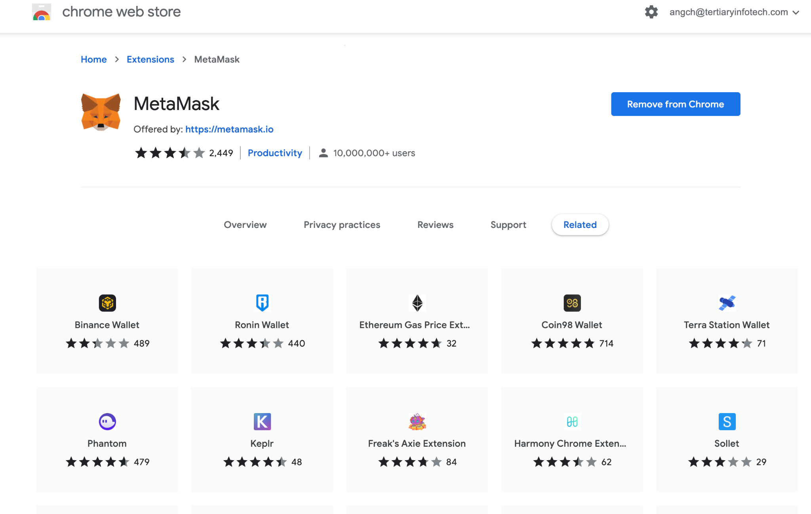
CODE • STATE • EVIDENCE
Wallet chain mismatch rejection • 82
RETAINED V17 • METAMASK WALLET
1
INPUT
wallet0x7a69 == decimal31337; Sepolia11155111 differs
https://metamask.io/
Technical reading: Compare BigInt chain identifiers to avoid decimal/hex display confusion. Block calls when wallet and deployment differ.
2
CONTROL
Compare BigInt chain identifiers to avoid decimal/hex display confusion. Block calls when wallet and deployment differ.
wallet0x7a69 == decimal31337; Sepolia11155111 differs
3
EVIDENCE
Getter/receipt values must satisfy this exact source-specific condition
Copied original diagram • v17 source 82
Develop Blockchain and Web3 App with Vibe Coding | TGS-2021009338
© 2026 Tertiary Infotech Academy Pte Ltd
90
Notes:
Course Develop Blockchain and Web3 App with Vibe Coding TGS-2021009338. Technical anchor: wallet0x7a69 == decimal31337; Sepolia11155111 differs. Source: https://docs.soliditylang.org/en/latest/ | https://web3py.readthedocs.io/en/stable/providers.html. Toolchain Solidity 0.8.30, OpenZeppelin 5.4.0, web3.py 8.0.0, Py-EVM 0.12.1b1; checked 13 September 2026.
Original v17 slide 82 verbatim content:
‹#›
MetaMask Wallet
https://metamask.io/

Slide 91
CODE • STATE • EVIDENCE
Wallet installation provenance and test-only boundary • 83
RETAINED V17 TOPIC
1
INPUT
EIP1193 provider injected; no private-key form in dApp
Technical reading: Install from official MetaMask distribution and use a disposable local account. The activity page never receives or stores a signing secret.
Acceptance: EIP1193 provider injected; no private-key form in dApp
2
CONTROL
Install from official MetaMask distribution and use a disposable local account. The activity page never receives or stores a signing secret.
EIP1193 provider injected; no private-key form in dApp
3
EVIDENCE
Getter/receipt values must satisfy this exact source-specific condition
Develop Blockchain and Web3 App with Vibe Coding | TGS-2021009338
© 2026 Tertiary Infotech Academy Pte Ltd
91
Notes:
Course Develop Blockchain and Web3 App with Vibe Coding TGS-2021009338. Technical anchor: EIP1193 provider injected; no private-key form in dApp. Source: https://docs.soliditylang.org/en/latest/ | https://web3py.readthedocs.io/en/stable/providers.html. Toolchain Solidity 0.8.30, OpenZeppelin 5.4.0, web3.py 8.0.0, Py-EVM 0.12.1b1; checked 13 September 2026.
Original v17 slide 83 verbatim content:
‹#›
Activity: Install Metamask Wallet
Goto https://metamask.io/download/
Install Metamask Wallet

Slide 92
CODE • STATE • EVIDENCE
Mainnet versus Sepolia deployment identity • 84
RETAINED V17 • MAINNET VS TESNET
1
INPUT
(chainId,address) together identify deployment
Mainnet is the term used to describe when a blockchain protocol is fully developed and deployed, meaning that cryptocurrency transactions are being broadcasted, verified, and recorded on a distributed ledger technology blockchain. A testnet is used by programmers and developers to test and troubleshoot…
Technical reading: Same address format can exist on different chains. Manifest chainId11155111 identifies Sepolia while local31337 identifies specified Anvil.
2
CONTROL
Same address format can exist on different chains. Manifest chainId11155111 identifies Sepolia while local31337 identifies specified Anvil.
(chainId,address) together identify deployment
3
EVIDENCE
Getter/receipt values must satisfy this exact source-specific condition
Develop Blockchain and Web3 App with Vibe Coding | TGS-2021009338
© 2026 Tertiary Infotech Academy Pte Ltd
92
Notes:
Course Develop Blockchain and Web3 App with Vibe Coding TGS-2021009338. Technical anchor: (chainId,address) together identify deployment. Source: https://docs.soliditylang.org/en/latest/ | https://web3py.readthedocs.io/en/stable/providers.html. Toolchain Solidity 0.8.30, OpenZeppelin 5.4.0, web3.py 8.0.0, Py-EVM 0.12.1b1; checked 13 September 2026.
Original v17 slide 84 verbatim content:
Mainnet vs Tesnet
‹#›
Mainnet is the term used to describe when a blockchain protocol is fully developed and deployed, meaning that cryptocurrency transactions are being broadcasted, verified, and recorded on a distributed ledger technology blockchain.
A testnet is used by programmers and developers to test and troubleshoot all the aspects and features of a blockchain network before they are sure the system is secure and ready for the mainnet launch.

Slide 93
CODE • STATE • EVIDENCE
Retired testnets and selected Sepolia route • 85
HISTORICAL V17 • ETHEREUM TESTNETS
1
INPUT
Sepolia chainId11155111; explorer sepolia.etherscan.io
Görli Kovan Rinkeby Ropsten ETH on testnets has no real value; therefore, there are no markets for testnet ETH. Since you need ETH to actually interact with Ethereum, most people get testnet ETH from faucets.
Current exercise: Rinkeby and Ropsten in original content are retired. The detailed public route uses Ethereum Sepolia and records chain ID plus successful receipt.
2
CONTROL
Rinkeby and Ropsten in original content are retired. The detailed public route uses Ethereum Sepolia and records chain ID plus successful receipt.
Sepolia chainId11155111; explorer sepolia.etherscan.io
3
EVIDENCE
Getter/receipt values must satisfy this exact source-specific condition
Develop Blockchain and Web3 App with Vibe Coding | TGS-2021009338
© 2026 Tertiary Infotech Academy Pte Ltd
93
Notes:
Course Develop Blockchain and Web3 App with Vibe Coding TGS-2021009338. Technical anchor: Sepolia chainId11155111; explorer sepolia.etherscan.io. Source: https://docs.soliditylang.org/en/latest/ | https://web3py.readthedocs.io/en/stable/providers.html. Toolchain Solidity 0.8.30, OpenZeppelin 5.4.0, web3.py 8.0.0, Py-EVM 0.12.1b1; checked 13 September 2026.
Original v17 slide 85 verbatim content:
Ethereum Testnets
‹#›
Görli
Kovan
Rinkeby
Ropsten
ETH on testnets has no real value; therefore, there are no markets for testnet ETH. Since you need ETH to actually interact with Ethereum, most people get testnet ETH from faucets.

Slide 94
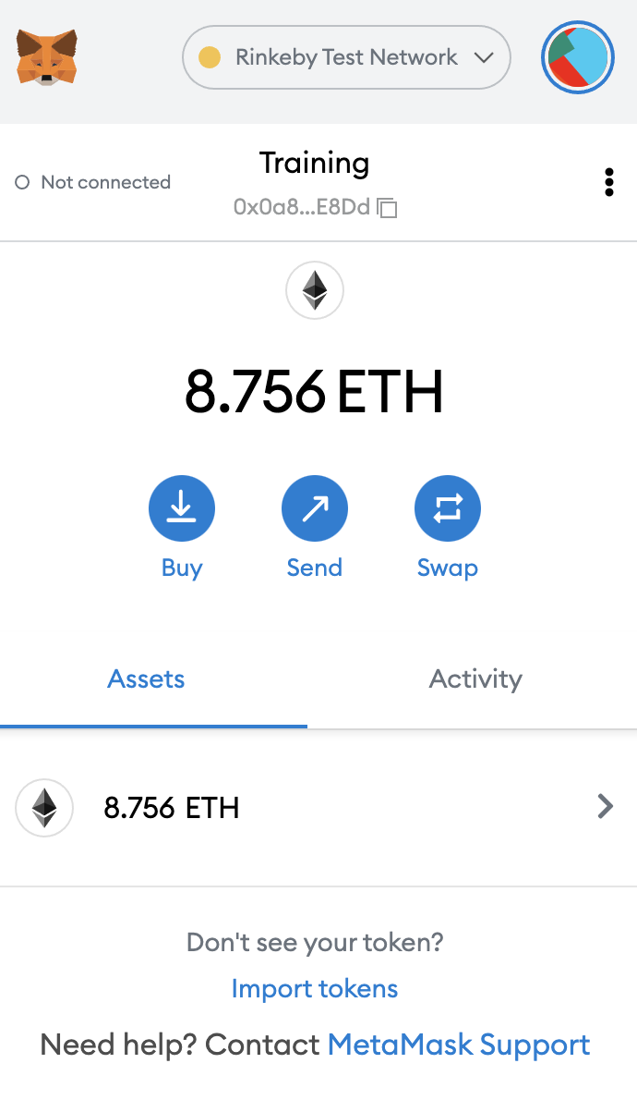
CODE • STATE • EVIDENCE
Faucet-funded test signing account • 86
HISTORICAL V17 • ACTIVITY: GET TESTNET ETHERS
1
INPUT
get_balance(test_account) sufficient for test fee
You can get Rinkeby testnets ethers from the faucets below https://faucet.rinkeby.io/ Send the testnet ethers to each other in the class
Current exercise: Testnet Ether pays execution fees but has no production-value claim. Verify funded account on the selected chain before deployment.
2
CONTROL
Testnet Ether pays execution fees but has no production-value claim. Verify funded account on the selected chain before deployment.
get_balance(test_account) sufficient for test fee
3
EVIDENCE
Getter/receipt values must satisfy this exact source-specific condition
Copied original diagram • v17 source 86
Develop Blockchain and Web3 App with Vibe Coding | TGS-2021009338
© 2026 Tertiary Infotech Academy Pte Ltd
94
Notes:
Course Develop Blockchain and Web3 App with Vibe Coding TGS-2021009338. Technical anchor: get_balance(test_account) sufficient for test fee. Source: https://docs.soliditylang.org/en/latest/ | https://web3py.readthedocs.io/en/stable/providers.html. Toolchain Solidity 0.8.30, OpenZeppelin 5.4.0, web3.py 8.0.0, Py-EVM 0.12.1b1; checked 13 September 2026.
Original v17 slide 86 verbatim content:
Activity: Get Testnet Ethers
You can get Rinkeby testnets ethers from the faucets below
https://faucet.rinkeby.io/
Send the testnet ethers to each other in the class
‹#›

Slide 95
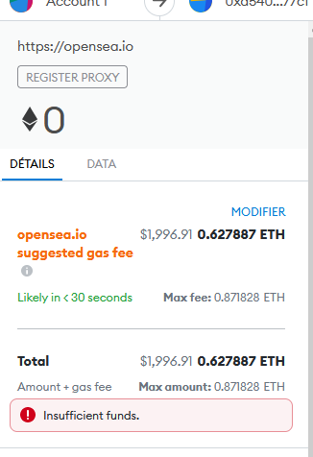
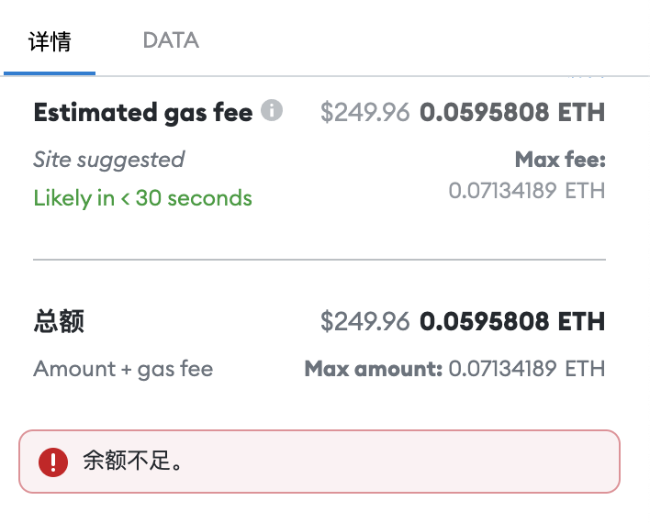
CODE • STATE • EVIDENCE
Gas limit and gas used are different fields • 87
RETAINED V17 • ETHEREUM GAS FEE
1
INPUT
gas=3000000; receipt.gasUsed; receipt.status
Ethereum Gas Fee
Technical reading: A3000000 gas limit is a cap; gasUsed is actual execution. Explicit gas avoids estimate-only claims but receipt status still detects execution revert.
2
CONTROL
A3000000 gas limit is a cap; gasUsed is actual execution. Explicit gas avoids estimate-only claims but receipt status still detects execution revert.
gas=3000000; receipt.gasUsed; receipt.status
3
EVIDENCE
Getter/receipt values must satisfy this exact source-specific condition
Copied original diagram • v17 source 87
Develop Blockchain and Web3 App with Vibe Coding | TGS-2021009338
© 2026 Tertiary Infotech Academy Pte Ltd
95
Notes:
Course Develop Blockchain and Web3 App with Vibe Coding TGS-2021009338. Technical anchor: gas=3000000; receipt.gasUsed; receipt.status. Source: https://docs.soliditylang.org/en/latest/ | https://web3py.readthedocs.io/en/stable/providers.html. Toolchain Solidity 0.8.30, OpenZeppelin 5.4.0, web3.py 8.0.0, Py-EVM 0.12.1b1; checked 13 September 2026.
Original v17 slide 87 verbatim content:
Ethereum Gas Fee
‹#›

Slide 96
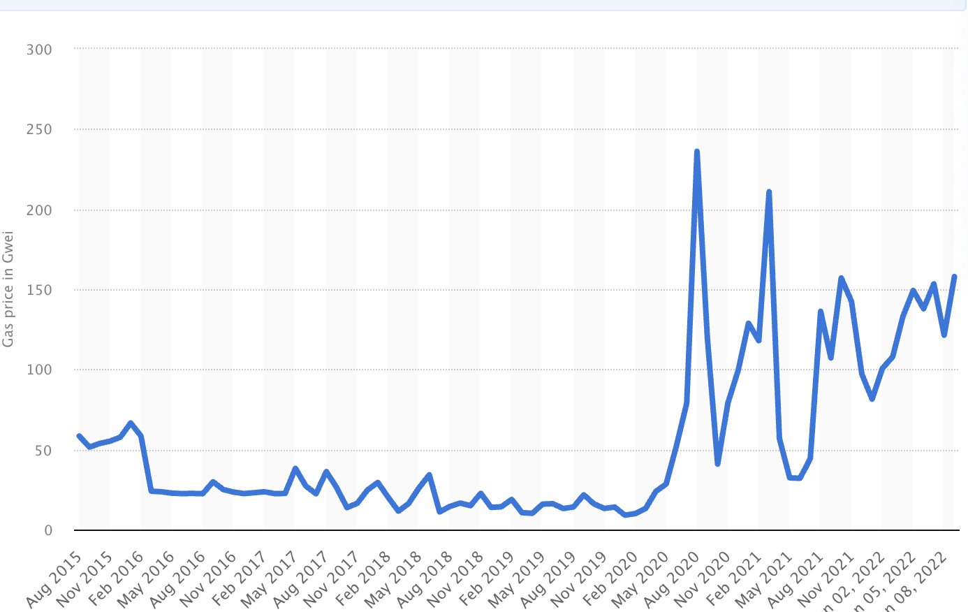
CODE • STATE • EVIDENCE
Effective gas price and actual fee • 88
RETAINED V17 • BEWARE OF ETHEREUM GAS PRICE
1
INPUT
fee = gasUsed × effectiveGasPrice; wei→ETH ÷10**18
Beware of Ethereum Gas Price
Technical reading: Calculate paid fee with effectiveGasPrice, not a quoted maximum alone. Record chain/state/toolchain when comparing receipt gas.
2
CONTROL
Calculate paid fee with effectiveGasPrice, not a quoted maximum alone. Record chain/state/toolchain when comparing receipt gas.
fee = gasUsed × effectiveGasPrice; wei→ETH ÷10**18
3
EVIDENCE
Getter/receipt values must satisfy this exact source-specific condition
Copied original diagram • v17 source 88
Develop Blockchain and Web3 App with Vibe Coding | TGS-2021009338
© 2026 Tertiary Infotech Academy Pte Ltd
96
Notes:
Course Develop Blockchain and Web3 App with Vibe Coding TGS-2021009338. Technical anchor: fee = gasUsed × effectiveGasPrice; wei→ETH ÷10**18. Source: https://docs.soliditylang.org/en/latest/ | https://web3py.readthedocs.io/en/stable/providers.html. Toolchain Solidity 0.8.30, OpenZeppelin 5.4.0, web3.py 8.0.0, Py-EVM 0.12.1b1; checked 13 September 2026.
Original v17 slide 88 verbatim content:
Beware of Ethereum Gas Price
‹#›

Slide 97
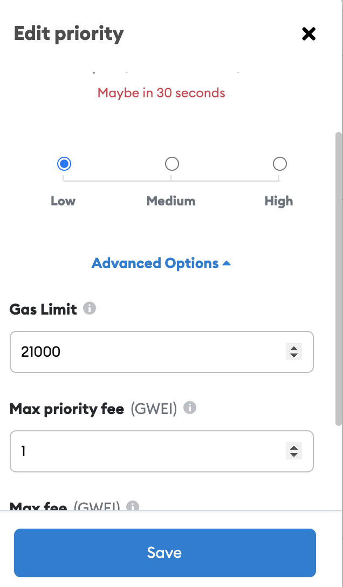
CODE • STATE • EVIDENCE
Two test accounts define role rejection • 89
HISTORICAL V17 • CREATE A 2ND TEST ACCOUNT ON RINKEBY TEST NETWORK
1
INPUT
a,b,c = w3.eth.accounts[:3]; a != c
Send 5 ether from the 1st test account to 2nd test account Specify the gas price used Activity: Ether Transaction and Gas
Current exercise: Buyer/issuer and outsider must be distinct addresses. Use account0/1/2 on an isolated chain, never expose production signing material.
2
CONTROL
Buyer/issuer and outsider must be distinct addresses. Use account0/1/2 on an isolated chain, never expose production signing material.
a,b,c = w3.eth.accounts[:3]; a != c
3
EVIDENCE
Getter/receipt values must satisfy this exact source-specific condition
Copied original diagram • v17 source 89
Develop Blockchain and Web3 App with Vibe Coding | TGS-2021009338
© 2026 Tertiary Infotech Academy Pte Ltd
97
Notes:
Course Develop Blockchain and Web3 App with Vibe Coding TGS-2021009338. Technical anchor: a,b,c = w3.eth.accounts[:3]; a != c. Source: https://docs.soliditylang.org/en/latest/ | https://web3py.readthedocs.io/en/stable/providers.html. Toolchain Solidity 0.8.30, OpenZeppelin 5.4.0, web3.py 8.0.0, Py-EVM 0.12.1b1; checked 13 September 2026.
Original v17 slide 89 verbatim content:
Create a 2nd test account on Rinkeby Test Network
Send 5 ether from the 1st test account to 2nd test account
Specify the gas price used
Activity: Ether Transaction and Gas
‹#›

Slide 98
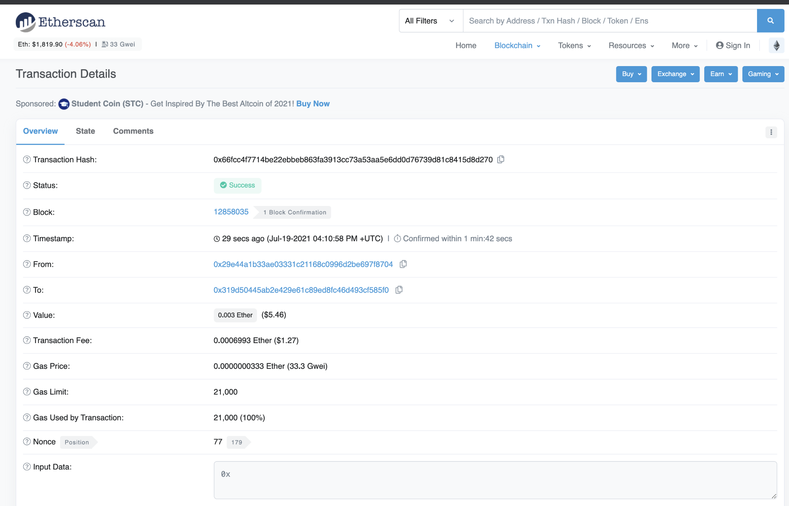
CODE • STATE • EVIDENCE
Transaction fields for runtime diagnosis • 90
RETAINED V17 • TRANSACTION DETAILS ON ETHERSCAN
1
INPUT
from=a; to=contract; value=10**17; receipt.status=1
Transaction Details on Etherscan
Technical reading: from,to,value,input,nonce and block/status identify sender, target and effect. A transaction hash without status/readback does not prove the requirement.
2
CONTROL
from,to,value,input,nonce and block/status identify sender, target and effect. A transaction hash without status/readback does not prove the requirement.
from=a; to=contract; value=10**17; receipt.status=1
3
EVIDENCE
Getter/receipt values must satisfy this exact source-specific condition
Copied original diagram • v17 source 90
Develop Blockchain and Web3 App with Vibe Coding | TGS-2021009338
© 2026 Tertiary Infotech Academy Pte Ltd
98
Notes:
Course Develop Blockchain and Web3 App with Vibe Coding TGS-2021009338. Technical anchor: from=a; to=contract; value=10**17; receipt.status=1. Source: https://docs.soliditylang.org/en/latest/ | https://web3py.readthedocs.io/en/stable/providers.html. Toolchain Solidity 0.8.30, OpenZeppelin 5.4.0, web3.py 8.0.0, Py-EVM 0.12.1b1; checked 13 September 2026.
Original v17 slide 90 verbatim content:
Transaction Details on Etherscan
‹#›

Slide 99
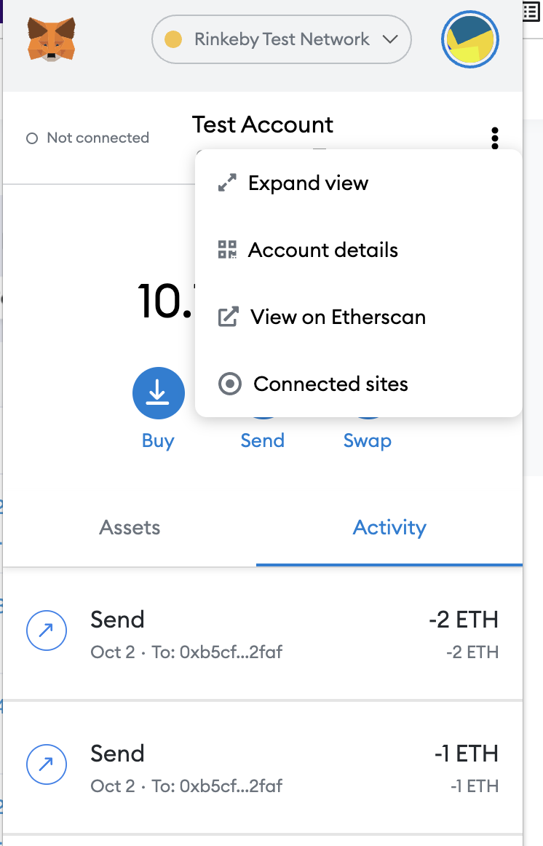
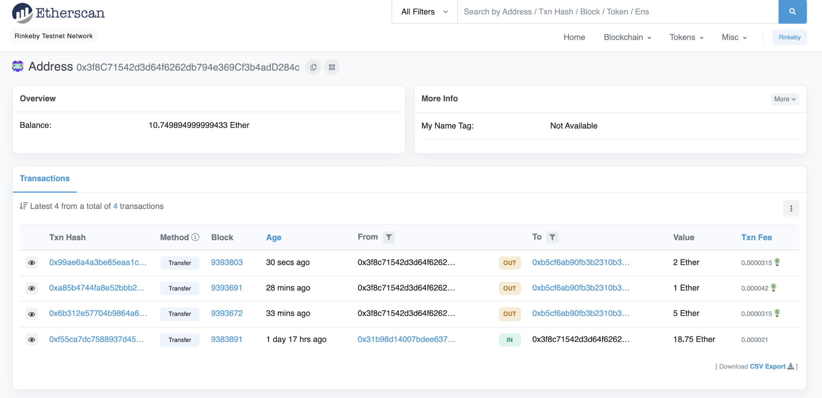
CODE • STATE • EVIDENCE
Explorer monitoring evidence for deployed state • 91
HISTORICAL V17 • ACTIVITY: ETHERSCAN
1
INPUT
receipt → ownerOf / revoked or balanceOf / totalSupply
View all your test transactions on Rinkeby Etherscan https://rinkeby.etherscan.io/
Current exercise: Read creation or transfer receipt and then reconcile state getters. For NFT verify owner and revocation; for ERC20 verify recipient and totalSupply.
2
CONTROL
Read creation or transfer receipt and then reconcile state getters. For NFT verify owner and revocation; for ERC20 verify recipient and totalSupply.
receipt → ownerOf / revoked or balanceOf / totalSupply
3
EVIDENCE
Getter/receipt values must satisfy this exact source-specific condition
Copied original diagram • v17 source 91
Develop Blockchain and Web3 App with Vibe Coding | TGS-2021009338
© 2026 Tertiary Infotech Academy Pte Ltd
99
Notes:
Course Develop Blockchain and Web3 App with Vibe Coding TGS-2021009338. Technical anchor: receipt → ownerOf / revoked or balanceOf / totalSupply. Source: https://docs.soliditylang.org/en/latest/ | https://web3py.readthedocs.io/en/stable/providers.html. Toolchain Solidity 0.8.30, OpenZeppelin 5.4.0, web3.py 8.0.0, Py-EVM 0.12.1b1; checked 13 September 2026.
Original v17 slide 91 verbatim content:
Activity: Etherscan
‹#›
View all your test transactions on Rinkeby Etherscan https://rinkeby.etherscan.io/

Slide 100
CODE • STATE • EVIDENCE
Solidity static types and state layout • 92
RETAINED V17 • SOLIDITY
1
INPUT
uint256 quantity; address supplier; bytes32 orderId;
Solidity is an object-oriented, high-level language for implementing smart contracts. Smart contracts are programs which govern the behaviour of accounts within the Ethereum state. Solidity was influenced by C++, Python and JavaScript and is designed to target the Ethereum Virtual Machine (EVM). Solidity…
Technical reading: The compiler checks parameter types before EVM bytecode exists. uint256 quantity, address supplier and bytes32 identifier encode distinct fields.
2
CONTROL
The compiler checks parameter types before EVM bytecode exists. uint256 quantity, address supplier and bytes32 identifier encode distinct fields.
uint256 quantity; address supplier; bytes32 orderId;
3
EVIDENCE
Getter/receipt values must satisfy this exact source-specific condition
Develop Blockchain and Web3 App with Vibe Coding | TGS-2021009338
© 2026 Tertiary Infotech Academy Pte Ltd
100
Notes:
Course Develop Blockchain and Web3 App with Vibe Coding TGS-2021009338. Technical anchor: uint256 quantity; address supplier; bytes32 orderId;. Source: https://docs.soliditylang.org/en/latest/ | https://web3py.readthedocs.io/en/stable/providers.html. Toolchain Solidity 0.8.30, OpenZeppelin 5.4.0, web3.py 8.0.0, Py-EVM 0.12.1b1; checked 13 September 2026.
Original v17 slide 92 verbatim content:
Solidity
Solidity is an object-oriented, high-level language for implementing smart contracts. Smart contracts are programs which govern the behaviour of accounts within the Ethereum state.
Solidity was influenced by C++, Python and JavaScript and is designed to target the Ethereum Virtual Machine (EVM).
Solidity is statically typed, supports inheritance, libraries and complex user-defined types among other features.
With Solidity you can create contracts for uses such as voting, crowdfunding, blind auctions, and multi-signature wallets.
‹#›

Slide 101

CODE • STATE • EVIDENCE
Remix compilation settings and output contract • 93
RETAINED V17 • REMIX IDE FOR SOLIDITY
1
INPUT
compiler0.8.30; optimizer200; EVM Cancun; intended contract
Remix is a suite of tools to interact with the Ethereum blockchain in order to debug transactions, stored in this Git repository Remix IDE is a browser-based IDE built by the Ethereum development team. http://remix.ethereum.org
Technical reading: Remix must select the exact contract/compiler/optimizer/EVM settings. A source editor screenshot alone is not successful compilation or deployment.
2
CONTROL
Remix must select the exact contract/compiler/optimizer/EVM settings. A source editor screenshot alone is not successful compilation or deployment.
compiler0.8.30; optimizer200; EVM Cancun; intended contract
3
EVIDENCE
Getter/receipt values must satisfy this exact source-specific condition
Copied original diagram • v17 source 93
Develop Blockchain and Web3 App with Vibe Coding | TGS-2021009338
© 2026 Tertiary Infotech Academy Pte Ltd
101
Notes:
Course Develop Blockchain and Web3 App with Vibe Coding TGS-2021009338. Technical anchor: compiler0.8.30; optimizer200; EVM Cancun; intended contract. Source: https://docs.soliditylang.org/en/latest/ | https://web3py.readthedocs.io/en/stable/providers.html. Toolchain Solidity 0.8.30, OpenZeppelin 5.4.0, web3.py 8.0.0, Py-EVM 0.12.1b1; checked 13 September 2026.
Original v17 slide 93 verbatim content:
Remix IDE for Solidity
Remix is a suite of tools to interact with the Ethereum blockchain in order to debug transactions, stored in this Git repository
Remix IDE is a browser-based IDE built by the Ethereum development team.
http://remix.ethereum.org
‹#›

Slide 102
CODE • STATE • EVIDENCE
Source file declaration order • 94
RETAINED V17 • LAYOUT OF A SOLIDITY SOURCE FILE
1
INPUT
SPDX → pragma solidity ^0.8.30 → import → contract
Source files can contain an arbitrary number of contract definitions, import directives, pragma directives and struct, enum, function, error and constant variable definitions. A typical layout of solidity source file includes: SPDX License Identifier Pragmas Contract Comments - Single-line comments (//)…
Technical reading: SPDX label, pragma, imports and contract declaration express licensing, compiler range and dependency graph. Retain resolved lock versions for reproduction.
2
CONTROL
SPDX label, pragma, imports and contract declaration express licensing, compiler range and dependency graph. Retain resolved lock versions for reproduction.
SPDX → pragma solidity ^0.8.30 → import → contract
3
EVIDENCE
Getter/receipt values must satisfy this exact source-specific condition
Develop Blockchain and Web3 App with Vibe Coding | TGS-2021009338
© 2026 Tertiary Infotech Academy Pte Ltd
102
Notes:
Course Develop Blockchain and Web3 App with Vibe Coding TGS-2021009338. Technical anchor: SPDX → pragma solidity ^0.8.30 → import → contract. Source: https://docs.soliditylang.org/en/latest/ | https://web3py.readthedocs.io/en/stable/providers.html. Toolchain Solidity 0.8.30, OpenZeppelin 5.4.0, web3.py 8.0.0, Py-EVM 0.12.1b1; checked 13 September 2026.
Original v17 slide 94 verbatim content:
Layout of a Solidity Source File
Source files can contain an arbitrary number of contract definitions, import directives, pragma directives and struct, enum, function, error and constant variable definitions.
A typical layout of solidity source file includes:
SPDX License Identifier
Pragmas
Contract
Comments - Single-line comments (//) and multi-line comments (/*...*/) are possible
‹#›

Slide 103
CODE • STATE • EVIDENCE
Public storage getter and authorized setter • 95
RETAINED V17 • SAMPLE SMART CONTRACT
1
INPUT
mapping(bytes32=>bool) public registered; issuer-only register
// SPDX-License-Identifier: GPL-3.0 pragma solidity >=0.7.0 <0.9.0; contract Storage { uint256 number; function store(uint256 num) public { number = num; } function retrieve() public view returns (uint256){ return number; } // This is a comment }
Technical reading: A public mapping produces a getter. A protected register function adds state; public visibility is not itself write authorization.
2
CONTROL
A public mapping produces a getter. A protected register function adds state; public visibility is not itself write authorization.
mapping(bytes32=>bool) public registered; issuer-only register
3
EVIDENCE
Getter/receipt values must satisfy this exact source-specific condition
Develop Blockchain and Web3 App with Vibe Coding | TGS-2021009338
© 2026 Tertiary Infotech Academy Pte Ltd
103
Notes:
Course Develop Blockchain and Web3 App with Vibe Coding TGS-2021009338. Technical anchor: mapping(bytes32=>bool) public registered; issuer-only register. Source: https://docs.soliditylang.org/en/latest/ | https://web3py.readthedocs.io/en/stable/providers.html. Toolchain Solidity 0.8.30, OpenZeppelin 5.4.0, web3.py 8.0.0, Py-EVM 0.12.1b1; checked 13 September 2026.
Original v17 slide 95 verbatim content:
Sample Smart Contract
// SPDX-License-Identifier: GPL-3.0
pragma solidity >=0.7.0 <0.9.0;
contract Storage {
uint256 number;
function store(uint256 num) public {
number = num;
}
function retrieve() public view returns (uint256){
return number;
}
// This is a comment
}
‹#›

Slide 104
CODE • STATE • EVIDENCE
SPDX annotation does not establish runtime safety • 96
RETAINED V17 • SPDX LICENSE IDENTIFIER
1
INPUT
// SPDX-License-Identifier: MIT
Since making source code available always touches on legal problems with regards to copyright, the Solidity compiler encourages the use of machine-readable SPDX license identifiers. Every source file should start with a comment indicating its license For example // SPDX-License-Identifier: MIT //…
Technical reading: MIT metadata identifies source licensing; it does not validate business rules. Runtime evidence remains tests and receipts, with license policy separately checked.
2
CONTROL
MIT metadata identifies source licensing; it does not validate business rules. Runtime evidence remains tests and receipts, with license policy separately check
// SPDX-License-Identifier: MIT
3
EVIDENCE
Getter/receipt values must satisfy this exact source-specific condition
Develop Blockchain and Web3 App with Vibe Coding | TGS-2021009338
© 2026 Tertiary Infotech Academy Pte Ltd
104
Notes:
Course Develop Blockchain and Web3 App with Vibe Coding TGS-2021009338. Technical anchor: // SPDX-License-Identifier: MIT. Source: https://docs.soliditylang.org/en/latest/ | https://web3py.readthedocs.io/en/stable/providers.html. Toolchain Solidity 0.8.30, OpenZeppelin 5.4.0, web3.py 8.0.0, Py-EVM 0.12.1b1; checked 13 September 2026.
Original v17 slide 96 verbatim content:
SPDX License Identifier
Since making source code available always touches on legal problems with regards to copyright, the Solidity compiler encourages the use of machine-readable SPDX license identifiers.
Every source file should start with a comment indicating its license
For example
// SPDX-License-Identifier: MIT
// SPDX-License-Identifier: GPL-3.0
‹#›

Slide 105
CODE • STATE • EVIDENCE
Compiler pragma range versus executed version • 97
RETAINED V17 • PRAGMAS
1
INPUT
pragma ^0.8.30; solc.version() exact execution label
The pragma keyword is used to enable certain compiler features or checks. A pragma directive is always local to a source file, so you have to add the pragma to all your files if you want to enable it in your whole project. If you import another file, the pragma from that file does not automatically apply…
Technical reading: ^0.8.30 permits compatible0.8.x versions. package lock pins executed solc0.8.30; record exact compiler and bytecode settings rather than pragma alone.
2
CONTROL
^0.8.30 permits compatible0.8.x versions. package lock pins executed solc0.8.30; record exact compiler and bytecode settings rather than pragma alone.
pragma ^0.8.30; solc.version() exact execution label
3
EVIDENCE
Getter/receipt values must satisfy this exact source-specific condition
Develop Blockchain and Web3 App with Vibe Coding | TGS-2021009338
© 2026 Tertiary Infotech Academy Pte Ltd
105
Notes:
Course Develop Blockchain and Web3 App with Vibe Coding TGS-2021009338. Technical anchor: pragma ^0.8.30; solc.version() exact execution label. Source: https://docs.soliditylang.org/en/latest/ | https://web3py.readthedocs.io/en/stable/providers.html. Toolchain Solidity 0.8.30, OpenZeppelin 5.4.0, web3.py 8.0.0, Py-EVM 0.12.1b1; checked 13 September 2026.
Original v17 slide 97 verbatim content:
Pragmas
The pragma keyword is used to enable certain compiler features or checks.
A pragma directive is always local to a source file, so you have to add the pragma to all your files if you want to enable it in your whole project.
If you import another file, the pragma from that file does not automatically apply to the importing file.
For Example:
pragma solidity ^0.5.2;
pragma solidity >=0.7.0 <0.9.0;
‹#›

Slide 106
CODE • STATE • EVIDENCE
Contract constructor creates instance-specific roles • 98
RETAINED V17 • CONTRACT
1
INPUT
address public immutable issuer = msg.sender;
Contracts in Solidity are similar to classes in object-oriented languages. Contracts in Solidity is a collection of code (its functions) and data (its state) Each contract can contain declarations of State Variables, Functions, Function Modifiers, Events, Struct Types and Enum Types. Contracts can inherit…
Technical reading: The contract deployment initializes issuer=msg.sender. Another deployment has its own storage and authority even when source is identical.
2
CONTROL
The contract deployment initializes issuer=msg.sender. Another deployment has its own storage and authority even when source is identical.
address public immutable issuer = msg.sender;
3
EVIDENCE
Getter/receipt values must satisfy this exact source-specific condition
Develop Blockchain and Web3 App with Vibe Coding | TGS-2021009338
© 2026 Tertiary Infotech Academy Pte Ltd
106
Notes:
Course Develop Blockchain and Web3 App with Vibe Coding TGS-2021009338. Technical anchor: address public immutable issuer = msg.sender;. Source: https://docs.soliditylang.org/en/latest/ | https://web3py.readthedocs.io/en/stable/providers.html. Toolchain Solidity 0.8.30, OpenZeppelin 5.4.0, web3.py 8.0.0, Py-EVM 0.12.1b1; checked 13 September 2026.
Original v17 slide 98 verbatim content:
Contract
Contracts in Solidity are similar to classes in object-oriented languages.
Contracts in Solidity is a collection of code (its functions) and data (its state)
Each contract can contain declarations of State Variables, Functions, Function Modifiers, Events, Struct Types and Enum Types.
Contracts can inherit from other contracts.
‹#›

Slide 107
CODE • STATE • EVIDENCE
Contract members define the application surface • 99
RETAINED V17 • STRUCTURE OF A CONTRACT
1
INPUT
issuer | registered | Registered | register(bytes32)
Contract in Solidity is similar to a Class in C++. A Contract have following properties. Constructor − A special function declared with constructor keyword which will be executed once per contract and is invoked when a contract is created. State Variables − Variables per Contract to store the state of the…
Technical reading: Constructor, immutable fields, mapping, event and external functions form the inspectable contract. Review every state-changing callable member.
2
CONTROL
Constructor, immutable fields, mapping, event and external functions form the inspectable contract. Review every state-changing callable member.
issuer | registered | Registered | register(bytes32)
3
EVIDENCE
Getter/receipt values must satisfy this exact source-specific condition
Develop Blockchain and Web3 App with Vibe Coding | TGS-2021009338
© 2026 Tertiary Infotech Academy Pte Ltd
107
Notes:
Course Develop Blockchain and Web3 App with Vibe Coding TGS-2021009338. Technical anchor: issuer | registered | Registered | register(bytes32). Source: https://docs.soliditylang.org/en/latest/ | https://web3py.readthedocs.io/en/stable/providers.html. Toolchain Solidity 0.8.30, OpenZeppelin 5.4.0, web3.py 8.0.0, Py-EVM 0.12.1b1; checked 13 September 2026.
Original v17 slide 99 verbatim content:
Structure of a Contract
Contract in Solidity is similar to a Class in C++. A Contract have following properties.
Constructor − A special function declared with constructor keyword which will be executed once per contract and is invoked when a contract is created.
State Variables − Variables per Contract to store the state of the contract.
Functions − Functions per Contract which can modify the state variables to alter the state of a contract.
‹#›

Slide 108
CODE • STATE • EVIDENCE
Storage mutation and event emission order • 100
RETAINED V17 • SOLIDITY CONTRACT STRUCTURE
1
INPUT
registered[digest]=true; emit Registered(digest,msg.sender);
// SPDX-License-Identifier: MIT pragma solidity 0.8.6; <import library> contract ContractName { <state variable declaration> <mapping> <constructor> <modifiers> <functions> }
Technical reading: Register sets the digest true before emitting the evidence event. Current getter state and emitted history answer different questions.
2
CONTROL
Register sets the digest true before emitting the evidence event. Current getter state and emitted history answer different questions.
registered[digest]=true; emit Registered(digest,msg.sender);
3
EVIDENCE
Getter/receipt values must satisfy this exact source-specific condition
Develop Blockchain and Web3 App with Vibe Coding | TGS-2021009338
© 2026 Tertiary Infotech Academy Pte Ltd
108
Notes:
Course Develop Blockchain and Web3 App with Vibe Coding TGS-2021009338. Technical anchor: registered[digest]=true; emit Registered(digest,msg.sender);. Source: https://docs.soliditylang.org/en/latest/ | https://web3py.readthedocs.io/en/stable/providers.html. Toolchain Solidity 0.8.30, OpenZeppelin 5.4.0, web3.py 8.0.0, Py-EVM 0.12.1b1; checked 13 September 2026.
Original v17 slide 100 verbatim content:
Solidity Contract Structure
// SPDX-License-Identifier: MIT
pragma solidity 0.8.6;
<import library>
contract ContractName {
<state variable declaration>
<mapping>
<constructor>
<modifiers>
<functions>
}
‹#›

Slide 109
CODE • STATE • EVIDENCE
Deployment and getter acceptance example • 101
RETAINED V17 • HELLO WORLD CONTRACT DEMO
1
INPUT
deploy(); register(digest); assert registered(digest)
// SPDX-License-Identifier: GPL-3.0 pragma solidity >=0.7.0 <0.9.0; contract Hello { uint256 public myNum; function store(uint256 _myNum) public { myNum = _myNum; } }
Technical reading: The original HelloWorld pattern becomes an actual compiled/deployed registry assertion. A successful constructor does not yet prove a protected write rule.
2
CONTROL
The original HelloWorld pattern becomes an actual compiled/deployed registry assertion. A successful constructor does not yet prove a protected write rule.
deploy(); register(digest); assert registered(digest)
3
EVIDENCE
Getter/receipt values must satisfy this exact source-specific condition
Develop Blockchain and Web3 App with Vibe Coding | TGS-2021009338
© 2026 Tertiary Infotech Academy Pte Ltd
109
Notes:
Course Develop Blockchain and Web3 App with Vibe Coding TGS-2021009338. Technical anchor: deploy(); register(digest); assert registered(digest). Source: https://docs.soliditylang.org/en/latest/ | https://web3py.readthedocs.io/en/stable/providers.html. Toolchain Solidity 0.8.30, OpenZeppelin 5.4.0, web3.py 8.0.0, Py-EVM 0.12.1b1; checked 13 September 2026.
Original v17 slide 101 verbatim content:
Hello World Contract Demo
// SPDX-License-Identifier: GPL-3.0
pragma solidity >=0.7.0 <0.9.0;
contract Hello {
uint256 public myNum;
function store(uint256 _myNum) public {
myNum = _myNum;
}
}
‹#›

Slide 110
CODE • STATE • EVIDENCE
Visibility versus access-control precondition • 102
RETAINED V17 • VISIBILITY QUANTIFIERS
1
INPUT
external register(...) + require(msg.sender==issuer)
External − External functions are meant to be called by other contracts. They cannot be used for internal call. To call external function within contract this.function_name() call is required. State variables cannot be marked as external. Public − Public functions/ Variables can be used both externally…
Technical reading: external/public expose ABI calls; private/internal constrain access paths but do not establish business identity. Use explicit role checks on protected external functions.
2
CONTROL
external/public expose ABI calls; private/internal constrain access paths but do not establish business identity. Use explicit role checks on protected external
external register(...) + require(msg.sender==issuer)
3
EVIDENCE
Getter/receipt values must satisfy this exact source-specific condition
Develop Blockchain and Web3 App with Vibe Coding | TGS-2021009338
© 2026 Tertiary Infotech Academy Pte Ltd
110
Notes:
Course Develop Blockchain and Web3 App with Vibe Coding TGS-2021009338. Technical anchor: external register(...) + require(msg.sender==issuer). Source: https://docs.soliditylang.org/en/latest/ | https://web3py.readthedocs.io/en/stable/providers.html. Toolchain Solidity 0.8.30, OpenZeppelin 5.4.0, web3.py 8.0.0, Py-EVM 0.12.1b1; checked 13 September 2026.
Original v17 slide 102 verbatim content:
Visibility Quantifiers
External − External functions are meant to be called by other contracts. They cannot be used for internal call. To call external function within contract this.function_name() call is required. State variables cannot be marked as external.
Public − Public functions/ Variables can be used both externally and internally. For public state variable, Solidity automatically creates a getter function.
Internal − Internal functions/ Variables can only be used internally or by derived contracts.
Private − Private functions/ Variables can only be used internally and not even by derived contracts.
‹#›

Slide 111
CODE • STATE • EVIDENCE
Compiler artifacts and error severity gate • 103
RETAINED V17 TOPIC
1
INPUT
errors.filter(e=>e.severity==="error").length == 0
Technical reading: The compiler returns diagnostics, ABI and bytecode. Any severity=error blocks artifact output; warnings must be reviewed rather than confused with runtime success.
Acceptance: errors.filter(e=>e.severity==="error").length == 0
2
CONTROL
The compiler returns diagnostics, ABI and bytecode. Any severity=error blocks artifact output; warnings must be reviewed rather than confused with runtime succe
errors.filter(e=>e.severity==="error").length == 0
3
EVIDENCE
Getter/receipt values must satisfy this exact source-specific condition
Develop Blockchain and Web3 App with Vibe Coding | TGS-2021009338
© 2026 Tertiary Infotech Academy Pte Ltd
111
Notes:
Course Develop Blockchain and Web3 App with Vibe Coding TGS-2021009338. Technical anchor: errors.filter(e=>e.severity==="error").length == 0. Source: https://docs.soliditylang.org/en/latest/ | https://web3py.readthedocs.io/en/stable/providers.html. Toolchain Solidity 0.8.30, OpenZeppelin 5.4.0, web3.py 8.0.0, Py-EVM 0.12.1b1; checked 13 September 2026.
Original v17 slide 103 verbatim content:
Compile Smart Contract
Choose the Solidity compiler version
Compile the smart contract.
Compiler will output the bytecode and ABI
You can copy the Bytecode and ABI after you compile here
‹#›

Slide 112
CODE • STATE • EVIDENCE
Canonical function signature and selector • 104
RETAINED V17 TOPIC
1
INPUT
keccak256("ownerOf(uint256)")[0:4] + uint256(1)
Technical reading: ABI encodes named types, not UI labels. ownerOf(uint256) produces a4-byte selector followed by a32-byte token ID word.
Acceptance: keccak256("ownerOf(uint256)")[0:4] + uint256(1)
2
CONTROL
ABI encodes named types, not UI labels. ownerOf(uint256) produces a4-byte selector followed by a32-byte token ID word.
keccak256("ownerOf(uint256)")[0:4] + uint256(1)
3
EVIDENCE
Getter/receipt values must satisfy this exact source-specific condition
Develop Blockchain and Web3 App with Vibe Coding | TGS-2021009338
© 2026 Tertiary Infotech Academy Pte Ltd
112
Notes:
Course Develop Blockchain and Web3 App with Vibe Coding TGS-2021009338. Technical anchor: keccak256("ownerOf(uint256)")[0:4] + uint256(1). Source: https://docs.soliditylang.org/en/latest/ | https://web3py.readthedocs.io/en/stable/providers.html. Toolchain Solidity 0.8.30, OpenZeppelin 5.4.0, web3.py 8.0.0, Py-EVM 0.12.1b1; checked 13 September 2026.
Original v17 slide 104 verbatim content:
The Contract Application Binary Interface (ABI) is the standard way to interact with contracts in the Ethereum ecosystem, both from outside the blockchain and for contract-to-contract interaction.
Data is encoded according to its type, as described in this specification.
The encoding is not self describing and thus requires a schema in order to decode
Contract ABI
‹#›

Slide 113
CODE • STATE • EVIDENCE
Constructor receipt and runtime code readback • 105
RETAINED V17 TOPIC
1
INPUT
contractAddress = receipt.contractAddress; get_code(address)
Technical reading: Wait for deployment receipt, require status1, use contractAddress and read runtime code. Address display or a pending wallet request is insufficient.
Acceptance: contractAddress = receipt.contractAddress; get_code(address)
2
CONTROL
Wait for deployment receipt, require status1, use contractAddress and read runtime code. Address display or a pending wallet request is insufficient.
contractAddress = receipt.contractAddress; get_code(address)
3
EVIDENCE
Getter/receipt values must satisfy this exact source-specific condition
Develop Blockchain and Web3 App with Vibe Coding | TGS-2021009338
© 2026 Tertiary Infotech Academy Pte Ltd
113
Notes:
Course Develop Blockchain and Web3 App with Vibe Coding TGS-2021009338. Technical anchor: contractAddress = receipt.contractAddress; get_code(address). Source: https://docs.soliditylang.org/en/latest/ | https://web3py.readthedocs.io/en/stable/providers.html. Toolchain Solidity 0.8.30, OpenZeppelin 5.4.0, web3.py 8.0.0, Py-EVM 0.12.1b1; checked 13 September 2026.
Original v17 slide 105 verbatim content:
Deploy Smart Contract
Choose the Javascript VM
Click on Deploy button
‹#›

Slide 114
CODE • STATE • EVIDENCE
Function arguments and revert contract • 106
RETAINED V17 TOPIC
1
INPUT
function release() external {require(...); ...}
Technical reading: A function accepts typed parameters and validates preconditions. release has no arguments because buyer, price and seller are fixed at construction.
Acceptance: function release() external {require(...); ...}
2
CONTROL
A function accepts typed parameters and validates preconditions. release has no arguments because buyer, price and seller are fixed at construction.
function release() external {require(...); ...}
3
EVIDENCE
Getter/receipt values must satisfy this exact source-specific condition
Develop Blockchain and Web3 App with Vibe Coding | TGS-2021009338
© 2026 Tertiary Infotech Academy Pte Ltd
114
Notes:
Course Develop Blockchain and Web3 App with Vibe Coding TGS-2021009338. Technical anchor: function release() external {require(...); ...}. Source: https://docs.soliditylang.org/en/latest/ | https://web3py.readthedocs.io/en/stable/providers.html. Toolchain Solidity 0.8.30, OpenZeppelin 5.4.0, web3.py 8.0.0, Py-EVM 0.12.1b1; checked 13 September 2026.
Original v17 slide 106 verbatim content:
Function Syntax
function functionName(arguments…) <visibility> <state mutability> returns <return types> {....}
Function return type
State Mutability
Function Visibility
function functionName(arguments…)
public/private/… pure/view/payable
returns <return types> {
…..code your function logic here
}
‹#›

Slide 115
CODE • STATE • EVIDENCE
Numeric getter and quantity invariant • 107
RETAINED V17 • STORE AND RETRIEVE NUMBER
1
INPUT
constructor:require(q>0); quantity=q; getter quantity()
// SPDX-License-Identifier: GPL-3.0 pragma solidity >=0.7.0 <0.9.0; contract Hello { uint256 public myNum; function store(uint256 _myNum) public { myNum = _myNum; } function retrieve() public view returns(uint256) { return myNum; } }
Technical reading: PurchaseOrder quantity is initialized positive and immutable. Read it after deployment; reject a zero-quantity constructor in an extension test.
2
CONTROL
PurchaseOrder quantity is initialized positive and immutable. Read it after deployment; reject a zero-quantity constructor in an extension test.
constructor:require(q>0); quantity=q; getter quantity()
3
EVIDENCE
Getter/receipt values must satisfy this exact source-specific condition
Develop Blockchain and Web3 App with Vibe Coding | TGS-2021009338
© 2026 Tertiary Infotech Academy Pte Ltd
115
Notes:
Course Develop Blockchain and Web3 App with Vibe Coding TGS-2021009338. Technical anchor: constructor:require(q>0); quantity=q; getter quantity(). Source: https://docs.soliditylang.org/en/latest/ | https://web3py.readthedocs.io/en/stable/providers.html. Toolchain Solidity 0.8.30, OpenZeppelin 5.4.0, web3.py 8.0.0, Py-EVM 0.12.1b1; checked 13 September 2026.
Original v17 slide 107 verbatim content:
Store and Retrieve Number
// SPDX-License-Identifier: GPL-3.0
pragma solidity >=0.7.0 <0.9.0;
contract Hello {
uint256 public myNum;
function store(uint256 _myNum) public {
myNum = _myNum;
}
function retrieve() public view returns(uint256) {
return myNum;
}
}
‹#›

Slide 116
CODE • STATE • EVIDENCE
String labels versus bytes32 evidence identity • 108
RETAINED V17 • STORE AND RETRIEVE STRING
1
INPUT
name():string; documentHash(id):bytes32
// SPDX-License-Identifier: GPL-3.0 pragma solidity >=0.7.0 <0.9.0; contract Hello { string public myString; function store(string memory _myString) public { myString = _myString; } function retrieve() public view returns(string memory) { return myString; } }
Technical reading: Human token name/symbol strings are labels. A document digest uses bytes32 and canonical bytes; string equality cannot replace evidence hashing.
2
CONTROL
Human token name/symbol strings are labels. A document digest uses bytes32 and canonical bytes; string equality cannot replace evidence hashing.
name():string; documentHash(id):bytes32
3
EVIDENCE
Getter/receipt values must satisfy this exact source-specific condition
Develop Blockchain and Web3 App with Vibe Coding | TGS-2021009338
© 2026 Tertiary Infotech Academy Pte Ltd
116
Notes:
Course Develop Blockchain and Web3 App with Vibe Coding TGS-2021009338. Technical anchor: name():string; documentHash(id):bytes32. Source: https://docs.soliditylang.org/en/latest/ | https://web3py.readthedocs.io/en/stable/providers.html. Toolchain Solidity 0.8.30, OpenZeppelin 5.4.0, web3.py 8.0.0, Py-EVM 0.12.1b1; checked 13 September 2026.
Original v17 slide 108 verbatim content:
Store and Retrieve String
// SPDX-License-Identifier: GPL-3.0
pragma solidity >=0.7.0 <0.9.0;
contract Hello {
string public myString;
function store(string memory _myString) public {
myString = _myString;
}
function retrieve() public view returns(string memory) {
return myString;
}
}
‹#›

Slide 117
CODE • STATE • EVIDENCE
Constructor arguments and deployment ABI • 109
RETAINED V17 • CONSTRUCTOR
1
INPUT
constructor(address payable seller,uint256 price)
Constructor is a special function declared using constructor keyword. When a contract is created, its constructor (a function declared with the constructor keyword) is executed once. Constructor is generally used to set the default values for state variables A constructor is optional. Only one constructor…
Technical reading: Escrow constructor requires seller address and wei price. ABI and argument order must match; a swapped/incorrect unit fails the business requirement.
2
CONTROL
Escrow constructor requires seller address and wei price. ABI and argument order must match; a swapped/incorrect unit fails the business requirement.
constructor(address payable seller,uint256 price)
3
EVIDENCE
Getter/receipt values must satisfy this exact source-specific condition
Develop Blockchain and Web3 App with Vibe Coding | TGS-2021009338
© 2026 Tertiary Infotech Academy Pte Ltd
117
Notes:
Course Develop Blockchain and Web3 App with Vibe Coding TGS-2021009338. Technical anchor: constructor(address payable seller,uint256 price). Source: https://docs.soliditylang.org/en/latest/ | https://web3py.readthedocs.io/en/stable/providers.html. Toolchain Solidity 0.8.30, OpenZeppelin 5.4.0, web3.py 8.0.0, Py-EVM 0.12.1b1; checked 13 September 2026.
Original v17 slide 109 verbatim content:
Constructor
Constructor is a special function declared using constructor keyword.
When a contract is created, its constructor (a function declared with the constructor keyword) is executed once.
Constructor is generally used to set the default values for state variables
A constructor is optional.
Only one constructor is allowed for a contract
‹#›

Slide 118
CODE • STATE • EVIDENCE
Constructor-set buyer authority • 110
RETAINED V17 • CONTRACTOR DEMO
1
INPUT
buyer=msg.sender; seller=s; price=p;
// SPDX-License-Identifier: GPL-3.0 pragma solidity >=0.7.0 <0.9.0; contract Hello { uint256 number; constructor() { number = 10; } function store(uint256 num) public { number = num; } function retrieve() public view returns (uint256){ return number; } }
Technical reading: Deployment sender becomes buyer. The seller cannot authorize release merely because they receive funds; buyer identity is a constructor-defined role.
2
CONTROL
Deployment sender becomes buyer. The seller cannot authorize release merely because they receive funds; buyer identity is a constructor-defined role.
buyer=msg.sender; seller=s; price=p;
3
EVIDENCE
Getter/receipt values must satisfy this exact source-specific condition
Develop Blockchain and Web3 App with Vibe Coding | TGS-2021009338
© 2026 Tertiary Infotech Academy Pte Ltd
118
Notes:
Course Develop Blockchain and Web3 App with Vibe Coding TGS-2021009338. Technical anchor: buyer=msg.sender; seller=s; price=p;. Source: https://docs.soliditylang.org/en/latest/ | https://web3py.readthedocs.io/en/stable/providers.html. Toolchain Solidity 0.8.30, OpenZeppelin 5.4.0, web3.py 8.0.0, Py-EVM 0.12.1b1; checked 13 September 2026.
Original v17 slide 110 verbatim content:
Contractor Demo
// SPDX-License-Identifier: GPL-3.0
pragma solidity >=0.7.0 <0.9.0;
contract Hello {
uint256 number;
constructor() {
number = 10;
}
function store(uint256 num) public {
number = num;
}
function retrieve() public view returns (uint256){
return number;
}
}
‹#›

Slide 119
CODE • STATE • EVIDENCE
Constructor negative requirement review • 111
RETAINED V17 • ACTIVITY: CONSTRUCTOR
1
INPUT
PurchaseOrder(q=25) accepted; q=0 rejected
Create a constructor to assign a string value Hint: string myString; constructor() { myString = "Hello"; }
Technical reading: Test zero/invalid quantity and explicit seller assumptions before accepting generated code. Compare the requirement to constructor validation lines and getter evidence.
2
CONTROL
Test zero/invalid quantity and explicit seller assumptions before accepting generated code. Compare the requirement to constructor validation lines and getter e
PurchaseOrder(q=25) accepted; q=0 rejected
3
EVIDENCE
Getter/receipt values must satisfy this exact source-specific condition
Develop Blockchain and Web3 App with Vibe Coding | TGS-2021009338
© 2026 Tertiary Infotech Academy Pte Ltd
119
Notes:
Course Develop Blockchain and Web3 App with Vibe Coding TGS-2021009338. Technical anchor: PurchaseOrder(q=25) accepted; q=0 rejected. Source: https://docs.soliditylang.org/en/latest/ | https://web3py.readthedocs.io/en/stable/providers.html. Toolchain Solidity 0.8.30, OpenZeppelin 5.4.0, web3.py 8.0.0, Py-EVM 0.12.1b1; checked 13 September 2026.
Original v17 slide 111 verbatim content:
Activity: Constructor
Create a constructor to assign a string value
Hint:
string myString;
constructor() {
myString = "Hello";
}
‹#›

Slide 120

CODE • STATE • EVIDENCE
Public-chain deployment requires selected provider • 112
HISTORICAL V17 • DEPLOY SMART CONTRACT ON TESTNET
1
INPUT
provider chainId11155111; receipt.status1; contract code
To deploy your smart contract on Rinkeby, change the environment from Javascript VM to Injected Web3. Each transaction will cost a gas fee. View the transactions on Rinkeby Etherscan
Current exercise: Injected MetaMask deployment must target Sepolia. Record actual creation receipt and explorer matching the network; local deployment evidence is separate.
2
CONTROL
Injected MetaMask deployment must target Sepolia. Record actual creation receipt and explorer matching the network; local deployment evidence is separate.
provider chainId11155111; receipt.status1; contract code
3
EVIDENCE
Getter/receipt values must satisfy this exact source-specific condition
Copied original diagram • v17 source 112
Develop Blockchain and Web3 App with Vibe Coding | TGS-2021009338
© 2026 Tertiary Infotech Academy Pte Ltd
120
Notes:
Course Develop Blockchain and Web3 App with Vibe Coding TGS-2021009338. Technical anchor: provider chainId11155111; receipt.status1; contract code. Source: https://docs.soliditylang.org/en/latest/ | https://web3py.readthedocs.io/en/stable/providers.html. Toolchain Solidity 0.8.30, OpenZeppelin 5.4.0, web3.py 8.0.0, Py-EVM 0.12.1b1; checked 13 September 2026.
Original v17 slide 112 verbatim content:
Deploy Smart Contract on TestNet
To deploy your smart contract on Rinkeby, change the environment from Javascript VM to Injected Web3.
Each transaction will cost a gas fee.
View the transactions on Rinkeby Etherscan
‹#›

Slide 121
CODE • STATE • EVIDENCE
Sepolia manifest and source-verification settings • 113
HISTORICAL V17 • ACTIVITY: DEPLOY CONTRACT TO TESTNET
1
INPUT
source hash + solc0.8.30 + optimizer200 + Cancun
Deploy the contract in previous constructor activity to Rinkeby testnet
Current exercise: Public source verification requires the same compiler, optimizer, EVM target, imports and constructor arguments used to deploy. Source text alone is not an artifact match.
2
CONTROL
Public source verification requires the same compiler, optimizer, EVM target, imports and constructor arguments used to deploy. Source text alone is not an arti
source hash + solc0.8.30 + optimizer200 + Cancun
3
EVIDENCE
Getter/receipt values must satisfy this exact source-specific condition
Develop Blockchain and Web3 App with Vibe Coding | TGS-2021009338
© 2026 Tertiary Infotech Academy Pte Ltd
121
Notes:
Course Develop Blockchain and Web3 App with Vibe Coding TGS-2021009338. Technical anchor: source hash + solc0.8.30 + optimizer200 + Cancun. Source: https://docs.soliditylang.org/en/latest/ | https://web3py.readthedocs.io/en/stable/providers.html. Toolchain Solidity 0.8.30, OpenZeppelin 5.4.0, web3.py 8.0.0, Py-EVM 0.12.1b1; checked 13 September 2026.
Original v17 slide 113 verbatim content:
Activity: Deploy Contract to Testnet
Deploy the contract in previous constructor activity to Rinkeby testnet
‹#›

Slide 122
CODE • STATE • EVIDENCE
Value types and integer-unit assertions • 114
RETAINED V17 • SIMPLE DATA TYPES
1
INPUT
quantity:uint256; funded:bool; digest:bytes32; issuer:address
String Integers (int or uint) Bool Address Bytes Data Types Complex Data Types Array Struct Enum Mapping
Technical reading: address, uint256, bool and bytes32 carry different semantics. Token units and Ether wei are integers; boolean states encode acceptance, not arbitrary text.
2
CONTROL
address, uint256, bool and bytes32 carry different semantics. Token units and Ether wei are integers; boolean states encode acceptance, not arbitrary text.
quantity:uint256; funded:bool; digest:bytes32; issuer:address
3
EVIDENCE
Getter/receipt values must satisfy this exact source-specific condition
Develop Blockchain and Web3 App with Vibe Coding | TGS-2021009338
© 2026 Tertiary Infotech Academy Pte Ltd
122
Notes:
Course Develop Blockchain and Web3 App with Vibe Coding TGS-2021009338. Technical anchor: quantity:uint256; funded:bool; digest:bytes32; issuer:address. Source: https://docs.soliditylang.org/en/latest/ | https://web3py.readthedocs.io/en/stable/providers.html. Toolchain Solidity 0.8.30, OpenZeppelin 5.4.0, web3.py 8.0.0, Py-EVM 0.12.1b1; checked 13 September 2026.
Original v17 slide 114 verbatim content:
Simple Data Types
String
Integers (int or uint)
Bool
Address
Bytes
Data Types
Complex Data Types
Array
Struct
Enum
Mapping
‹#›

Slide 123
CODE • STATE • EVIDENCE
Constant versus immutable parameter decision • 115
RETAINED V17 • CONSTANT
1
INPUT
constant fixed literal; immutable assigned at constructor
// SPDX-License-Identifier: MIT pragma solidity >=0.7.0 <0.9.0; contract MyContract { string public constant myString= "Hello"; }
Technical reading: A constant is fixed in source while immutable is initialized during deployment. Choose immutable for seller/price so each test instance captures its requirement.
2
CONTROL
A constant is fixed in source while immutable is initialized during deployment. Choose immutable for seller/price so each test instance captures its requirement
constant fixed literal; immutable assigned at constructor
3
EVIDENCE
Getter/receipt values must satisfy this exact source-specific condition
Develop Blockchain and Web3 App with Vibe Coding | TGS-2021009338
© 2026 Tertiary Infotech Academy Pte Ltd
123
Notes:
Course Develop Blockchain and Web3 App with Vibe Coding TGS-2021009338. Technical anchor: constant fixed literal; immutable assigned at constructor. Source: https://docs.soliditylang.org/en/latest/ | https://web3py.readthedocs.io/en/stable/providers.html. Toolchain Solidity 0.8.30, OpenZeppelin 5.4.0, web3.py 8.0.0, Py-EVM 0.12.1b1; checked 13 September 2026.
Original v17 slide 115 verbatim content:
Constant
// SPDX-License-Identifier: MIT
pragma solidity >=0.7.0 <0.9.0;
contract MyContract {
string public constant myString= "Hello";
}
‹#›

Slide 124
CODE • STATE • EVIDENCE
Enum state values and getter comparison • 116
RETAINED V17 • SIMPLE DATA TYPES DEMO
1
INPUT
state()==0 → accept →1 → deliver →2
// SPDX-License-Identifier: MIT pragma solidity >=0.7.0 <0.9.0; contract MyContract { string public myString = "myString"; bool public myBool = true; int public myInt = 1; uint public myUint = 1; uint8 public mUint8 = 8; uint256 public myUint265 = 9999; }
Technical reading: Enums compile to bounded integer state. PurchaseOrder exposes Created0,Accepted1,Delivered2; compare exact values after each authorized transition.
2
CONTROL
Enums compile to bounded integer state. PurchaseOrder exposes Created0,Accepted1,Delivered2; compare exact values after each authorized transition.
state()==0 → accept →1 → deliver →2
3
EVIDENCE
Getter/receipt values must satisfy this exact source-specific condition
Develop Blockchain and Web3 App with Vibe Coding | TGS-2021009338
© 2026 Tertiary Infotech Academy Pte Ltd
124
Notes:
Course Develop Blockchain and Web3 App with Vibe Coding TGS-2021009338. Technical anchor: state()==0 → accept →1 → deliver →2. Source: https://docs.soliditylang.org/en/latest/ | https://web3py.readthedocs.io/en/stable/providers.html. Toolchain Solidity 0.8.30, OpenZeppelin 5.4.0, web3.py 8.0.0, Py-EVM 0.12.1b1; checked 13 September 2026.
Original v17 slide 116 verbatim content:
Simple Data Types Demo
// SPDX-License-Identifier: MIT
pragma solidity >=0.7.0 <0.9.0;
contract MyContract {
string public myString = "myString";
bool public myBool = true;
int public myInt = 1;
uint public myUint = 1;
uint8 public mUint8 = 8;
uint256 public myUint265 = 9999;
}
‹#›

Slide 125
CODE • STATE • EVIDENCE
Mapping default and populated entry • 117
RETAINED V17 TOPIC
1
INPUT
registered[newDigest]==false; batches[id].custodian==0
Technical reading: A missing registry digest reads false. A missing SupplyVerify batch custodian reads zero address; creation checks this before establishing ownership.
Acceptance: registered[newDigest]==false; batches[id].custodian==0
2
CONTROL
A missing registry digest reads false. A missing SupplyVerify batch custodian reads zero address; creation checks this before establishing ownership.
registered[newDigest]==false; batches[id].custodian==0
3
EVIDENCE
Getter/receipt values must satisfy this exact source-specific condition
Develop Blockchain and Web3 App with Vibe Coding | TGS-2021009338
© 2026 Tertiary Infotech Academy Pte Ltd
125
Notes:
Course Develop Blockchain and Web3 App with Vibe Coding TGS-2021009338. Technical anchor: registered[newDigest]==false; batches[id].custodian==0. Source: https://docs.soliditylang.org/en/latest/ | https://web3py.readthedocs.io/en/stable/providers.html. Toolchain Solidity 0.8.30, OpenZeppelin 5.4.0, web3.py 8.0.0, Py-EVM 0.12.1b1; checked 13 September 2026.
Original v17 slide 117 verbatim content:
Mapping
Mapping is a reference type as arrays and structs. Following is the syntax to declare a mapping type.\
Syntax:
mapping(_KeyType => _ValueType)
‹#›

Slide 126
CODE • STATE • EVIDENCE
Mapping update and independent evidence keys • 118
RETAINED V17 • MAPPING DEMO
1
INPUT
registered[digestA]=true; registered[digestB]==false
// SPDX-License-Identifier: MIT pragma solidity 0.8.6; contract Hello { mapping(string => uint256) public person; function addPerson(string memory _name, uint256 _age) public { person[_name] = _age; } }
Technical reading: Different digest keys address different mapping entries. Register one and verify another remains false to detect accidental global-state logic.
2
CONTROL
Different digest keys address different mapping entries. Register one and verify another remains false to detect accidental global-state logic.
registered[digestA]=true; registered[digestB]==false
3
EVIDENCE
Getter/receipt values must satisfy this exact source-specific condition
Develop Blockchain and Web3 App with Vibe Coding | TGS-2021009338
© 2026 Tertiary Infotech Academy Pte Ltd
126
Notes:
Course Develop Blockchain and Web3 App with Vibe Coding TGS-2021009338. Technical anchor: registered[digestA]=true; registered[digestB]==false. Source: https://docs.soliditylang.org/en/latest/ | https://web3py.readthedocs.io/en/stable/providers.html. Toolchain Solidity 0.8.30, OpenZeppelin 5.4.0, web3.py 8.0.0, Py-EVM 0.12.1b1; checked 13 September 2026.
Original v17 slide 118 verbatim content:
Mapping Demo
// SPDX-License-Identifier: MIT
pragma solidity 0.8.6;
contract Hello {
mapping(string => uint256) public person;
function addPerson(string memory _name, uint256 _age) public {
person[_name] = _age;
}
}
‹#›

Slide 127
CODE • STATE • EVIDENCE
Duplicate mapping write rejection • 119
RETAINED V17 • ACTIVITY: MAPPING
1
INPUT
require(!registered[digest],"duplicate")
Create a mapping to people count to Person struct and to keep track of the people Hint: struct Person { uint _id; string _firstname; string _lastname; } uint256 public peopleCount = 0; mapping(uint => Person) public people;
Technical reading: A repeated registration fails before state mutation. Explicit uniqueness prevents duplicate evidence records from masquerading as new history.
2
CONTROL
A repeated registration fails before state mutation. Explicit uniqueness prevents duplicate evidence records from masquerading as new history.
require(!registered[digest],"duplicate")
3
EVIDENCE
Getter/receipt values must satisfy this exact source-specific condition
Develop Blockchain and Web3 App with Vibe Coding | TGS-2021009338
© 2026 Tertiary Infotech Academy Pte Ltd
127
Notes:
Course Develop Blockchain and Web3 App with Vibe Coding TGS-2021009338. Technical anchor: require(!registered[digest],"duplicate"). Source: https://docs.soliditylang.org/en/latest/ | https://web3py.readthedocs.io/en/stable/providers.html. Toolchain Solidity 0.8.30, OpenZeppelin 5.4.0, web3.py 8.0.0, Py-EVM 0.12.1b1; checked 13 September 2026.
Original v17 slide 119 verbatim content:
Activity: Mapping
Create a mapping to people count to Person struct and to keep track of the people
Hint:
struct Person {
uint _id;
string _firstname;
string _lastname;
}
uint256 public peopleCount = 0;
mapping(uint => Person) public people;
‹#›

Slide 128
CODE • STATE • EVIDENCE
Global msg.sender and msg.value boundaries • 120
RETAINED V17 • IN SOLIDITY THERE ARE SPECIAL VARIABLES AND FUNCTIONS W
1
INPUT
msg.sender==buyer && msg.value==price
They can also be used to assist with error handling, employ mathematical and cryptographic functions, and present information about contract addresses and the contracts themselves. Common global variables are: msg gas tx block Global Variables
Technical reading: msg.sender identifies direct caller; msg.value is native Ether in the call. Require both buyer and exact price when funding; never use tx.origin authorization.
2
CONTROL
msg.sender identifies direct caller; msg.value is native Ether in the call. Require both buyer and exact price when funding; never use tx.origin authorization.
msg.sender==buyer && msg.value==price
3
EVIDENCE
Getter/receipt values must satisfy this exact source-specific condition
Develop Blockchain and Web3 App with Vibe Coding | TGS-2021009338
© 2026 Tertiary Infotech Academy Pte Ltd
128
Notes:
Course Develop Blockchain and Web3 App with Vibe Coding TGS-2021009338. Technical anchor: msg.sender==buyer && msg.value==price. Source: https://docs.soliditylang.org/en/latest/ | https://web3py.readthedocs.io/en/stable/providers.html. Toolchain Solidity 0.8.30, OpenZeppelin 5.4.0, web3.py 8.0.0, Py-EVM 0.12.1b1; checked 13 September 2026.
Original v17 slide 120 verbatim content:
In Solidity there are special variables and functions which always exist globally and are mainly used to provide information about the blockchain.
They can also be used to assist with error handling, employ mathematical and cryptographic functions, and present information about contract addresses and the contracts themselves.
Common global variables are:
msg
gas
tx
block
Global Variables
‹#›

Slide 129
CODE • STATE • EVIDENCE
Block timestamp evidence limitation • 121
RETAINED V17 • BLOCKHASH (UINT BLOCKNUMBER) RETURNS (BYTES32) - HASH O
1
INPUT
emit Evidence(id,digest,block.timestamp)
block.coinbase (address payable) = Current block miner's address. block.difficulty (uint) - current block difficulty. block.gaslimit (uint) - Current block gaslimit. block.number (uint) - Current block number. block.timestamp - Current block timestamp as seconds since unix epoch. gasleft() returns…
Technical reading: EventLedger records block.timestamp from the execution environment. It is a chain timestamp, not a trusted physical inspection timestamp or arbitrary off-chain clock.
2
CONTROL
EventLedger records block.timestamp from the execution environment. It is a chain timestamp, not a trusted physical inspection timestamp or arbitrary off-chain
emit Evidence(id,digest,block.timestamp)
3
EVIDENCE
Getter/receipt values must satisfy this exact source-specific condition
Develop Blockchain and Web3 App with Vibe Coding | TGS-2021009338
© 2026 Tertiary Infotech Academy Pte Ltd
129
Notes:
Course Develop Blockchain and Web3 App with Vibe Coding TGS-2021009338. Technical anchor: emit Evidence(id,digest,block.timestamp). Source: https://docs.soliditylang.org/en/latest/ | https://web3py.readthedocs.io/en/stable/providers.html. Toolchain Solidity 0.8.30, OpenZeppelin 5.4.0, web3.py 8.0.0, Py-EVM 0.12.1b1; checked 13 September 2026.
Original v17 slide 121 verbatim content:
blockhash (uint blockNumber) returns (bytes32) - Hash of the given blocks.
block.coinbase (address payable) = Current block miner's address.
block.difficulty (uint) - current block difficulty.
block.gaslimit (uint) - Current block gaslimit.
block.number (uint) - Current block number.
block.timestamp - Current block timestamp as seconds since unix epoch.
gasleft() returns (uint256) - Remaining gas.
msg.data (bytes calldata) - Complete calldata.
msg.sender (address payable) - Sender of the message (current call).
msg.sig (bytes4) - First four bytes of the calldata (i.e. function identifier)
msg.value (uint) - Number of wei sent with the message.
now (uint) - Current block timestamp (alias for block.timestamp).
tx.gasprice (uint) - Gas price of the transaction.
tx.origin (address payable) - Sender of the transaction (full call chain)
Global Properties
‹#›

Slide 130
CODE • STATE • EVIDENCE
Payable funding and integer Ether amount • 122
RETAINED V17 • GLOBAL VARIABLE AND PAYABLE DEMO
1
INPUT
function fund() external payable; require(msg.value==price)
// SPDX-License-Identifier: MIT pragma solidity >=0.6.6 <0.9.0; contract FundMe { mapping(address => uint256) public addrToAmt; function fund() public payable { addrToAmt[msg.sender] += msg.value; } }
Technical reading: payable permits receiving Ether but does not constrain sender/amount/state. fund separately requires buyer, not-funded and exact wei price.
2
CONTROL
payable permits receiving Ether but does not constrain sender/amount/state. fund separately requires buyer, not-funded and exact wei price.
function fund() external payable; require(msg.value==price)
3
EVIDENCE
Getter/receipt values must satisfy this exact source-specific condition
Develop Blockchain and Web3 App with Vibe Coding | TGS-2021009338
© 2026 Tertiary Infotech Academy Pte Ltd
130
Notes:
Course Develop Blockchain and Web3 App with Vibe Coding TGS-2021009338. Technical anchor: function fund() external payable; require(msg.value==price). Source: https://docs.soliditylang.org/en/latest/ | https://web3py.readthedocs.io/en/stable/providers.html. Toolchain Solidity 0.8.30, OpenZeppelin 5.4.0, web3.py 8.0.0, Py-EVM 0.12.1b1; checked 13 September 2026.
Original v17 slide 122 verbatim content:
Global Variable and Payable Demo
// SPDX-License-Identifier: MIT
pragma solidity >=0.6.6 <0.9.0;
contract FundMe {
mapping(address => uint256) public addrToAmt;
function fund() public payable {
addrToAmt[msg.sender] += msg.value;
}
}
‹#›

Slide 131
CODE • STATE • EVIDENCE
Access modifier policy versus generated syntax • 123
RETAINED V17 TOPIC
1
INPUT
modifier onlyIssuer(){require(msg.sender==issuer);_;}
Technical reading: A modifier can centralize checks, but each protected external function must actually apply it. Review call surfaces against the issuer-only policy.
Acceptance: modifier onlyIssuer(){require(msg.sender==issuer);_;}
2
CONTROL
A modifier can centralize checks, but each protected external function must actually apply it. Review call surfaces against the issuer-only policy.
modifier onlyIssuer(){require(msg.sender==issuer);_;}
3
EVIDENCE
Getter/receipt values must satisfy this exact source-specific condition
Develop Blockchain and Web3 App with Vibe Coding | TGS-2021009338
© 2026 Tertiary Infotech Academy Pte Ltd
131
Notes:
Course Develop Blockchain and Web3 App with Vibe Coding TGS-2021009338. Technical anchor: modifier onlyIssuer(){require(msg.sender==issuer);_;}. Source: https://docs.soliditylang.org/en/latest/ | https://web3py.readthedocs.io/en/stable/providers.html. Toolchain Solidity 0.8.30, OpenZeppelin 5.4.0, web3.py 8.0.0, Py-EVM 0.12.1b1; checked 13 September 2026.
Original v17 slide 123 verbatim content:
Function Modifier
Function modifier is mainly used to check a condition (restriction) prior to executing the function.
You can think of function modifier as an extension of a function.
Modifier code will run first when assigned by a function.
_; means to return the flow of execution to the original function code.
‹#›

Slide 132
CODE • STATE • EVIDENCE
Modifier omission creates a specific defect • 124
RETAINED V17 • FUNCTION MODIFIER DEMO
1
INPUT
revoke(id) must enforce onlyIssuer or equivalent require
// SPDX-License-Identifier: MIT pragma solidity >=0.6.6 <0.9.0; contract FundMe { mapping(address => uint256) public addrToAmt; address public owner; constructor() { owner = msg.sender; } modifier onlyOwner { require(msg.sender == owner); _; } function fund() public payable onlyOwner {…
Technical reading: An omitted modifier on revoke permits unauthorized validity changes. Add a failing outsider revocation test before accepting a generated refactor.
2
CONTROL
An omitted modifier on revoke permits unauthorized validity changes. Add a failing outsider revocation test before accepting a generated refactor.
revoke(id) must enforce onlyIssuer or equivalent require
3
EVIDENCE
Getter/receipt values must satisfy this exact source-specific condition
Develop Blockchain and Web3 App with Vibe Coding | TGS-2021009338
© 2026 Tertiary Infotech Academy Pte Ltd
132
Notes:
Course Develop Blockchain and Web3 App with Vibe Coding TGS-2021009338. Technical anchor: revoke(id) must enforce onlyIssuer or equivalent require. Source: https://docs.soliditylang.org/en/latest/ | https://web3py.readthedocs.io/en/stable/providers.html. Toolchain Solidity 0.8.30, OpenZeppelin 5.4.0, web3.py 8.0.0, Py-EVM 0.12.1b1; checked 13 September 2026.
Original v17 slide 124 verbatim content:
Function Modifier Demo
// SPDX-License-Identifier: MIT
pragma solidity >=0.6.6 <0.9.0;
contract FundMe {
mapping(address => uint256) public addrToAmt;
address public owner;
constructor() {
owner = msg.sender;
}
modifier onlyOwner {
require(msg.sender == owner);
_;
}
function fund() public payable onlyOwner {
addrToAmt[msg.sender] += msg.value;
}
}
‹#›

Slide 133
CODE • STATE • EVIDENCE
Role test before modifier refactor • 125
RETAINED V17 • ACTIVITY: FUNCTION MODIFIER
1
INPUT
issuer issue accepted; outsider issue rejected
Add a function modifier to the previous activity on mapping that only the owner can add person to the lis. Hint: mapping(uint => Person) public people; uint256 public peopleCount; address owner; modifier onlyOwner { require(msg.sender == owner); _; } constructor() { owner = msg.sender; }
Technical reading: Refactor a repeated issuer require into a modifier and keep the same positive/negative assertions. Syntax improvement must not change the access policy.
2
CONTROL
Refactor a repeated issuer require into a modifier and keep the same positive/negative assertions. Syntax improvement must not change the access policy.
issuer issue accepted; outsider issue rejected
3
EVIDENCE
Getter/receipt values must satisfy this exact source-specific condition
Develop Blockchain and Web3 App with Vibe Coding | TGS-2021009338
© 2026 Tertiary Infotech Academy Pte Ltd
133
Notes:
Course Develop Blockchain and Web3 App with Vibe Coding TGS-2021009338. Technical anchor: issuer issue accepted; outsider issue rejected. Source: https://docs.soliditylang.org/en/latest/ | https://web3py.readthedocs.io/en/stable/providers.html. Toolchain Solidity 0.8.30, OpenZeppelin 5.4.0, web3.py 8.0.0, Py-EVM 0.12.1b1; checked 13 September 2026.
Original v17 slide 125 verbatim content:
Activity: Function Modifier
Add a function modifier to the previous activity on mapping that only the owner can add person to the lis.
Hint:
mapping(uint => Person) public people;
uint256 public peopleCount;
address owner;
modifier onlyOwner {
require(msg.sender == owner);
_;
}
constructor() {
owner = msg.sender;
}
‹#›

Slide 134
CODE • STATE • EVIDENCE
ERC20 transfer function and recipient effect • 126
RETAINED V17 • THE TRANSFER() FUNCTION OF THE ERC20 STANDARD IS USED T
1
INPUT
transfer(b,500*10**18); balanceOf(b)==500*10**18
As per the standard, the transfer() function must emit the Transfer event on a successful transferal of tokens. The transaction should revert if msg.sender does not have enough tokens to spend. A transfer of a 0 (zero) must also be treated as a valid transfer, and must log the Transfer event. The address…
Technical reading: transfer deducts sender balance and adds recipient balance in smallest units. It returns success and emits Transfer through the standard base implementation.
2
CONTROL
transfer deducts sender balance and adds recipient balance in smallest units. It returns success and emits Transfer through the standard base implementation.
transfer(b,500*10**18); balanceOf(b)==500*10**18
3
EVIDENCE
Getter/receipt values must satisfy this exact source-specific condition
Develop Blockchain and Web3 App with Vibe Coding | TGS-2021009338
© 2026 Tertiary Infotech Academy Pte Ltd
134
Notes:
Course Develop Blockchain and Web3 App with Vibe Coding TGS-2021009338. Technical anchor: transfer(b,500*10**18); balanceOf(b)==500*10**18. Source: https://docs.soliditylang.org/en/latest/ | https://web3py.readthedocs.io/en/stable/providers.html. Toolchain Solidity 0.8.30, OpenZeppelin 5.4.0, web3.py 8.0.0, Py-EVM 0.12.1b1; checked 13 September 2026.
Original v17 slide 126 verbatim content:
The transfer() function of the ERC20 standard is used to transfer the tokens from the owner of the token to some other address.
As per the standard, the transfer() function must emit the Transfer event on a successful transferal of tokens.
The transaction should revert if msg.sender does not have enough tokens to spend.
A transfer of a 0 (zero) must also be treated as a valid transfer, and must log the Transfer event.
The address that's calling the function must have sufficient tokens to transfer to another address.
Transfer Function
‹#›

Slide 135
CODE • STATE • EVIDENCE
ETH external transfer versus ERC20 method • 127
RETAINED V17 • TRANSFER FUNCTION DEMO
1
INPUT
ETH:call{value:price}; token:transfer(to,amount)
// SPDX-License-Identifier: MIT pragma solidity >=0.6.6 <0.9.0; contract Token { mapping(address => uint256) public balances; address payable funder; address owner; constructor(address payable _funder) { funder = _funder; owner = msg.sender; } modifier onlyOwner { require(msg.sender == owner); _; }…
Technical reading: seller.call{value:price} sends native Ether. ERC20 transfer changes token balances. Apply checks-effects-interactions around Ether callbacks and test actual recipient effects.
2
CONTROL
seller.call{value:price} sends native Ether. ERC20 transfer changes token balances. Apply checks-effects-interactions around Ether callbacks and test actual rec
ETH:call{value:price}; token:transfer(to,amount)
3
EVIDENCE
Getter/receipt values must satisfy this exact source-specific condition
Develop Blockchain and Web3 App with Vibe Coding | TGS-2021009338
© 2026 Tertiary Infotech Academy Pte Ltd
135
Notes:
Course Develop Blockchain and Web3 App with Vibe Coding TGS-2021009338. Technical anchor: ETH:call{value:price}; token:transfer(to,amount). Source: https://docs.soliditylang.org/en/latest/ | https://web3py.readthedocs.io/en/stable/providers.html. Toolchain Solidity 0.8.30, OpenZeppelin 5.4.0, web3.py 8.0.0, Py-EVM 0.12.1b1; checked 13 September 2026.
Original v17 slide 127 verbatim content:
Transfer Function Demo
// SPDX-License-Identifier: MIT
pragma solidity >=0.6.6 <0.9.0;
contract Token {
mapping(address => uint256) public balances;
address payable funder;
address owner;
constructor(address payable _funder) {
funder = _funder;
owner = msg.sender;
}
modifier onlyOwner {
require(msg.sender == owner);
_;
}
function myToken() public payable onlyOwner {
balances[msg.sender] += 1;
funder.transfer(msg.value);
}
}
‹#›

Slide 136
CODE • STATE • EVIDENCE
Token transfer negative balance test • 128
RETAINED V17 • ACTIVITY: TRANSFER FUNCTION
1
INPUT
reject(transfer(a,501*10**18), learner)
Add a SellToken function when owner sell the token Hint: function sellToken() public payable { balances[msg.sender] -= 1; payable(owner).transfer(msg.value); }
Technical reading: After learner receives500 and delegates20, their480 balance cannot support501 transfer. Rejection must be an EVM revert, not an RPC/ABI error.
2
CONTROL
After learner receives500 and delegates20, their480 balance cannot support501 transfer. Rejection must be an EVM revert, not an RPC/ABI error.
reject(transfer(a,501*10**18), learner)
3
EVIDENCE
Getter/receipt values must satisfy this exact source-specific condition
Develop Blockchain and Web3 App with Vibe Coding | TGS-2021009338
© 2026 Tertiary Infotech Academy Pte Ltd
136
Notes:
Course Develop Blockchain and Web3 App with Vibe Coding TGS-2021009338. Technical anchor: reject(transfer(a,501*10**18), learner). Source: https://docs.soliditylang.org/en/latest/ | https://web3py.readthedocs.io/en/stable/providers.html. Toolchain Solidity 0.8.30, OpenZeppelin 5.4.0, web3.py 8.0.0, Py-EVM 0.12.1b1; checked 13 September 2026.
Original v17 slide 128 verbatim content:
Activity: Transfer Function
Add a SellToken function when owner sell the token
Hint:
function sellToken() public payable {
balances[msg.sender] -= 1;
payable(owner).transfer(msg.value);
}
‹#›

Slide 137
CODE • STATE • EVIDENCE
Inherited ERC721 receiver checks • 129
RETAINED V17 • INHERITANCE IS A WAY TO EXTEND FUNCTIONALITY OF A CONTR
1
INPUT
CertificateNFT is ERC721; _safeMint(learner,id)
A derived contract can access all non-private members including internal methods and state variables. But using this is not allowed. Inheritance Syntax: contract MyToken is ERC20Token Inheritance
Technical reading: CertificateNFT inherits the standard ERC721 implementation. Safe mint to an EOA succeeds; contract recipients must satisfy onERC721Received before mint acceptance.
2
CONTROL
CertificateNFT inherits the standard ERC721 implementation. Safe mint to an EOA succeeds; contract recipients must satisfy onERC721Received before mint acceptan
CertificateNFT is ERC721; _safeMint(learner,id)
3
EVIDENCE
Getter/receipt values must satisfy this exact source-specific condition
Develop Blockchain and Web3 App with Vibe Coding | TGS-2021009338
© 2026 Tertiary Infotech Academy Pte Ltd
137
Notes:
Course Develop Blockchain and Web3 App with Vibe Coding TGS-2021009338. Technical anchor: CertificateNFT is ERC721; _safeMint(learner,id). Source: https://docs.soliditylang.org/en/latest/ | https://web3py.readthedocs.io/en/stable/providers.html. Toolchain Solidity 0.8.30, OpenZeppelin 5.4.0, web3.py 8.0.0, Py-EVM 0.12.1b1; checked 13 September 2026.
Original v17 slide 129 verbatim content:
Inheritance is a way to extend functionality of a contract. Solidity supports both single as well as multiple inheritance. Following are the key highlights.
A derived contract can access all non-private members including internal methods and state variables. But using this is not allowed.
Inheritance Syntax:
contract MyToken is ERC20Token
Inheritance
‹#›

Slide 138
CODE • STATE • EVIDENCE
ERC20 pinned base and total supply • 130
RETAINED V17 TOPIC
1
INPUT
_mint(msg.sender,1000000*10**decimals())
Technical reading: WorkshopToken inherits OpenZeppelin ERC20 version5.4.0 and mints one million credits once in constructor. Fixed source and lock establish the implementation.
Acceptance: _mint(msg.sender,1000000*10**decimals())
2
CONTROL
WorkshopToken inherits OpenZeppelin ERC20 version5.4.0 and mints one million credits once in constructor. Fixed source and lock establish the implementation.
_mint(msg.sender,1000000*10**decimals())
3
EVIDENCE
Getter/receipt values must satisfy this exact source-specific condition
Develop Blockchain and Web3 App with Vibe Coding | TGS-2021009338
© 2026 Tertiary Infotech Academy Pte Ltd
138
Notes:
Course Develop Blockchain and Web3 App with Vibe Coding TGS-2021009338. Technical anchor: _mint(msg.sender,1000000*10**decimals()). Source: https://docs.soliditylang.org/en/latest/ | https://web3py.readthedocs.io/en/stable/providers.html. Toolchain Solidity 0.8.30, OpenZeppelin 5.4.0, web3.py 8.0.0, Py-EVM 0.12.1b1; checked 13 September 2026.
Original v17 slide 130 verbatim content:
The ERC-20 (Ethereum Request for Comments 20), proposed by Fabian Vogelsteller in November 2015, is a Token Standard that implements an API for tokens within Smart Contracts.
ERC-20 introduces a standard for Fungible Tokens, in other words, they have a property that makes each Token be exactly the same (in type and value) of another Token. For example, an ERC-20 Token acts just like the ETH, meaning that 1 Token is and will always be equal to all the other Tokens.
It provides functionalities like to transfer tokens from one account to another, to get the current token balance of an account and also the total supply of the token available on the network. Besides these it also has some other functionalities like to approve that an amount of token from an account can be spent by a third party account.
ERC20 Token
‹#›

Slide 139

CODE • STATE • EVIDENCE
ERC20 transfer allowance state diagram • 131
RETAINED V17 • HOW ERC20 TOKEN WORKS
1
INPUT
approve(c,20*unit) from b; transferFrom(b,c,20*unit) from c
This diagram illustrate the steps of how the process works. First an ERC20 token is published to the ethereum network The token is assigned a contract address and has an ABI An address that holds the token approves a contract to spend on its behalf The contract then sends the token to a receiving address
Technical reading: transfer is sender-controlled; transferFrom is spender-controlled with allowance. These are distinct authorization paths even with the same recipient and amount.
2
CONTROL
transfer is sender-controlled; transferFrom is spender-controlled with allowance. These are distinct authorization paths even with the same recipient and amount
approve(c,20*unit) from b; transferFrom(b,c,20*unit) from c
3
EVIDENCE
Getter/receipt values must satisfy this exact source-specific condition
Copied original diagram • v17 source 131
Develop Blockchain and Web3 App with Vibe Coding | TGS-2021009338
© 2026 Tertiary Infotech Academy Pte Ltd
139
Notes:
Course Develop Blockchain and Web3 App with Vibe Coding TGS-2021009338. Technical anchor: approve(c,20*unit) from b; transferFrom(b,c,20*unit) from c. Source: https://docs.soliditylang.org/en/latest/ | https://web3py.readthedocs.io/en/stable/providers.html. Toolchain Solidity 0.8.30, OpenZeppelin 5.4.0, web3.py 8.0.0, Py-EVM 0.12.1b1; checked 13 September 2026.
Original v17 slide 131 verbatim content:
How ERC20 Token Works
‹#›
This diagram illustrate the steps of how the process works.
First an ERC20 token is published to the ethereum network
The token is assigned a contract address and has an ABI
An address that holds the token approves a contract to spend on its behalf
The contract then sends the token to a receiving address

Slide 140

CODE • STATE • EVIDENCE
ERC20 standard interface readbacks • 132
RETAINED V17 • HTTPS://EIPS.ETHEREUM.ORG/EIPS/EIP-20
1
INPUT
balanceOf(address); allowance(owner,spender); totalSupply()
ERC20 Token
Technical reading: name, symbol and decimals are optional metadata conventions; totalSupply, balanceOf, transfer, allowance, approve and transferFrom implement the core token contract.
2
CONTROL
name, symbol and decimals are optional metadata conventions; totalSupply, balanceOf, transfer, allowance, approve and transferFrom implement the core token cont
balanceOf(address); allowance(owner,spender); totalSupply()
3
EVIDENCE
Getter/receipt values must satisfy this exact source-specific condition
Copied original diagram • v17 source 132
Develop Blockchain and Web3 App with Vibe Coding | TGS-2021009338
© 2026 Tertiary Infotech Academy Pte Ltd
140
Notes:
Course Develop Blockchain and Web3 App with Vibe Coding TGS-2021009338. Technical anchor: balanceOf(address); allowance(owner,spender); totalSupply(). Source: https://docs.soliditylang.org/en/latest/ | https://web3py.readthedocs.io/en/stable/providers.html. Toolchain Solidity 0.8.30, OpenZeppelin 5.4.0, web3.py 8.0.0, Py-EVM 0.12.1b1; checked 13 September 2026.
Original v17 slide 132 verbatim content:
https://eips.ethereum.org/EIPS/eip-20
ERC20 Token
‹#›

Slide 141
CODE • STATE • EVIDENCE
ERC20 supply and smallest-unit conversion • 133
RETAINED V17 • TOTALSUPPLY() - RETURNS CURRENT TOTAL NUMBER OF TOKENS
1
INPUT
totalSupply()==1000000*10**18
balanceOf() - Returns current balance of specified account allowance() - Returns remaining number of tokens allowed to be transferred from one specific account to another specific account transfer() - Transfers tokens from the owner to specified target account transferFrom() - Transfers tokens from one…
Technical reading: totalSupply stores one million multiplied by10^18. Display units divide by decimals, but client assertions operate on integers.
2
CONTROL
totalSupply stores one million multiplied by10^18. Display units divide by decimals, but client assertions operate on integers.
totalSupply()==1000000*10**18
3
EVIDENCE
Getter/receipt values must satisfy this exact source-specific condition
Develop Blockchain and Web3 App with Vibe Coding | TGS-2021009338
© 2026 Tertiary Infotech Academy Pte Ltd
141
Notes:
Course Develop Blockchain and Web3 App with Vibe Coding TGS-2021009338. Technical anchor: totalSupply()==1000000*10**18. Source: https://docs.soliditylang.org/en/latest/ | https://web3py.readthedocs.io/en/stable/providers.html. Toolchain Solidity 0.8.30, OpenZeppelin 5.4.0, web3.py 8.0.0, Py-EVM 0.12.1b1; checked 13 September 2026.
Original v17 slide 133 verbatim content:
totalSupply() - Returns current total number of tokens
balanceOf() - Returns current balance of specified account
allowance() - Returns remaining number of tokens allowed to be transferred from one specific account to another specific account
transfer() - Transfers tokens from the owner to specified target account
transferFrom() - Transfers tokens from one specific account to another specific account
approve() - Maximum allowed tokens that can be transferred from one specific account to another specific account
Typical ERC20 Key Functions
‹#›

Slide 142
CODE • STATE • EVIDENCE
ERC20 allowance spending invariant • 134
RETAINED V17 • TOTSUPPLY - TOTAL NUMBER OF TOKENS IN CIRCULATION
1
INPUT
allowance(b,c)==0; balanceOf(c)==20*10**18
name - Descriptive token name decimals - Number of decimals to use when displaying token amounts symbol - Short identifier balances - Current balance of each participating account, mapped to the account’s address allowed - Number of tokens authorized to transfer between accounts, mapped to sender’s…
Technical reading: After approving20 and spending20, allowance is0. Owner balance decreases by20, recipient increases by20 and totalSupply stays unchanged.
2
CONTROL
After approving20 and spending20, allowance is0. Owner balance decreases by20, recipient increases by20 and totalSupply stays unchanged.
allowance(b,c)==0; balanceOf(c)==20*10**18
3
EVIDENCE
Getter/receipt values must satisfy this exact source-specific condition
Develop Blockchain and Web3 App with Vibe Coding | TGS-2021009338
© 2026 Tertiary Infotech Academy Pte Ltd
142
Notes:
Course Develop Blockchain and Web3 App with Vibe Coding TGS-2021009338. Technical anchor: allowance(b,c)==0; balanceOf(c)==20*10**18. Source: https://docs.soliditylang.org/en/latest/ | https://web3py.readthedocs.io/en/stable/providers.html. Toolchain Solidity 0.8.30, OpenZeppelin 5.4.0, web3.py 8.0.0, Py-EVM 0.12.1b1; checked 13 September 2026.
Original v17 slide 134 verbatim content:
totSupply - Total number of tokens in circulation
name - Descriptive token name
decimals - Number of decimals to use when displaying token amounts
symbol - Short identifier
balances - Current balance of each participating account, mapped to the account’s address
allowed - Number of tokens authorized to transfer between accounts, mapped to sender’s address
Typical ERC20 Data Items
‹#›

Slide 143

CODE • STATE • EVIDENCE
OpenZeppelin dependency resolved from lock • 135
RETAINED V17 • OPENZEPPELIN CONTRACTS (HTTPS://DOCS.OPENZEPPELIN.COM/)
1
INPUT
package-lock resolves @openzeppelin/contracts5.4.0
OpenZeppelin
Technical reading: Importing a package name alone is not reproducible. Every activity package pins OpenZeppelin5.4.0 and records solc version/settings in contract.json.
2
CONTROL
Importing a package name alone is not reproducible. Every activity package pins OpenZeppelin5.4.0 and records solc version/settings in contract.json.
package-lock resolves @openzeppelin/contracts5.4.0
3
EVIDENCE
Getter/receipt values must satisfy this exact source-specific condition
Copied original diagram • v17 source 135
Develop Blockchain and Web3 App with Vibe Coding | TGS-2021009338
© 2026 Tertiary Infotech Academy Pte Ltd
143
Notes:
Course Develop Blockchain and Web3 App with Vibe Coding TGS-2021009338. Technical anchor: package-lock resolves @openzeppelin/contracts5.4.0. Source: https://docs.soliditylang.org/en/latest/ | https://web3py.readthedocs.io/en/stable/providers.html. Toolchain Solidity 0.8.30, OpenZeppelin 5.4.0, web3.py 8.0.0, Py-EVM 0.12.1b1; checked 13 September 2026.
Original v17 slide 135 verbatim content:
OpenZeppelin Contracts (https://docs.openzeppelin.com/) helps you minimize risk by using battle-tested libraries of smart contracts for Ethereum and other blockchains. It includes the most used implementations of ERC standards.
OpenZeppelin
‹#›

Slide 144

CODE • STATE • EVIDENCE
ERC20 source dependency and inherited methods • 136
RETAINED V17 • HTTPS://GITHUB.COM/OPENZEPPELIN/OPENZEPPELIN-CONTRACTS/
1
INPUT
import ERC20; contract WorkshopToken is ERC20
OpenZeppelin Token Codes
Technical reading: The base ERC20 supplies balance, transfer and allowance checks. Review the imported implementation alongside the derived constructor; do not substitute a partial interface as executable code.
2
CONTROL
The base ERC20 supplies balance, transfer and allowance checks. Review the imported implementation alongside the derived constructor; do not substitute a partia
import ERC20; contract WorkshopToken is ERC20
3
EVIDENCE
Getter/receipt values must satisfy this exact source-specific condition
Copied original diagram • v17 source 136
Develop Blockchain and Web3 App with Vibe Coding | TGS-2021009338
© 2026 Tertiary Infotech Academy Pte Ltd
144
Notes:
Course Develop Blockchain and Web3 App with Vibe Coding TGS-2021009338. Technical anchor: import ERC20; contract WorkshopToken is ERC20. Source: https://docs.soliditylang.org/en/latest/ | https://web3py.readthedocs.io/en/stable/providers.html. Toolchain Solidity 0.8.30, OpenZeppelin 5.4.0, web3.py 8.0.0, Py-EVM 0.12.1b1; checked 13 September 2026.
Original v17 slide 136 verbatim content:
https://github.com/OpenZeppelin/openzeppelin-contracts/tree/master/contracts/token
OpenZeppelin Token Codes
‹#›

Slide 145
CODE • STATE • EVIDENCE
Wizard-generated code and review gate • 137
RETAINED V17 TOPIC
1
INPUT
Requirement:one constructor mint; no public mint function
Technical reading: A generator may add minting/burning/admin options beyond requirements. Compare its actual constructor and public functions against the fixed-supply requirement before compilation.
Acceptance: Requirement:one constructor mint; no public mint function
2
CONTROL
A generator may add minting/burning/admin options beyond requirements. Compare its actual constructor and public functions against the fixed-supply requirement
Requirement:one constructor mint; no public mint function
3
EVIDENCE
Getter/receipt values must satisfy this exact source-specific condition
Develop Blockchain and Web3 App with Vibe Coding | TGS-2021009338
© 2026 Tertiary Infotech Academy Pte Ltd
145
Notes:
Course Develop Blockchain and Web3 App with Vibe Coding TGS-2021009338. Technical anchor: Requirement:one constructor mint; no public mint function. Source: https://docs.soliditylang.org/en/latest/ | https://web3py.readthedocs.io/en/stable/providers.html. Toolchain Solidity 0.8.30, OpenZeppelin 5.4.0, web3.py 8.0.0, Py-EVM 0.12.1b1; checked 13 September 2026.
Original v17 slide 137 verbatim content:
Goto OpenZeppelin Contract Wizard page
https://docs.openzeppelin.com/contracts/4.x/wizard
Enter your Token Setting
Create ERC20 Token Smart Contract
‹#›

Slide 146
CODE • STATE • EVIDENCE
Generated Solidity compilation match • 138
RETAINED V17 TOPIC
1
INPUT
ABI function list contains transfer/approve; no unrestricted mint
Technical reading: Compile generated code with the same pinned import/compiler settings. Inspect ABI for unwanted authority surfaces rather than assuming generator output is safe.
Acceptance: ABI function list contains transfer/approve; no unrestricted mint
2
CONTROL
Compile generated code with the same pinned import/compiler settings. Inspect ABI for unwanted authority surfaces rather than assuming generator output is safe.
ABI function list contains transfer/approve; no unrestricted mint
3
EVIDENCE
Getter/receipt values must satisfy this exact source-specific condition
Develop Blockchain and Web3 App with Vibe Coding | TGS-2021009338
© 2026 Tertiary Infotech Academy Pte Ltd
146
Notes:
Course Develop Blockchain and Web3 App with Vibe Coding TGS-2021009338. Technical anchor: ABI function list contains transfer/approve; no unrestricted mint. Source: https://docs.soliditylang.org/en/latest/ | https://web3py.readthedocs.io/en/stable/providers.html. Toolchain Solidity 0.8.30, OpenZeppelin 5.4.0, web3.py 8.0.0, Py-EVM 0.12.1b1; checked 13 September 2026.
Original v17 slide 138 verbatim content:
Copy the generated smart contract to a new file in Remix
Replace the import to
https://github.com/OpenZeppelin/openzeppelin-contracts/blob/master/contracts/token/ERC20/ERC20.sol
Compile the smart contract in Javascript
Test the transfer of tokens from one account to another account
Compile and Test Your ERC20 Token
‹#›

Slide 147

CODE • STATE • EVIDENCE
ERC20 Sepolia constructor receipt • 139
RETAINED V17 • DEPLOY THE ERC20 TOKEN SMART CONTRACT ON TESTNET VIA TH
1
INPUT
chainId11155111; constructor mint1e6 WSC; receipt.status1
Deploy ERC20 Token on Testnet
Technical reading: Deploy WorkshopToken through the selected Sepolia wallet provider, then read totalSupply and deployer balance. Public receipt is a separate learner/assessment evidence requirement.
2
CONTROL
Deploy WorkshopToken through the selected Sepolia wallet provider, then read totalSupply and deployer balance. Public receipt is a separate learner/assessment e
chainId11155111; constructor mint1e6 WSC; receipt.status1
3
EVIDENCE
Getter/receipt values must satisfy this exact source-specific condition
Copied original diagram • v17 source 139
Develop Blockchain and Web3 App with Vibe Coding | TGS-2021009338
© 2026 Tertiary Infotech Academy Pte Ltd
147
Notes:
Course Develop Blockchain and Web3 App with Vibe Coding TGS-2021009338. Technical anchor: chainId11155111; constructor mint1e6 WSC; receipt.status1. Source: https://docs.soliditylang.org/en/latest/ | https://web3py.readthedocs.io/en/stable/providers.html. Toolchain Solidity 0.8.30, OpenZeppelin 5.4.0, web3.py 8.0.0, Py-EVM 0.12.1b1; checked 13 September 2026.
Original v17 slide 139 verbatim content:
Deploy the ERC20 token smart contract on testnet via the Metamask
Deploy ERC20 Token on Testnet
‹#›

Slide 148
CODE • STATE • EVIDENCE
Explorer network and current token address • 140
RETAINED V17 TOPIC
1
INPUT
sepolia.etherscan.io/address/<current_contractAddress>
Technical reading: Use the actual Sepolia creation address for explorer/source checks. A token address copied from another chain or old deployment is not the current package instance.
Acceptance: sepolia.etherscan.io/address/<current_contractAddress>
2
CONTROL
Use the actual Sepolia creation address for explorer/source checks. A token address copied from another chain or old deployment is not the current package insta
sepolia.etherscan.io/address/<current_contractAddress>
3
EVIDENCE
Getter/receipt values must satisfy this exact source-specific condition
Develop Blockchain and Web3 App with Vibe Coding | TGS-2021009338
© 2026 Tertiary Infotech Academy Pte Ltd
148
Notes:
Course Develop Blockchain and Web3 App with Vibe Coding TGS-2021009338. Technical anchor: sepolia.etherscan.io/address/<current_contractAddress>. Source: https://docs.soliditylang.org/en/latest/ | https://web3py.readthedocs.io/en/stable/providers.html. Toolchain Solidity 0.8.30, OpenZeppelin 5.4.0, web3.py 8.0.0, Py-EVM 0.12.1b1; checked 13 September 2026.
Original v17 slide 140 verbatim content:
Check the contract deployment on testnet etherscan
Copy the contract address
Review Token Contract on Etherscan
‹#›

Slide 149


CODE • STATE • EVIDENCE
Wallet custom-token metadata readback • 141
RETAINED V17 • IMPORT THE TOKENS TO THE METAMASK BY ENTERING THE CONTR
1
INPUT
name=Workshop Credits; symbol=WSC; decimals=18
Import ERC20 Token to Metamask
Technical reading: Import the current contract address on the matching network. Wallet name/symbol/decimals should agree with chain getters; adding a token display does not mint tokens.
2
CONTROL
Import the current contract address on the matching network. Wallet name/symbol/decimals should agree with chain getters; adding a token display does not mint t
name=Workshop Credits; symbol=WSC; decimals=18
3
EVIDENCE
Getter/receipt values must satisfy this exact source-specific condition
Copied original diagram • v17 source 141
Develop Blockchain and Web3 App with Vibe Coding | TGS-2021009338
© 2026 Tertiary Infotech Academy Pte Ltd
149
Notes:
Course Develop Blockchain and Web3 App with Vibe Coding TGS-2021009338. Technical anchor: name=Workshop Credits; symbol=WSC; decimals=18. Source: https://docs.soliditylang.org/en/latest/ | https://web3py.readthedocs.io/en/stable/providers.html. Toolchain Solidity 0.8.30, OpenZeppelin 5.4.0, web3.py 8.0.0, Py-EVM 0.12.1b1; checked 13 September 2026.
Original v17 slide 141 verbatim content:
Import the tokens to the metamask by entering the contract address.
Import ERC20 Token to Metamask
‹#›

Slide 150
CODE • STATE • EVIDENCE
Wallet token transfer and recipient balance • 142
RETAINED V17 TOPIC
1
INPUT
balanceOf(recipient)_after - before ==500*10**18
Technical reading: After approving a token transfer, wait for its successful receipt and verify balanceOf on the recipient. A wallet pending state is not transfer acceptance.
Acceptance: balanceOf(recipient)_after - before ==500*10**18
2
CONTROL
After approving a token transfer, wait for its successful receipt and verify balanceOf on the recipient. A wallet pending state is not transfer acceptance.
balanceOf(recipient)_after - before ==500*10**18
3
EVIDENCE
Getter/receipt values must satisfy this exact source-specific condition
Develop Blockchain and Web3 App with Vibe Coding | TGS-2021009338
© 2026 Tertiary Infotech Academy Pte Ltd
150
Notes:
Course Develop Blockchain and Web3 App with Vibe Coding TGS-2021009338. Technical anchor: balanceOf(recipient)_after - before ==500*10**18. Source: https://docs.soliditylang.org/en/latest/ | https://web3py.readthedocs.io/en/stable/providers.html. Toolchain Solidity 0.8.30, OpenZeppelin 5.4.0, web3.py 8.0.0, Py-EVM 0.12.1b1; checked 13 September 2026.
Original v17 slide 142 verbatim content:
Click on the tokens to send to other wallet address.
Send ERC20 Token to Others
‹#›

Slide 151
CODE • STATE • EVIDENCE
Retired-network generator correction • 143
HISTORICAL V17 TOPIC
1
INPUT
Rinkeby/Ropsten retired; current exercise local or Sepolia
Technical reading: Original Rinkeby/Ropsten generator instructions are historical. Use the supplied fixed-supply Solidity source and Sepolia/local routes with explicit network manifests.
Acceptance: Rinkeby/Ropsten retired; current exercise local or Sepolia
2
CONTROL
Original Rinkeby/Ropsten generator instructions are historical. Use the supplied fixed-supply Solidity source and Sepolia/local routes with explicit network man
Rinkeby/Ropsten retired; current exercise local or Sepolia
3
EVIDENCE
Getter/receipt values must satisfy this exact source-specific condition
Develop Blockchain and Web3 App with Vibe Coding | TGS-2021009338
© 2026 Tertiary Infotech Academy Pte Ltd
151
Notes:
Course Develop Blockchain and Web3 App with Vibe Coding TGS-2021009338. Technical anchor: Rinkeby/Ropsten retired; current exercise local or Sepolia. Source: https://docs.soliditylang.org/en/latest/ | https://web3py.readthedocs.io/en/stable/providers.html. Toolchain Solidity 0.8.30, OpenZeppelin 5.4.0, web3.py 8.0.0, Py-EVM 0.12.1b1; checked 13 September 2026.
Original v17 slide 143 verbatim content:
Create a ERC20 Token below
https://vittominacori.github.io/erc20-generator/create-token/
Enter your own Token name, Token symbol
Choose SimpleERC20 on Rinkeby /Ropsten testnet
Create ERC20 Token
‹#›

Slide 152


CODE • STATE • EVIDENCE
Token display reconciliation across wallet and explorer • 144
RETAINED V17 • ADD THE TOKENS TO YOUR METAMASK
1
INPUT
walletChainId == manifest.chainId; current token address
View your token transaction on testnet etherscan Transfer some of you tokens to other Transact ERC20 Token
Technical reading: Wallet balances are a display of contract state. Reconcile selected chain/address and integer balance getter before interpreting a display discrepancy.
2
CONTROL
Wallet balances are a display of contract state. Reconcile selected chain/address and integer balance getter before interpreting a display discrepancy.
walletChainId == manifest.chainId; current token address
3
EVIDENCE
Getter/receipt values must satisfy this exact source-specific condition
Copied original diagram • v17 source 144
Develop Blockchain and Web3 App with Vibe Coding | TGS-2021009338
© 2026 Tertiary Infotech Academy Pte Ltd
152
Notes:
Course Develop Blockchain and Web3 App with Vibe Coding TGS-2021009338. Technical anchor: walletChainId == manifest.chainId; current token address. Source: https://docs.soliditylang.org/en/latest/ | https://web3py.readthedocs.io/en/stable/providers.html. Toolchain Solidity 0.8.30, OpenZeppelin 5.4.0, web3.py 8.0.0, Py-EVM 0.12.1b1; checked 13 September 2026.
Original v17 slide 144 verbatim content:
Add the tokens to your Metamask
View your token transaction on testnet etherscan
Transfer some of you tokens to other
Transact ERC20 Token
‹#›

Slide 153
CODE • STATE • EVIDENCE
ERC20 complete acceptance trace • 145
HISTORICAL V17 • ACTIVITY: CREATE ERC20 TOKEN
1
INPUT
1e6 supply;500 transfer;20 delegation;501 overdraft rejected
Code a ERC-20 token smart contract on Remix Compile and deploy on Javascript VM Test out by transfer your own token from one account to another account Deploy the tokens on Ethereum testnet eg Rinkeby Check the token contract on Etherscan Import your tokens to your metamask wallet Transfer some of your…
Current exercise: Evidence covers fixed supply, sender/recipient balances, allowance spend and overdraft rejection. These assertions teach the original token creation/transfer topic through real EVM results.
2
CONTROL
Evidence covers fixed supply, sender/recipient balances, allowance spend and overdraft rejection. These assertions teach the original token creation/transfer to
1e6 supply;500 transfer;20 delegation;501 overdraft rejected
3
EVIDENCE
Getter/receipt values must satisfy this exact source-specific condition
Develop Blockchain and Web3 App with Vibe Coding | TGS-2021009338
© 2026 Tertiary Infotech Academy Pte Ltd
153
Notes:
Course Develop Blockchain and Web3 App with Vibe Coding TGS-2021009338. Technical anchor: 1e6 supply;500 transfer;20 delegation;501 overdraft rejected. Source: https://docs.soliditylang.org/en/latest/ | https://web3py.readthedocs.io/en/stable/providers.html. Toolchain Solidity 0.8.30, OpenZeppelin 5.4.0, web3.py 8.0.0, Py-EVM 0.12.1b1; checked 13 September 2026.
Original v17 slide 145 verbatim content:
Activity: Create ERC20 Token
Code a ERC-20 token smart contract on Remix
Compile and deploy on Javascript VM
Test out by transfer your own token from one account to another account
Deploy the tokens on Ethereum testnet eg Rinkeby
Check the token contract on Etherscan
Import your tokens to your metamask wallet
Transfer some of your tokens to others
‹#›

Slide 154
ALIGNED PRACTICE
Compile and review a supplier purchase order
ACTIVITY 03
A2, A3, K3
enum state, immutable quantity and supplier-only transitions implement a business requirement trace.
YOU'LL BUILD
TOOLCHAIN
DONE WHEN
PurchaseOrder source, Python assertions and receipts
Solidity 0.8.30 • Python Web3 • local Py-EVM
All actual EVM positive/negative assertions pass
Develop Blockchain and Web3 App with Vibe Coding | TGS-2021009338
© 2026 Tertiary Infotech Academy Pte Ltd
154
Notes:
Course Develop Blockchain and Web3 App with Vibe Coding TGS-2021009338. Technical anchor: enum state, immutable quantity and supplier-only transitions implement a business requirement trace.. Source: https://docs.soliditylang.org/en/latest/ | https://web3py.readthedocs.io/en/stable/providers.html. Toolchain Solidity 0.8.30, OpenZeppelin 5.4.0, web3.py 8.0.0, Py-EVM 0.12.1b1; checked 13 September 2026.

Slide 155
CODE • STATE • EVIDENCE
PurchaseOrder runtime boundary
NAMED STATE AND CONTROL
1
INPUT
mock-data.json + actor accounts
enum state, immutable quantity and supplier-only transitions implement a business requirement trace.
2
CONTROL
Solidity authorization and state requirements
Contract.sol → ABI / bytecode → EVM → receipt
3
EVIDENCE
run_activity.py asserts actual chain outputs
Develop Blockchain and Web3 App with Vibe Coding | TGS-2021009338
© 2026 Tertiary Infotech Academy Pte Ltd
155
Notes:
Course Develop Blockchain and Web3 App with Vibe Coding TGS-2021009338. Technical anchor: Contract.sol → ABI / bytecode → EVM → receipt. Source: https://docs.soliditylang.org/en/latest/ | https://web3py.readthedocs.io/en/stable/providers.html. Toolchain Solidity 0.8.30, OpenZeppelin 5.4.0, web3.py 8.0.0, Py-EVM 0.12.1b1; checked 13 September 2026.

Slide 156
CODE • STATE • EVIDENCE
Vibe Coding prompt 03 • 1/2
PROMPT • COMPILE AND REVIEW A SUPPLIER PURCHASE ORDER
1
INPUT
Exact business requirement and mock schema
Act as a Solidity and Python Web3 developer. Build compile and review a supplier purchase order for an isolated test chain. Use Solidity 0.8.30 and web3.py 8.0.0 with EthereumTesterProvider backed by Py-EVM; also allow --rpc for an isolated unlocked local JSON-RPC test chain. Requirements: enum state, immutable quantity and supplier-only transitions implement a business requirement trace. Read mock-data.json, derive a canonical SHA-256 digest where required, compile using pinned solc-js 0.8.30, deploy actual EVM
2
CONTROL
Require pinned compiler, negative tests and receipts
Generate actual Solidity EVM tests; never mock contract state.
3
EVIDENCE
Review generated code against supplied baseline
Develop Blockchain and Web3 App with Vibe Coding | TGS-2021009338
© 2026 Tertiary Infotech Academy Pte Ltd
156
Notes:
Course Develop Blockchain and Web3 App with Vibe Coding TGS-2021009338. Technical anchor: Generate actual Solidity EVM tests; never mock contract state.. Source: https://docs.soliditylang.org/en/latest/ | https://web3py.readthedocs.io/en/stable/providers.html. Toolchain Solidity 0.8.30, OpenZeppelin 5.4.0, web3.py 8.0.0, Py-EVM 0.12.1b1; checked 13 September 2026.

Slide 157
CODE • STATE • EVIDENCE
Vibe Coding prompt 03 • 2/2
PROMPT • COMPILE AND REVIEW A SUPPLIER PURCHASE ORDER
1
INPUT
Exact business requirement and mock schema
bytecode, wait for every receipt and assert receipt status. Include positive and negative authorization/state tests, output chain ID/address/transaction hashes/gas and a deployment manifest. Do not simulate contract state in Python or use mainnet keys. Use OpenZeppelin 5.4.0 for ERC standards. Return Contract.sol, run_activity.py, mock-data.json, compile.cjs, requirements.txt and a detailed troubleshooting guide. Explain integer units, failure cases and what the assertions prove. Never claim a browser wallet or public testnet succeeded unless actually exercised.
2
CONTROL
Require pinned compiler, negative tests and receipts
Generate actual Solidity EVM tests; never mock contract state.
3
EVIDENCE
Review generated code against supplied baseline
Develop Blockchain and Web3 App with Vibe Coding | TGS-2021009338
© 2026 Tertiary Infotech Academy Pte Ltd
157
Notes:
Course Develop Blockchain and Web3 App with Vibe Coding TGS-2021009338. Technical anchor: Generate actual Solidity EVM tests; never mock contract state.. Source: https://docs.soliditylang.org/en/latest/ | https://web3py.readthedocs.io/en/stable/providers.html. Toolchain Solidity 0.8.30, OpenZeppelin 5.4.0, web3.py 8.0.0, Py-EVM 0.12.1b1; checked 13 September 2026.

Slide 158
CODE • STATE • EVIDENCE
Acceptance evidence • 03
REAL LOCAL EVM OUTPUT
1
INPUT
Synthetic record and deterministic assertions
Block 1 | gasUsed 237595 | tx 1c1423931bc56bce2b…
Block 2 | gasUsed 26606 | tx 5b833f987666b84e6a…
Block 3 | gasUsed 26639 | tx a0b5f79d5181786af2…
2
CONTROL
Positive state assertions + rejected invalid calls
enum state, immutable quantity and supplier-only transitions implement a business requirement trace.
3
EVIDENCE
Local EVM execution only; browser/Sepolia separate
Develop Blockchain and Web3 App with Vibe Coding | TGS-2021009338
© 2026 Tertiary Infotech Academy Pte Ltd
158
Notes:
Course Develop Blockchain and Web3 App with Vibe Coding TGS-2021009338. Technical anchor: enum state, immutable quantity and supplier-only transitions implement a business requirement trace.. Source: https://docs.soliditylang.org/en/latest/ | https://web3py.readthedocs.io/en/stable/providers.html. Toolchain Solidity 0.8.30, OpenZeppelin 5.4.0, web3.py 8.0.0, Py-EVM 0.12.1b1; checked 13 September 2026.

Slide 159
ALIGNED PRACTICE
Issue and transfer ERC-20 workshop credits
ACTIVITY 04
A2, A3, K3
ERC-20 balanceOf, transfer, approve and transferFrom preserve totalSupply with 18-decimal integer units.
YOU'LL BUILD
TOOLCHAIN
DONE WHEN
WorkshopToken source, Python assertions and receipts
Solidity 0.8.30 • Python Web3 • local Py-EVM
All actual EVM positive/negative assertions pass
Develop Blockchain and Web3 App with Vibe Coding | TGS-2021009338
© 2026 Tertiary Infotech Academy Pte Ltd
159
Notes:
Course Develop Blockchain and Web3 App with Vibe Coding TGS-2021009338. Technical anchor: ERC-20 balanceOf, transfer, approve and transferFrom preserve totalSupply with 18-decimal integer units.. Source: https://docs.soliditylang.org/en/latest/ | https://web3py.readthedocs.io/en/stable/providers.html. Toolchain Solidity 0.8.30, OpenZeppelin 5.4.0, web3.py 8.0.0, Py-EVM 0.12.1b1; checked 13 September 2026.

Slide 160
CODE • STATE • EVIDENCE
WorkshopToken runtime boundary
NAMED STATE AND CONTROL
1
INPUT
mock-data.json + actor accounts
ERC-20 balanceOf, transfer, approve and transferFrom preserve totalSupply with 18-decimal integer units.
2
CONTROL
Solidity authorization and state requirements
Contract.sol → ABI / bytecode → EVM → receipt
3
EVIDENCE
run_activity.py asserts actual chain outputs
Develop Blockchain and Web3 App with Vibe Coding | TGS-2021009338
© 2026 Tertiary Infotech Academy Pte Ltd
160
Notes:
Course Develop Blockchain and Web3 App with Vibe Coding TGS-2021009338. Technical anchor: Contract.sol → ABI / bytecode → EVM → receipt. Source: https://docs.soliditylang.org/en/latest/ | https://web3py.readthedocs.io/en/stable/providers.html. Toolchain Solidity 0.8.30, OpenZeppelin 5.4.0, web3.py 8.0.0, Py-EVM 0.12.1b1; checked 13 September 2026.

Slide 161
CODE • STATE • EVIDENCE
Vibe Coding prompt 04 • 1/2
PROMPT • ISSUE AND TRANSFER ERC-20 WORKSHOP CREDITS
1
INPUT
Exact business requirement and mock schema
Act as a Solidity and Python Web3 developer. Build issue and transfer erc-20 workshop credits for an isolated test chain. Use Solidity 0.8.30 and web3.py 8.0.0 with EthereumTesterProvider backed by Py-EVM; also allow --rpc for an isolated unlocked local JSON-RPC test chain. Requirements: ERC-20 balanceOf, transfer, approve and transferFrom preserve totalSupply with 18-decimal integer units. Read mock-data.json, derive a canonical SHA-256 digest where required, compile using pinned solc-js 0.8.30, deploy actual EVM
2
CONTROL
Require pinned compiler, negative tests and receipts
Generate actual Solidity EVM tests; never mock contract state.
3
EVIDENCE
Review generated code against supplied baseline
Develop Blockchain and Web3 App with Vibe Coding | TGS-2021009338
© 2026 Tertiary Infotech Academy Pte Ltd
161
Notes:
Course Develop Blockchain and Web3 App with Vibe Coding TGS-2021009338. Technical anchor: Generate actual Solidity EVM tests; never mock contract state.. Source: https://docs.soliditylang.org/en/latest/ | https://web3py.readthedocs.io/en/stable/providers.html. Toolchain Solidity 0.8.30, OpenZeppelin 5.4.0, web3.py 8.0.0, Py-EVM 0.12.1b1; checked 13 September 2026.

Slide 162
CODE • STATE • EVIDENCE
Vibe Coding prompt 04 • 2/2
PROMPT • ISSUE AND TRANSFER ERC-20 WORKSHOP CREDITS
1
INPUT
Exact business requirement and mock schema
bytecode, wait for every receipt and assert receipt status. Include positive and negative authorization/state tests, output chain ID/address/transaction hashes/gas and a deployment manifest. Do not simulate contract state in Python or use mainnet keys. Use OpenZeppelin 5.4.0 for ERC standards. Return Contract.sol, run_activity.py, mock-data.json, compile.cjs, requirements.txt and a detailed troubleshooting guide. Explain integer units, failure cases and what the assertions prove. Never claim a browser wallet or public testnet succeeded unless actually exercised.
2
CONTROL
Require pinned compiler, negative tests and receipts
Generate actual Solidity EVM tests; never mock contract state.
3
EVIDENCE
Review generated code against supplied baseline
Develop Blockchain and Web3 App with Vibe Coding | TGS-2021009338
© 2026 Tertiary Infotech Academy Pte Ltd
162
Notes:
Course Develop Blockchain and Web3 App with Vibe Coding TGS-2021009338. Technical anchor: Generate actual Solidity EVM tests; never mock contract state.. Source: https://docs.soliditylang.org/en/latest/ | https://web3py.readthedocs.io/en/stable/providers.html. Toolchain Solidity 0.8.30, OpenZeppelin 5.4.0, web3.py 8.0.0, Py-EVM 0.12.1b1; checked 13 September 2026.

Slide 163
CODE • STATE • EVIDENCE
Acceptance evidence • 04
REAL LOCAL EVM OUTPUT
1
INPUT
Synthetic record and deterministic assertions
Block 1 | gasUsed 545252 | tx 8c8bfd3b53fe829d8f…
Block 2 | gasUsed 51625 | tx b412507a1dfe35a234…
Block 3 | gasUsed 46366 | tx 34d38332bce1b16750…
2
CONTROL
Positive state assertions + rejected invalid calls
ERC-20 balanceOf, transfer, approve and transferFrom preserve totalSupply with 18-decimal integer units.
3
EVIDENCE
Local EVM execution only; browser/Sepolia separate
Develop Blockchain and Web3 App with Vibe Coding | TGS-2021009338
© 2026 Tertiary Infotech Academy Pte Ltd
163
Notes:
Course Develop Blockchain and Web3 App with Vibe Coding TGS-2021009338. Technical anchor: ERC-20 balanceOf, transfer, approve and transferFrom preserve totalSupply with 18-decimal integer units.. Source: https://docs.soliditylang.org/en/latest/ | https://web3py.readthedocs.io/en/stable/providers.html. Toolchain Solidity 0.8.30, OpenZeppelin 5.4.0, web3.py 8.0.0, Py-EVM 0.12.1b1; checked 13 September 2026.

Slide 164
ALIGNED PRACTICE
Issue and revoke ERC-721 course certificates
ACTIVITY 05
A2, A3, K3
ERC-721 ownerOf and documentHash prove holder and document binding; revocation remains an explicit status.
YOU'LL BUILD
TOOLCHAIN
DONE WHEN
CertificateNFT source, Python assertions and receipts
Solidity 0.8.30 • Python Web3 • local Py-EVM
All actual EVM positive/negative assertions pass
Develop Blockchain and Web3 App with Vibe Coding | TGS-2021009338
© 2026 Tertiary Infotech Academy Pte Ltd
164
Notes:
Course Develop Blockchain and Web3 App with Vibe Coding TGS-2021009338. Technical anchor: ERC-721 ownerOf and documentHash prove holder and document binding; revocation remains an explicit status.. Source: https://docs.soliditylang.org/en/latest/ | https://web3py.readthedocs.io/en/stable/providers.html. Toolchain Solidity 0.8.30, OpenZeppelin 5.4.0, web3.py 8.0.0, Py-EVM 0.12.1b1; checked 13 September 2026.

Slide 165
CODE • STATE • EVIDENCE
CertificateNFT runtime boundary
NAMED STATE AND CONTROL
1
INPUT
mock-data.json + actor accounts
ERC-721 ownerOf and documentHash prove holder and document binding; revocation remains an explicit status.
2
CONTROL
Solidity authorization and state requirements
Contract.sol → ABI / bytecode → EVM → receipt
3
EVIDENCE
run_activity.py asserts actual chain outputs
Develop Blockchain and Web3 App with Vibe Coding | TGS-2021009338
© 2026 Tertiary Infotech Academy Pte Ltd
165
Notes:
Course Develop Blockchain and Web3 App with Vibe Coding TGS-2021009338. Technical anchor: Contract.sol → ABI / bytecode → EVM → receipt. Source: https://docs.soliditylang.org/en/latest/ | https://web3py.readthedocs.io/en/stable/providers.html. Toolchain Solidity 0.8.30, OpenZeppelin 5.4.0, web3.py 8.0.0, Py-EVM 0.12.1b1; checked 13 September 2026.

Slide 166
CODE • STATE • EVIDENCE
Vibe Coding prompt 05 • 1/2
PROMPT • ISSUE AND REVOKE ERC-721 COURSE CERTIFICATES
1
INPUT
Exact business requirement and mock schema
Act as a Solidity and Python Web3 developer. Build issue and revoke erc-721 course certificates for an isolated test chain. Use Solidity 0.8.30 and web3.py 8.0.0 with EthereumTesterProvider backed by Py-EVM; also allow --rpc for an isolated unlocked local JSON-RPC test chain. Requirements: ERC-721 ownerOf and documentHash prove holder and document binding; revocation remains an explicit status. Read mock-data.json, derive a canonical SHA-256 digest where required, compile using pinned solc-js 0.8.30, deploy actual
2
CONTROL
Require pinned compiler, negative tests and receipts
Generate actual Solidity EVM tests; never mock contract state.
3
EVIDENCE
Review generated code against supplied baseline
Develop Blockchain and Web3 App with Vibe Coding | TGS-2021009338
© 2026 Tertiary Infotech Academy Pte Ltd
166
Notes:
Course Develop Blockchain and Web3 App with Vibe Coding TGS-2021009338. Technical anchor: Generate actual Solidity EVM tests; never mock contract state.. Source: https://docs.soliditylang.org/en/latest/ | https://web3py.readthedocs.io/en/stable/providers.html. Toolchain Solidity 0.8.30, OpenZeppelin 5.4.0, web3.py 8.0.0, Py-EVM 0.12.1b1; checked 13 September 2026.

Slide 167
CODE • STATE • EVIDENCE
Vibe Coding prompt 05 • 2/2
PROMPT • ISSUE AND REVOKE ERC-721 COURSE CERTIFICATES
1
INPUT
Exact business requirement and mock schema
EVM bytecode, wait for every receipt and assert receipt status. Include positive and negative authorization/state tests, output chain ID/address/transaction hashes/gas and a deployment manifest. Do not simulate contract state in Python or use mainnet keys. Use OpenZeppelin 5.4.0 for ERC standards. Return Contract.sol, run_activity.py, mock-data.json, compile.cjs, requirements.txt and a detailed troubleshooting guide. Explain integer units, failure cases and what the assertions prove. Never claim a browser wallet or public testnet succeeded unless actually exercised.
2
CONTROL
Require pinned compiler, negative tests and receipts
Generate actual Solidity EVM tests; never mock contract state.
3
EVIDENCE
Review generated code against supplied baseline
Develop Blockchain and Web3 App with Vibe Coding | TGS-2021009338
© 2026 Tertiary Infotech Academy Pte Ltd
167
Notes:
Course Develop Blockchain and Web3 App with Vibe Coding TGS-2021009338. Technical anchor: Generate actual Solidity EVM tests; never mock contract state.. Source: https://docs.soliditylang.org/en/latest/ | https://web3py.readthedocs.io/en/stable/providers.html. Toolchain Solidity 0.8.30, OpenZeppelin 5.4.0, web3.py 8.0.0, Py-EVM 0.12.1b1; checked 13 September 2026.

Slide 168
CODE • STATE • EVIDENCE
Acceptance evidence • 05
REAL LOCAL EVM OUTPUT
1
INPUT
Synthetic record and deterministic assertions
Block 1 | gasUsed 1062997 | tx f76b0b7602f1ca1ebd…
Block 2 | gasUsed 94344 | tx 3199aa7358abcfc3e2…
Block 3 | gasUsed 45897 | tx ef4c85b77545918477…
2
CONTROL
Positive state assertions + rejected invalid calls
ERC-721 ownerOf and documentHash prove holder and document binding; revocation remains an explicit status.
3
EVIDENCE
Local EVM execution only; browser/Sepolia separate
Develop Blockchain and Web3 App with Vibe Coding | TGS-2021009338
© 2026 Tertiary Infotech Academy Pte Ltd
168
Notes:
Course Develop Blockchain and Web3 App with Vibe Coding TGS-2021009338. Technical anchor: ERC-721 ownerOf and documentHash prove holder and document binding; revocation remains an explicit status.. Source: https://docs.soliditylang.org/en/latest/ | https://web3py.readthedocs.io/en/stable/providers.html. Toolchain Solidity 0.8.30, OpenZeppelin 5.4.0, web3.py 8.0.0, Py-EVM 0.12.1b1; checked 13 September 2026.

Slide 169
ALIGNED PRACTICE
Track custody for pharmaceutical batches
ACTIVITY 06
A2, A3, K3
Batch ID + evidence digest + custodian + stage create a custody state machine; unauthorized handover reverts.
YOU'LL BUILD
TOOLCHAIN
DONE WHEN
SupplyVerify source, Python assertions and receipts
Solidity 0.8.30 • Python Web3 • local Py-EVM
All actual EVM positive/negative assertions pass
Develop Blockchain and Web3 App with Vibe Coding | TGS-2021009338
© 2026 Tertiary Infotech Academy Pte Ltd
169
Notes:
Course Develop Blockchain and Web3 App with Vibe Coding TGS-2021009338. Technical anchor: Batch ID + evidence digest + custodian + stage create a custody state machine; unauthorized handover reverts.. Source: https://docs.soliditylang.org/en/latest/ | https://web3py.readthedocs.io/en/stable/providers.html. Toolchain Solidity 0.8.30, OpenZeppelin 5.4.0, web3.py 8.0.0, Py-EVM 0.12.1b1; checked 13 September 2026.

Slide 170
CODE • STATE • EVIDENCE
SupplyVerify runtime boundary
NAMED STATE AND CONTROL
1
INPUT
mock-data.json + actor accounts
Batch ID + evidence digest + custodian + stage create a custody state machine; unauthorized handover reverts.
2
CONTROL
Solidity authorization and state requirements
Contract.sol → ABI / bytecode → EVM → receipt
3
EVIDENCE
run_activity.py asserts actual chain outputs
Develop Blockchain and Web3 App with Vibe Coding | TGS-2021009338
© 2026 Tertiary Infotech Academy Pte Ltd
170
Notes:
Course Develop Blockchain and Web3 App with Vibe Coding TGS-2021009338. Technical anchor: Contract.sol → ABI / bytecode → EVM → receipt. Source: https://docs.soliditylang.org/en/latest/ | https://web3py.readthedocs.io/en/stable/providers.html. Toolchain Solidity 0.8.30, OpenZeppelin 5.4.0, web3.py 8.0.0, Py-EVM 0.12.1b1; checked 13 September 2026.

Slide 171
CODE • STATE • EVIDENCE
Vibe Coding prompt 06 • 1/2
PROMPT • TRACK CUSTODY FOR PHARMACEUTICAL BATCHES
1
INPUT
Exact business requirement and mock schema
Act as a Solidity and Python Web3 developer. Build track custody for pharmaceutical batches for an isolated test chain. Use Solidity 0.8.30 and web3.py 8.0.0 with EthereumTesterProvider backed by Py-EVM; also allow --rpc for an isolated unlocked local JSON-RPC test chain. Requirements: Batch ID + evidence digest + custodian + stage create a custody state machine; unauthorized handover reverts. Read mock-data.json, derive a canonical SHA-256 digest where required, compile using pinned solc-js 0.8.30, deploy
2
CONTROL
Require pinned compiler, negative tests and receipts
Generate actual Solidity EVM tests; never mock contract state.
3
EVIDENCE
Review generated code against supplied baseline
Develop Blockchain and Web3 App with Vibe Coding | TGS-2021009338
© 2026 Tertiary Infotech Academy Pte Ltd
171
Notes:
Course Develop Blockchain and Web3 App with Vibe Coding TGS-2021009338. Technical anchor: Generate actual Solidity EVM tests; never mock contract state.. Source: https://docs.soliditylang.org/en/latest/ | https://web3py.readthedocs.io/en/stable/providers.html. Toolchain Solidity 0.8.30, OpenZeppelin 5.4.0, web3.py 8.0.0, Py-EVM 0.12.1b1; checked 13 September 2026.

Slide 172
CODE • STATE • EVIDENCE
Vibe Coding prompt 06 • 2/2
PROMPT • TRACK CUSTODY FOR PHARMACEUTICAL BATCHES
1
INPUT
Exact business requirement and mock schema
actual EVM bytecode, wait for every receipt and assert receipt status. Include positive and negative authorization/state tests, output chain ID/address/transaction hashes/gas and a deployment manifest. Do not simulate contract state in Python or use mainnet keys. Use OpenZeppelin 5.4.0 for ERC standards. Return Contract.sol, run_activity.py, mock-data.json, compile.cjs, requirements.txt and a detailed troubleshooting guide. Explain integer units, failure cases and what the assertions prove. Never claim a browser wallet or public testnet succeeded unless actually exercised.
2
CONTROL
Require pinned compiler, negative tests and receipts
Generate actual Solidity EVM tests; never mock contract state.
3
EVIDENCE
Review generated code against supplied baseline
Develop Blockchain and Web3 App with Vibe Coding | TGS-2021009338
© 2026 Tertiary Infotech Academy Pte Ltd
172
Notes:
Course Develop Blockchain and Web3 App with Vibe Coding TGS-2021009338. Technical anchor: Generate actual Solidity EVM tests; never mock contract state.. Source: https://docs.soliditylang.org/en/latest/ | https://web3py.readthedocs.io/en/stable/providers.html. Toolchain Solidity 0.8.30, OpenZeppelin 5.4.0, web3.py 8.0.0, Py-EVM 0.12.1b1; checked 13 September 2026.

Slide 173
CODE • STATE • EVIDENCE
Acceptance evidence • 06
REAL LOCAL EVM OUTPUT
1
INPUT
Synthetic record and deterministic assertions
Block 1 | gasUsed 229544 | tx 4c54f3582eda8af375…
Block 2 | gasUsed 69185 | tx be58f122cb875f0cb7…
Block 3 | gasUsed 52092 | tx f86d3a97a16e19e8f8…
2
CONTROL
Positive state assertions + rejected invalid calls
Batch ID + evidence digest + custodian + stage create a custody state machine; unauthorized handover reverts.
3
EVIDENCE
Local EVM execution only; browser/Sepolia separate
Develop Blockchain and Web3 App with Vibe Coding | TGS-2021009338
© 2026 Tertiary Infotech Academy Pte Ltd
173
Notes:
Course Develop Blockchain and Web3 App with Vibe Coding TGS-2021009338. Technical anchor: Batch ID + evidence digest + custodian + stage create a custody state machine; unauthorized handover reverts.. Source: https://docs.soliditylang.org/en/latest/ | https://web3py.readthedocs.io/en/stable/providers.html. Toolchain Solidity 0.8.30, OpenZeppelin 5.4.0, web3.py 8.0.0, Py-EVM 0.12.1b1; checked 13 September 2026.

Slide 174
EDITABLE MODEL
ERC-20 delegated transfer — integer-unit model
WHAT THE DATA SHOWS
One million credits with 18 decimals. 500 credits transferred, then 20 delegated. totalSupply stays one million.
Develop Blockchain and Web3 App with Vibe Coding | TGS-2021009338
© 2026 Tertiary Infotech Academy Pte Ltd
174
Notes:
Course Develop Blockchain and Web3 App with Vibe Coding TGS-2021009338. Technical anchor: ERC20 balance conservation after actual Activity04. Source: https://docs.soliditylang.org/en/latest/ | https://web3py.readthedocs.io/en/stable/providers.html. Toolchain Solidity 0.8.30, OpenZeppelin 5.4.0, web3.py 8.0.0, Py-EVM 0.12.1b1; checked 13 September 2026.

Slide 175
3
TOPIC 3
Smart Contract Testing
A4, A5, K4
Develop Blockchain and Web3 App with Vibe Coding | TGS-2021009338
© 2026 Tertiary Infotech Academy Pte Ltd
175
Notes:
Course Develop Blockchain and Web3 App with Vibe Coding TGS-2021009338. Technical anchor: . Source: https://docs.soliditylang.org/en/latest/ | https://web3py.readthedocs.io/en/stable/providers.html. Toolchain Solidity 0.8.30, OpenZeppelin 5.4.0, web3.py 8.0.0, Py-EVM 0.12.1b1; checked 13 September 2026.

Slide 176
CODE • STATE • EVIDENCE
Provider node request boundary • 147
RETAINED V17 TOPIC
1
INPUT
w3.is_connected(); w3.eth.chain_id
Technical reading: The provider is the client’s transport, not the consensus network itself. Verify connectivity, chain identity and returned receipt/state on one endpoint.
Acceptance: w3.is_connected(); w3.eth.chain_id
2
CONTROL
The provider is the client’s transport, not the consensus network itself. Verify connectivity, chain identity and returned receipt/state on one endpoint.
w3.is_connected(); w3.eth.chain_id
3
EVIDENCE
Getter/receipt values must satisfy this exact source-specific condition
Develop Blockchain and Web3 App with Vibe Coding | TGS-2021009338
© 2026 Tertiary Infotech Academy Pte Ltd
176
Notes:
Course Develop Blockchain and Web3 App with Vibe Coding TGS-2021009338. Technical anchor: w3.is_connected(); w3.eth.chain_id. Source: https://docs.soliditylang.org/en/latest/ | https://web3py.readthedocs.io/en/stable/providers.html. Toolchain Solidity 0.8.30, OpenZeppelin 5.4.0, web3.py 8.0.0, Py-EVM 0.12.1b1; checked 13 September 2026.
Original v17 slide 147 verbatim content:
The Ethereum protocol defines a way for people to interact with smart contracts and each other over a network.
In order to have up-to-date information about the status of contracts, balances, and new transactions, the protocol requires a connection to nodes on the network. These nodes are constantly sharing new data with each other.
Web3 is a framework for connecting to these nodes. It does not run its own node internally.
Ethereum Node and Web3
‹#›

Slide 177

CODE • STATE • EVIDENCE
Web3js versus Python client API • 148
RETAINED V17 • WEB3.JS IS A COLLECTION OF LIBRARIES THAT ALLOW YOU TO
1
INPUT
Python:Web3(provider); browser:ethereum.request(...)
Web3.js
Technical reading: Original Web3js content is retained as context. The supplied executable client uses web3.py8, while the browser directly requests the EIP1193 provider.
2
CONTROL
Original Web3js content is retained as context. The supplied executable client uses web3.py8, while the browser directly requests the EIP1193 provider.
Python:Web3(provider); browser:ethereum.request(...)
3
EVIDENCE
Getter/receipt values must satisfy this exact source-specific condition
Copied original diagram • v17 source 148
Develop Blockchain and Web3 App with Vibe Coding | TGS-2021009338
© 2026 Tertiary Infotech Academy Pte Ltd
177
Notes:
Course Develop Blockchain and Web3 App with Vibe Coding TGS-2021009338. Technical anchor: Python:Web3(provider); browser:ethereum.request(...). Source: https://docs.soliditylang.org/en/latest/ | https://web3py.readthedocs.io/en/stable/providers.html. Toolchain Solidity 0.8.30, OpenZeppelin 5.4.0, web3.py 8.0.0, Py-EVM 0.12.1b1; checked 13 September 2026.
Original v17 slide 148 verbatim content:
Web3.js is a collection of libraries that allow you to interact with a local or remote ethereum node using HTTP, IPC or WebSocket.
Web3.js
‹#›

Slide 178
CODE • STATE • EVIDENCE
Faucet balance and deployment funding • 149
HISTORICAL V17 • TEST NETWORKS USUALLY HAVE SOMETHING CALLED A “FAUCET”
1
INPUT
w3.eth.get_balance(sender) > estimated test fee
Each test network has its own version of test ether, so each one must maintain its own faucet.. Here are some links to testnet ether instructions (in no particular order): Kovan Rinkeby Ropsten Test Networks
Current exercise: Testnet funding is separate from local pre-funded accounts. A public sender must hold enough test ETH to pay its deployment transaction fee.
2
CONTROL
Testnet funding is separate from local pre-funded accounts. A public sender must hold enough test ETH to pay its deployment transaction fee.
w3.eth.get_balance(sender) > estimated test fee
3
EVIDENCE
Getter/receipt values must satisfy this exact source-specific condition
Develop Blockchain and Web3 App with Vibe Coding | TGS-2021009338
© 2026 Tertiary Infotech Academy Pte Ltd
178
Notes:
Course Develop Blockchain and Web3 App with Vibe Coding TGS-2021009338. Technical anchor: w3.eth.get_balance(sender) > estimated test fee. Source: https://docs.soliditylang.org/en/latest/ | https://web3py.readthedocs.io/en/stable/providers.html. Toolchain Solidity 0.8.30, OpenZeppelin 5.4.0, web3.py 8.0.0, Py-EVM 0.12.1b1; checked 13 September 2026.
Original v17 slide 149 verbatim content:
Test networks usually have something called a “faucet” to help get test ether to people who want to use it. The faucet simply sends you test ether when you visit a web page, or ping a chat bot, etc.
Each test network has its own version of test ether, so each one must maintain its own faucet..
Here are some links to testnet ether instructions (in no particular order):
Kovan
Rinkeby
Ropsten
Test Networks
‹#›

Slide 179
CODE • STATE • EVIDENCE
HTTP provider timeout and connection evidence • 150
RETAINED V17 • THE PROVIDER IS HOW WEB3 TALKS TO THE BLOCKCHAIN. PROVI
1
INPUT
Web3(Web3.HTTPProvider("http://127.0.0.1:8545"))
The most common ways to connect to your node are: IPC (uses local filesystem: fastest and most secure) Websockets (works remotely, faster than HTTP) HTTP (more nodes support it) Providers
Technical reading: Choose the exact isolated RPC URL. Connectivity failures must fail the activity, not be swallowed as a successful negative authorization test.
2
CONTROL
Choose the exact isolated RPC URL. Connectivity failures must fail the activity, not be swallowed as a successful negative authorization test.
Web3(Web3.HTTPProvider("http://127.0.0.1:8545"))
3
EVIDENCE
Getter/receipt values must satisfy this exact source-specific condition
Develop Blockchain and Web3 App with Vibe Coding | TGS-2021009338
© 2026 Tertiary Infotech Academy Pte Ltd
179
Notes:
Course Develop Blockchain and Web3 App with Vibe Coding TGS-2021009338. Technical anchor: Web3(Web3.HTTPProvider("http://127.0.0.1:8545")). Source: https://docs.soliditylang.org/en/latest/ | https://web3py.readthedocs.io/en/stable/providers.html. Toolchain Solidity 0.8.30, OpenZeppelin 5.4.0, web3.py 8.0.0, Py-EVM 0.12.1b1; checked 13 September 2026.
Original v17 slide 150 verbatim content:
The provider is how web3 talks to the blockchain. Providers take JSON-RPC requests and return the response. This is normally done by submitting the request to an HTTP or IPC socket based server.
The most common ways to connect to your node are:
IPC (uses local filesystem: fastest and most secure)
Websockets (works remotely, faster than HTTP)
HTTP (more nodes support it)
Providers
‹#›

Slide 180
CODE • STATE • EVIDENCE
Chain ID readback before contract calls • 151
RETAINED V17 TOPIC
1
INPUT
provider.chain_id == manifest["chainId"]
Technical reading: Read the provider chain ID and compare it to the manifest before invoking an ABI at the address. Different chains may have different code at the same address.
Acceptance: provider.chain_id == manifest["chainId"]
2
CONTROL
Read the provider chain ID and compare it to the manifest before invoking an ABI at the address. Different chains may have different code at the same address.
provider.chain_id == manifest["chainId"]
3
EVIDENCE
Getter/receipt values must satisfy this exact source-specific condition
Develop Blockchain and Web3 App with Vibe Coding | TGS-2021009338
© 2026 Tertiary Infotech Academy Pte Ltd
180
Notes:
Course Develop Blockchain and Web3 App with Vibe Coding TGS-2021009338. Technical anchor: provider.chain_id == manifest["chainId"]. Source: https://docs.soliditylang.org/en/latest/ | https://web3py.readthedocs.io/en/stable/providers.html. Toolchain Solidity 0.8.30, OpenZeppelin 5.4.0, web3.py 8.0.0, Py-EVM 0.12.1b1; checked 13 September 2026.
Original v17 slide 151 verbatim content:
The Ethereum protocol defines a way for people to interact with smart contracts and each other over a network. In order to have up-to-date information about the status of contracts, balances, and new transactions, the protocol requires a connection to nodes on the network. These nodes are constantly sharing new data with each other.
Web3.py is a python library for connecting to these nodes. It does not run its own node internally.
Web3.py
‹#›

Slide 181
CODE • STATE • EVIDENCE
Python interpreter and pinned dependency identity • 152
RETAINED V17 TOPIC
1
INPUT
python -m pip show web3 eth-tester py-evm
Technical reading: Use an activated activity environment and python -m pip. Verify package versions to avoid calling a different interpreter or stale client API.
Acceptance: python -m pip show web3 eth-tester py-evm
2
CONTROL
Use an activated activity environment and python -m pip. Verify package versions to avoid calling a different interpreter or stale client API.
python -m pip show web3 eth-tester py-evm
3
EVIDENCE
Getter/receipt values must satisfy this exact source-specific condition
Develop Blockchain and Web3 App with Vibe Coding | TGS-2021009338
© 2026 Tertiary Infotech Academy Pte Ltd
181
Notes:
Course Develop Blockchain and Web3 App with Vibe Coding TGS-2021009338. Technical anchor: python -m pip show web3 eth-tester py-evm. Source: https://docs.soliditylang.org/en/latest/ | https://web3py.readthedocs.io/en/stable/providers.html. Toolchain Solidity 0.8.30, OpenZeppelin 5.4.0, web3.py 8.0.0, Py-EVM 0.12.1b1; checked 13 September 2026.
Original v17 slide 152 verbatim content:
Install Python from
https://www.python.org/downloads/
Open the terminal and install Web3 Python package as follows:
pip install web3
Mac
pip3 install web3
Install Web3 Python Package
‹#›

Slide 182
CODE • STATE • EVIDENCE
Initialize real PyEVM-backed provider • 153
RETAINED V17 • FROM WEB3 IMPORT WEB3
1
INPUT
EthereumTester(PyEVMBackend()) → EthereumTesterProvider
w3 = Web3(Web3.HTTPProvider('http://127.0.0.1:8545')) The quickest way to interact with the Ethereum blockchain is to use a remote node provider, like Infura. You can connect to a remote node by specifying the endpoint, just like the previous local node example: from web3 import Web3 w3 =…
Technical reading: EthereumTesterProvider can execute actual EVM bytecode with the selected backend. It is not a Python mapping pretending to be a contract.
2
CONTROL
EthereumTesterProvider can execute actual EVM bytecode with the selected backend. It is not a Python mapping pretending to be a contract.
EthereumTester(PyEVMBackend()) → EthereumTesterProvider
3
EVIDENCE
Getter/receipt values must satisfy this exact source-specific condition
Develop Blockchain and Web3 App with Vibe Coding | TGS-2021009338
© 2026 Tertiary Infotech Academy Pte Ltd
182
Notes:
Course Develop Blockchain and Web3 App with Vibe Coding TGS-2021009338. Technical anchor: EthereumTester(PyEVMBackend()) → EthereumTesterProvider. Source: https://docs.soliditylang.org/en/latest/ | https://web3py.readthedocs.io/en/stable/providers.html. Toolchain Solidity 0.8.30, OpenZeppelin 5.4.0, web3.py 8.0.0, Py-EVM 0.12.1b1; checked 13 September 2026.
Original v17 slide 153 verbatim content:
from web3 import Web3
w3 = Web3(Web3.HTTPProvider('http://127.0.0.1:8545'))
The quickest way to interact with the Ethereum blockchain is to use a remote node provider, like Infura.
You can connect to a remote node by specifying the endpoint, just like the previous local node example:
from web3 import Web3
w3 = Web3(Web3.HTTPProvider('https://mainnet.infura.io/v3/<infura-project-id>'))
Using Web3.py
‹#›

Slide 183

CODE • STATE • EVIDENCE
Hosted provider and local key boundary • 154
RETAINED V17 • INFURA ALLOWS YOU TO ASSESS THE ETHEREUM BLOCKCHAIN.
1
INPUT
HTTPProvider endpoint != account signer
Sign up an account here https://infura.io/ Sign Up Infura
Technical reading: Original Infura instructions are dated tool context. Hosted RPC authentication keys do not grant signing authority; this course baseline needs no hosted API key.
2
CONTROL
Original Infura instructions are dated tool context. Hosted RPC authentication keys do not grant signing authority; this course baseline needs no hosted API key
HTTPProvider endpoint != account signer
3
EVIDENCE
Getter/receipt values must satisfy this exact source-specific condition
Copied original diagram • v17 source 154
Develop Blockchain and Web3 App with Vibe Coding | TGS-2021009338
© 2026 Tertiary Infotech Academy Pte Ltd
183
Notes:
Course Develop Blockchain and Web3 App with Vibe Coding TGS-2021009338. Technical anchor: HTTPProvider endpoint != account signer. Source: https://docs.soliditylang.org/en/latest/ | https://web3py.readthedocs.io/en/stable/providers.html. Toolchain Solidity 0.8.30, OpenZeppelin 5.4.0, web3.py 8.0.0, Py-EVM 0.12.1b1; checked 13 September 2026.
Original v17 slide 154 verbatim content:
Infura allows you to assess the Ethereum blockchain.
Sign up an account here https://infura.io/
Sign Up Infura
‹#›

Slide 184
CODE • STATE • EVIDENCE
Provider endpoint configuration and secret exclusion • 155
RETAINED V17 TOPIC
1
INPUT
Local baseline RPC URL; no hosted credential required
Technical reading: A hosted project endpoint belongs in an excluded environment file if used. Never place production API credentials in a public activity, prompt or deployment manifest.
Acceptance: Local baseline RPC URL; no hosted credential required
2
CONTROL
A hosted project endpoint belongs in an excluded environment file if used. Never place production API credentials in a public activity, prompt or deployment man
Local baseline RPC URL; no hosted credential required
3
EVIDENCE
Getter/receipt values must satisfy this exact source-specific condition
Develop Blockchain and Web3 App with Vibe Coding | TGS-2021009338
© 2026 Tertiary Infotech Academy Pte Ltd
184
Notes:
Course Develop Blockchain and Web3 App with Vibe Coding TGS-2021009338. Technical anchor: Local baseline RPC URL; no hosted credential required. Source: https://docs.soliditylang.org/en/latest/ | https://web3py.readthedocs.io/en/stable/providers.html. Toolchain Solidity 0.8.30, OpenZeppelin 5.4.0, web3.py 8.0.0, Py-EVM 0.12.1b1; checked 13 September 2026.
Original v17 slide 155 verbatim content:
Create a Infura project
Copy the endpoints key on mainnet
Get Endpoint
endpoint
‹#›

Slide 185
CODE • STATE • EVIDENCE
Provider connectivity and account availability • 156
RETAINED V17 • FROM WEB3 IMPORT WEB3
1
INPUT
assert w3.is_connected(); assert len(w3.eth.accounts)>=3
# Fill in your infura API key here infura_url = "https://mainnet.infura.io/v3/YOUR_INFURA_API_KEY_GOES_HERE" web3 = Web3(Web3.HTTPProvider(infura_url)) print(web3.isConnected()) print(web3.eth.blockNumber) Test Infura EP with Web3 Python
Technical reading: The optional local RPC route needs at least three unlocked disposable accounts. Public RPC endpoints commonly do not expose unlocked signing accounts.
2
CONTROL
The optional local RPC route needs at least three unlocked disposable accounts. Public RPC endpoints commonly do not expose unlocked signing accounts.
assert w3.is_connected(); assert len(w3.eth.accounts)>=3
3
EVIDENCE
Getter/receipt values must satisfy this exact source-specific condition
Develop Blockchain and Web3 App with Vibe Coding | TGS-2021009338
© 2026 Tertiary Infotech Academy Pte Ltd
185
Notes:
Course Develop Blockchain and Web3 App with Vibe Coding TGS-2021009338. Technical anchor: assert w3.is_connected(); assert len(w3.eth.accounts)>=3. Source: https://docs.soliditylang.org/en/latest/ | https://web3py.readthedocs.io/en/stable/providers.html. Toolchain Solidity 0.8.30, OpenZeppelin 5.4.0, web3.py 8.0.0, Py-EVM 0.12.1b1; checked 13 September 2026.
Original v17 slide 156 verbatim content:
from web3 import Web3
# Fill in your infura API key here
infura_url = "https://mainnet.infura.io/v3/YOUR_INFURA_API_KEY_GOES_HERE"
web3 = Web3(Web3.HTTPProvider(infura_url))
print(web3.isConnected())
print(web3.eth.blockNumber)
Test Infura EP with Web3 Python
‹#›

Slide 186
CODE • STATE • EVIDENCE
web3py8 block-number API readback • 157
RETAINED V17 • WEB3.ETH.BLOCKNUMBER
1
INPUT
head=w3.eth.block_number; w3.eth.get_block(head)
web3.eth.gasPrice web3.eth.default_account web3.eth.get_balance('<address>') web3.eth.get_transaction('<address>'') Getting Blockchain Info
Technical reading: Original camelCase client calls are historical. Read current head using block_number and identify the receipt block explicitly for repeatable monitoring.
2
CONTROL
Original camelCase client calls are historical. Read current head using block_number and identify the receipt block explicitly for repeatable monitoring.
head=w3.eth.block_number; w3.eth.get_block(head)
3
EVIDENCE
Getter/receipt values must satisfy this exact source-specific condition
Develop Blockchain and Web3 App with Vibe Coding | TGS-2021009338
© 2026 Tertiary Infotech Academy Pte Ltd
186
Notes:
Course Develop Blockchain and Web3 App with Vibe Coding TGS-2021009338. Technical anchor: head=w3.eth.block_number; w3.eth.get_block(head). Source: https://docs.soliditylang.org/en/latest/ | https://web3py.readthedocs.io/en/stable/providers.html. Toolchain Solidity 0.8.30, OpenZeppelin 5.4.0, web3.py 8.0.0, Py-EVM 0.12.1b1; checked 13 September 2026.
Original v17 slide 157 verbatim content:
web3.eth.blockNumber
web3.eth.gasPrice
web3.eth.default_account
web3.eth.get_balance('<address>')
web3.eth.get_transaction('<address>'')
Getting Blockchain Info
‹#›

Slide 187
CODE • STATE • EVIDENCE
Block hash and transaction list reconciliation • 158
RETAINED V17 TOPIC
1
INPUT
receipt.transactionHash in get_block(n).transactions
Technical reading: Retrieve the receipt block and verify the transaction hash is included. This links a contract action to an actual execution block.
Acceptance: receipt.transactionHash in get_block(n).transactions
2
CONTROL
Retrieve the receipt block and verify the transaction hash is included. This links a contract action to an actual execution block.
receipt.transactionHash in get_block(n).transactions
3
EVIDENCE
Getter/receipt values must satisfy this exact source-specific condition
Develop Blockchain and Web3 App with Vibe Coding | TGS-2021009338
© 2026 Tertiary Infotech Academy Pte Ltd
187
Notes:
Course Develop Blockchain and Web3 App with Vibe Coding TGS-2021009338. Technical anchor: receipt.transactionHash in get_block(n).transactions. Source: https://docs.soliditylang.org/en/latest/ | https://web3py.readthedocs.io/en/stable/providers.html. Toolchain Solidity 0.8.30, OpenZeppelin 5.4.0, web3.py 8.0.0, Py-EVM 0.12.1b1; checked 13 September 2026.
Original v17 slide 158 verbatim content:
Goto etherscan and get a block no
Use Web3.py to request for the block info
Activity: Web3.py
‹#›

Slide 188

CODE • STATE • EVIDENCE
Account balance in wei and native transfer delta • 159
RETAINED V17 • YOU CAN USE WEB3 TO CHECK OUR ETHEREUM WALLET BALANCE A
1
INPUT
w3.from_wei(w3.eth.get_balance(b),"ether")
balance = web3.eth.getBalance("YOUR_ACCOUNT_GOES_HERE") print(web3.fromWei(balance, "ether")) Check Your Account Balance
Technical reading: get_balance returns wei on the selected chain. Convert for display only; seller’s incoming escrow delta equals price while sender pays gas.
2
CONTROL
get_balance returns wei on the selected chain. Convert for display only; seller’s incoming escrow delta equals price while sender pays gas.
w3.from_wei(w3.eth.get_balance(b),"ether")
3
EVIDENCE
Getter/receipt values must satisfy this exact source-specific condition
Copied original diagram • v17 source 159
Develop Blockchain and Web3 App with Vibe Coding | TGS-2021009338
© 2026 Tertiary Infotech Academy Pte Ltd
188
Notes:
Course Develop Blockchain and Web3 App with Vibe Coding TGS-2021009338. Technical anchor: w3.from_wei(w3.eth.get_balance(b),"ether"). Source: https://docs.soliditylang.org/en/latest/ | https://web3py.readthedocs.io/en/stable/providers.html. Toolchain Solidity 0.8.30, OpenZeppelin 5.4.0, web3.py 8.0.0, Py-EVM 0.12.1b1; checked 13 September 2026.
Original v17 slide 159 verbatim content:
You can use Web3 to check our Ethereum wallet balance as follows:
balance = web3.eth.getBalance("YOUR_ACCOUNT_GOES_HERE")
print(web3.fromWei(balance, "ether"))
Check Your Account Balance
‹#›

Slide 189

CODE • STATE • EVIDENCE
Token-address ABI and network match • 160
RETAINED V17 • HTTPS://ETHERSCAN.IO/TOKEN/0XD26114CD6EE289ACCF82350C8D
1
INPUT
contract(address=manifest.address,abi=manifest.contract)
OMG Token
Technical reading: An arbitrary published token address is not this activity instance. Use current deployment ABI/address/chain tuple and check name/symbol against that source.
2
CONTROL
An arbitrary published token address is not this activity instance. Use current deployment ABI/address/chain tuple and check name/symbol against that source.
contract(address=manifest.address,abi=manifest.contract)
3
EVIDENCE
Getter/receipt values must satisfy this exact source-specific condition
Copied original diagram • v17 source 160
Develop Blockchain and Web3 App with Vibe Coding | TGS-2021009338
© 2026 Tertiary Infotech Academy Pte Ltd
189
Notes:
Course Develop Blockchain and Web3 App with Vibe Coding TGS-2021009338. Technical anchor: contract(address=manifest.address,abi=manifest.contract). Source: https://docs.soliditylang.org/en/latest/ | https://web3py.readthedocs.io/en/stable/providers.html. Toolchain Solidity 0.8.30, OpenZeppelin 5.4.0, web3.py 8.0.0, Py-EVM 0.12.1b1; checked 13 September 2026.
Original v17 slide 160 verbatim content:
https://etherscan.io/token/0xd26114cd6EE289AccF82350c8d8487fedB8A0C07
OMG Token
‹#›

Slide 190
CODE • STATE • EVIDENCE
ABI JSON and contract instance creation • 161
RETAINED V17 • IMPORT JSON
1
INPUT
art=json.load(...); w3.eth.contract(abi=art["abi"])
from web3 import Web3 # Fill in your infura API key here infura_url = "https://mainnet.infura.io/v3/95408920a948489c99c5bcb436235bd2" web3 = Web3(Web3.HTTPProvider(infura_url)) # OMG Address abi = json.loads('[{"...."}]') # OMG ABI address = '0xd26114cd6EE289AccF82350c8d8487fedB8A0C07' contract =…
Technical reading: Load the generated contract.json ABI without inventing methods. The same ABI describes deployment constructor and callable interfaces.
2
CONTROL
Load the generated contract.json ABI without inventing methods. The same ABI describes deployment constructor and callable interfaces.
art=json.load(...); w3.eth.contract(abi=art["abi"])
3
EVIDENCE
Getter/receipt values must satisfy this exact source-specific condition
Develop Blockchain and Web3 App with Vibe Coding | TGS-2021009338
© 2026 Tertiary Infotech Academy Pte Ltd
190
Notes:
Course Develop Blockchain and Web3 App with Vibe Coding TGS-2021009338. Technical anchor: art=json.load(...); w3.eth.contract(abi=art["abi"]). Source: https://docs.soliditylang.org/en/latest/ | https://web3py.readthedocs.io/en/stable/providers.html. Toolchain Solidity 0.8.30, OpenZeppelin 5.4.0, web3.py 8.0.0, Py-EVM 0.12.1b1; checked 13 September 2026.
Original v17 slide 161 verbatim content:
import json
from web3 import Web3
# Fill in your infura API key here
infura_url = "https://mainnet.infura.io/v3/95408920a948489c99c5bcb436235bd2"
web3 = Web3(Web3.HTTPProvider(infura_url))
# OMG Address
abi = json.loads('[{"...."}]')
# OMG ABI
address = '0xd26114cd6EE289AccF82350c8d8487fedB8A0C07'
contract = web3.eth.contract(address=address, abi=abi)
totalSupply = contract.functions.totalSupply().call()
print(web3.fromWei(totalSupply, 'ether'))
print(contract.functions.name().call())
print(contract.functions.symbol().call())
Get Info on OMG Token with Web3
‹#›

Slide 191

CODE • STATE • EVIDENCE
ERC20 metadata query against supplied token • 162
RETAINED V17 • USE WEB3.PY TO REQUEST THE NAME AND SYMBOL OF BANCOR TO
1
INPUT
name().call(); symbol().call(); decimals().call()
https://etherscan.io/address/0x1f573d6fb3f13d689ff844b4ce37794d79a7ff1c#code Activity: Bancor Token
Technical reading: The legacy Bancor example is historical. Query WorkshopToken name,symbol,decimals from the actual local deployment to prove client ABI readback.
2
CONTROL
The legacy Bancor example is historical. Query WorkshopToken name,symbol,decimals from the actual local deployment to prove client ABI readback.
name().call(); symbol().call(); decimals().call()
3
EVIDENCE
Getter/receipt values must satisfy this exact source-specific condition
Copied original diagram • v17 source 162
Develop Blockchain and Web3 App with Vibe Coding | TGS-2021009338
© 2026 Tertiary Infotech Academy Pte Ltd
191
Notes:
Course Develop Blockchain and Web3 App with Vibe Coding TGS-2021009338. Technical anchor: name().call(); symbol().call(); decimals().call(). Source: https://docs.soliditylang.org/en/latest/ | https://web3py.readthedocs.io/en/stable/providers.html. Toolchain Solidity 0.8.30, OpenZeppelin 5.4.0, web3.py 8.0.0, Py-EVM 0.12.1b1; checked 13 September 2026.
Original v17 slide 162 verbatim content:
Use Web3.py to request the name and symbol of Bancor Token
https://etherscan.io/address/0x1f573d6fb3f13d689ff844b4ce37794d79a7ff1c#code
Activity: Bancor Token
‹#›

Slide 192
CODE • STATE • EVIDENCE
Ganache historical node versus current local EVM • 163
HISTORICAL V17 TOPIC
1
INPUT
Py-EVM default; Anvil optional chain31337
Technical reading: Original Ganache content is retained as dated tooling. Actual exercises use Py-EVM or an optional persistent Anvil JSONRPC node.
Acceptance: Py-EVM default; Anvil optional chain31337
2
CONTROL
Original Ganache content is retained as dated tooling. Actual exercises use Py-EVM or an optional persistent Anvil JSONRPC node.
Py-EVM default; Anvil optional chain31337
3
EVIDENCE
Getter/receipt values must satisfy this exact source-specific condition
Develop Blockchain and Web3 App with Vibe Coding | TGS-2021009338
© 2026 Tertiary Infotech Academy Pte Ltd
192
Notes:
Course Develop Blockchain and Web3 App with Vibe Coding TGS-2021009338. Technical anchor: Py-EVM default; Anvil optional chain31337. Source: https://docs.soliditylang.org/en/latest/ | https://web3py.readthedocs.io/en/stable/providers.html. Toolchain Solidity 0.8.30, OpenZeppelin 5.4.0, web3.py 8.0.0, Py-EVM 0.12.1b1; checked 13 September 2026.
Original v17 slide 163 verbatim content:
Ganache is a personal Ethereum blockchain which you can use to run tests, execute commands, and inspect state while controlling how the chain operates.
Download and install Ganache https://www.trufflesuite.com/ganache
Ganache - Personal Ethereum
‹#›

Slide 193

CODE • STATE • EVIDENCE
Persistent local node network parameters • 164
HISTORICAL V17 • SETUP GANACHE
1
INPUT
anvil --chain-id31337 --host127.0.0.1 --port8545
account private key Ganache network
Current exercise: Specify localhost host,port and chain ID. A browser needs this persistent RPC node; an in-process Py-EVM chain does not expose an HTTP endpoint.
2
CONTROL
Specify localhost host,port and chain ID. A browser needs this persistent RPC node; an in-process Py-EVM chain does not expose an HTTP endpoint.
anvil --chain-id31337 --host127.0.0.1 --port8545
3
EVIDENCE
Getter/receipt values must satisfy this exact source-specific condition
Copied original diagram • v17 source 164
Develop Blockchain and Web3 App with Vibe Coding | TGS-2021009338
© 2026 Tertiary Infotech Academy Pte Ltd
193
Notes:
Course Develop Blockchain and Web3 App with Vibe Coding TGS-2021009338. Technical anchor: anvil --chain-id31337 --host127.0.0.1 --port8545. Source: https://docs.soliditylang.org/en/latest/ | https://web3py.readthedocs.io/en/stable/providers.html. Toolchain Solidity 0.8.30, OpenZeppelin 5.4.0, web3.py 8.0.0, Py-EVM 0.12.1b1; checked 13 September 2026.
Original v17 slide 164 verbatim content:
Setup Ganache
account
private key
Ganache network
‹#›

Slide 194
CODE • STATE • EVIDENCE
Compile Solidity and inspect executable artifacts • 165
HISTORICAL V17 TOPIC
1
INPUT
solc0.8.30 + optimizer200 + Cancun → contract.json
Technical reading: The source must produce ABI and nonempty bytecode using locked compiler settings. Source text alone does not establish compiled compatibility.
Acceptance: solc0.8.30 + optimizer200 + Cancun → contract.json
2
CONTROL
The source must produce ABI and nonempty bytecode using locked compiler settings. Source text alone does not establish compiled compatibility.
solc0.8.30 + optimizer200 + Cancun → contract.json
3
EVIDENCE
Getter/receipt values must satisfy this exact source-specific condition
Develop Blockchain and Web3 App with Vibe Coding | TGS-2021009338
© 2026 Tertiary Infotech Academy Pte Ltd
194
Notes:
Course Develop Blockchain and Web3 App with Vibe Coding TGS-2021009338. Technical anchor: solc0.8.30 + optimizer200 + Cancun → contract.json. Source: https://docs.soliditylang.org/en/latest/ | https://web3py.readthedocs.io/en/stable/providers.html. Toolchain Solidity 0.8.30, OpenZeppelin 5.4.0, web3.py 8.0.0, Py-EVM 0.12.1b1; checked 13 September 2026.
Original v17 slide 165 verbatim content:
// SPDX-License-Identifier: GPL-3.0
pragma solidity >=0.7.0 <0.9.0;
contract Hello {
string public myString;
function store(string memory _myString) public {
myString = _myString;
}
function retrieve() public view returns(string memory) {
return myString;
}
}
Transact Contract on Ganache
Choose Web3 Provider
Set to Ganache network
‹#›

Slide 195
CODE • STATE • EVIDENCE
Deploy local bytecode and assert resulting storage • 166
HISTORICAL V17 • TEST THE FOLLOWING SMART CONTRACT ON GANACHE
1
INPUT
constructor.transact → receipt.contractAddress → getter
// SPDX-License-Identifier: GPL-3.0 pragma solidity >=0.7.0 <0.9.0; contract Storage { uint256 myNum; constructor() { myNum = 5; } function store(uint256 num) public { myNum = num; } function retrieve() public view returns (uint256){ return myNum; } } Activity: Transact on Ganache
Current exercise: Submit constructor through the selected provider, wait for receipt and instantiate the deployed address. Call a getter and test a state change.
2
CONTROL
Submit constructor through the selected provider, wait for receipt and instantiate the deployed address. Call a getter and test a state change.
constructor.transact → receipt.contractAddress → getter
3
EVIDENCE
Getter/receipt values must satisfy this exact source-specific condition
Develop Blockchain and Web3 App with Vibe Coding | TGS-2021009338
© 2026 Tertiary Infotech Academy Pte Ltd
195
Notes:
Course Develop Blockchain and Web3 App with Vibe Coding TGS-2021009338. Technical anchor: constructor.transact → receipt.contractAddress → getter. Source: https://docs.soliditylang.org/en/latest/ | https://web3py.readthedocs.io/en/stable/providers.html. Toolchain Solidity 0.8.30, OpenZeppelin 5.4.0, web3.py 8.0.0, Py-EVM 0.12.1b1; checked 13 September 2026.
Original v17 slide 166 verbatim content:
Test the following smart contract on Ganache
// SPDX-License-Identifier: GPL-3.0
pragma solidity >=0.7.0 <0.9.0;
contract Storage {
uint256 myNum;
constructor() {
myNum = 5;
}
function store(uint256 num) public {
myNum = num;
}
function retrieve() public view returns (uint256){
return myNum;
}
}
Activity: Transact on Ganache
‹#›

Slide 196

CODE • STATE • EVIDENCE
Transaction to local block monitor • 167
HISTORICAL V17 • GANACHE BLOCKS AND TRANSACTIONS
1
INPUT
results.json.receipts:[hash,gasUsed,block]
Ganache Blocks and Transactions
Current exercise: Each positive transaction records hash,gasUsed and block. Inspect local receipts rather than pretending a local hash is visible on public Etherscan.
2
CONTROL
Each positive transaction records hash,gasUsed and block. Inspect local receipts rather than pretending a local hash is visible on public Etherscan.
results.json.receipts:[hash,gasUsed,block]
3
EVIDENCE
Getter/receipt values must satisfy this exact source-specific condition
Copied original diagram • v17 source 167
Develop Blockchain and Web3 App with Vibe Coding | TGS-2021009338
© 2026 Tertiary Infotech Academy Pte Ltd
196
Notes:
Course Develop Blockchain and Web3 App with Vibe Coding TGS-2021009338. Technical anchor: results.json.receipts:[hash,gasUsed,block]. Source: https://docs.soliditylang.org/en/latest/ | https://web3py.readthedocs.io/en/stable/providers.html. Toolchain Solidity 0.8.30, OpenZeppelin 5.4.0, web3.py 8.0.0, Py-EVM 0.12.1b1; checked 13 September 2026.
Original v17 slide 167 verbatim content:
Ganache Blocks and Transactions
‹#›

Slide 197
CODE • STATE • EVIDENCE
Transaction fields and node-managed test signing • 168
RETAINED V17 • # STEP1: CREATE THE TRANSACTION
1
INPUT
fn.transact({from:a,value:price,gas:3000000})
tx = { 'nonce': nonce, 'to': account_2, 'value': web3.toWei(5, 'ether'), 'gas': 2000000, 'gasPrice': web3.toWei('50', 'gwei'), } # Step2: Sign the transaction signed_tx = web3.eth.account.signTransaction(tx, private_key) # Step 3: Send the transaction tx_hash =…
Technical reading: For isolated unlocked Anvil accounts, transact delegates test signing to the local node. Sender,value and gas are explicit; production/public signing is a separate route.
2
CONTROL
For isolated unlocked Anvil accounts, transact delegates test signing to the local node. Sender,value and gas are explicit; production/public signing is a separ
fn.transact({from:a,value:price,gas:3000000})
3
EVIDENCE
Getter/receipt values must satisfy this exact source-specific condition
Develop Blockchain and Web3 App with Vibe Coding | TGS-2021009338
© 2026 Tertiary Infotech Academy Pte Ltd
197
Notes:
Course Develop Blockchain and Web3 App with Vibe Coding TGS-2021009338. Technical anchor: fn.transact({from:a,value:price,gas:3000000}). Source: https://docs.soliditylang.org/en/latest/ | https://web3py.readthedocs.io/en/stable/providers.html. Toolchain Solidity 0.8.30, OpenZeppelin 5.4.0, web3.py 8.0.0, Py-EVM 0.12.1b1; checked 13 September 2026.
Original v17 slide 168 verbatim content:
# Step1: Create the transaction
tx = {
'nonce': nonce,
'to': account_2,
'value': web3.toWei(5, 'ether'),
'gas': 2000000,
'gasPrice': web3.toWei('50', 'gwei'),
}
# Step2: Sign the transaction
signed_tx = web3.eth.account.signTransaction(tx, private_key)
# Step 3: Send the transaction
tx_hash = web3.eth.sendRawTransaction(signed_tx.rawTransaction)
Blockchain Transaction
‹#›

Slide 198
CODE • STATE • EVIDENCE
Receipt status and exception discrimination • 169
HISTORICAL V17 • FROM WEB3 IMPORT WEB3
1
INPUT
except(TransactionFailed,ContractLogicError): expected revert
ganache_url = "http://127.0.0.1:7545" web3 = Web3(Web3.HTTPProvider(ganache_url)) account_1 = '' # Fill me in account_2 = '' # Fill me in private_key = '' # Fill me in nonce = web3.eth.getTransactionCount(account_1) tx = { 'nonce': nonce, 'to': account_2, 'value': web3.toWei(1, 'ether'), 'gas': 2000000,…
Current exercise: Wait for the actual receipt and require status1. Negative tests accept actual EVM reverts only; RPC errors or ABI mistakes propagate as failures.
2
CONTROL
Wait for the actual receipt and require status1. Negative tests accept actual EVM reverts only; RPC errors or ABI mistakes propagate as failures.
except(TransactionFailed,ContractLogicError): expected revert
3
EVIDENCE
Getter/receipt values must satisfy this exact source-specific condition
Develop Blockchain and Web3 App with Vibe Coding | TGS-2021009338
© 2026 Tertiary Infotech Academy Pte Ltd
198
Notes:
Course Develop Blockchain and Web3 App with Vibe Coding TGS-2021009338. Technical anchor: except(TransactionFailed,ContractLogicError): expected revert. Source: https://docs.soliditylang.org/en/latest/ | https://web3py.readthedocs.io/en/stable/providers.html. Toolchain Solidity 0.8.30, OpenZeppelin 5.4.0, web3.py 8.0.0, Py-EVM 0.12.1b1; checked 13 September 2026.
Original v17 slide 169 verbatim content:
from web3 import Web3
ganache_url = "http://127.0.0.1:7545"
web3 = Web3(Web3.HTTPProvider(ganache_url))
account_1 = '' # Fill me in
account_2 = '' # Fill me in
private_key = '' # Fill me in
nonce = web3.eth.getTransactionCount(account_1)
tx = {
'nonce': nonce,
'to': account_2,
'value': web3.toWei(1, 'ether'),
'gas': 2000000,
'gasPrice': web3.toWei('50', 'gwei'),
}
signed_tx = web3.eth.account.signTransaction(tx, private_key)
tx_hash = web3.eth.sendRawTransaction(signed_tx.rawTransaction)
print(web3.toHex(tx_hash))
Transaction between 2 Accounts
Get the account and private key from Ganache
‹#›

Slide 199

CODE • STATE • EVIDENCE
Nonce and sequential local transaction receipts • 170
HISTORICAL V17 • TRANSACTIONS ON GANACHE
1
INPUT
fund receipt before release transaction
Transactions on Ganache
Current exercise: Sequentially await receipts so state-dependent calls observe committed predecessor actions. Parallel nonce contention is outside the supplied local baseline.
2
CONTROL
Sequentially await receipts so state-dependent calls observe committed predecessor actions. Parallel nonce contention is outside the supplied local baseline.
fund receipt before release transaction
3
EVIDENCE
Getter/receipt values must satisfy this exact source-specific condition
Copied original diagram • v17 source 170
Develop Blockchain and Web3 App with Vibe Coding | TGS-2021009338
© 2026 Tertiary Infotech Academy Pte Ltd
199
Notes:
Course Develop Blockchain and Web3 App with Vibe Coding TGS-2021009338. Technical anchor: fund receipt before release transaction. Source: https://docs.soliditylang.org/en/latest/ | https://web3py.readthedocs.io/en/stable/providers.html. Toolchain Solidity 0.8.30, OpenZeppelin 5.4.0, web3.py 8.0.0, Py-EVM 0.12.1b1; checked 13 September 2026.
Original v17 slide 170 verbatim content:
Transactions on Ganache
‹#›

Slide 200
CODE • STATE • EVIDENCE
Native Ether amount and sender fee • 171
HISTORICAL V17 • TRANSFER 5 ETHERS FROM ACCOUNT 2 TO 3 IN GANACHE
1
INPUT
seller balance delta ==10**17wei; sender also pays gas
Activity: Transactions on Ganache
Current exercise: The original5ETH local transfer example is retained as context. Our0.1ETH escrow separates recipient principal from sender execution cost.
2
CONTROL
The original5ETH local transfer example is retained as context. Our0.1ETH escrow separates recipient principal from sender execution cost.
seller balance delta ==10**17wei; sender also pays gas
3
EVIDENCE
Getter/receipt values must satisfy this exact source-specific condition
Copied original diagram • v17 source 171
Develop Blockchain and Web3 App with Vibe Coding | TGS-2021009338
© 2026 Tertiary Infotech Academy Pte Ltd
200
Notes:
Course Develop Blockchain and Web3 App with Vibe Coding TGS-2021009338. Technical anchor: seller balance delta ==10**17wei; sender also pays gas. Source: https://docs.soliditylang.org/en/latest/ | https://web3py.readthedocs.io/en/stable/providers.html. Toolchain Solidity 0.8.30, OpenZeppelin 5.4.0, web3.py 8.0.0, Py-EVM 0.12.1b1; checked 13 September 2026.
Original v17 slide 171 verbatim content:
Transfer 5 ethers from account 2 to 3 in Ganache
Activity: Transactions on Ganache
‹#›

Slide 201
CODE • STATE • EVIDENCE
Source contract versus client acceptance oracle • 172
RETAINED V17 • // SPDX-LICENSE-IDENTIFIER: GPL-3.0
1
INPUT
Contract.sol runtime state → contract.functions getter
pragma solidity >=0.7.0 <0.9.0; contract Hello { string public myString; function store(string memory _myString) public { myString = _myString; } function retrieve() public view returns(string memory) { return myString; } } Deploy Test Contract on Remix
Technical reading: Solidity implements storage/control; Python only drives actual transactions and asserts returned state. It must not reproduce state in an in-memory mock.
2
CONTROL
Solidity implements storage/control; Python only drives actual transactions and asserts returned state. It must not reproduce state in an in-memory mock.
Contract.sol runtime state → contract.functions getter
3
EVIDENCE
Getter/receipt values must satisfy this exact source-specific condition
Develop Blockchain and Web3 App with Vibe Coding | TGS-2021009338
© 2026 Tertiary Infotech Academy Pte Ltd
201
Notes:
Course Develop Blockchain and Web3 App with Vibe Coding TGS-2021009338. Technical anchor: Contract.sol runtime state → contract.functions getter. Source: https://docs.soliditylang.org/en/latest/ | https://web3py.readthedocs.io/en/stable/providers.html. Toolchain Solidity 0.8.30, OpenZeppelin 5.4.0, web3.py 8.0.0, Py-EVM 0.12.1b1; checked 13 September 2026.
Original v17 slide 172 verbatim content:
// SPDX-License-Identifier: GPL-3.0
pragma solidity >=0.7.0 <0.9.0;
contract Hello {
string public myString;
function store(string memory _myString) public {
myString = _myString;
}
function retrieve() public view returns(string memory) {
return myString;
}
}
Deploy Test Contract on Remix
‹#›

Slide 202
CODE • STATE • EVIDENCE
ABI decoding for current deployment • 173
HISTORICAL V17 • IMPORT JSON
1
INPUT
w3.eth.contract(address=receipt.contractAddress,abi=art.abi)
from web3 import Web3 # Set up web3 connection with Ganache ganache_url = "http://127.0.0.1:7545" web3 = Web3(Web3.HTTPProvider(ganache_url)) # Set a default account to sign transaction web3.eth.defaultAccount = web3.eth.accounts[0] # Contract ABI abi = json.loads('XXXX') # Contract address address =…
Current exercise: Read the compiled ABI and connect it to the deployed contract address on the same chain. Mismatched ABI/address is an error, not a rejected authorization test.
2
CONTROL
Read the compiled ABI and connect it to the deployed contract address on the same chain. Mismatched ABI/address is an error, not a rejected authorization test.
w3.eth.contract(address=receipt.contractAddress,abi=art.abi)
3
EVIDENCE
Getter/receipt values must satisfy this exact source-specific condition
Develop Blockchain and Web3 App with Vibe Coding | TGS-2021009338
© 2026 Tertiary Infotech Academy Pte Ltd
202
Notes:
Course Develop Blockchain and Web3 App with Vibe Coding TGS-2021009338. Technical anchor: w3.eth.contract(address=receipt.contractAddress,abi=art.abi). Source: https://docs.soliditylang.org/en/latest/ | https://web3py.readthedocs.io/en/stable/providers.html. Toolchain Solidity 0.8.30, OpenZeppelin 5.4.0, web3.py 8.0.0, Py-EVM 0.12.1b1; checked 13 September 2026.
Original v17 slide 173 verbatim content:
import json
from web3 import Web3
# Set up web3 connection with Ganache
ganache_url = "http://127.0.0.1:7545"
web3 = Web3(Web3.HTTPProvider(ganache_url))
# Set a default account to sign transaction
web3.eth.defaultAccount = web3.eth.accounts[0]
# Contract ABI
abi = json.loads('XXXX')
# Contract address
address = web3.toChecksumAddress('XXXX')
Test Contract with Web3
‹#›

Slide 203
CODE • STATE • EVIDENCE
Constructor ABI bytecode and initialized instance • 174
RETAINED V17 • # INITIALIZE CONTRACT
1
INPUT
factory(ABI,bytecode) → deployed(ABI,address)
contract = web3.eth.contract(address=address, abi=abi) # Store value tx_hash = contract.functions.store('Good Day').transact() # Wait for transaction to be mined web3.eth.waitForTransactionReceipt(tx_hash) # Retrieve value print(f'Retrive the value: {contract.functions.retrieve().call()}') Test Contract…
Technical reading: The contract factory needs ABI+bytecode while readback instance needs ABI+address. These correspond to different points in deployment lifecycle.
2
CONTROL
The contract factory needs ABI+bytecode while readback instance needs ABI+address. These correspond to different points in deployment lifecycle.
factory(ABI,bytecode) → deployed(ABI,address)
3
EVIDENCE
Getter/receipt values must satisfy this exact source-specific condition
Develop Blockchain and Web3 App with Vibe Coding | TGS-2021009338
© 2026 Tertiary Infotech Academy Pte Ltd
203
Notes:
Course Develop Blockchain and Web3 App with Vibe Coding TGS-2021009338. Technical anchor: factory(ABI,bytecode) → deployed(ABI,address). Source: https://docs.soliditylang.org/en/latest/ | https://web3py.readthedocs.io/en/stable/providers.html. Toolchain Solidity 0.8.30, OpenZeppelin 5.4.0, web3.py 8.0.0, Py-EVM 0.12.1b1; checked 13 September 2026.
Original v17 slide 174 verbatim content:
# Initialize contract
contract = web3.eth.contract(address=address, abi=abi)
# Store value
tx_hash = contract.functions.store('Good Day').transact()
# Wait for transaction to be mined
web3.eth.waitForTransactionReceipt(tx_hash)
# Retrieve value
print(f'Retrive the value: {contract.functions.retrieve().call()}')
Test Contract with Web3
‹#›

Slide 204
CODE • STATE • EVIDENCE
ABI and bytecode from reproducible compilation • 175
RETAINED V17 • WHERE TO GET ABI AND BYTECODE
1
INPUT
contract.json:{abi,bytecode,compiler,evmVersion,optimizerRuns}
Where to Get ABI and ByteCode
Technical reading: compile.cjs writes contract.json with ABI,bytecode,compiler,target and optimizer. Keep source/locks alongside it for reconstruction.
2
CONTROL
compile.cjs writes contract.json with ABI,bytecode,compiler,target and optimizer. Keep source/locks alongside it for reconstruction.
contract.json:{abi,bytecode,compiler,evmVersion,optimizerRuns}
3
EVIDENCE
Getter/receipt values must satisfy this exact source-specific condition
Develop Blockchain and Web3 App with Vibe Coding | TGS-2021009338
© 2026 Tertiary Infotech Academy Pte Ltd
204
Notes:
Course Develop Blockchain and Web3 App with Vibe Coding TGS-2021009338. Technical anchor: contract.json:{abi,bytecode,compiler,evmVersion,optimizerRuns}. Source: https://docs.soliditylang.org/en/latest/ | https://web3py.readthedocs.io/en/stable/providers.html. Toolchain Solidity 0.8.30, OpenZeppelin 5.4.0, web3.py 8.0.0, Py-EVM 0.12.1b1; checked 13 September 2026.
Original v17 slide 175 verbatim content:
Where to Get ABI and ByteCode
‹#›

Slide 205
CODE • STATE • EVIDENCE
Current deployed address from successful receipt • 176
RETAINED V17 TOPIC
1
INPUT
address=receipt.contractAddress; get_code(address)
Technical reading: Read contractAddress from the constructor receipt; do not copy a stale example address. Validate nonempty code and manifest chain ID.
Acceptance: address=receipt.contractAddress; get_code(address)
2
CONTROL
Read contractAddress from the constructor receipt; do not copy a stale example address. Validate nonempty code and manifest chain ID.
address=receipt.contractAddress; get_code(address)
3
EVIDENCE
Getter/receipt values must satisfy this exact source-specific condition
Develop Blockchain and Web3 App with Vibe Coding | TGS-2021009338
© 2026 Tertiary Infotech Academy Pte Ltd
205
Notes:
Course Develop Blockchain and Web3 App with Vibe Coding TGS-2021009338. Technical anchor: address=receipt.contractAddress; get_code(address). Source: https://docs.soliditylang.org/en/latest/ | https://web3py.readthedocs.io/en/stable/providers.html. Toolchain Solidity 0.8.30, OpenZeppelin 5.4.0, web3.py 8.0.0, Py-EVM 0.12.1b1; checked 13 September 2026.
Original v17 slide 176 verbatim content:
Where to Get Contract Address
Click on the icon here
‹#›

Slide 206

CODE • STATE • EVIDENCE
Block and receipt evidence field cross-check • 177
HISTORICAL V17 • CHECK BLOCKS ON GANACHE
1
INPUT
results.hash → current get_transaction_receipt(hash)
Check Blocks on Ganache
Current exercise: Match recorded result block/hash against current provider data. Preserve results before resetting the local chain; old ephemeral addresses cannot prove new state.
2
CONTROL
Match recorded result block/hash against current provider data. Preserve results before resetting the local chain; old ephemeral addresses cannot prove new stat
results.hash → current get_transaction_receipt(hash)
3
EVIDENCE
Getter/receipt values must satisfy this exact source-specific condition
Copied original diagram • v17 source 177
Develop Blockchain and Web3 App with Vibe Coding | TGS-2021009338
© 2026 Tertiary Infotech Academy Pte Ltd
206
Notes:
Course Develop Blockchain and Web3 App with Vibe Coding TGS-2021009338. Technical anchor: results.hash → current get_transaction_receipt(hash). Source: https://docs.soliditylang.org/en/latest/ | https://web3py.readthedocs.io/en/stable/providers.html. Toolchain Solidity 0.8.30, OpenZeppelin 5.4.0, web3.py 8.0.0, Py-EVM 0.12.1b1; checked 13 September 2026.
Original v17 slide 177 verbatim content:
Check Blocks on Ganache
‹#›

Slide 207
CODE • STATE • EVIDENCE
Complete local EVM acceptance workflow • 178
HISTORICAL V17 • DEPLOY THE FOLLOWING SMART CONTRACT ON GANACHE AND TEST
1
INPUT
ABI+bytecode → EVM receipts → assertions → manifest
// SPDX-License-Identifier: GPL-3.0 pragma solidity >=0.7.0 <0.9.0; contract Storage { uint256 myNum; constructor() { myNum = 5; } function store(uint256 num) public { myNum = num; } function retrieve() public view returns (uint256){ return myNum; } } Activity: Test Transaction with Web3
Current exercise: Compile,deploy,execute valid actions and check rejected invalid calls. Record state,receipt and source manifests; separate public-chain/browser boundaries.
2
CONTROL
Compile,deploy,execute valid actions and check rejected invalid calls. Record state,receipt and source manifests; separate public-chain/browser boundaries.
ABI+bytecode → EVM receipts → assertions → manifest
3
EVIDENCE
Getter/receipt values must satisfy this exact source-specific condition
Develop Blockchain and Web3 App with Vibe Coding | TGS-2021009338
© 2026 Tertiary Infotech Academy Pte Ltd
207
Notes:
Course Develop Blockchain and Web3 App with Vibe Coding TGS-2021009338. Technical anchor: ABI+bytecode → EVM receipts → assertions → manifest. Source: https://docs.soliditylang.org/en/latest/ | https://web3py.readthedocs.io/en/stable/providers.html. Toolchain Solidity 0.8.30, OpenZeppelin 5.4.0, web3.py 8.0.0, Py-EVM 0.12.1b1; checked 13 September 2026.
Original v17 slide 178 verbatim content:
Deploy the following smart contract on Ganache and test with Web3
// SPDX-License-Identifier: GPL-3.0
pragma solidity >=0.7.0 <0.9.0;
contract Storage {
uint256 myNum;
constructor() {
myNum = 5;
}
function store(uint256 num) public {
myNum = num;
}
function retrieve() public view returns (uint256){
return myNum;
}
}
Activity: Test Transaction with Web3
‹#›

Slide 208
ALIGNED PRACTICE
Test eligible voting and duplicate controls
ACTIVITY 07
A4, A5, K4
enrol defines eligibility; vote bounds option and flips voted before incrementing count.
YOU'LL BUILD
TOOLCHAIN
DONE WHEN
Ballot source, Python assertions and receipts
Solidity 0.8.30 • Python Web3 • local Py-EVM
All actual EVM positive/negative assertions pass
Develop Blockchain and Web3 App with Vibe Coding | TGS-2021009338
© 2026 Tertiary Infotech Academy Pte Ltd
208
Notes:
Course Develop Blockchain and Web3 App with Vibe Coding TGS-2021009338. Technical anchor: enrol defines eligibility; vote bounds option and flips voted before incrementing count.. Source: https://docs.soliditylang.org/en/latest/ | https://web3py.readthedocs.io/en/stable/providers.html. Toolchain Solidity 0.8.30, OpenZeppelin 5.4.0, web3.py 8.0.0, Py-EVM 0.12.1b1; checked 13 September 2026.

Slide 209
CODE • STATE • EVIDENCE
Ballot runtime boundary
NAMED STATE AND CONTROL
1
INPUT
mock-data.json + actor accounts
enrol defines eligibility; vote bounds option and flips voted before incrementing count.
2
CONTROL
Solidity authorization and state requirements
Contract.sol → ABI / bytecode → EVM → receipt
3
EVIDENCE
run_activity.py asserts actual chain outputs
Develop Blockchain and Web3 App with Vibe Coding | TGS-2021009338
© 2026 Tertiary Infotech Academy Pte Ltd
209
Notes:
Course Develop Blockchain and Web3 App with Vibe Coding TGS-2021009338. Technical anchor: Contract.sol → ABI / bytecode → EVM → receipt. Source: https://docs.soliditylang.org/en/latest/ | https://web3py.readthedocs.io/en/stable/providers.html. Toolchain Solidity 0.8.30, OpenZeppelin 5.4.0, web3.py 8.0.0, Py-EVM 0.12.1b1; checked 13 September 2026.

Slide 210
CODE • STATE • EVIDENCE
Vibe Coding prompt 07 • 1/2
PROMPT • TEST ELIGIBLE VOTING AND DUPLICATE CONTROLS
1
INPUT
Exact business requirement and mock schema
Act as a Solidity and Python Web3 developer. Build test eligible voting and duplicate controls for an isolated test chain. Use Solidity 0.8.30 and web3.py 8.0.0 with EthereumTesterProvider backed by Py-EVM; also allow --rpc for an isolated unlocked local JSON-RPC test chain. Requirements: enrol defines eligibility; vote bounds option and flips voted before incrementing count. Read mock-data.json, derive a canonical SHA-256 digest where required, compile using pinned solc-js 0.8.30, deploy actual EVM
2
CONTROL
Require pinned compiler, negative tests and receipts
Generate actual Solidity EVM tests; never mock contract state.
3
EVIDENCE
Review generated code against supplied baseline
Develop Blockchain and Web3 App with Vibe Coding | TGS-2021009338
© 2026 Tertiary Infotech Academy Pte Ltd
210
Notes:
Course Develop Blockchain and Web3 App with Vibe Coding TGS-2021009338. Technical anchor: Generate actual Solidity EVM tests; never mock contract state.. Source: https://docs.soliditylang.org/en/latest/ | https://web3py.readthedocs.io/en/stable/providers.html. Toolchain Solidity 0.8.30, OpenZeppelin 5.4.0, web3.py 8.0.0, Py-EVM 0.12.1b1; checked 13 September 2026.

Slide 211
CODE • STATE • EVIDENCE
Vibe Coding prompt 07 • 2/2
PROMPT • TEST ELIGIBLE VOTING AND DUPLICATE CONTROLS
1
INPUT
Exact business requirement and mock schema
bytecode, wait for every receipt and assert receipt status. Include positive and negative authorization/state tests, output chain ID/address/transaction hashes/gas and a deployment manifest. Do not simulate contract state in Python or use mainnet keys. Use OpenZeppelin 5.4.0 for ERC standards. Return Contract.sol, run_activity.py, mock-data.json, compile.cjs, requirements.txt and a detailed troubleshooting guide. Explain integer units, failure cases and what the assertions prove. Never claim a browser wallet or public testnet succeeded unless actually exercised.
2
CONTROL
Require pinned compiler, negative tests and receipts
Generate actual Solidity EVM tests; never mock contract state.
3
EVIDENCE
Review generated code against supplied baseline
Develop Blockchain and Web3 App with Vibe Coding | TGS-2021009338
© 2026 Tertiary Infotech Academy Pte Ltd
211
Notes:
Course Develop Blockchain and Web3 App with Vibe Coding TGS-2021009338. Technical anchor: Generate actual Solidity EVM tests; never mock contract state.. Source: https://docs.soliditylang.org/en/latest/ | https://web3py.readthedocs.io/en/stable/providers.html. Toolchain Solidity 0.8.30, OpenZeppelin 5.4.0, web3.py 8.0.0, Py-EVM 0.12.1b1; checked 13 September 2026.

Slide 212
CODE • STATE • EVIDENCE
Acceptance evidence • 07
REAL LOCAL EVM OUTPUT
1
INPUT
Synthetic record and deterministic assertions
Block 1 | gasUsed 236450 | tx cdfc600f1591e69601…
Block 2 | gasUsed 43969 | tx b806e630b64e954e84…
Block 3 | gasUsed 68268 | tx 08d74a9c60f172d65c…
2
CONTROL
Positive state assertions + rejected invalid calls
enrol defines eligibility; vote bounds option and flips voted before incrementing count.
3
EVIDENCE
Local EVM execution only; browser/Sepolia separate
Develop Blockchain and Web3 App with Vibe Coding | TGS-2021009338
© 2026 Tertiary Infotech Academy Pte Ltd
212
Notes:
Course Develop Blockchain and Web3 App with Vibe Coding TGS-2021009338. Technical anchor: enrol defines eligibility; vote bounds option and flips voted before incrementing count.. Source: https://docs.soliditylang.org/en/latest/ | https://web3py.readthedocs.io/en/stable/providers.html. Toolchain Solidity 0.8.30, OpenZeppelin 5.4.0, web3.py 8.0.0, Py-EVM 0.12.1b1; checked 13 September 2026.

Slide 213
ALIGNED PRACTICE
Verify withdrawal controls against reentrancy
ACTIVITY 08
A4, A5, K4
Checks-effects-interactions plus entered guard prevent recursive withdrawal; an actual adversarial contract probes the boundary.
YOU'LL BUILD
TOOLCHAIN
DONE WHEN
SafeVault source, Python assertions and receipts
Solidity 0.8.30 • Python Web3 • local Py-EVM
All actual EVM positive/negative assertions pass
Develop Blockchain and Web3 App with Vibe Coding | TGS-2021009338
© 2026 Tertiary Infotech Academy Pte Ltd
213
Notes:
Course Develop Blockchain and Web3 App with Vibe Coding TGS-2021009338. Technical anchor: Checks-effects-interactions plus entered guard prevent recursive withdrawal; an actual adversarial contract probes the boundary.. Source: https://docs.soliditylang.org/en/latest/ | https://web3py.readthedocs.io/en/stable/providers.html. Toolchain Solidity 0.8.30, OpenZeppelin 5.4.0, web3.py 8.0.0, Py-EVM 0.12.1b1; checked 13 September 2026.

Slide 214
CODE • STATE • EVIDENCE
SafeVault runtime boundary
NAMED STATE AND CONTROL
1
INPUT
mock-data.json + actor accounts
Checks-effects-interactions plus entered guard prevent recursive withdrawal; an actual adversarial contract probes the boundary.
2
CONTROL
Solidity authorization and state requirements
Contract.sol → ABI / bytecode → EVM → receipt
3
EVIDENCE
run_activity.py asserts actual chain outputs
Develop Blockchain and Web3 App with Vibe Coding | TGS-2021009338
© 2026 Tertiary Infotech Academy Pte Ltd
214
Notes:
Course Develop Blockchain and Web3 App with Vibe Coding TGS-2021009338. Technical anchor: Contract.sol → ABI / bytecode → EVM → receipt. Source: https://docs.soliditylang.org/en/latest/ | https://web3py.readthedocs.io/en/stable/providers.html. Toolchain Solidity 0.8.30, OpenZeppelin 5.4.0, web3.py 8.0.0, Py-EVM 0.12.1b1; checked 13 September 2026.

Slide 215
CODE • STATE • EVIDENCE
Vibe Coding prompt 08 • 1/2
PROMPT • VERIFY WITHDRAWAL CONTROLS AGAINST REENTRANCY
1
INPUT
Exact business requirement and mock schema
Act as a Solidity and Python Web3 developer. Build verify withdrawal controls against reentrancy for an isolated test chain. Use Solidity 0.8.30 and web3.py 8.0.0 with EthereumTesterProvider backed by Py-EVM; also allow --rpc for an isolated unlocked local JSON-RPC test chain. Requirements: Checks-effects-interactions plus entered guard prevent recursive withdrawal; an actual adversarial contract probes the boundary. Read mock-data.json, derive a canonical SHA-256 digest where required, compile using pinned solc-js 0.8.30, deploy actual EVM
2
CONTROL
Require pinned compiler, negative tests and receipts
Generate actual Solidity EVM tests; never mock contract state.
3
EVIDENCE
Review generated code against supplied baseline
Develop Blockchain and Web3 App with Vibe Coding | TGS-2021009338
© 2026 Tertiary Infotech Academy Pte Ltd
215
Notes:
Course Develop Blockchain and Web3 App with Vibe Coding TGS-2021009338. Technical anchor: Generate actual Solidity EVM tests; never mock contract state.. Source: https://docs.soliditylang.org/en/latest/ | https://web3py.readthedocs.io/en/stable/providers.html. Toolchain Solidity 0.8.30, OpenZeppelin 5.4.0, web3.py 8.0.0, Py-EVM 0.12.1b1; checked 13 September 2026.

Slide 216
CODE • STATE • EVIDENCE
Vibe Coding prompt 08 • 2/2
PROMPT • VERIFY WITHDRAWAL CONTROLS AGAINST REENTRANCY
1
INPUT
Exact business requirement and mock schema
bytecode, wait for every receipt and assert receipt status. Include positive and negative authorization/state tests, output chain ID/address/transaction hashes/gas and a deployment manifest. Do not simulate contract state in Python or use mainnet keys. Use OpenZeppelin 5.4.0 for ERC standards. Return Contract.sol, run_activity.py, mock-data.json, compile.cjs, requirements.txt and a detailed troubleshooting guide. Explain integer units, failure cases and what the assertions prove. Never claim a browser wallet or public testnet succeeded unless actually exercised.
2
CONTROL
Require pinned compiler, negative tests and receipts
Generate actual Solidity EVM tests; never mock contract state.
3
EVIDENCE
Review generated code against supplied baseline
Develop Blockchain and Web3 App with Vibe Coding | TGS-2021009338
© 2026 Tertiary Infotech Academy Pte Ltd
216
Notes:
Course Develop Blockchain and Web3 App with Vibe Coding TGS-2021009338. Technical anchor: Generate actual Solidity EVM tests; never mock contract state.. Source: https://docs.soliditylang.org/en/latest/ | https://web3py.readthedocs.io/en/stable/providers.html. Toolchain Solidity 0.8.30, OpenZeppelin 5.4.0, web3.py 8.0.0, Py-EVM 0.12.1b1; checked 13 September 2026.

Slide 217
CODE • STATE • EVIDENCE
Acceptance evidence • 08
REAL LOCAL EVM OUTPUT
1
INPUT
Synthetic record and deterministic assertions
Block 1 | gasUsed 187795 | tx e1ee4c682e4512f616…
Block 2 | gasUsed 43455 | tx 8e808cb4e16b50eb46…
Block 3 | gasUsed 188874 | tx 397773fe4b0cf440ad…
2
CONTROL
Positive state assertions + rejected invalid calls
Checks-effects-interactions plus entered guard prevent recursive withdrawal; an actual adversarial contract probes the b
3
EVIDENCE
Local EVM execution only; browser/Sepolia separate
Develop Blockchain and Web3 App with Vibe Coding | TGS-2021009338
© 2026 Tertiary Infotech Academy Pte Ltd
217
Notes:
Course Develop Blockchain and Web3 App with Vibe Coding TGS-2021009338. Technical anchor: Checks-effects-interactions plus entered guard prevent recursive withdrawal; an actual adversarial contract probes the b. Source: https://docs.soliditylang.org/en/latest/ | https://web3py.readthedocs.io/en/stable/providers.html. Toolchain Solidity 0.8.30, OpenZeppelin 5.4.0, web3.py 8.0.0, Py-EVM 0.12.1b1; checked 13 September 2026.

Slide 218
ALIGNED PRACTICE
Measure gas for storage transition classes
ACTIVITY 09
A4, A5, K4
Measure cold zero-to-nonzero versus nonzero-to-nonzero SSTORE through receipts; report measured gas, not an assumed universal price.
YOU'LL BUILD
TOOLCHAIN
DONE WHEN
GasBench source, Python assertions and receipts
Solidity 0.8.30 • Python Web3 • local Py-EVM
All actual EVM positive/negative assertions pass
Develop Blockchain and Web3 App with Vibe Coding | TGS-2021009338
© 2026 Tertiary Infotech Academy Pte Ltd
218
Notes:
Course Develop Blockchain and Web3 App with Vibe Coding TGS-2021009338. Technical anchor: Measure cold zero-to-nonzero versus nonzero-to-nonzero SSTORE through receipts; report measured gas, not an assumed universal price.. Source: https://docs.soliditylang.org/en/latest/ | https://web3py.readthedocs.io/en/stable/providers.html. Toolchain Solidity 0.8.30, OpenZeppelin 5.4.0, web3.py 8.0.0, Py-EVM 0.12.1b1; checked 13 September 2026.

Slide 219
CODE • STATE • EVIDENCE
GasBench runtime boundary
NAMED STATE AND CONTROL
1
INPUT
mock-data.json + actor accounts
Measure cold zero-to-nonzero versus nonzero-to-nonzero SSTORE through receipts; report measured gas, not an assumed universal price.
2
CONTROL
Solidity authorization and state requirements
Contract.sol → ABI / bytecode → EVM → receipt
3
EVIDENCE
run_activity.py asserts actual chain outputs
Develop Blockchain and Web3 App with Vibe Coding | TGS-2021009338
© 2026 Tertiary Infotech Academy Pte Ltd
219
Notes:
Course Develop Blockchain and Web3 App with Vibe Coding TGS-2021009338. Technical anchor: Contract.sol → ABI / bytecode → EVM → receipt. Source: https://docs.soliditylang.org/en/latest/ | https://web3py.readthedocs.io/en/stable/providers.html. Toolchain Solidity 0.8.30, OpenZeppelin 5.4.0, web3.py 8.0.0, Py-EVM 0.12.1b1; checked 13 September 2026.

Slide 220
CODE • STATE • EVIDENCE
Vibe Coding prompt 09 • 1/2
PROMPT • MEASURE GAS FOR STORAGE TRANSITION CLASSES
1
INPUT
Exact business requirement and mock schema
Act as a Solidity and Python Web3 developer. Build measure gas for storage transition classes for an isolated test chain. Use Solidity 0.8.30 and web3.py 8.0.0 with EthereumTesterProvider backed by Py-EVM; also allow --rpc for an isolated unlocked local JSON-RPC test chain. Requirements: Measure cold zero-to-nonzero versus nonzero-to-nonzero SSTORE through receipts; report measured gas, not an assumed universal price. Read mock-data.json, derive a canonical SHA-256 digest where required, compile using pinned solc-js 0.8.30, deploy
2
CONTROL
Require pinned compiler, negative tests and receipts
Generate actual Solidity EVM tests; never mock contract state.
3
EVIDENCE
Review generated code against supplied baseline
Develop Blockchain and Web3 App with Vibe Coding | TGS-2021009338
© 2026 Tertiary Infotech Academy Pte Ltd
220
Notes:
Course Develop Blockchain and Web3 App with Vibe Coding TGS-2021009338. Technical anchor: Generate actual Solidity EVM tests; never mock contract state.. Source: https://docs.soliditylang.org/en/latest/ | https://web3py.readthedocs.io/en/stable/providers.html. Toolchain Solidity 0.8.30, OpenZeppelin 5.4.0, web3.py 8.0.0, Py-EVM 0.12.1b1; checked 13 September 2026.

Slide 221
CODE • STATE • EVIDENCE
Vibe Coding prompt 09 • 2/2
PROMPT • MEASURE GAS FOR STORAGE TRANSITION CLASSES
1
INPUT
Exact business requirement and mock schema
actual EVM bytecode, wait for every receipt and assert receipt status. Include positive and negative authorization/state tests, output chain ID/address/transaction hashes/gas and a deployment manifest. Do not simulate contract state in Python or use mainnet keys. Use OpenZeppelin 5.4.0 for ERC standards. Return Contract.sol, run_activity.py, mock-data.json, compile.cjs, requirements.txt and a detailed troubleshooting guide. Explain integer units, failure cases and what the assertions prove. Never claim a browser wallet or public testnet succeeded unless actually exercised.
2
CONTROL
Require pinned compiler, negative tests and receipts
Generate actual Solidity EVM tests; never mock contract state.
3
EVIDENCE
Review generated code against supplied baseline
Develop Blockchain and Web3 App with Vibe Coding | TGS-2021009338
© 2026 Tertiary Infotech Academy Pte Ltd
221
Notes:
Course Develop Blockchain and Web3 App with Vibe Coding TGS-2021009338. Technical anchor: Generate actual Solidity EVM tests; never mock contract state.. Source: https://docs.soliditylang.org/en/latest/ | https://web3py.readthedocs.io/en/stable/providers.html. Toolchain Solidity 0.8.30, OpenZeppelin 5.4.0, web3.py 8.0.0, Py-EVM 0.12.1b1; checked 13 September 2026.

Slide 222
CODE • STATE • EVIDENCE
Acceptance evidence • 09
REAL LOCAL EVM OUTPUT
1
INPUT
Synthetic record and deterministic assertions
Block 1 | gasUsed 138683 | tx 513147763ebf03d504…
Block 2 | gasUsed 43776 | tx 37326bc3e9e6fe13a4…
Block 3 | gasUsed 26676 | tx dd2d62ff0dd40735b2…
2
CONTROL
Positive state assertions + rejected invalid calls
Measure cold zero-to-nonzero versus nonzero-to-nonzero SSTORE through receipts; report measured gas, not an assumed univ
3
EVIDENCE
Local EVM execution only; browser/Sepolia separate
Develop Blockchain and Web3 App with Vibe Coding | TGS-2021009338
© 2026 Tertiary Infotech Academy Pte Ltd
222
Notes:
Course Develop Blockchain and Web3 App with Vibe Coding TGS-2021009338. Technical anchor: Measure cold zero-to-nonzero versus nonzero-to-nonzero SSTORE through receipts; report measured gas, not an assumed univ. Source: https://docs.soliditylang.org/en/latest/ | https://web3py.readthedocs.io/en/stable/providers.html. Toolchain Solidity 0.8.30, OpenZeppelin 5.4.0, web3.py 8.0.0, Py-EVM 0.12.1b1; checked 13 September 2026.

Slide 223
ALIGNED PRACTICE
Index receipt events and reconcile records
ACTIVITY 10
A4, A5, K4
Event ID, digest and timestamp are decoded from actual EVM receipts and reconciled with the business evidence list.
YOU'LL BUILD
TOOLCHAIN
DONE WHEN
EventLedger source, Python assertions and receipts
Solidity 0.8.30 • Python Web3 • local Py-EVM
All actual EVM positive/negative assertions pass
Develop Blockchain and Web3 App with Vibe Coding | TGS-2021009338
© 2026 Tertiary Infotech Academy Pte Ltd
223
Notes:
Course Develop Blockchain and Web3 App with Vibe Coding TGS-2021009338. Technical anchor: Event ID, digest and timestamp are decoded from actual EVM receipts and reconciled with the business evidence list.. Source: https://docs.soliditylang.org/en/latest/ | https://web3py.readthedocs.io/en/stable/providers.html. Toolchain Solidity 0.8.30, OpenZeppelin 5.4.0, web3.py 8.0.0, Py-EVM 0.12.1b1; checked 13 September 2026.

Slide 224
CODE • STATE • EVIDENCE
EventLedger runtime boundary
NAMED STATE AND CONTROL
1
INPUT
mock-data.json + actor accounts
Event ID, digest and timestamp are decoded from actual EVM receipts and reconciled with the business evidence list.
2
CONTROL
Solidity authorization and state requirements
Contract.sol → ABI / bytecode → EVM → receipt
3
EVIDENCE
run_activity.py asserts actual chain outputs
Develop Blockchain and Web3 App with Vibe Coding | TGS-2021009338
© 2026 Tertiary Infotech Academy Pte Ltd
224
Notes:
Course Develop Blockchain and Web3 App with Vibe Coding TGS-2021009338. Technical anchor: Contract.sol → ABI / bytecode → EVM → receipt. Source: https://docs.soliditylang.org/en/latest/ | https://web3py.readthedocs.io/en/stable/providers.html. Toolchain Solidity 0.8.30, OpenZeppelin 5.4.0, web3.py 8.0.0, Py-EVM 0.12.1b1; checked 13 September 2026.

Slide 225
CODE • STATE • EVIDENCE
Vibe Coding prompt 10 • 1/2
PROMPT • INDEX RECEIPT EVENTS AND RECONCILE RECORDS
1
INPUT
Exact business requirement and mock schema
Act as a Solidity and Python Web3 developer. Build index receipt events and reconcile records for an isolated test chain. Use Solidity 0.8.30 and web3.py 8.0.0 with EthereumTesterProvider backed by Py-EVM; also allow --rpc for an isolated unlocked local JSON-RPC test chain. Requirements: Event ID, digest and timestamp are decoded from actual EVM receipts and reconciled with the business evidence list. Read mock-data.json, derive a canonical SHA-256 digest where required, compile using pinned solc-js 0.8.30,
2
CONTROL
Require pinned compiler, negative tests and receipts
Generate actual Solidity EVM tests; never mock contract state.
3
EVIDENCE
Review generated code against supplied baseline
Develop Blockchain and Web3 App with Vibe Coding | TGS-2021009338
© 2026 Tertiary Infotech Academy Pte Ltd
225
Notes:
Course Develop Blockchain and Web3 App with Vibe Coding TGS-2021009338. Technical anchor: Generate actual Solidity EVM tests; never mock contract state.. Source: https://docs.soliditylang.org/en/latest/ | https://web3py.readthedocs.io/en/stable/providers.html. Toolchain Solidity 0.8.30, OpenZeppelin 5.4.0, web3.py 8.0.0, Py-EVM 0.12.1b1; checked 13 September 2026.

Slide 226
CODE • STATE • EVIDENCE
Vibe Coding prompt 10 • 2/2
PROMPT • INDEX RECEIPT EVENTS AND RECONCILE RECORDS
1
INPUT
Exact business requirement and mock schema
deploy actual EVM bytecode, wait for every receipt and assert receipt status. Include positive and negative authorization/state tests, output chain ID/address/transaction hashes/gas and a deployment manifest. Do not simulate contract state in Python or use mainnet keys. Use OpenZeppelin 5.4.0 for ERC standards. Return Contract.sol, run_activity.py, mock-data.json, compile.cjs, requirements.txt and a detailed troubleshooting guide. Explain integer units, failure cases and what the assertions prove. Never claim a browser wallet or public testnet succeeded unless actually exercised.
2
CONTROL
Require pinned compiler, negative tests and receipts
Generate actual Solidity EVM tests; never mock contract state.
3
EVIDENCE
Review generated code against supplied baseline
Develop Blockchain and Web3 App with Vibe Coding | TGS-2021009338
© 2026 Tertiary Infotech Academy Pte Ltd
226
Notes:
Course Develop Blockchain and Web3 App with Vibe Coding TGS-2021009338. Technical anchor: Generate actual Solidity EVM tests; never mock contract state.. Source: https://docs.soliditylang.org/en/latest/ | https://web3py.readthedocs.io/en/stable/providers.html. Toolchain Solidity 0.8.30, OpenZeppelin 5.4.0, web3.py 8.0.0, Py-EVM 0.12.1b1; checked 13 September 2026.

Slide 227
CODE • STATE • EVIDENCE
Acceptance evidence • 10
REAL LOCAL EVM OUTPUT
1
INPUT
Synthetic record and deterministic assertions
Block 1 | gasUsed 172059 | tx a2fe60a2fd565e2cdd…
Block 2 | gasUsed 46508 | tx 99a9a2ed8ef62eb3e6…
2
CONTROL
Positive state assertions + rejected invalid calls
Event ID, digest and timestamp are decoded from actual EVM receipts and reconciled with the business evidence list.
3
EVIDENCE
Local EVM execution only; browser/Sepolia separate
Develop Blockchain and Web3 App with Vibe Coding | TGS-2021009338
© 2026 Tertiary Infotech Academy Pte Ltd
227
Notes:
Course Develop Blockchain and Web3 App with Vibe Coding TGS-2021009338. Technical anchor: Event ID, digest and timestamp are decoded from actual EVM receipts and reconciled with the business evidence list.. Source: https://docs.soliditylang.org/en/latest/ | https://web3py.readthedocs.io/en/stable/providers.html. Toolchain Solidity 0.8.30, OpenZeppelin 5.4.0, web3.py 8.0.0, Py-EVM 0.12.1b1; checked 13 September 2026.

Slide 228
ACTIVITY 09 • PY-EVM
Gas receipt comparison — actual local measurement
WHAT THE DATA SHOWS
Measured with Solidity 0.8.30, Cancun and optimizer 200. State transition affects gas; values are not universal public-chain fees.
Develop Blockchain and Web3 App with Vibe Coding | TGS-2021009338
© 2026 Tertiary Infotech Academy Pte Ltd
228
Notes:
Course Develop Blockchain and Web3 App with Vibe Coding TGS-2021009338. Technical anchor: Measured receipt.gasUsed dataset. Source: https://docs.soliditylang.org/en/latest/ | https://web3py.readthedocs.io/en/stable/providers.html. Toolchain Solidity 0.8.30, OpenZeppelin 5.4.0, web3.py 8.0.0, Py-EVM 0.12.1b1; checked 13 September 2026.

Slide 229
4
TOPIC 4
Smart Contract Deployment
A6, A7, K5
Develop Blockchain and Web3 App with Vibe Coding | TGS-2021009338
© 2026 Tertiary Infotech Academy Pte Ltd
229
Notes:
Course Develop Blockchain and Web3 App with Vibe Coding TGS-2021009338. Technical anchor: . Source: https://docs.soliditylang.org/en/latest/ | https://web3py.readthedocs.io/en/stable/providers.html. Toolchain Solidity 0.8.30, OpenZeppelin 5.4.0, web3.py 8.0.0, Py-EVM 0.12.1b1; checked 13 September 2026.

Slide 230


CODE • STATE • EVIDENCE
dApp read-only certificate verification path • 180
RETAINED V17 • DEVELOP DAPP
1
INPUT
index.html → deployment.json → eth_call CertificateNFT
To develop and deploy an DApp requires the following components: smart contract (solidity) deploy smart contract on Blockchain Web3 to interact with Blockchain Metamask to interface between Web3 and Browser Node.js or React to build the frontend and backend server.
Technical reading: The actual static page reads a local manifest,checks injected wallet chain and calls owner/hash/revocation. A named RPC path binds frontend and contract state.
2
CONTROL
The actual static page reads a local manifest,checks injected wallet chain and calls owner/hash/revocation. A named RPC path binds frontend and contract state.
index.html → deployment.json → eth_call CertificateNFT
3
EVIDENCE
Getter/receipt values must satisfy this exact source-specific condition
Copied original diagram • v17 source 180
Develop Blockchain and Web3 App with Vibe Coding | TGS-2021009338
© 2026 Tertiary Infotech Academy Pte Ltd
230
Notes:
Course Develop Blockchain and Web3 App with Vibe Coding TGS-2021009338. Technical anchor: index.html → deployment.json → eth_call CertificateNFT. Source: https://docs.soliditylang.org/en/latest/ | https://web3py.readthedocs.io/en/stable/providers.html. Toolchain Solidity 0.8.30, OpenZeppelin 5.4.0, web3.py 8.0.0, Py-EVM 0.12.1b1; checked 13 September 2026.
Original v17 slide 180 verbatim content:
Develop DApp
‹#›
To develop and deploy an DApp requires the following components:
smart contract (solidity)
deploy smart contract on Blockchain
Web3 to interact with Blockchain
Metamask to interface between Web3 and Browser
Node.js or React to build the frontend and backend server.

Slide 231


CODE • STATE • EVIDENCE
Build framework responsibilities separated • 181
HISTORICAL V17 • DAPP DEVELOPMENT FRAMEWORKS
1
INPUT
compile.cjs → contract.json → run_activity.py → results.json
Truffle (Javascript) Hardhat (Typescript) Brownies (Python)
Current exercise: The original Truffle framework combines compilation,deployment and testing. The current package exposes each artifact explicitly with solc-js and Python client assertions.
2
CONTROL
The original Truffle framework combines compilation,deployment and testing. The current package exposes each artifact explicitly with solc-js and Python client
compile.cjs → contract.json → run_activity.py → results.json
3
EVIDENCE
Getter/receipt values must satisfy this exact source-specific condition
Copied original diagram • v17 source 181
Develop Blockchain and Web3 App with Vibe Coding | TGS-2021009338
© 2026 Tertiary Infotech Academy Pte Ltd
231
Notes:
Course Develop Blockchain and Web3 App with Vibe Coding TGS-2021009338. Technical anchor: compile.cjs → contract.json → run_activity.py → results.json. Source: https://docs.soliditylang.org/en/latest/ | https://web3py.readthedocs.io/en/stable/providers.html. Toolchain Solidity 0.8.30, OpenZeppelin 5.4.0, web3.py 8.0.0, Py-EVM 0.12.1b1; checked 13 September 2026.
Original v17 slide 181 verbatim content:
DApp Development Frameworks
‹#›
Truffle (Javascript)
Hardhat (Typescript)
Brownies (Python)

Slide 232
CODE • STATE • EVIDENCE
Retired toolchain replaced with pinned compiler package • 182
HISTORICAL V17 TOPIC
1
INPUT
npm ci; node compile.cjs
Technical reading: Original Truffle installation is historical. The learner lock pins solc0.8.30 and OpenZeppelin5.4.0, with a readable compiler entrypoint.
Acceptance: npm ci; node compile.cjs
2
CONTROL
Original Truffle installation is historical. The learner lock pins solc0.8.30 and OpenZeppelin5.4.0, with a readable compiler entrypoint.
npm ci; node compile.cjs
3
EVIDENCE
Getter/receipt values must satisfy this exact source-specific condition
Develop Blockchain and Web3 App with Vibe Coding | TGS-2021009338
© 2026 Tertiary Infotech Academy Pte Ltd
232
Notes:
Course Develop Blockchain and Web3 App with Vibe Coding TGS-2021009338. Technical anchor: npm ci; node compile.cjs. Source: https://docs.soliditylang.org/en/latest/ | https://web3py.readthedocs.io/en/stable/providers.html. Toolchain Solidity 0.8.30, OpenZeppelin 5.4.0, web3.py 8.0.0, Py-EVM 0.12.1b1; checked 13 September 2026.
Original v17 slide 182 verbatim content:
Install Truffle
‹#›
Install node.js (https://nodejs.org/en/)
Install Truffle by typing the following CML:
npm install -g truffle

Slide 233
CODE • STATE • EVIDENCE
Self-contained project dependency graph • 183
HISTORICAL V17 TOPIC
1
INPUT
Contract.sol + run_activity.py + mocks + package lock
Technical reading: Each activity independently contains contract,client,mocks,prompts,compiler config and dependency locks. It must run without importing another activity.
Acceptance: Contract.sol + run_activity.py + mocks + package lock
2
CONTROL
Each activity independently contains contract,client,mocks,prompts,compiler config and dependency locks. It must run without importing another activity.
Contract.sol + run_activity.py + mocks + package lock
3
EVIDENCE
Getter/receipt values must satisfy this exact source-specific condition
Develop Blockchain and Web3 App with Vibe Coding | TGS-2021009338
© 2026 Tertiary Infotech Academy Pte Ltd
233
Notes:
Course Develop Blockchain and Web3 App with Vibe Coding TGS-2021009338. Technical anchor: Contract.sol + run_activity.py + mocks + package lock. Source: https://docs.soliditylang.org/en/latest/ | https://web3py.readthedocs.io/en/stable/providers.html. Toolchain Solidity 0.8.30, OpenZeppelin 5.4.0, web3.py 8.0.0, Py-EVM 0.12.1b1; checked 13 September 2026.
Original v17 slide 183 verbatim content:
Start a Simple Truffle Project (Optional)
‹#›
Creating a project as follows in CML
mkdir hello
cd hello
truffle init
Open the project from VS Code
Create a new file hello.sol under contract folder and insert your hello.sol script
Change your compiler version at truffle-config.js
Compile the smart contract as follows in CML:
truffle compile

Slide 234
CODE • STATE • EVIDENCE
Deployment manifest replaces hidden migration state • 184
HISTORICAL V17 TOPIC
1
INPUT
deployment.json.chainId/address/sourceSha256/runtimeKeccak
Technical reading: Use successful receipt address plus ABI/source/runtime hashes. A deployment script exit code alone is not current-chain proof.
Acceptance: deployment.json.chainId/address/sourceSha256/runtimeKeccak
2
CONTROL
Use successful receipt address plus ABI/source/runtime hashes. A deployment script exit code alone is not current-chain proof.
deployment.json.chainId/address/sourceSha256/runtimeKeccak
3
EVIDENCE
Getter/receipt values must satisfy this exact source-specific condition
Develop Blockchain and Web3 App with Vibe Coding | TGS-2021009338
© 2026 Tertiary Infotech Academy Pte Ltd
234
Notes:
Course Develop Blockchain and Web3 App with Vibe Coding TGS-2021009338. Technical anchor: deployment.json.chainId/address/sourceSha256/runtimeKeccak. Source: https://docs.soliditylang.org/en/latest/ | https://web3py.readthedocs.io/en/stable/providers.html. Toolchain Solidity 0.8.30, OpenZeppelin 5.4.0, web3.py 8.0.0, Py-EVM 0.12.1b1; checked 13 September 2026.
Original v17 slide 184 verbatim content:
Deploy a Simple Truffle Project
‹#›
Change the migration script to:
const Hello= artifacts.require("hello");
module.exports = function (deployer) {
deployer.deploy(Hello);
};
Change the network setting to Ganache:
development: {
host: "127.0.0.1",
port: 7545,
network_id: "*",
},
Deploy the smart contract as follows in CML:
truffle deploy -reset

Slide 235
CODE • STATE • EVIDENCE
Test framework assertion and failure semantics • 185
HISTORICAL V17 TOPIC
1
INPUT
assert receipt.status==1; assert expected state; reject invalid
Technical reading: The supplied tests raise on failed receipt,state or missing rejection. A passing output is tied to exact toolchain/input and does not establish complete audit coverage.
Acceptance: assert receipt.status==1; assert expected state; reject invalid
2
CONTROL
The supplied tests raise on failed receipt,state or missing rejection. A passing output is tied to exact toolchain/input and does not establish complete audit c
assert receipt.status==1; assert expected state; reject invalid
3
EVIDENCE
Getter/receipt values must satisfy this exact source-specific condition
Develop Blockchain and Web3 App with Vibe Coding | TGS-2021009338
© 2026 Tertiary Infotech Academy Pte Ltd
235
Notes:
Course Develop Blockchain and Web3 App with Vibe Coding TGS-2021009338. Technical anchor: assert receipt.status==1; assert expected state; reject invalid. Source: https://docs.soliditylang.org/en/latest/ | https://web3py.readthedocs.io/en/stable/providers.html. Toolchain Solidity 0.8.30, OpenZeppelin 5.4.0, web3.py 8.0.0, Py-EVM 0.12.1b1; checked 13 September 2026.
Original v17 slide 185 verbatim content:
Test a Simple Truffle Project
‹#›
Test a truffle project as follows in CML
truffle console
Type the following to the console environment:
Hello.deployed().then(function(instance) {return instance.store(255) });
Hello.deployed().then(function(instance) {return instance.retrieve() });

Slide 236
CODE • STATE • EVIDENCE
Pet adoption reservation and custody correspondence • 186
HISTORICAL V17 TOPIC
1
INPUT
mapping(bytes32=>Batch); require(custodian==msg.sender)
Technical reading: Original pet-shop example uses an ID→owner reservation. SupplyVerify uses batchID→custodian and rejects duplicate creation/unauthorized transfer; identifiers require valid domain controls.
Acceptance: mapping(bytes32=>Batch); require(custodian==msg.sender)
2
CONTROL
Original pet-shop example uses an ID→owner reservation. SupplyVerify uses batchID→custodian and rejects duplicate creation/unauthorized transfer; identifiers re
mapping(bytes32=>Batch); require(custodian==msg.sender)
3
EVIDENCE
Getter/receipt values must satisfy this exact source-specific condition
Develop Blockchain and Web3 App with Vibe Coding | TGS-2021009338
© 2026 Tertiary Infotech Academy Pte Ltd
236
Notes:
Course Develop Blockchain and Web3 App with Vibe Coding TGS-2021009338. Technical anchor: mapping(bytes32=>Batch); require(custodian==msg.sender). Source: https://docs.soliditylang.org/en/latest/ | https://web3py.readthedocs.io/en/stable/providers.html. Toolchain Solidity 0.8.30, OpenZeppelin 5.4.0, web3.py 8.0.0, Py-EVM 0.12.1b1; checked 13 September 2026.
Original v17 slide 186 verbatim content:
Activity: Pet Shop Tutorial (Optional)
‹#›
This tutorial (https://www.trufflesuite.com/tutorial) will take you through the process of building your first dapp---an adoption tracking system for a pet shop!
This tutorial is meant for those with a basic knowledge of Ethereum and smart contracts, who have some knowledge of HTML and JavaScript,
In this tutorial we will be covering:
Setting up the development environment
Creating a Truffle project using a Truffle Box
Writing the smart contract
Compiling and migrating the smart contract
Testing the smart contract
Creating a user interface to interact with the smart contract
Interacting with the dapp in a browser

Slide 237
CODE • STATE • EVIDENCE
Reservation identifier and owner transition • 187
HISTORICAL V17 TOPIC
1
INPUT
require(existing custodian==0) before create
Technical reading: A reservation or custody ID maps to one current owner. Ensure an uninitialized record cannot be transferred and a duplicate identifier cannot be silently overwritten.
Acceptance: require(existing custodian==0) before create
2
CONTROL
A reservation or custody ID maps to one current owner. Ensure an uninitialized record cannot be transferred and a duplicate identifier cannot be silently overwr
require(existing custodian==0) before create
3
EVIDENCE
Getter/receipt values must satisfy this exact source-specific condition
Develop Blockchain and Web3 App with Vibe Coding | TGS-2021009338
© 2026 Tertiary Infotech Academy Pte Ltd
237
Notes:
Course Develop Blockchain and Web3 App with Vibe Coding TGS-2021009338. Technical anchor: require(existing custodian==0) before create. Source: https://docs.soliditylang.org/en/latest/ | https://web3py.readthedocs.io/en/stable/providers.html. Toolchain Solidity 0.8.30, OpenZeppelin 5.4.0, web3.py 8.0.0, Py-EVM 0.12.1b1; checked 13 September 2026.
Original v17 slide 187 verbatim content:
Get Started on Pet Shop Tutorial
‹#›
Creating a project as follows in CML
mkdir pet-shop
cd pet-shop
truffle unbox pet-shop
Open the project from VS Code

Slide 238
CODE • STATE • EVIDENCE
Adoption mapping versus supplier custody schema • 188
HISTORICAL V17 TOPIC
1
INPUT
Batch{address custodian;bytes32 digest;uint stage}
Technical reading: The original Adoption mapping is retained as a source artifact. Current Batch state adds evidence digest and stage so transition evidence is inspectable.
Acceptance: Batch{address custodian;bytes32 digest;uint stage}
2
CONTROL
The original Adoption mapping is retained as a source artifact. Current Batch state adds evidence digest and stage so transition evidence is inspectable.
Batch{address custodian;bytes32 digest;uint stage}
3
EVIDENCE
Getter/receipt values must satisfy this exact source-specific condition
Develop Blockchain and Web3 App with Vibe Coding | TGS-2021009338
© 2026 Tertiary Infotech Academy Pte Ltd
238
Notes:
Course Develop Blockchain and Web3 App with Vibe Coding TGS-2021009338. Technical anchor: Batch{address custodian;bytes32 digest;uint stage}. Source: https://docs.soliditylang.org/en/latest/ | https://web3py.readthedocs.io/en/stable/providers.html. Toolchain Solidity 0.8.30, OpenZeppelin 5.4.0, web3.py 8.0.0, Py-EVM 0.12.1b1; checked 13 September 2026.
Original v17 slide 188 verbatim content:
Adoption.sol
‹#›
Create a new file named Adoption.sol in the contracts/ directory and add the following content:
pragma solidity ^0.5.0;
contract Adoption {
address[16] public adopters;
// Adopting a pet
function adopt(uint petId) public returns (uint) {
require(petId >= 0 && petId <= 15);
adopters[petId] = msg.sender;
return petId;
}
// Retrieving the adopters
function getAdopters() public view returns (address[16] memory) {
return adopters;
}
}
Update the compiler version in truffle-config.js
truffle compile

Slide 239
CODE • STATE • EVIDENCE
Explicit constructor deployment and receipt evidence • 189
HISTORICAL V17 TOPIC
1
INPUT
fac.constructor(...).transact → wait_for_transaction_receipt
Technical reading: The original migration source is historical. The Python factory submits actual constructor bytecode and extracts address only after receipt status succeeds.
Acceptance: fac.constructor(...).transact → wait_for_transaction_receipt
2
CONTROL
The original migration source is historical. The Python factory submits actual constructor bytecode and extracts address only after receipt status succeeds.
fac.constructor(...).transact → wait_for_transaction_receipt
3
EVIDENCE
Getter/receipt values must satisfy this exact source-specific condition
Develop Blockchain and Web3 App with Vibe Coding | TGS-2021009338
© 2026 Tertiary Infotech Academy Pte Ltd
239
Notes:
Course Develop Blockchain and Web3 App with Vibe Coding TGS-2021009338. Technical anchor: fac.constructor(...).transact → wait_for_transaction_receipt. Source: https://docs.soliditylang.org/en/latest/ | https://web3py.readthedocs.io/en/stable/providers.html. Toolchain Solidity 0.8.30, OpenZeppelin 5.4.0, web3.py 8.0.0, Py-EVM 0.12.1b1; checked 13 September 2026.
Original v17 slide 189 verbatim content:
Migration Script
‹#›
Replace the migration script to:
var Adoption = artifacts.require("Adoption");
module.exports = function(deployer) {
deployer.deploy(Adoption);
};
Update the network info
truffle deploy -reset

Slide 240
CODE • STATE • EVIDENCE
Frontend provider chain and current contract manifest • 190
HISTORICAL V17 TOPIC
1
INPUT
manifest.rpc required; wallet chain must match
Technical reading: The page can be served statically but must load the same persistent-chain manifest. A Py-EVM manifest cannot be reached by a browser wallet.
Acceptance: manifest.rpc required; wallet chain must match
2
CONTROL
The page can be served statically but must load the same persistent-chain manifest. A Py-EVM manifest cannot be reached by a browser wallet.
manifest.rpc required; wallet chain must match
3
EVIDENCE
Getter/receipt values must satisfy this exact source-specific condition
Develop Blockchain and Web3 App with Vibe Coding | TGS-2021009338
© 2026 Tertiary Infotech Academy Pte Ltd
240
Notes:
Course Develop Blockchain and Web3 App with Vibe Coding TGS-2021009338. Technical anchor: manifest.rpc required; wallet chain must match. Source: https://docs.soliditylang.org/en/latest/ | https://web3py.readthedocs.io/en/stable/providers.html. Toolchain Solidity 0.8.30, OpenZeppelin 5.4.0, web3.py 8.0.0, Py-EVM 0.12.1b1; checked 13 September 2026.
Original v17 slide 190 verbatim content:
Creating a User Interface to Interact with
the Smart Contract
‹#›
Now that we've created the smart contract, deployed it to our local test blockchain and confirmed we can interact with it via the console, it's time to create a UI so that Pete has something to use for his pet shop!
Included with the pet-shop Truffle Box was code for the app's front-end. That code exists within the src/ directory.

Slide 241
CODE • STATE • EVIDENCE
EIP1193 provider connect request • 191
RETAINED V17 TOPIC
1
INPUT
ethereum.request({method:"eth_requestAccounts"})
Technical reading: Request wallet accounts under user approval and report actual connected address. Do not fake a wallet UI or infer signing approval from a button click.
Acceptance: ethereum.request({method:"eth_requestAccounts"})
2
CONTROL
Request wallet accounts under user approval and report actual connected address. Do not fake a wallet UI or infer signing approval from a button click.
ethereum.request({method:"eth_requestAccounts"})
3
EVIDENCE
Getter/receipt values must satisfy this exact source-specific condition
Develop Blockchain and Web3 App with Vibe Coding | TGS-2021009338
© 2026 Tertiary Infotech Academy Pte Ltd
241
Notes:
Course Develop Blockchain and Web3 App with Vibe Coding TGS-2021009338. Technical anchor: ethereum.request({method:"eth_requestAccounts"}). Source: https://docs.soliditylang.org/en/latest/ | https://web3py.readthedocs.io/en/stable/providers.html. Toolchain Solidity 0.8.30, OpenZeppelin 5.4.0, web3.py 8.0.0, Py-EVM 0.12.1b1; checked 13 September 2026.
Original v17 slide 191 verbatim content:
Instantiating Web3
‹#›
Open /src/js/app.js in a text editor.
Remove the multi-line comment from within initWeb3 and replace it with the following:

Slide 242
CODE • STATE • EVIDENCE
Frontend ABI selector and token ID word • 192
RETAINED V17 TOPIC
1
INPUT
data=selector + tokenId.toString(16).padStart(64,"0")
Technical reading: The supplied page uses exact Keccak-derived selectors and32-byte uint256 words for ownerOf/documentHash/revoked. ABI types define the request.
Acceptance: data=selector + tokenId.toString(16).padStart(64,"0")
2
CONTROL
The supplied page uses exact Keccak-derived selectors and32-byte uint256 words for ownerOf/documentHash/revoked. ABI types define the request.
data=selector + tokenId.toString(16).padStart(64,"0")
3
EVIDENCE
Getter/receipt values must satisfy this exact source-specific condition
Develop Blockchain and Web3 App with Vibe Coding | TGS-2021009338
© 2026 Tertiary Infotech Academy Pte Ltd
242
Notes:
Course Develop Blockchain and Web3 App with Vibe Coding TGS-2021009338. Technical anchor: data=selector + tokenId.toString(16).padStart(64,"0"). Source: https://docs.soliditylang.org/en/latest/ | https://web3py.readthedocs.io/en/stable/providers.html. Toolchain Solidity 0.8.30, OpenZeppelin 5.4.0, web3.py 8.0.0, Py-EVM 0.12.1b1; checked 13 September 2026.
Original v17 slide 192 verbatim content:
Instantiating Web3
‹#›
Still in /src/js/app.js, remove the multi-line comment from within initContract and replace it with the following:

Slide 243
CODE • STATE • EVIDENCE
Owner readback and certificate validity distinction • 193
RETAINED V17 TOPIC
1
INPUT
ownerOf(id) ∧ documentHash match ∧ !revoked(id)
Technical reading: An ERC721 holder can change through transfer. Read owner,digest and revoked independently; ownership is not immutable learner identity.
Acceptance: ownerOf(id) ∧ documentHash match ∧ !revoked(id)
2
CONTROL
An ERC721 holder can change through transfer. Read owner,digest and revoked independently; ownership is not immutable learner identity.
ownerOf(id) ∧ documentHash match ∧ !revoked(id)
3
EVIDENCE
Getter/receipt values must satisfy this exact source-specific condition
Develop Blockchain and Web3 App with Vibe Coding | TGS-2021009338
© 2026 Tertiary Infotech Academy Pte Ltd
243
Notes:
Course Develop Blockchain and Web3 App with Vibe Coding TGS-2021009338. Technical anchor: ownerOf(id) ∧ documentHash match ∧ !revoked(id). Source: https://docs.soliditylang.org/en/latest/ | https://web3py.readthedocs.io/en/stable/providers.html. Toolchain Solidity 0.8.30, OpenZeppelin 5.4.0, web3.py 8.0.0, Py-EVM 0.12.1b1; checked 13 September 2026.
Original v17 slide 193 verbatim content:
Instantiating Web3
‹#›
Still in /src/js/app.js, remove the multi-line comment from markAdopted and replace it with the following:

Slide 244
CODE • STATE • EVIDENCE
Provider errors and missing-ID rejection display • 194
RETAINED V17 TOPIC
1
INPUT
catch(e){out.textContent="Read failed: "+e.message}
Technical reading: The dApp catches failed reads and displays an error without a valid status. Missing token IDs and chain mismatch must not display old success evidence.
Acceptance: catch(e){out.textContent="Read failed: "+e.message}
2
CONTROL
The dApp catches failed reads and displays an error without a valid status. Missing token IDs and chain mismatch must not display old success evidence.
catch(e){out.textContent="Read failed: "+e.message}
3
EVIDENCE
Getter/receipt values must satisfy this exact source-specific condition
Develop Blockchain and Web3 App with Vibe Coding | TGS-2021009338
© 2026 Tertiary Infotech Academy Pte Ltd
244
Notes:
Course Develop Blockchain and Web3 App with Vibe Coding TGS-2021009338. Technical anchor: catch(e){out.textContent="Read failed: "+e.message}. Source: https://docs.soliditylang.org/en/latest/ | https://web3py.readthedocs.io/en/stable/providers.html. Toolchain Solidity 0.8.30, OpenZeppelin 5.4.0, web3.py 8.0.0, Py-EVM 0.12.1b1; checked 13 September 2026.
Original v17 slide 194 verbatim content:
Instantiating Web3
‹#›
Still in /src/js/app.js, remove the multi-line comment from handleAdopt and replace it with the following:

Slide 245
CODE • STATE • EVIDENCE
Local wallet network identity and RPC URL • 195
HISTORICAL V17 TOPIC
1
INPUT
RPC:http://127.0.0.1:8545; chainId31337
Technical reading: The original Ganache7545/1337 network is historical. The optional specified Anvil route uses localhost8545 and31337; manifest must agree.
Acceptance: RPC:http://127.0.0.1:8545; chainId31337
2
CONTROL
The original Ganache7545/1337 network is historical. The optional specified Anvil route uses localhost8545 and31337; manifest must agree.
RPC:http://127.0.0.1:8545; chainId31337
3
EVIDENCE
Getter/receipt values must satisfy this exact source-specific condition
Develop Blockchain and Web3 App with Vibe Coding | TGS-2021009338
© 2026 Tertiary Infotech Academy Pte Ltd
245
Notes:
Course Develop Blockchain and Web3 App with Vibe Coding TGS-2021009338. Technical anchor: RPC:http://127.0.0.1:8545; chainId31337. Source: https://docs.soliditylang.org/en/latest/ | https://web3py.readthedocs.io/en/stable/providers.html. Toolchain Solidity 0.8.30, OpenZeppelin 5.4.0, web3.py 8.0.0, Py-EVM 0.12.1b1; checked 13 September 2026.
Original v17 slide 195 verbatim content:
Create New Network in Metamask
‹#›
In the box titled "New Network" enter http://127.0.0.1:7545, in the box titled "Chain ID" enter 1337 (Default Chain ID for Ganache) and click Save

Slide 246
CODE • STATE • EVIDENCE
Disposable account import and key isolation • 196
HISTORICAL V17 TOPIC
1
INPUT
Wallet signer local test-only; no private key in source
Technical reading: Import only disposable local development keys when browser signing is needed. The page and public manifests store no signing secret; never reuse these keys on production.
Acceptance: Wallet signer local test-only; no private key in source
2
CONTROL
Import only disposable local development keys when browser signing is needed. The page and public manifests store no signing secret; never reuse these keys on p
Wallet signer local test-only; no private key in source
3
EVIDENCE
Getter/receipt values must satisfy this exact source-specific condition
Develop Blockchain and Web3 App with Vibe Coding | TGS-2021009338
© 2026 Tertiary Infotech Academy Pte Ltd
246
Notes:
Course Develop Blockchain and Web3 App with Vibe Coding TGS-2021009338. Technical anchor: Wallet signer local test-only; no private key in source. Source: https://docs.soliditylang.org/en/latest/ | https://web3py.readthedocs.io/en/stable/providers.html. Toolchain Solidity 0.8.30, OpenZeppelin 5.4.0, web3.py 8.0.0, Py-EVM 0.12.1b1; checked 13 September 2026.
Original v17 slide 196 verbatim content:
Import Account from Ganache
‹#›
Click the top-right X to close out of Settings and return to the Accounts page.
Import Account and enter your private key from Ganache
Each account created by Ganache is given 100 ether. You'll notice it's slightly less on the first account because some gas was used when the contract itself was deployed and when the tests were run.

Slide 247
CODE • STATE • EVIDENCE
Static server and manifest origin • 197
RETAINED V17 TOPIC
1
INPUT
python -m http.server8000 → localhost:8000/index.html
Technical reading: Serve the folder via an HTTP server so fetch can read deployment.json. The page uses local origin and current manifest; opening file:// is not the intended route.
Acceptance: python -m http.server8000 → localhost:8000/index.html
2
CONTROL
Serve the folder via an HTTP server so fetch can read deployment.json. The page uses local origin and current manifest; opening file:// is not the intended rout
python -m http.server8000 → localhost:8000/index.html
3
EVIDENCE
Getter/receipt values must satisfy this exact source-specific condition
Develop Blockchain and Web3 App with Vibe Coding | TGS-2021009338
© 2026 Tertiary Infotech Academy Pte Ltd
247
Notes:
Course Develop Blockchain and Web3 App with Vibe Coding TGS-2021009338. Technical anchor: python -m http.server8000 → localhost:8000/index.html. Source: https://docs.soliditylang.org/en/latest/ | https://web3py.readthedocs.io/en/stable/providers.html. Toolchain Solidity 0.8.30, OpenZeppelin 5.4.0, web3.py 8.0.0, Py-EVM 0.12.1b1; checked 13 September 2026.
Original v17 slide 197 verbatim content:
Run the DApp
‹#›
Enter the following command in CML
npm run dev
A MetaMask pop-up should appear requesting your approval to allow Pete's Pet Shop to connect to your MetaMask wallet. Without explicit approval, you will be unable to interact with the dapp. Click Connect.

Slide 248
CODE • STATE • EVIDENCE
Browser evidence and mismatch negative case • 198
RETAINED V17 TOPIC
1
INPUT
owner/hash/revoked readback + chain mismatch blocked
Technical reading: Record actual connected wallet,chain and readback for ID1,then switch network and show mismatch rejection. Local Python success is not browser execution evidence.
Acceptance: owner/hash/revoked readback + chain mismatch blocked
2
CONTROL
Record actual connected wallet,chain and readback for ID1,then switch network and show mismatch rejection. Local Python success is not browser execution evidenc
owner/hash/revoked readback + chain mismatch blocked
3
EVIDENCE
Getter/receipt values must satisfy this exact source-specific condition
Develop Blockchain and Web3 App with Vibe Coding | TGS-2021009338
© 2026 Tertiary Infotech Academy Pte Ltd
248
Notes:
Course Develop Blockchain and Web3 App with Vibe Coding TGS-2021009338. Technical anchor: owner/hash/revoked readback + chain mismatch blocked. Source: https://docs.soliditylang.org/en/latest/ | https://web3py.readthedocs.io/en/stable/providers.html. Toolchain Solidity 0.8.30, OpenZeppelin 5.4.0, web3.py 8.0.0, Py-EVM 0.12.1b1; checked 13 September 2026.
Original v17 slide 198 verbatim content:
Test the DApp
‹#›
To use the dapp, click the Adopt button on the pet of your choice.
You'll be automatically prompted to approve the transaction by MetaMask. Click Submit to approve the transaction.

Slide 249
CODE • STATE • EVIDENCE
MetaCoin historical transfer mapped to ERC20 accounting • 199
HISTORICAL V17 TOPIC
1
INPUT
ERC20 transfer500WSC; supply conserved
Technical reading: Original MetaCoin example is retained as legacy code. WorkshopToken uses the actual standard ERC20 implementation and smallest-unit conservation tests.
Acceptance: ERC20 transfer500WSC; supply conserved
2
CONTROL
Original MetaCoin example is retained as legacy code. WorkshopToken uses the actual standard ERC20 implementation and smallest-unit conservation tests.
ERC20 transfer500WSC; supply conserved
3
EVIDENCE
Getter/receipt values must satisfy this exact source-specific condition
Develop Blockchain and Web3 App with Vibe Coding | TGS-2021009338
© 2026 Tertiary Infotech Academy Pte Ltd
249
Notes:
Course Develop Blockchain and Web3 App with Vibe Coding TGS-2021009338. Technical anchor: ERC20 transfer500WSC; supply conserved. Source: https://docs.soliditylang.org/en/latest/ | https://web3py.readthedocs.io/en/stable/providers.html. Toolchain Solidity 0.8.30, OpenZeppelin 5.4.0, web3.py 8.0.0, Py-EVM 0.12.1b1; checked 13 September 2026.
Original v17 slide 199 verbatim content:
Test out Metacoin on Truffle as follows
mkdir MetaCoin
cd MetaCoin
truffle unbox metacoin
truffle compile
Open truffle-config.js in a text editor. Replace the content with the following:
module.exports = {
networks: {
development: {
host: "127.0.0.1",
port: 7545,
network_id: "*"
}
}
};
Activity: MetaCoin on Truffle
‹#›

Slide 250
CODE • STATE • EVIDENCE
Delegated transfer client call and state evidence • 200
HISTORICAL V17 TOPIC
1
INPUT
approve20 → spender transferFrom20 → allowance0
Technical reading: The spender executes transferFrom only within learner allowance. Inspect actual after-balances and allowance alongside successful receipt.
Acceptance: approve20 → spender transferFrom20 → allowance0
2
CONTROL
The spender executes transferFrom only within learner allowance. Inspect actual after-balances and allowance alongside successful receipt.
approve20 → spender transferFrom20 → allowance0
3
EVIDENCE
Getter/receipt values must satisfy this exact source-specific condition
Develop Blockchain and Web3 App with Vibe Coding | TGS-2021009338
© 2026 Tertiary Infotech Academy Pte Ltd
250
Notes:
Course Develop Blockchain and Web3 App with Vibe Coding TGS-2021009338. Technical anchor: approve20 → spender transferFrom20 → allowance0. Source: https://docs.soliditylang.org/en/latest/ | https://web3py.readthedocs.io/en/stable/providers.html. Toolchain Solidity 0.8.30, OpenZeppelin 5.4.0, web3.py 8.0.0, Py-EVM 0.12.1b1; checked 13 September 2026.
Original v17 slide 200 verbatim content:
On the terminal, migrate the contract to the blockchain created by Ganache:
truffle migrate
To interact with the contract, you can use the Truffle console.
truffle console
Begin by establishing both the deployed MetaCoin contract instance and the accounts created by either Truffle's built-in blockchain or Ganache:
let instance = await MetaCoin.deployed()
let accounts = await web3.eth.getAccounts()
Check the metacoin balance of the account that deployed the contract:
let balance = await instance.getBalance(accounts[0])
balance.toNumber()
See how much ether that balance is worth (and note that the contract defines a metacoin to be worth 2 ether):
let ether = await instance.getBalanceInEth(accounts[0])
ether.toNumber()
Transfer some metacoin from one account to another:
instance.sendCoin(accounts[1], 500)
Activity: MetaCoin on Truffle
‹#›

Slide 251
CODE • STATE • EVIDENCE
Recipient sender and supply reconciliation • 201
HISTORICAL V17 TOPIC
1
INPUT
999500+480+20 ==1000000WSC
Technical reading: After500 transfer and20 delegated spend, issuer999500,learner480 andspender20 sum to1000000 credits. Sender balances change while totalSupply stays fixed.
Acceptance: 999500+480+20 ==1000000WSC
2
CONTROL
After500 transfer and20 delegated spend, issuer999500,learner480 andspender20 sum to1000000 credits. Sender balances change while totalSupply stays fixed.
999500+480+20 ==1000000WSC
3
EVIDENCE
Getter/receipt values must satisfy this exact source-specific condition
Develop Blockchain and Web3 App with Vibe Coding | TGS-2021009338
© 2026 Tertiary Infotech Academy Pte Ltd
251
Notes:
Course Develop Blockchain and Web3 App with Vibe Coding TGS-2021009338. Technical anchor: 999500+480+20 ==1000000WSC. Source: https://docs.soliditylang.org/en/latest/ | https://web3py.readthedocs.io/en/stable/providers.html. Toolchain Solidity 0.8.30, OpenZeppelin 5.4.0, web3.py 8.0.0, Py-EVM 0.12.1b1; checked 13 September 2026.
Original v17 slide 201 verbatim content:
Check the balance of the account that received the metacoin:
let received = await instance.getBalance(accounts[1])
received.toNumber()
Check the balance of the account that sent the metacoin:
let newBalance = await instance.getBalance(accounts[0])
newBalance.toNumber()
Activity: MetaCoin on Truffle
‹#›

Slide 252
ALIGNED PRACTICE
Publish a reproducible local deployment manifest
ACTIVITY 11
A6, A7, K5
Chain ID, address, ABI, bytecode hash and compiler lock uniquely describe a test deployment.
YOU'LL BUILD
TOOLCHAIN
DONE WHEN
CertificateNFT source, Python assertions and receipts
Solidity 0.8.30 • Python Web3 • local Py-EVM
All actual EVM positive/negative assertions pass
Develop Blockchain and Web3 App with Vibe Coding | TGS-2021009338
© 2026 Tertiary Infotech Academy Pte Ltd
252
Notes:
Course Develop Blockchain and Web3 App with Vibe Coding TGS-2021009338. Technical anchor: Chain ID, address, ABI, bytecode hash and compiler lock uniquely describe a test deployment.. Source: https://docs.soliditylang.org/en/latest/ | https://web3py.readthedocs.io/en/stable/providers.html. Toolchain Solidity 0.8.30, OpenZeppelin 5.4.0, web3.py 8.0.0, Py-EVM 0.12.1b1; checked 13 September 2026.

Slide 253
CODE • STATE • EVIDENCE
CertificateNFT runtime boundary
NAMED STATE AND CONTROL
1
INPUT
mock-data.json + actor accounts
Chain ID, address, ABI, bytecode hash and compiler lock uniquely describe a test deployment.
2
CONTROL
Solidity authorization and state requirements
Contract.sol → ABI / bytecode → EVM → receipt
3
EVIDENCE
run_activity.py asserts actual chain outputs
Develop Blockchain and Web3 App with Vibe Coding | TGS-2021009338
© 2026 Tertiary Infotech Academy Pte Ltd
253
Notes:
Course Develop Blockchain and Web3 App with Vibe Coding TGS-2021009338. Technical anchor: Contract.sol → ABI / bytecode → EVM → receipt. Source: https://docs.soliditylang.org/en/latest/ | https://web3py.readthedocs.io/en/stable/providers.html. Toolchain Solidity 0.8.30, OpenZeppelin 5.4.0, web3.py 8.0.0, Py-EVM 0.12.1b1; checked 13 September 2026.

Slide 254
CODE • STATE • EVIDENCE
Vibe Coding prompt 11 • 1/2
PROMPT • PUBLISH A REPRODUCIBLE LOCAL DEPLOYMENT MANIFEST
1
INPUT
Exact business requirement and mock schema
Act as a Solidity and Python Web3 developer. Build publish a reproducible local deployment manifest for an isolated test chain. Use Solidity 0.8.30 and web3.py 8.0.0 with EthereumTesterProvider backed by Py-EVM; also allow --rpc for an isolated unlocked local JSON-RPC test chain. Requirements: Chain ID, address, ABI, bytecode hash and compiler lock uniquely describe a test deployment. Read mock-data.json, derive a canonical SHA-256 digest where required, compile using pinned solc-js 0.8.30, deploy actual
2
CONTROL
Require pinned compiler, negative tests and receipts
Generate actual Solidity EVM tests; never mock contract state.
3
EVIDENCE
Review generated code against supplied baseline
Develop Blockchain and Web3 App with Vibe Coding | TGS-2021009338
© 2026 Tertiary Infotech Academy Pte Ltd
254
Notes:
Course Develop Blockchain and Web3 App with Vibe Coding TGS-2021009338. Technical anchor: Generate actual Solidity EVM tests; never mock contract state.. Source: https://docs.soliditylang.org/en/latest/ | https://web3py.readthedocs.io/en/stable/providers.html. Toolchain Solidity 0.8.30, OpenZeppelin 5.4.0, web3.py 8.0.0, Py-EVM 0.12.1b1; checked 13 September 2026.

Slide 255
CODE • STATE • EVIDENCE
Vibe Coding prompt 11 • 2/2
PROMPT • PUBLISH A REPRODUCIBLE LOCAL DEPLOYMENT MANIFEST
1
INPUT
Exact business requirement and mock schema
EVM bytecode, wait for every receipt and assert receipt status. Include positive and negative authorization/state tests, output chain ID/address/transaction hashes/gas and a deployment manifest. Do not simulate contract state in Python or use mainnet keys. Use OpenZeppelin 5.4.0 for ERC standards. Return Contract.sol, run_activity.py, mock-data.json, compile.cjs, requirements.txt and a detailed troubleshooting guide. Explain integer units, failure cases and what the assertions prove. Never claim a browser wallet or public testnet succeeded unless actually exercised.
2
CONTROL
Require pinned compiler, negative tests and receipts
Generate actual Solidity EVM tests; never mock contract state.
3
EVIDENCE
Review generated code against supplied baseline
Develop Blockchain and Web3 App with Vibe Coding | TGS-2021009338
© 2026 Tertiary Infotech Academy Pte Ltd
255
Notes:
Course Develop Blockchain and Web3 App with Vibe Coding TGS-2021009338. Technical anchor: Generate actual Solidity EVM tests; never mock contract state.. Source: https://docs.soliditylang.org/en/latest/ | https://web3py.readthedocs.io/en/stable/providers.html. Toolchain Solidity 0.8.30, OpenZeppelin 5.4.0, web3.py 8.0.0, Py-EVM 0.12.1b1; checked 13 September 2026.

Slide 256
CODE • STATE • EVIDENCE
Acceptance evidence • 11
REAL LOCAL EVM OUTPUT
1
INPUT
Synthetic record and deterministic assertions
Block 1 | gasUsed 1062997 | tx f76b0b7602f1ca1ebd…
Block 2 | gasUsed 94344 | tx 8f720a92f2cc42652c…
2
CONTROL
Positive state assertions + rejected invalid calls
Chain ID, address, ABI, bytecode hash and compiler lock uniquely describe a test deployment.
3
EVIDENCE
Local EVM execution only; browser/Sepolia separate
Develop Blockchain and Web3 App with Vibe Coding | TGS-2021009338
© 2026 Tertiary Infotech Academy Pte Ltd
256
Notes:
Course Develop Blockchain and Web3 App with Vibe Coding TGS-2021009338. Technical anchor: Chain ID, address, ABI, bytecode hash and compiler lock uniquely describe a test deployment.. Source: https://docs.soliditylang.org/en/latest/ | https://web3py.readthedocs.io/en/stable/providers.html. Toolchain Solidity 0.8.30, OpenZeppelin 5.4.0, web3.py 8.0.0, Py-EVM 0.12.1b1; checked 13 September 2026.

Slide 257
ALIGNED PRACTICE
Connect a wallet and verify a certificate dApp
ACTIVITY 12
A6, A7, K5
EIP-1193 provider checks chain ID then eth_call ownerOf/documentHash; explicit local-RPC deployment provides manifest.
YOU'LL BUILD
TOOLCHAIN
DONE WHEN
CertificateNFT source, Python assertions and receipts
Solidity 0.8.30 • Python Web3 • local Py-EVM
All actual EVM positive/negative assertions pass
Develop Blockchain and Web3 App with Vibe Coding | TGS-2021009338
© 2026 Tertiary Infotech Academy Pte Ltd
257
Notes:
Course Develop Blockchain and Web3 App with Vibe Coding TGS-2021009338. Technical anchor: EIP-1193 provider checks chain ID then eth_call ownerOf/documentHash; explicit local-RPC deployment provides manifest.. Source: https://docs.soliditylang.org/en/latest/ | https://web3py.readthedocs.io/en/stable/providers.html. Toolchain Solidity 0.8.30, OpenZeppelin 5.4.0, web3.py 8.0.0, Py-EVM 0.12.1b1; checked 13 September 2026.

Slide 258
CODE • STATE • EVIDENCE
CertificateNFT runtime boundary
NAMED STATE AND CONTROL
1
INPUT
mock-data.json + actor accounts
EIP-1193 provider checks chain ID then eth_call ownerOf/documentHash; explicit local-RPC deployment provides manifest.
2
CONTROL
Solidity authorization and state requirements
Contract.sol → ABI / bytecode → EVM → receipt
3
EVIDENCE
run_activity.py asserts actual chain outputs
Develop Blockchain and Web3 App with Vibe Coding | TGS-2021009338
© 2026 Tertiary Infotech Academy Pte Ltd
258
Notes:
Course Develop Blockchain and Web3 App with Vibe Coding TGS-2021009338. Technical anchor: Contract.sol → ABI / bytecode → EVM → receipt. Source: https://docs.soliditylang.org/en/latest/ | https://web3py.readthedocs.io/en/stable/providers.html. Toolchain Solidity 0.8.30, OpenZeppelin 5.4.0, web3.py 8.0.0, Py-EVM 0.12.1b1; checked 13 September 2026.

Slide 259
CODE • STATE • EVIDENCE
Vibe Coding prompt 12 • 1/2
PROMPT • CONNECT A WALLET AND VERIFY A CERTIFICATE DAPP
1
INPUT
Exact business requirement and mock schema
Act as a Solidity and Python Web3 developer. Build connect a wallet and verify a certificate dapp for an isolated test chain. Use Solidity 0.8.30 and web3.py 8.0.0 with EthereumTesterProvider backed by Py-EVM; also allow --rpc for an isolated unlocked local JSON-RPC test chain. Requirements: EIP-1193 provider checks chain ID then eth_call ownerOf/documentHash; explicit local-RPC deployment provides manifest. Read mock-data.json, derive a canonical SHA-256 digest where required, compile using pinned solc-js 0.8.30, deploy actual
2
CONTROL
Require pinned compiler, negative tests and receipts
Generate actual Solidity EVM tests; never mock contract state.
3
EVIDENCE
Review generated code against supplied baseline
Develop Blockchain and Web3 App with Vibe Coding | TGS-2021009338
© 2026 Tertiary Infotech Academy Pte Ltd
259
Notes:
Course Develop Blockchain and Web3 App with Vibe Coding TGS-2021009338. Technical anchor: Generate actual Solidity EVM tests; never mock contract state.. Source: https://docs.soliditylang.org/en/latest/ | https://web3py.readthedocs.io/en/stable/providers.html. Toolchain Solidity 0.8.30, OpenZeppelin 5.4.0, web3.py 8.0.0, Py-EVM 0.12.1b1; checked 13 September 2026.

Slide 260
CODE • STATE • EVIDENCE
Vibe Coding prompt 12 • 2/2
PROMPT • CONNECT A WALLET AND VERIFY A CERTIFICATE DAPP
1
INPUT
Exact business requirement and mock schema
EVM bytecode, wait for every receipt and assert receipt status. Include positive and negative authorization/state tests, output chain ID/address/transaction hashes/gas and a deployment manifest. Do not simulate contract state in Python or use mainnet keys. Use OpenZeppelin 5.4.0 for ERC standards. Return Contract.sol, run_activity.py, mock-data.json, compile.cjs, requirements.txt and a detailed troubleshooting guide. Explain integer units, failure cases and what the assertions prove. Never claim a browser wallet or public testnet succeeded unless actually exercised.
2
CONTROL
Require pinned compiler, negative tests and receipts
Generate actual Solidity EVM tests; never mock contract state.
3
EVIDENCE
Review generated code against supplied baseline
Develop Blockchain and Web3 App with Vibe Coding | TGS-2021009338
© 2026 Tertiary Infotech Academy Pte Ltd
260
Notes:
Course Develop Blockchain and Web3 App with Vibe Coding TGS-2021009338. Technical anchor: Generate actual Solidity EVM tests; never mock contract state.. Source: https://docs.soliditylang.org/en/latest/ | https://web3py.readthedocs.io/en/stable/providers.html. Toolchain Solidity 0.8.30, OpenZeppelin 5.4.0, web3.py 8.0.0, Py-EVM 0.12.1b1; checked 13 September 2026.

Slide 261
CODE • STATE • EVIDENCE
Acceptance evidence • 12
REAL LOCAL EVM OUTPUT
1
INPUT
Synthetic record and deterministic assertions
Block 1 | gasUsed 1062997 | tx f76b0b7602f1ca1ebd…
Block 2 | gasUsed 94344 | tx ee8c1830f8d944833d…
2
CONTROL
Positive state assertions + rejected invalid calls
EIP-1193 provider checks chain ID then eth_call ownerOf/documentHash; explicit local-RPC deployment provides manifest.
3
EVIDENCE
Local EVM execution only; browser/Sepolia separate
Develop Blockchain and Web3 App with Vibe Coding | TGS-2021009338
© 2026 Tertiary Infotech Academy Pte Ltd
261
Notes:
Course Develop Blockchain and Web3 App with Vibe Coding TGS-2021009338. Technical anchor: EIP-1193 provider checks chain ID then eth_call ownerOf/documentHash; explicit local-RPC deployment provides manifest.. Source: https://docs.soliditylang.org/en/latest/ | https://web3py.readthedocs.io/en/stable/providers.html. Toolchain Solidity 0.8.30, OpenZeppelin 5.4.0, web3.py 8.0.0, Py-EVM 0.12.1b1; checked 13 September 2026.

Slide 262
EXACT CHAIN ID
Deployment network manifest
Network
Chain ID
Evidence boundary
In-process Py-EVM
Read actual deployment.json
Real opcode execution; browser cannot connect
Anvil localhost
31337 (specified launch)
Persistent JSON-RPC; optional wallet flow
Ethereum Sepolia
11155111
Public testnet execution must be separately evidenced
WHEN IT MATTERS Never reuse test signing accounts for production. Current manifest must match the connected network.
Develop Blockchain and Web3 App with Vibe Coding | TGS-2021009338
© 2026 Tertiary Infotech Academy Pte Ltd
262
Notes:
Course Develop Blockchain and Web3 App with Vibe Coding TGS-2021009338. Technical anchor: ChainID provider/deployment manifest verification. Source: https://docs.soliditylang.org/en/latest/ | https://web3py.readthedocs.io/en/stable/providers.html. Toolchain Solidity 0.8.30, OpenZeppelin 5.4.0, web3.py 8.0.0, Py-EVM 0.12.1b1; checked 13 September 2026.

Slide 263

ILLUSTRATIVE IMAGE • ACTIVITY 06
Physical inspection versus digital custody
Batch BATCH-SG-042 → inspection evidence digest → current custodian → Handover event
A digest binds bytes. It does not prove the physical batch is authentic or correctly handled. Named inspector, controlled collection and custody permissions close different boundaries.
Illustrative generated workplace image; contract evidence is the actual receipt and batch getter.
Develop Blockchain and Web3 App with Vibe Coding | TGS-2021009338
© 2026 Tertiary Infotech Academy Pte Ltd
263
Notes:
Course Develop Blockchain and Web3 App with Vibe Coding TGS-2021009338. Technical anchor: Batch digest/custodian/Handover evidence versus physical truth. Source: https://docs.soliditylang.org/en/latest/ | https://web3py.readthedocs.io/en/stable/providers.html. Toolchain Solidity 0.8.30, OpenZeppelin 5.4.0, web3.py 8.0.0, Py-EVM 0.12.1b1; checked 13 September 2026.

Slide 264
ASSESSMENT READINESS
Code review and evidence handover
Requirement trace
A1 requirement → actor/function/precondition → test → result.
Coding review
A2/A3 source lines, role checks, unit handling and repaired defect.
1
2
Test record
A4/A5 executed tests, rejected invalid calls, receipts and monitoring.
Deployment record
A6/A7 grouped source, locks, manifest and complete instructions.
3
4
Develop Blockchain and Web3 App with Vibe Coding | TGS-2021009338
© 2026 Tertiary Infotech Academy Pte Ltd
264
Notes:
Course Develop Blockchain and Web3 App with Vibe Coding TGS-2021009338. Technical anchor: Requirement-to-evidence matrix. Source: https://docs.soliditylang.org/en/latest/ | https://web3py.readthedocs.io/en/stable/providers.html. Toolchain Solidity 0.8.30, OpenZeppelin 5.4.0, web3.py 8.0.0, Py-EVM 0.12.1b1; checked 13 September 2026.

Slide 265
FINAL BRIEFING
Briefing before Assessment
WA 60 minutes
Answer all five knowledge questions individually.
PP 90 minutes
Complete four tasks and preserve source/test/deployment evidence.
1
2
Approved materials
Open-book slides, LG and approved materials.
Public deployment boundary
Follow assessor instructions for Sepolia. Local EVM evidence does not replace a required public-chain task.
3
4
Develop Blockchain and Web3 App with Vibe Coding | TGS-2021009338
© 2026 Tertiary Infotech Academy Pte Ltd
265
Notes:
Course Develop Blockchain and Web3 App with Vibe Coding TGS-2021009338. Technical anchor: . Source: https://docs.soliditylang.org/en/latest/ | https://web3py.readthedocs.io/en/stable/providers.html. Toolchain Solidity 0.8.30, OpenZeppelin 5.4.0, web3.py 8.0.0, Py-EVM 0.12.1b1; checked 13 September 2026.

Slide 266
APPROVED INSTRUMENTS
Assessment
WA 60 minutes • PP 90 minutes
Develop Blockchain and Web3 App with Vibe Coding | TGS-2021009338
© 2026 Tertiary Infotech Academy Pte Ltd
266
Notes:
Course Develop Blockchain and Web3 App with Vibe Coding TGS-2021009338. Technical anchor: . Source: https://docs.soliditylang.org/en/latest/ | https://web3py.readthedocs.io/en/stable/providers.html. Toolchain Solidity 0.8.30, OpenZeppelin 5.4.0, web3.py 8.0.0, Py-EVM 0.12.1b1; checked 13 September 2026.

Slide 267
ASSESSMENT
Assessment Flow
1
2
3
4
WA
PP
Assessor review
Sign-off / appeal
K1–K5 / 60 min
A1–A7 / 90 min
Evidence + outcome
Candidate informed
COMPETENCY DECISION
Assessor records evidence and competency decision under the approved assessment plan.
Develop Blockchain and Web3 App with Vibe Coding | TGS-2021009338
© 2026 Tertiary Infotech Academy Pte Ltd
267
Notes:
Course Develop Blockchain and Web3 App with Vibe Coding TGS-2021009338. Technical anchor: . Source: https://docs.soliditylang.org/en/latest/ | https://web3py.readthedocs.io/en/stable/providers.html. Toolchain Solidity 0.8.30, OpenZeppelin 5.4.0, web3.py 8.0.0, Py-EVM 0.12.1b1; checked 13 September 2026.

Slide 268
CLOSING
Digital Attendance and TRAQOM
1
2
3
Assessment attendance
TRAQOM survey
Course sign-off
Current SSG QR
LMS course page
Evidence retained
COMPLETE BEFORE LEAVING
Trainer supplies session QR and survey access. Do not publish live attendance QR in the static learner deck.
Develop Blockchain and Web3 App with Vibe Coding | TGS-2021009338
© 2026 Tertiary Infotech Academy Pte Ltd
268
Notes:
Course Develop Blockchain and Web3 App with Vibe Coding TGS-2021009338. Technical anchor: . Source: https://docs.soliditylang.org/en/latest/ | https://web3py.readthedocs.io/en/stable/providers.html. Toolchain Solidity 0.8.30, OpenZeppelin 5.4.0, web3.py 8.0.0, Py-EVM 0.12.1b1; checked 13 September 2026.

Slide 269
TERTIARY INFOTECH ACADEMY
Thank You
enquiry@tertiaryinfotech.com | +65 6100 0613
Develop Blockchain and Web3 App with Vibe Coding | TGS-2021009338
© 2026 Tertiary Infotech Academy Pte Ltd
269
Notes:
Course Develop Blockchain and Web3 App with Vibe Coding TGS-2021009338. Technical anchor: . Source: https://docs.soliditylang.org/en/latest/ | https://web3py.readthedocs.io/en/stable/providers.html. Toolchain Solidity 0.8.30, OpenZeppelin 5.4.0, web3.py 8.0.0, Py-EVM 0.12.1b1; checked 13 September 2026.

